Slide 1
Site
These slides are based on material prepared by Kinniburgh, J. (2019), The University of Technology of Sydney for the Place Agency program for placemaking pedagogy.

Slide 2
Context: Site… it is more than current Placemaking approaches consider
Using Country as the basis for Site, this module shows a personal journey to integrate Indigenous Perspectives of Country to an area.

Slide 3
Learning outcomes
Understand site analysis and interpretation as a generative process that is inherently political
Understand the importance of moving beyond a harmonizing narrative with respect to site and place

Slide 4
Outline
The Case Study
Site and Country
Practicing in respectful ways
The strategy used by our case study to Integrate Indigenous Perspectives of place. (through tutorial activities)
Listening to Country
Walking on Country
Reading Country

Slide 7
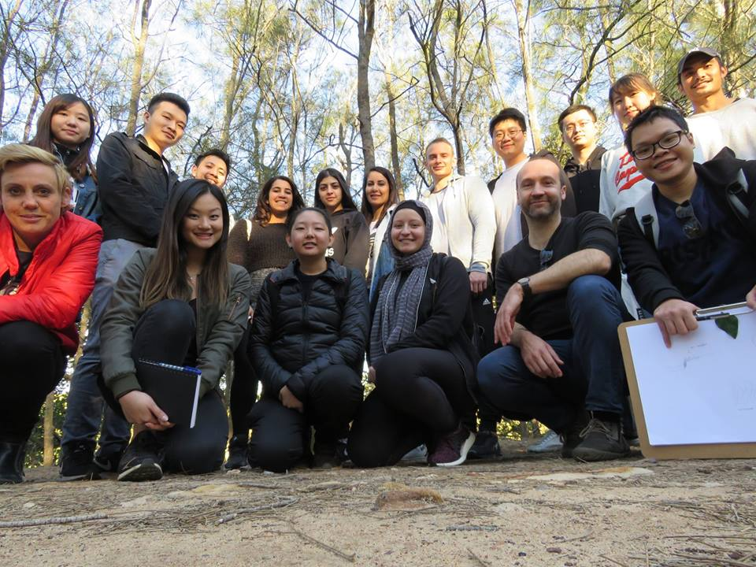
Case Study
Notes:
Please refer to reading:

Slide 8
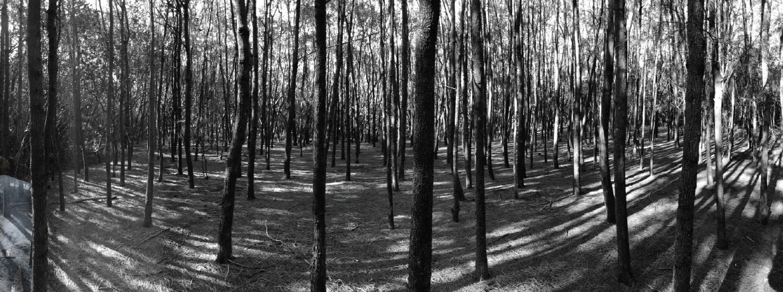
Case Study

Slide 9
Case Study

Slide 10
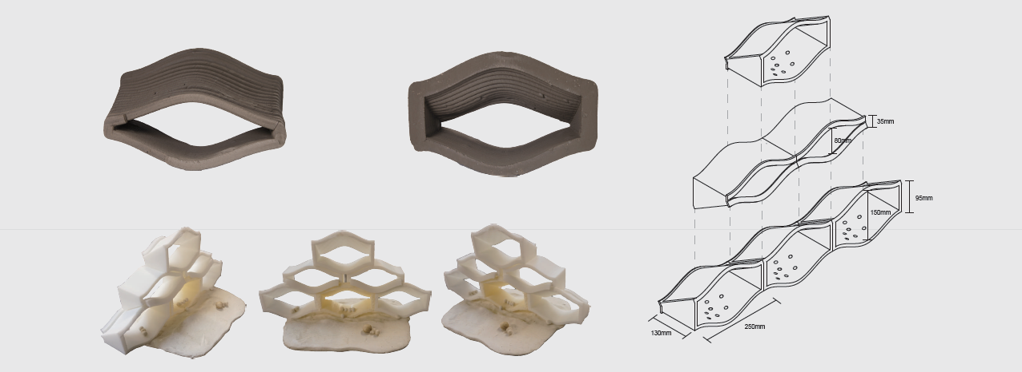
Case Study

Slide 11
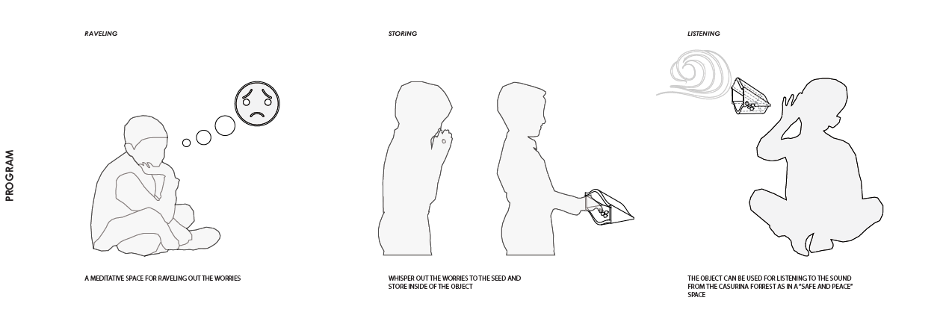
Case Study

Slide 12
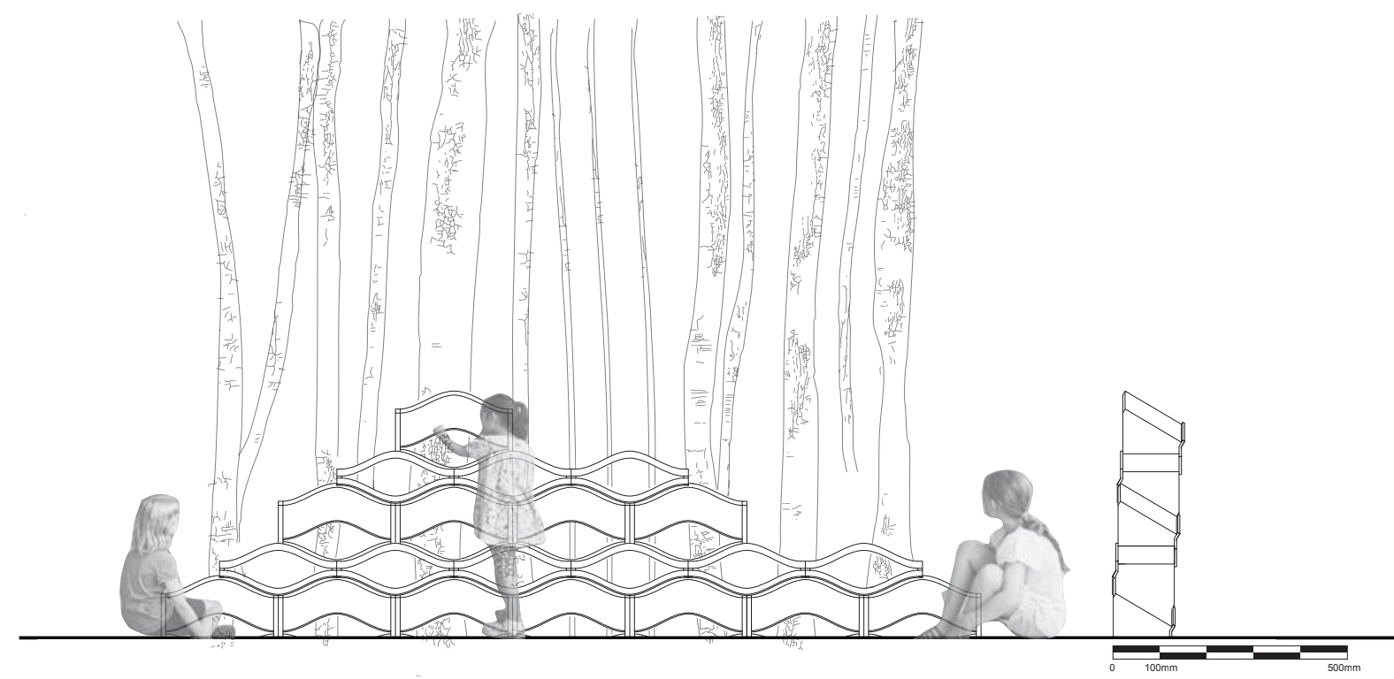
Case Study

Slide 13
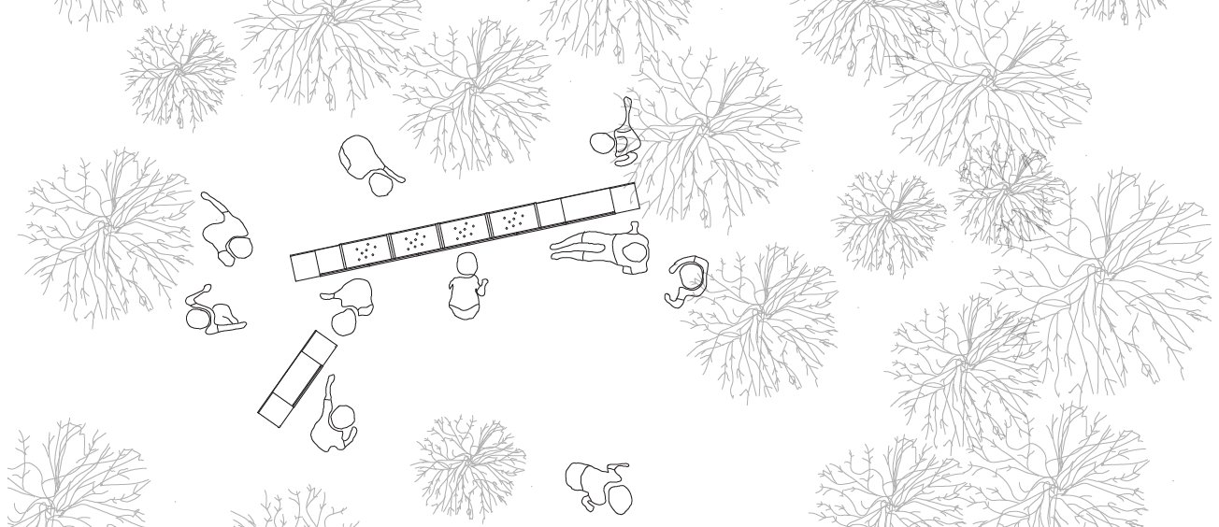
Case Study

Slide 14
site and Country
Site in an Australian context is inseparable from Country
The colonial notion of "…terra firma, means solid earth or ground, an inert, material foundation on which architecture is sited. The traditional pan-Aboriginal concept of Country, by contrast, is inclusive of earth, water, and sky, as well as the plants and animals they support" p92
McGaw, J., Tootell, N., 2015. Aboriginal “Country”: An Implicit Critique of Terra Firma and Traditional Architectural Practices. Architectural Theory Review 20, 91–114. https://doi.org/10.1080/13264826.2015.1050042
Notes:
‘Site’ in contemporary Australia as inextricably linked to Country, first and foremost, and demanding at least awareness of the erasures of Indigenous ‘sites’ and ‘places’, and the ongoing and inadequate redress of historical injustices.
An awareness that placemaking always takes place ‘in public’, and that therefore what constitutes public values in contemporary Australia.
The importance of community-specific working.
Avoiding cultural misappropriation.

Slide 15
site and Country
Notion of Aboriginal Country as an implicit critique of the European concept of terra firma and the architectural notion of ‘site.’
Notes:
‘Site’ in contemporary Australia as inextricably linked to Country, first and foremost, and demanding at least awareness of the erasures of Indigenous ‘sites’ and ‘places’, and the ongoing and inadequate redress of historical injustices.
An awareness that placemaking always takes place ‘in public’, and that therefore what constitutes public values in contemporary Australia.
The importance of community-specific working.
Avoiding cultural misappropriation.

Slide 16
site and Country
We can practice in a way that is respectful of the Aboriginal (hi)stories, cultures, languages and knowledges of country, and when we acknowledge these spatial histories of place and country, only then can we speculate on more inclusive, culturally-rich and sustainable future spaces and places, and challenge the erasure of Aboriginality from our built environment
Notes:
‘Site’ in contemporary Australia as inextricably linked to Country, first and foremost, and demanding at least awareness of the erasures of Indigenous ‘sites’ and ‘places’, and the ongoing and inadequate redress of historical injustices.
An awareness that placemaking always takes place ‘in public’, and that therefore what constitutes public values in contemporary Australia.
The importance of community-specific working.
Avoiding cultural misappropriation.

Slide 17
Consultation
What approaches to site are you using that overlook marginal spatial stories, histories, knowledges?
Consultation
KPIs
Minimum Code compliance

Slide 18
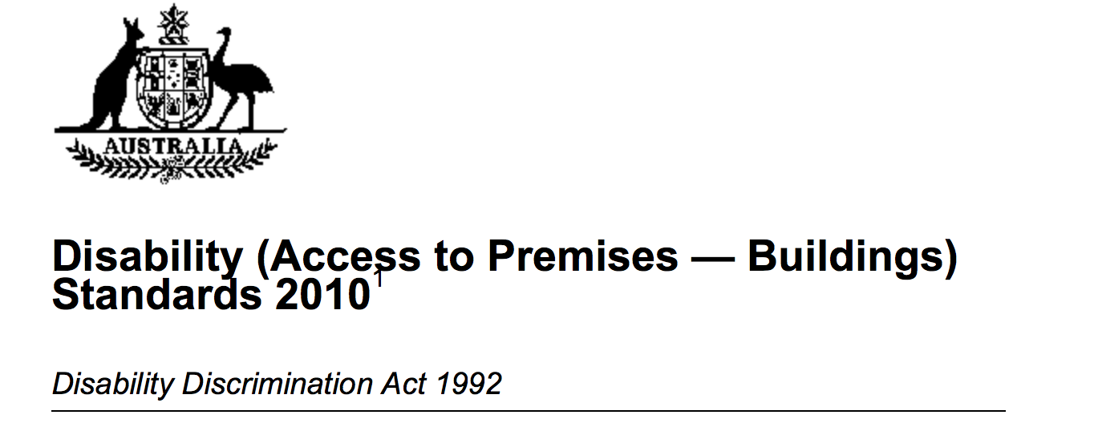
Compliance
What approaches to site are you using that overlook marginal spatial stories, histories, knowledges?
Code compliance

Slide 19
In Groups
What approaches to site are you using that overlook marginal spatial stories, histories, knowledges?
How can we broaden the idea of site to consider these

