Slide 1

Site –
Traditional Placemaking approaches
These slides were prepared to provide context on some common site analysis strategies under traditional placemaking process. It is meant as a resource to support some exercises to understand how people behave in places.

Slide 2
Outline
Why is listening to the place important?
How to do site thinking?
  Power of 10+
  Behavioural mapping
  A day in a life
Summary and conclusion

Slide 3
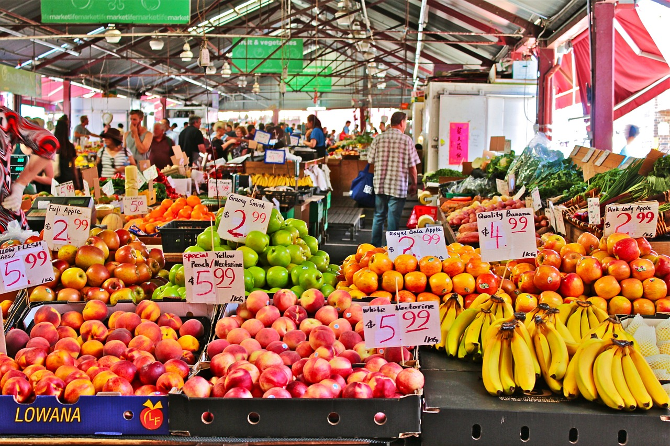
Why is listening to place important?

Slide 4



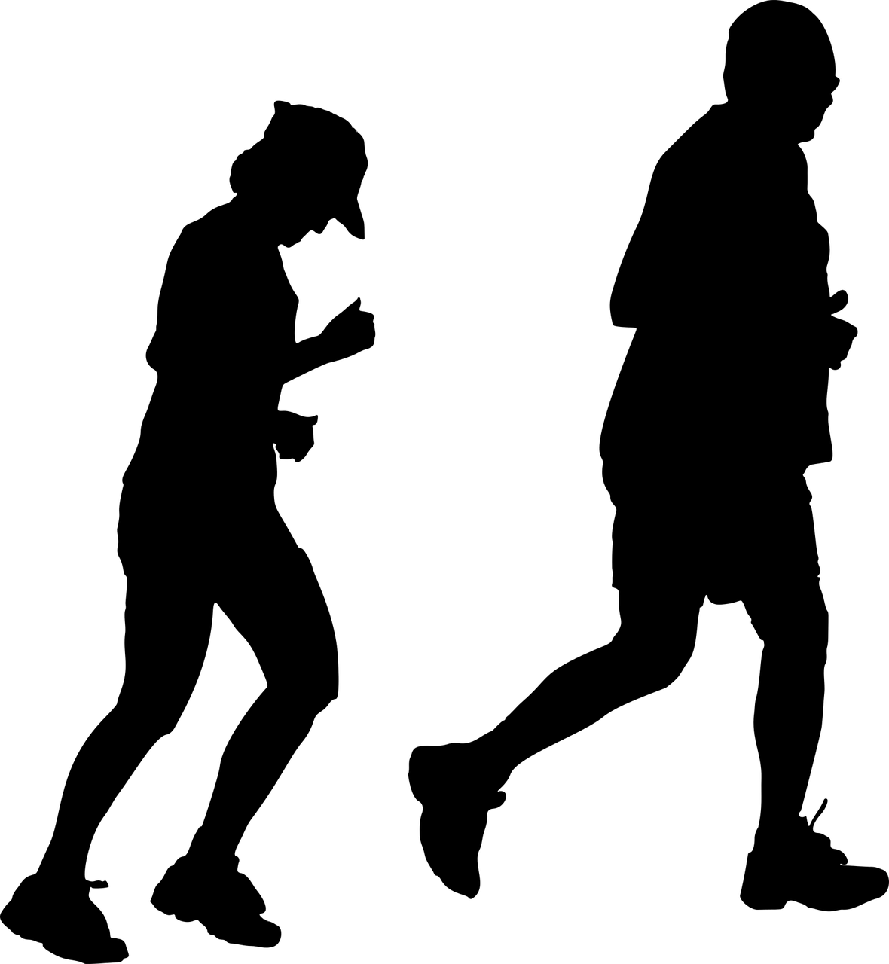


Why?
We want to understand the urbanism – or the urban way of life
Identification of problems/challenges due to urbanisation
Characteristics of urban/public life
Tests solutions to challenges (assets-based placemaking, tactical placemaking)
INTERACTION
PHYSICAL
MOVEMENT
CONCENTRATION
SNAPSHOT
the WAY individuals in urban areas INTERACT
PHYSICAL NEEDS of urban societies
MOVEMENT of the population to urban areas
CONCENTRATION of population in an urban area
…for many this is expressed as a condition, a snapshot of time, place & circumstance
There are 60+++, too many perspectives!!!

Slide 5
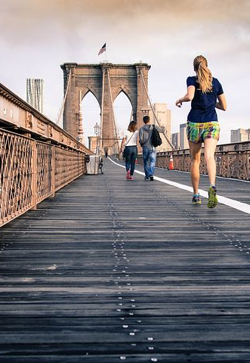




Manifestation…..
Physical
Social
Cultural
in terms of the relationships between land uses and with infrastructure
in terms of the distribution of wealth and participation in decision-making
in terms of the celebration of cultural, ethnicity
and entertainment

Slide 6











Factors shaping the built environment
Societal
Environmental
Demographic
Political
Cultural
others
Economic
Technological
Notes:
City’s character is the outcome of a range of interactions, triggers or structural forces operating at various SCALES (e.g. global-local)
many European and American cities and towns experienced economic, social and spatial structural change. Globalization of culture and economy, increased mobility, de-industrialization and the growing importance of service sectors have transformed urban and regional economies into post-industrial knowledge-based economies. Corresponding to these structural changes, the construction of place is a characteristic of urban transformation, as cities shift from being centres of production to centres of consumption (Pacione 2005). Moreover, urban development also faces challenges from processes of global warming and climate change, and the local implications that follow

Slide 7
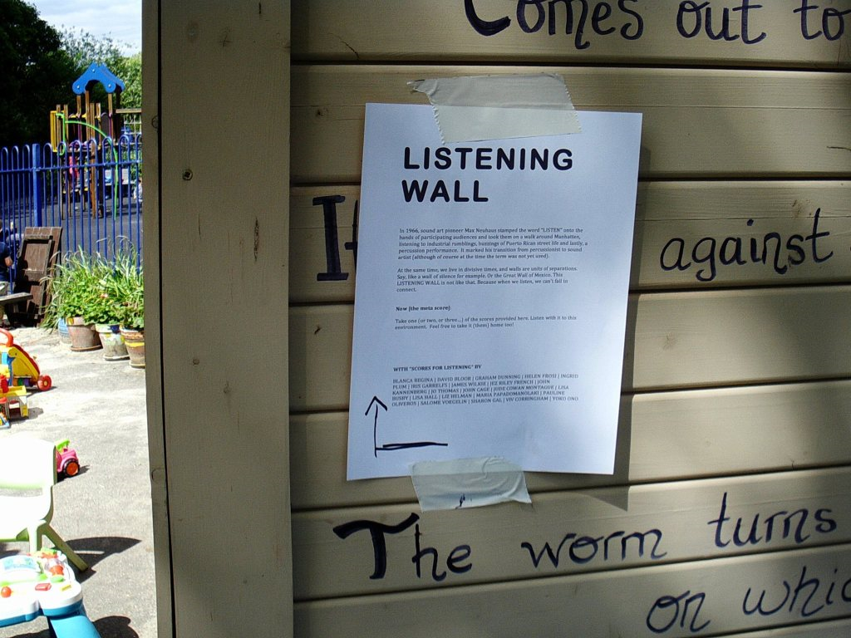
How do we listen to place?
SOURCE: https://pointsoflistening.wordpress.com/2017/09/11/pol-37-scores-for-listening/
Notes:
Listening has long been in the foreground of sound arts practice. In 1966, sound art pioneer Max Neuhaus stamped the word “LISTEN” onto the hands of participating audiences and took them on a walk around Manhatten, listening to industrial rumblings, buzzings of Puerto Rican street life and lastly, a percussion performance

Slide 8
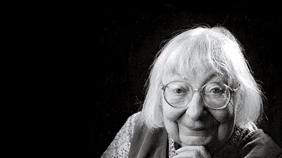
“…please look closely at real cities. While you are looking, you might as well also LISTEN, LINGER AND THINK about what you see.”
Jane Jacobs
SOURCE: This Photo by Unknown Author is licensed under CC BY-NC

Slide 9
Power of 10
10 things to do,
10 places within a destination area,
10 destinations within the city or region

Slide 10
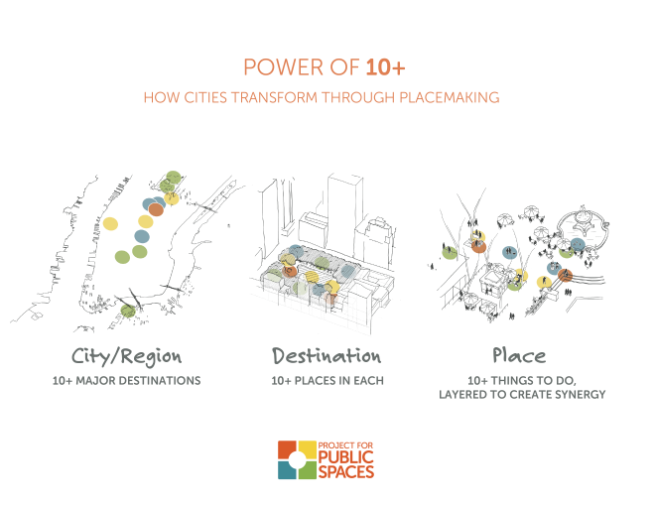
https://www.pps.org/article/the-power-of-10
Notes:
The Power of 10+ is a concept PPS developed to evaluate and facilitate Placemaking at multiple city scales. It is a powerful tool for generating constructive conversations to identify targeted Placemaking efforts. Cities succeed or fail at the human scale - the place scale - and this scale is often overlooked. The Power of 10+ shows how paying attention to the human experience when building a city's destinations and districts can have immediate and widespread impacts.

Slide 11
Observing behaviour in place

Slide 12
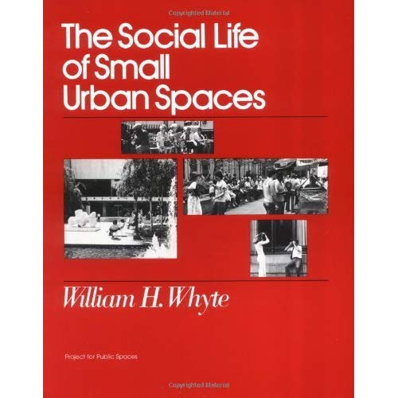
Observation technique
“….to watch or study someone or something with care and attention in order to discover something.”
gather useful knowledge to simplify complexity in public space; and
must be a systematic approach.
https://i.gr-assets.com/images/S/compressed.photo.goodreads.com/books/1433896046i/552476._UY500_SS500_.jpg
Notes:
“Observation is “to watch or study someone or something with care and attention in order to discover something.”
Anyone who decides to study life in the city will quickly realise that you have to be systematic in order to get useful knowledge from the complex confusion of life in public space.
William Hollingsworth an urbanist and people-watcher.
Whyte studied human behaviours in urban settings.
He published several books on the topic, including The Social Life of Small Urban Spaces
He used direct observation to describe behaviors in urban settings
With research assistants wielding still cameras, movie cameras, and notebooks, Whyte described the substance of urban public life in an objective and measurable way.
This has culminated in a book called the "Street Life Project", an ongoing study of pedestrian behavior and city dynamics.

Slide 13
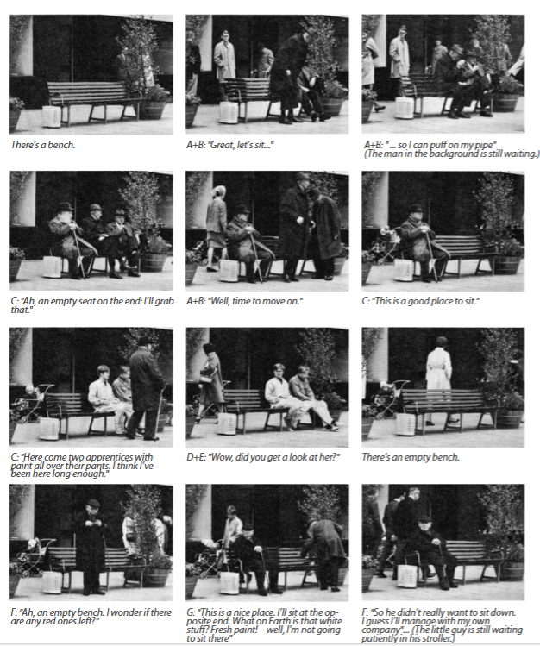
Sidewalk ballet
How is a bench used?
Gehl, J., & Svarre, B. (2013). How to study public life. Island Press.
Notes:
Sidewalk ballet is rendered as brief scenes in which public life unfolds like a ballet involving a bench in inner Copenhagen.
The study of the nuances of bench use originated from an article by Jan Gehl “People on Foot” from 1968.

Slide 14
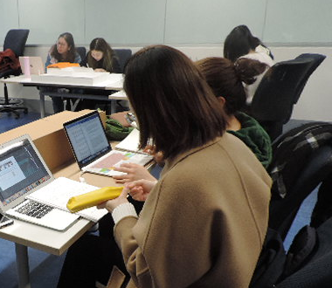
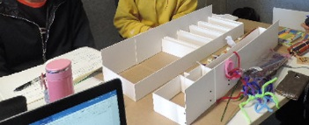
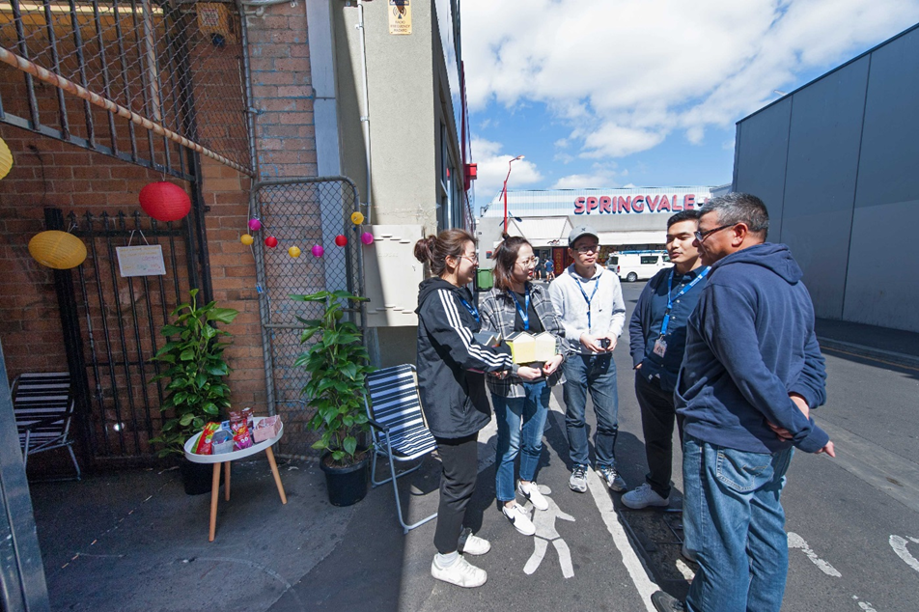
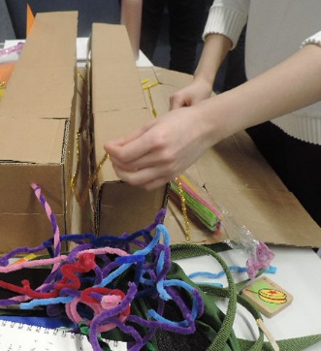
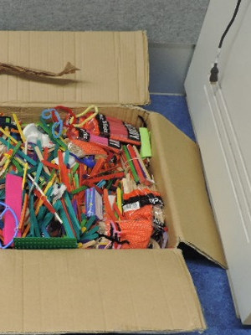
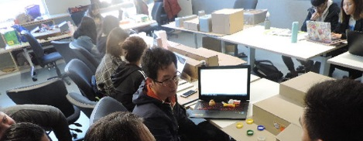
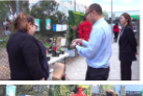
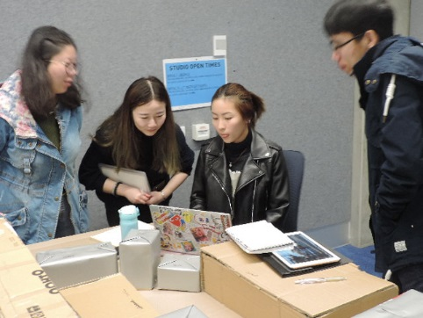
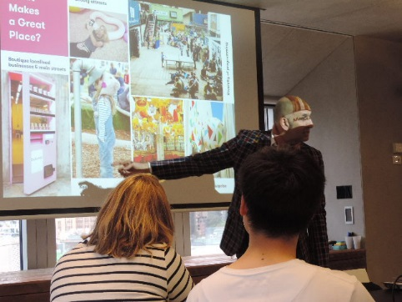
Different approaches to understanding place

Slide 15
Who?
Age and/or gender
the presence of women serves as a barometer of safety
Notes:
We gather about people’s behaviour. When referring to people, we actually refer to a widely different groups of people – different age, gender, when it is relevant to be more specific and precise. Research shows that the presence of women serves as a barometer of safety – more women, the safer is a public space. In Bryant Park in the middle of Manhattan between Times Square and the Grand Central Terminal, the gender proportion is 52% women and 48% men.

Slide 16
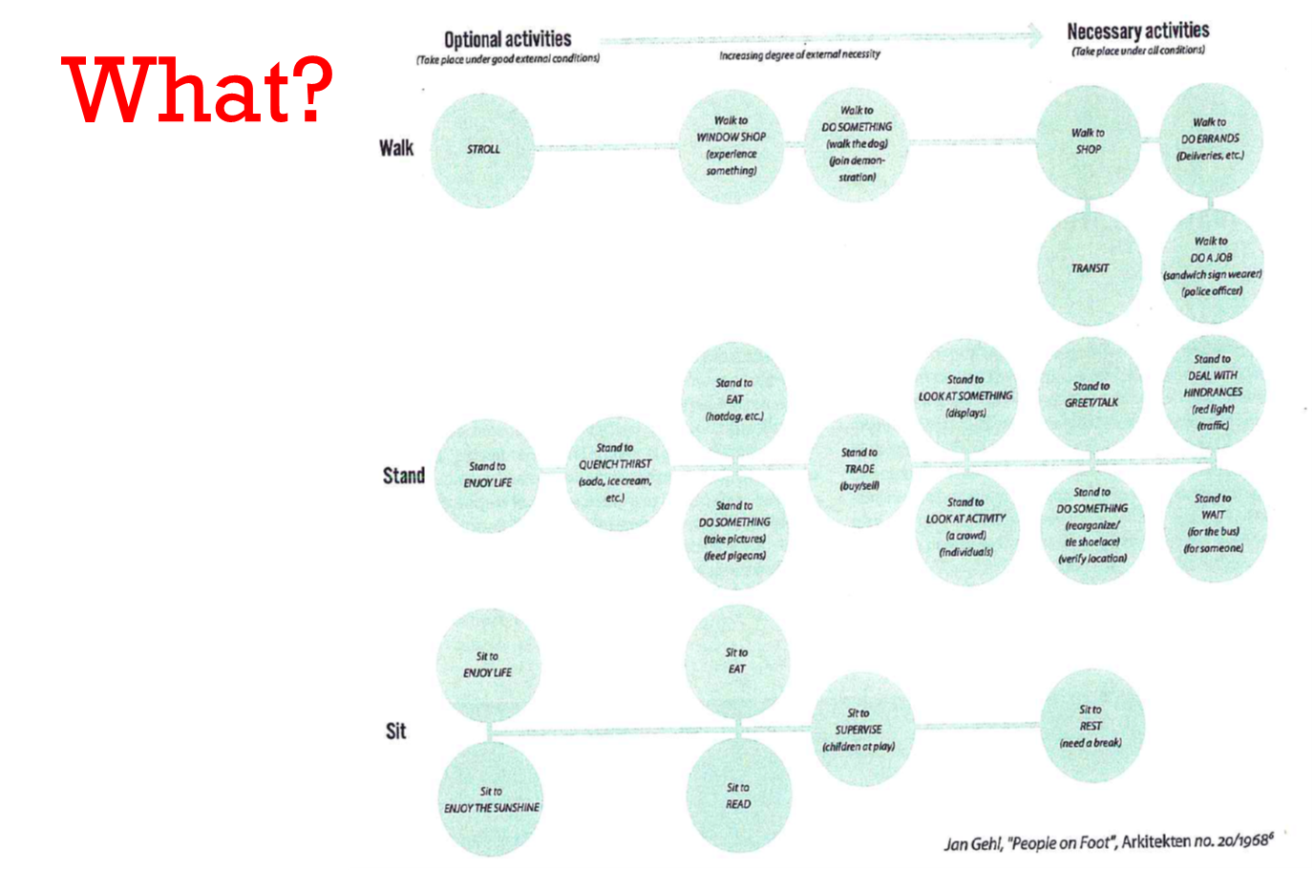
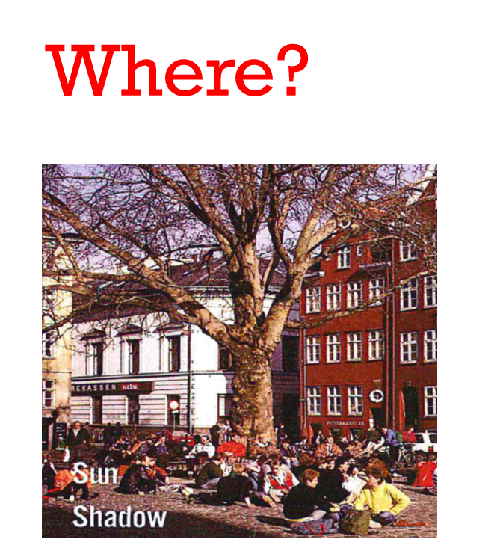
Notes:
The microclimate, the local climate of the specific site, can heavily impact whether people stay there. For walking, people are okay to walk in sub-optimal wind, sun, shadow conditions. However, to encourage people to stay, a place needs higher level of climate quality.

Slide 17
How long?
Notes:
The time dimension is essential to understanding public life. How long it takes a person to cover a certain distance, how long they sty in a certain place? How long the activity lasts?

Slide 18
Before and after
How many are walking and how many are staying?
Notes:
How many people are walking, how many are stationary?
A public life study helped to determine use before and after improvements were made. The number of pedestrians rose by 62% after the street was converted into a pedestrian only zone. The number of stationary activities increased by 600%

Slide 19
Mapping
Tracing
Tracking
Looking for traces
Photographing
Test walks
Keeping a diary

Slide 20
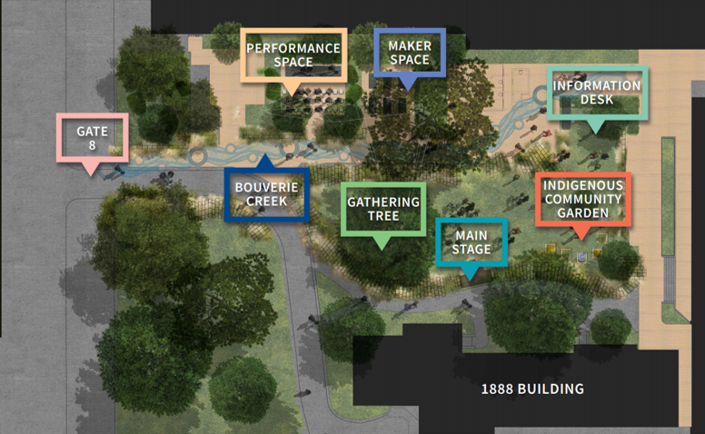
Observation – Using the space
Demographics (age, sex, background)
How they use the space (sitting, standing, walking, eating)
How long they stay.
Are they alone or in a group – do people act differently when alone than when with a group?
Are there any hot-spots on the site (where do people congregate and why?)
What design elements are people interacting with? (gathering tree, soundscapes, performance space, makers space,
Are people engaging with the signs?
Does it seem like people are intentionally seeking the site (to attend an event or similar) or stumbling upon it.
What are the differences between programmed and unprogrammed times?
Draw a map to show spatial distribution of people you observed.
2.
Insert the date and time of your observations.
Document ONLY 10 min during your help times.
Observed stakeholder number | People | Demographics | Movement or how they use the space | Main activity | Time and time spent | Interactions with design | Programmed?
1 | Single Person | Male adult | Walked East to west | walking quickly – going to work | 8am 3 minutes | Read X sign.
2 | Group of 5 |  |  | Sat down to have lunch | ~30 min | Sitting in front of main stage. | Programmed time but users did not attend the workshop

Slide 21
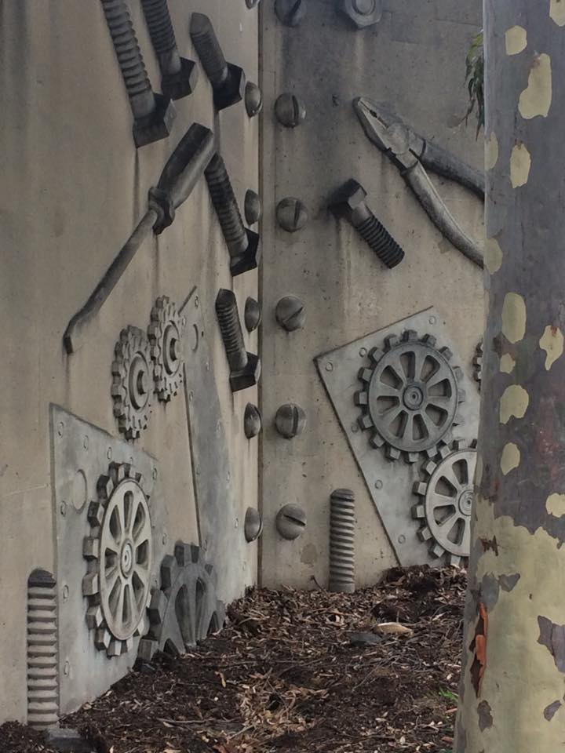
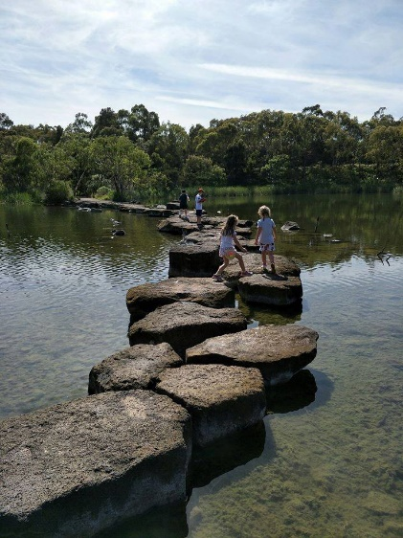
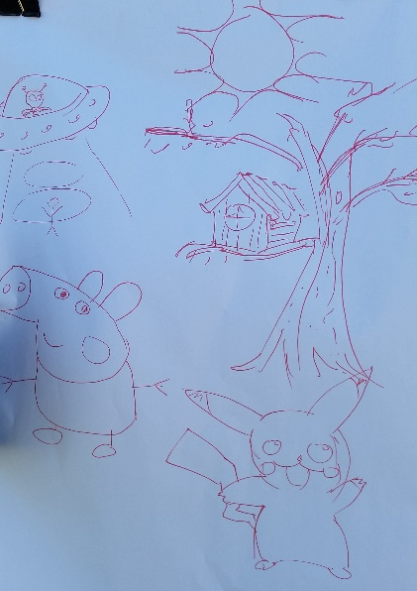
Taking photos
Include drawings if you want.
Experiences
Stories of moments encountered
Photos of what people do and interacting with plants,
Your judgement on people’s reactions (excited, bored, engaged) include note on what experience (at a workshop, at event, unprogrammed time?)
Are kids enjoying the kid focused activities.
Any stories that may be evidence of changing perceptions of the site or learning something: “I had no idea that….”
Any stories/ observations of people interacting with new people (are social interactions higher? People making friends?).
Document any personal experiences you want to share. We encourage drawings or pictures.

Slide 22
Curiosities and learnings
Document questions that you get asked.
What things / themes are people discussing?
What were people’s impressions on the placemaking initiative? What questions or comments do you get about plants and animals on the site?
Is anyone asking for more information than is available?
Synthesis of observations:
What keeps coming up in discussions and responses to the space?

Slide 23
A day in the life of
Exploring the journey through place, portfolio of places and categorising different stakeholders through storytelling of a day in their life.

Slide 24
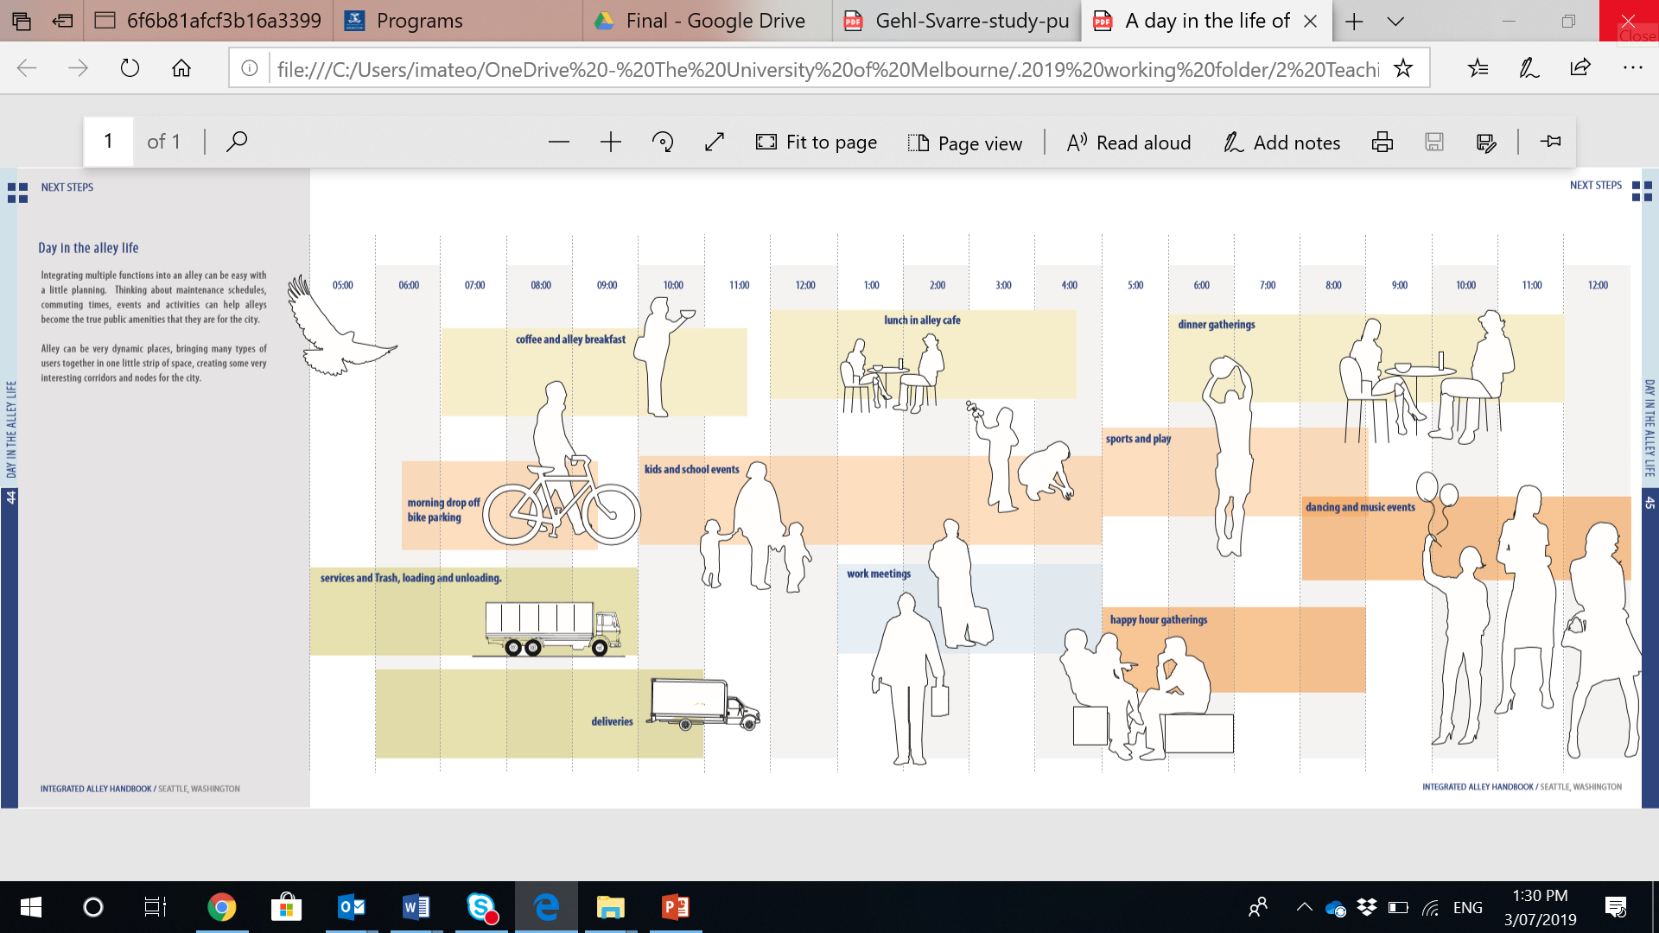
A day in the life of…..
Notes:
Integrating multiple functions into an alley can be easy with a little planning. Thinking about maintenance schedules, commuting times, events and activities can help alleys become the true public amenities that they are for the city.
Alley can be very dynamic places, bringing many types of users together in one little strip of space, creating some very interesting corridors and nodes for the city.

Slide 25
Discussion:
What are the pros/cons of different site analysis strategies?
What is the best way/approach/strategy to understand the public life of the case study?

Slide 26

Questions?

