Slide 1
Disclaimer: The following slides were intentionally left text based to allow you to personalise and contextualise with your own images.

Slide 2
Community Engagement Process
These slides are based on material prepared by Nursey-Bray (2019), The University of Adelaide for the Place Agency program for placemaking pedagogy.

Slide 3
Context: Where does community engagement fits in placemaking
A quote first introduced in People in Place Module
It is a process… “We can enjoy a place, but only by taking part in its processes can we meaningfully connect to it” (Day 2012)
Community engagement is a critical component to the development of sense of place.
Placemaking is:
Participatory
A form of engagement in itself
PlaceAgency, 2018.

Slide 4
Learning outcomes
Understand the general concepts for community engagement (understand)
Map community and place with appropriate engagement strategies (apply)
Develop an appropriate place-based community engagement strategy (apply)
Built skills in/deeper understanding of conflict resolution, negotiation and listening (apply)
Reflect on evaluation for place-based community engagement (not the project but evaluating the engagement strategy- Analyse).

Slide 5
Case Study From Lane to Place Crawford Lane (5:54 min)
Notes:
In this module, you are aiming to help students develop their own community engagement processes. For it to be effective, there is a lot of preparation required.
The students must watch the selected videos ahead of time to enable us to shift the in-class time to questions, clarification of the process, the students designing their own process, adapting it and practicing some skills for engagement.
Then after the session is over, students might need to spend time outside of the classroom for further preparation as relevant to their specific assessment task.
The module was created in a practice-led approach where the students are
Conducting their own community engagement session to inform their design, OR
Designing a community engagement process that could be applied after the semester is over
This video is used as a way of showing how a group of students has gone through a similar process, engaging a croup and coming with strategies to activate a non-attractive pathway.

Slide 6
Outline
Revisiting key concepts:
What is community?
What is community engagement?
Engaging with different cultures
Engaging with conflict
Stakeholder mapping and analysis
Exploring the toolbox of community engagement techniques
Deep engagement through fun activities.
Ethical engagement and preparing to engage
Evaluating community engagement

Slide 7
What is a community
Identifying community
Notes:
The following slides are provided as an overview but should not spend too long in these set as the first set of videos cover many of this topics.
What is Community? (4:27 min)
What is Community Engagement? (9:23 min)
Stakeholders (2:24 min)
Techniques for Community Engagement (5:39 min)

Slide 8
What is a community?
“a group of people with diverse characteristics who are linked by social ties, share common perspectives, and engage in joint action in geographical locations or settings”
(MacQueen et al. 2001).
A collection of human individuals; it is a socio-cultural system; it is socially organized
(Bartle 2007)
PlaceAgency, 2018.

Slide 9
Constructions of community
As Fellowship. “Fellowship is heaven, and lack of fellowship is hell; fellowship is life, and lack of fellowship is death; and the deeds that ye do upon the earth, it is for fellowship’s sake ye do them.” (A Dream of John Ball, Ch. 4; first published in The Commonweal 1886/7)
Place. Territorial or place community can be seen as where people have something in common, and this shared element is understood geographically.
Interest. In interest or ‘elective’ communities people share a common characteristic other than place. They are linked together by factors such as religious belief, sexual orientation, occupation or ethnic origin.
Communion. In its weakest form we can approach this as a sense of attachment to a place, group or idea (in other words, whether there is a ‘spirit of community’). In its strongest form ‘communion’ entails a profound meeting or encounter – not just with other people, but also with God and creation.
Attachment – communities of meaning: “People construct community symbolically, making it a resource and repository of meaning, and a referent of their identity’ (Cohen 1985: 118).

Slide 10
the local family-dependent support network.
Relied on close kin (sharing household or lived locally).
the locally integrated support network.
Local family, friends and neighbours.
the local self-contained support network.
Usually restricted in scale (mainly neighbours, little kin involvement).
the wider community-focused support network.
Involving a high level of community activities (high number of friends and kin).
the private restricted support network.
Characterized by an absence of close kin, aside from a spouse in some cases (few friends or neighbours).
Social Networks
https://socialmediaexplorer.com/content-sections/news-and-noise/5-up-and-coming-social-networks-you-should-know-about/
(Wenger 1984)

Slide 11
What is community?
Six dimensions relevant to community and culture
NOT STATIC
1.Technological,
2.Economic,
3.Political,
4.Institutional (social),
5.Aesthetic-value, and
6.Belief-conceptual.
(Bartle 2007)

Slide 12
Community…
A Community has Fuzzy Boundaries
Communities Can be Within Communities
Communities May Move
Anderson’s notion of ‘imagined communities’ is important
Today we have ‘virtual communities’

Slide 13
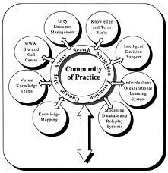
Communities of Practice (COP)
Communities of practice are groups of people who share a concern or a passion for something they do and learn how to do it better as they interact regularly
(Wenger 2002)

Slide 14
Community
Take Home Message
There are many ‘communities’ to consider in community engagement…
- Who are the people most affected by, and most likely to be interested in the project?
- Interest may vary from being affected by a decision,
to wanting to make a difference to a project, a
community or a region; to having specific information,
experience or knowledge to contribute to outcomes
Notes:
Ask students to add more take home messages from what they learned from the videos.

Slide 15
Activity 1: Stakeholder Analysis
This section will take approximate 1 hr.

Slide 16
Engaging community
Why engage –what is the purpose? -> Give people a stake on their places
Who to engage? – Stakeholders
Defining the ‘community’
Identifying Stakeholders
Can you consult ALL the community?
When to engage?
How to engage? –
Tokenism versus real participation
How do we develop communications that are relevant to all sectors/ can we?
How to evaluate the process?
Understanding their likely positions and interests
What’s in it for them?
Notes:
OK – now you have thought about what ‘community’ is, lets look at engagement

Slide 17
Who needs to be engaged?
The engagement outcomes are directly determined by the people participating in the engagement, depending on the focus of the project, you may need to aim for general engagement or target groups. Some groups to consider:
Women
Children
Disability in the public place
Migrants
First Nations People

Slide 18
Stakeholders
An individual or group who
is likely to be affected
directly or indirectly
positively or negatively
can affect the outcome of the decision
through their access to, or influence of, the use of resources and power.
Are stakeholders likely to have a pre-determined position about the project / proposal?
What are the likely underlying interests and concerns?
What level of interest is each stakeholder group likely to have?

Slide 19
Stakeholder mapping…
Why do it?
Who we need to work with? (Who constitutes this “community?”)
What their interests and influences might be?
Informs how we engage and what methods we might use.
Can bring out issues that might emerge (for example, project risks).
How do we do it?
Lots of ways! Generally, with a matrix of a type.
Can mind-map and then categorise.

Slide 20
One way…
Critical (can stop a project) | Essential (can delay a project) | Important (Interest in a project)

Slide 21
High Stake - Low Resources Often marginalised: often require special efforts to engage for sustainable results.
High Stake - High Resources
Have the capacity to implement outputs themselves, keep engaged at a
high level. This group do not always see the need to engage with others, especially those without resources.
Low Stake - Low Resources
Not immediately involved, keep track of
changing situation.
Low Stake - High Resources
Can redirect their resources elsewhere if lobbied by others. Often don’t want to be involved at a high level, but need to be kept informed of what is happening.

Slide 22
Remember…
Never make assumptions about what community will decide!
Every person sees something else…
What do you see?

Slide 23
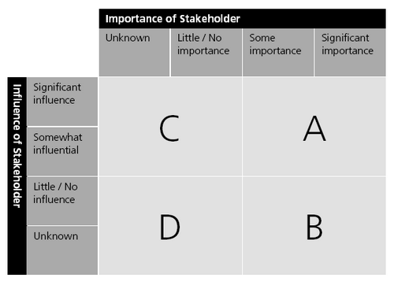
Lets practice…
40 min – As a whole group discussion, develop a stakeholder analysis based on the research students prepared before the session for the area the students are using for their final assignment:
10 min What are the issues?
5 min - Who will you need to consult?
15-20 min - Who will be the most important and influential stakeholders? Map out the different stakeholders based on the importance of the stakeholder for the placemaking initiative and their level of influence
10 min - Note: What does this map tell us?
Notes:
For placemaking, the key stakeholders tend to have little influence or power.

Slide 24
Activity 2: Designing a community engagement process

Slide 25
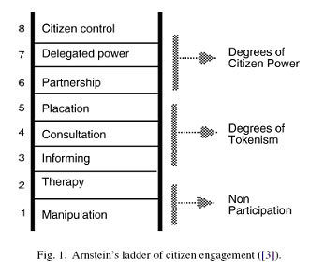
Arnstein’s ladder and principles
Operating principles re community engagement:
Open and transparent
Accessible
Relationship consolidation and connections at multiple scales
Continuous feedback loops
Being flexible
Open to other perspectives/views (culturally appropriate)
Acknowledge diversity
Due diligence
Relevance to demographic
Appeals process
Independent
Open ended questions, unbiased questions
Notes:
Sherry Arnstein discusses eight types of participation in A Ladder of Citizen Participation (1969). Often termed as "Arnstein's ladder", these are broadly categorized as:
Citizen Power: Citizen Control, Delegated Power, Partnership.
Tokenism: Placation, Consultation, Informing.
Non-participation: Therapy, Manipulation.
She defines citizen participation as the redistribution of power that enables the have-not citizens, presently excluded from the political and economic processes, to be deliberately included in the future.^{[3]}
Developed in the late 1990s, with updates by IAP2 Australasia in 2014, the IAP2 Public Participation Spectrum is one of the most utilised and applied of international public participation models. It explains the different levels of engagement that organisations can engage their communities, with the furthest right of the spectrum highlighting the greater community influence on decision making
What is the continuum she suggests?
Is it useful?
Do you think it works?

Slide 26
Doing community engagement
Multiplicity of techniques for community engagement available
What kind of method and when?
Depending on the objectives of CE plan
Use a variety to accommodate
levels of interest
available time
preferred styles of receiving / giving information
Individual vs. group basis
Spoken or written
Notes:
Crucial to undertaking effective community engagement is understanding how to engage with different cultures. In this part of the module we will in particular focus on introducing students to some core principles for engaging Indigenous peoples. Given the centrality of country for Indigenous peoples and the focus on place in this course, this is an important element of the module. In this hour we will examine: (i) appropriate engagement strategies for Indigenous peoples, and (ii) introduce the idea of welcome to country and acknowledgement of country. The class will then be tasked with identifying which country and which people/s were originally across a series of place based scenarios (up to 3). Discussion is then to be held on how (using one case study) Indigenous engagement could occur. Students will use the Indigenous engagement strategies they have found on the web (previous self directed activity) to have as basis for discussion.
Ideally whenever this part of the course is delivered it would be great to have an Indigenous person come in and give an hours presentation but in lieu of that we suggest the activities above. If funds permit we will film a 10 minute video lecture by an Indigenous person to support this section.

Slide 27
http://www.iap2.org/

Slide 28
Methods: the usual suspects
Flyers
Public meetings
Citizen juries
Focus groups
Interviews
Phone calls
Facebook/twitter
Notes:
Crucial to undertaking effective community engagement is understanding how to engage with different cultures. In this part of the module we will in particular focus on introducing students to some core principles for engaging Indigenous peoples. Given the centrality of country for Indigenous peoples and the focus on place in this course, this is an important element of the module. In this hour we will examine: (i) appropriate engagement strategies for Indigenous peoples, and (ii) introduce the idea of welcome to country and acknowledgement of country. The class will then be tasked with identifying which country and which people/s were originally across a series of place based scenarios (up to 3). Discussion is then to be held on how (using one case study) Indigenous engagement could occur. Students will use the Indigenous engagement strategies they have found on the web (previous self directed activity) to have as basis for discussion.
Ideally whenever this part of the course is delivered it would be great to have an Indigenous person come in and give an hours presentation but in lieu of that we suggest the activities above. If funds permit we will film a 10 minute video lecture by an Indigenous person to support this section.

Slide 29
Citizen jury
https://youtu.be/1rjvGMzCKn8
Notes:
Citizen juries (sometimes called ‘Panels) have now been employed in several local government settings around Australia – and, increasingly, in Victoria. They differ in their scale, scope and level of resourcing but have all sought to improve both understanding and decision-making on the issue at hand. How does a jury work ?
Citizen juries provide the opportunity for a randomly selected ‘mini-public’ to deliberate thoroughly over an issue, often over several days. Typically, invitations will be sent out to a randomly-selected group of ratepayers. From those who take up the invitation, a further (stratified) sample will be selected to ensure that the final jury best represents the demographic of the wider community.
The selected ‘jurors’ are given a key question, or ‘remit’ to work through, with the aim of working together towards a clearly defined set of recommendations. This process is typically facilitated by an independent, expert facilitator; this is important, because it affords council some distance from the process and means that the outcomes of the process are more likely to be trusted. In the course of their deliberations, the jury has access to expert help, through background material and presentations from ‘witnesses’ with expert knowledge relevant to their task. These experts are sometimes internal to councils – but, most often, content experts are called on from outside of council. The jury’s deliberations are typically closed sessions but are open to observers at certain times, subject to observers signing a code of conduct.
In 2013/14 Darebin Council committed to consulting the community on how to utilise the then recently established infrastructure fund, living up to the Council Plan goal of Open and Accountable Democracy.
Accordingly, in 2014 Darebin Council was the first Victorian Council to undertake a dynamic new participatory budgeting process, A Citizen's Jury of 31 randomly selected community members reflecting Darebin's diverse population profile decided: How should we best spend $2 million to improve our community through the use of infrastructure funding? The wider community was invited to submit their ideas for the Jury to consider. Council unanimously approved the Jury's recommendations in September 2014.

Slide 30
Methods: the not so usual suspects
Notes:
Crucial to undertaking effective community engagement is understanding how to engage with different cultures. In this part of the module we will in particular focus on introducing students to some core principles for engaging Indigenous peoples. Given the centrality of country for Indigenous peoples and the focus on place in this course, this is an important element of the module. In this hour we will examine: (i) appropriate engagement strategies for Indigenous peoples, and (ii) introduce the idea of welcome to country and acknowledgement of country. The class will then be tasked with identifying which country and which people/s were originally across a series of place based scenarios (up to 3). Discussion is then to be held on how (using one case study) Indigenous engagement could occur. Students will use the Indigenous engagement strategies they have found on the web (previous self directed activity) to have as basis for discussion.
Ideally whenever this part of the course is delivered it would be great to have an Indigenous person come in and give an hours presentation but in lieu of that we suggest the activities above. If funds permit we will film a 10 minute video lecture by an Indigenous person to support this section.

Slide 31
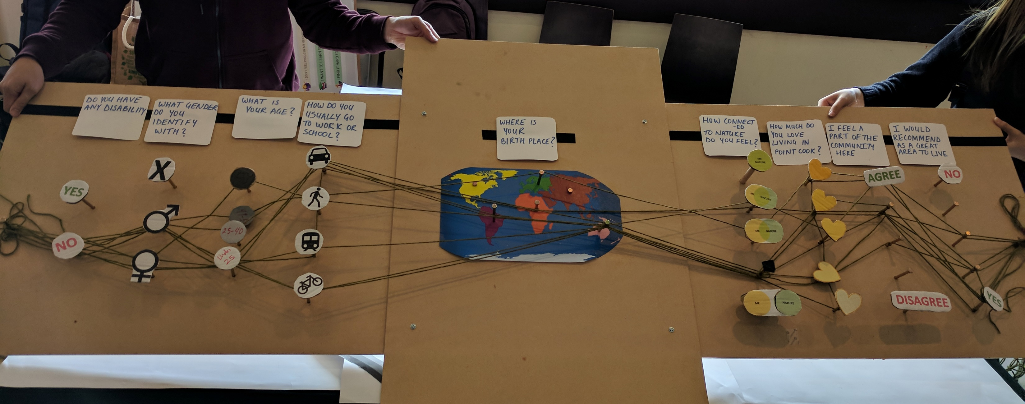
Getting to know your community
(interactive demographic survey)
@ Creating Capacity for CoLocal, PlaceAgency, 2019.

Slide 32
Mapping
(for feedback)
Use of maps, map overlay, community members provided their feedback to the Streets for People planning at Darebin
file:///C:/Users/imateo/Downloads/Streets_for_People_Final_Report_(A4752064).pdf
Notes:
Streets_for_People

Slide 33
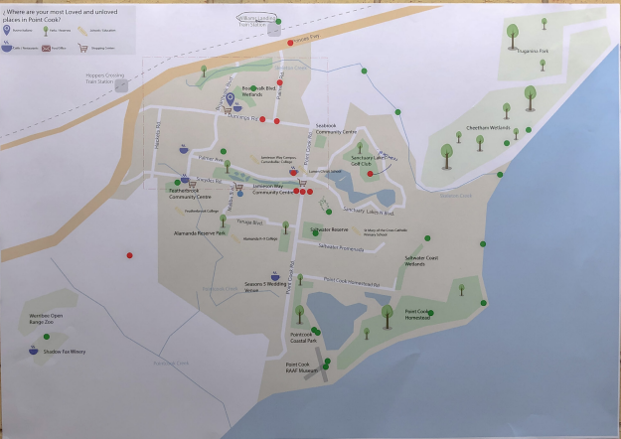
Mapping
(to find valued places)
Use of maps as conversation trigger to find areas that are loved/unloved in your site and why.
Image by Juan Planells, Anlin He & Disha Chandanshive
@ Creating Capacity for CoLocal, PlaceAgency, 2019.
Notes:
Image by Juan Planells, Anlin He & Disha Chandanshive

Slide 34
Hosting a conversation
@ Newport Project, PlaceAgency, 2018.

Slide 35
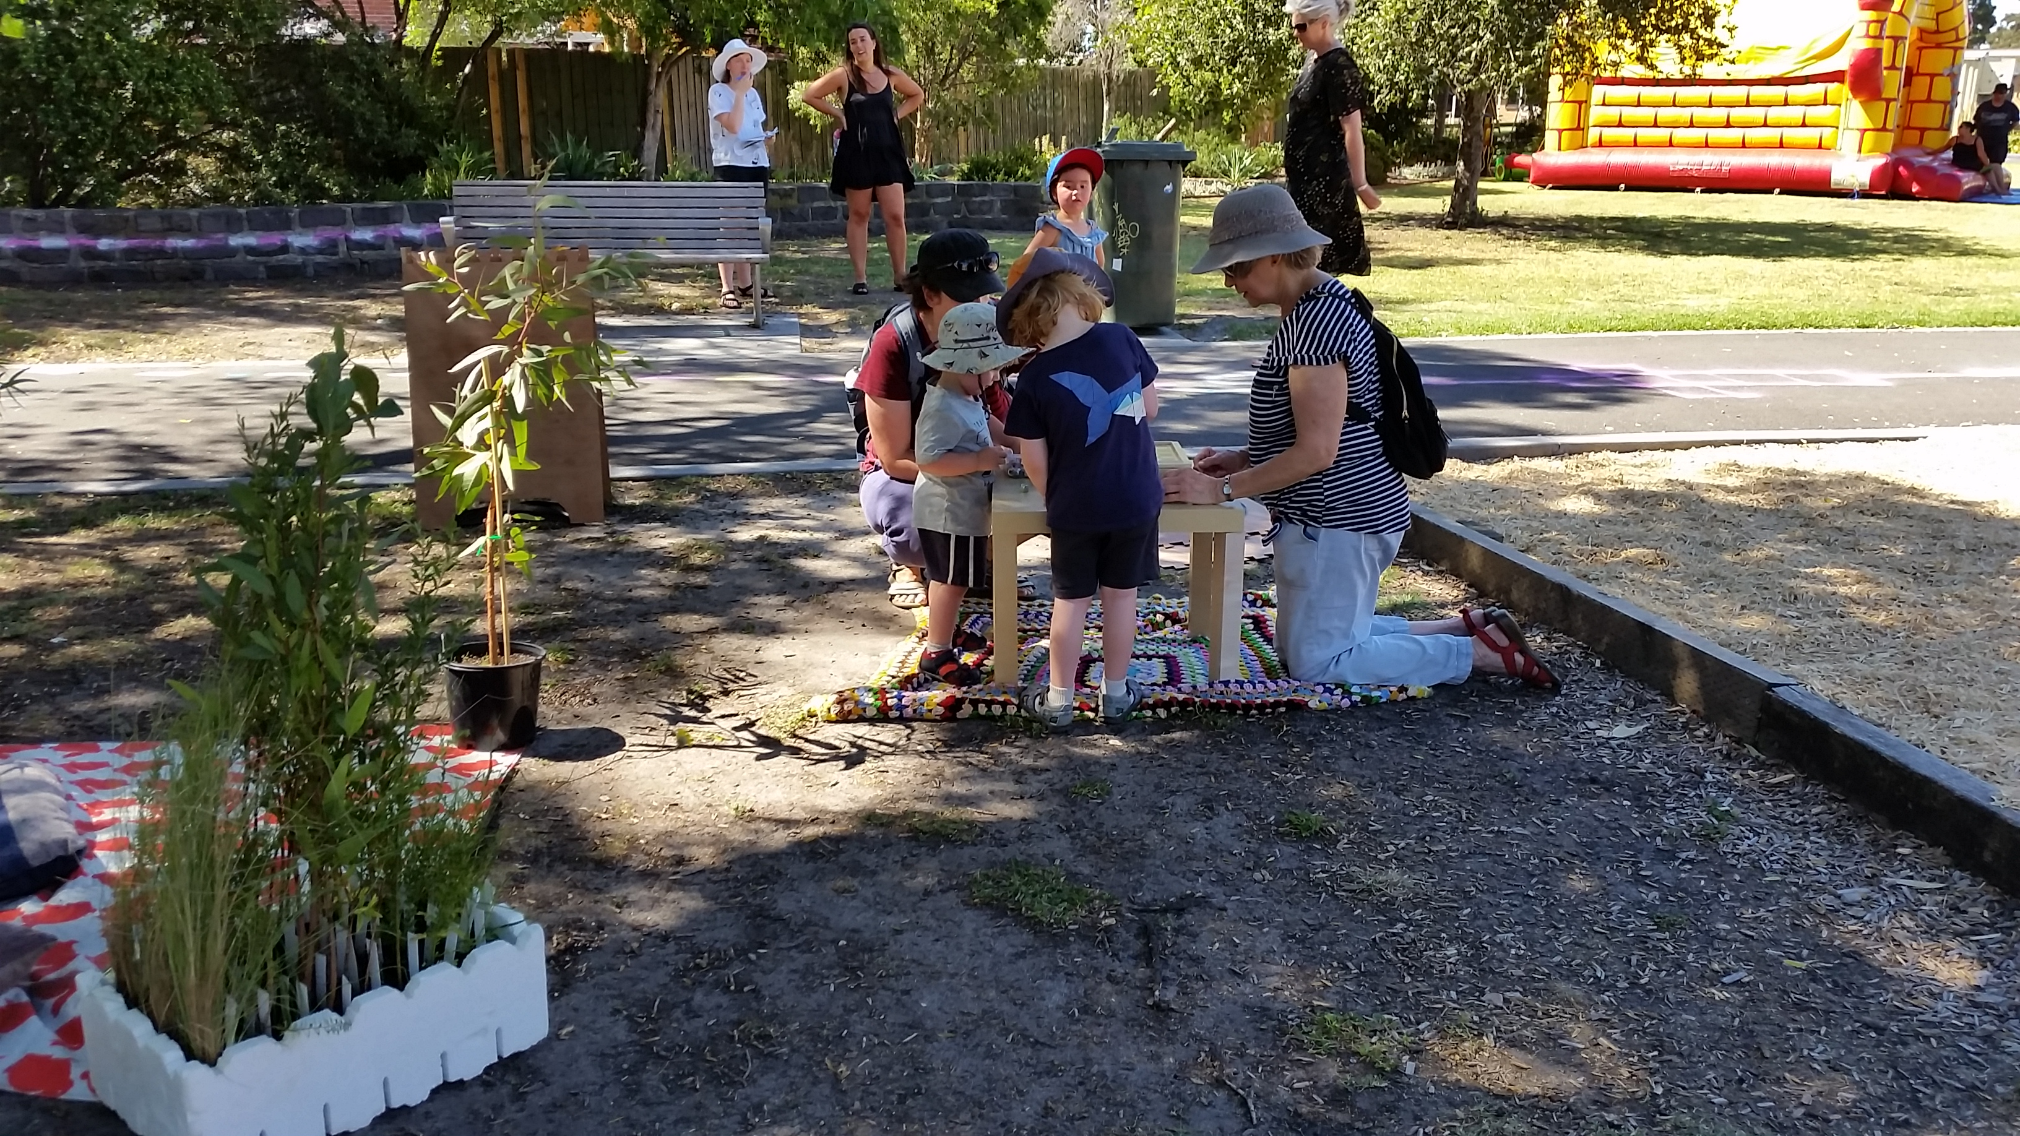
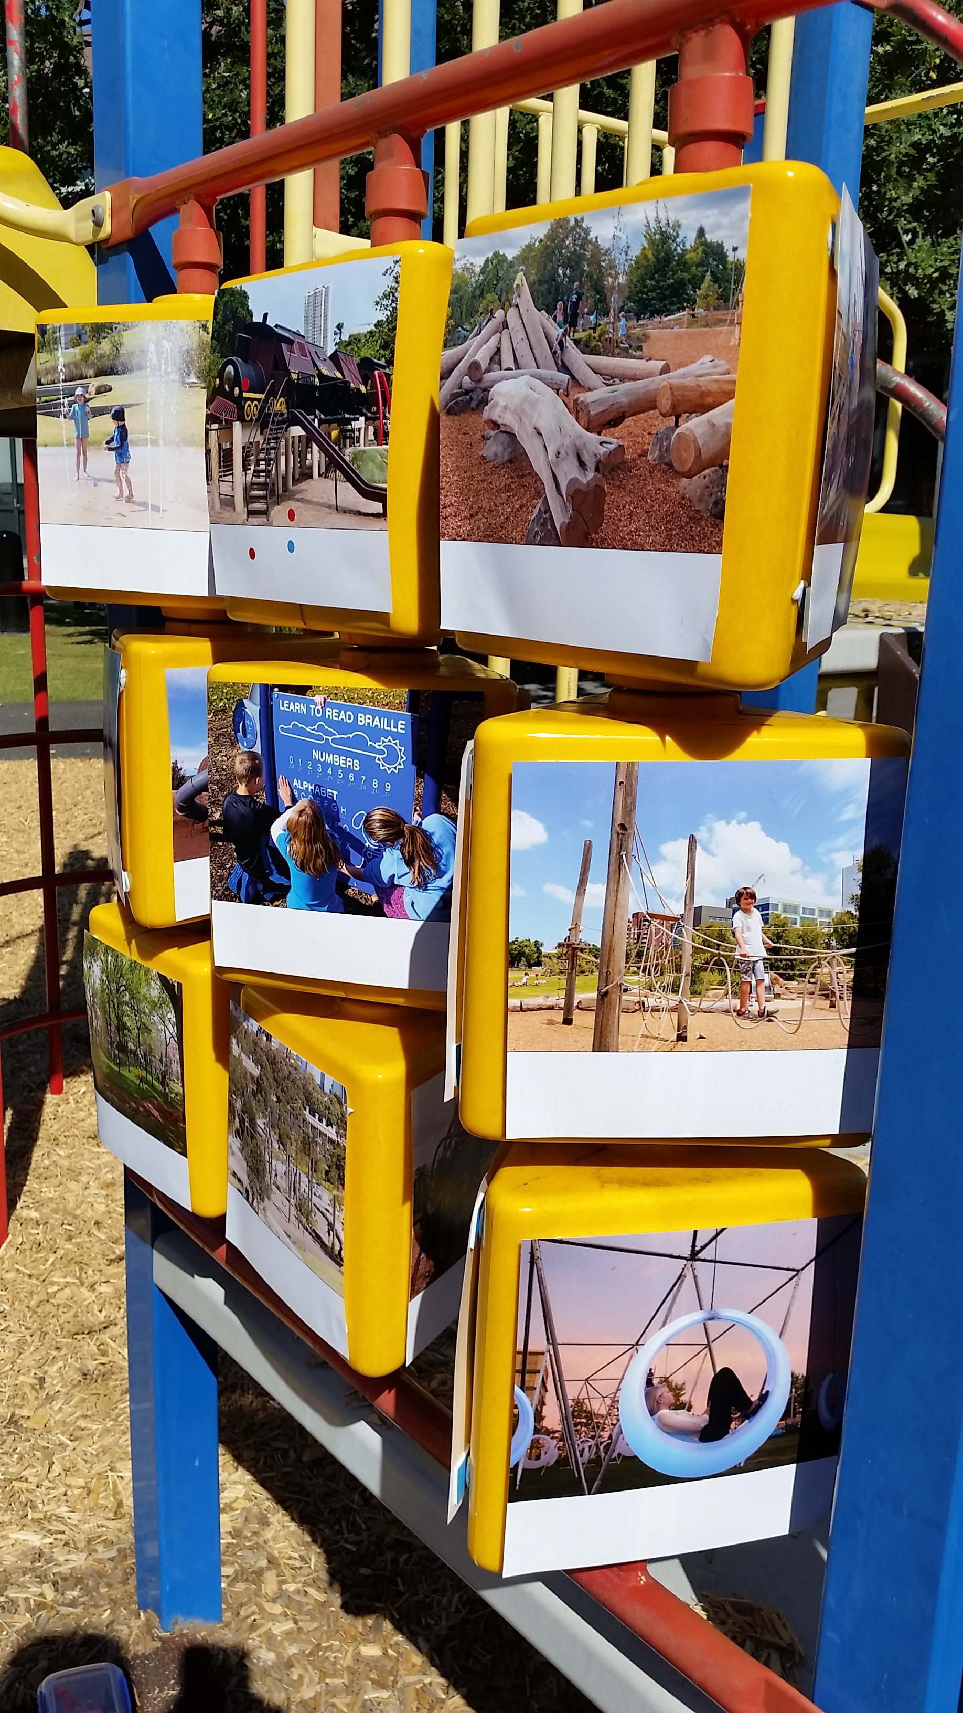
Engaging through Play
@ Newport Project, PlaceAgency, 2018.
Notes:
Tic tac toe visual preferencing sought to understand the hardware that the community would be interested to see in their playground. Each participant was presented nine different concepts (e.g. Trains, water play, novelty, shade, nature adventure, climbing). Each concept was presented with three images for a total of 27 images whereby using 5 dot stickers, participants were to select their favourite 5. Over 2 hours 22 people participated and the favourite concept voted in was an image of waterplay with a favourite image being an image of sitting with your feet in a creek. Data was then combined across age groups and genders. Students did however reflect on the bias of the images they selected.

Slide 36
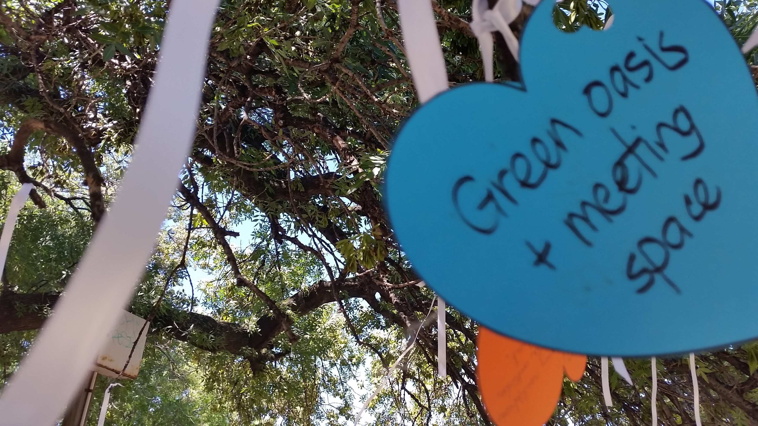
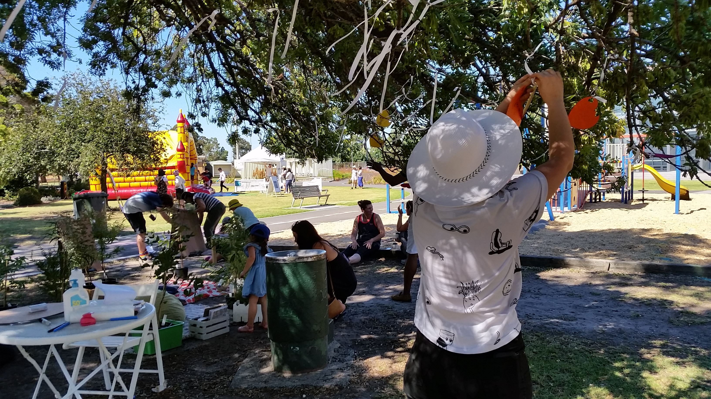
Finding Aspirations: The Wishing Tree
@ Newport Project, PlaceAgency, 2018.
Notes:
The wishing tree activity served as a dreaming exercise which was used to uncover the spirit of the site where a central question was posed to locals, what is the personality of Paine Reserve? Participants were asked to respond using a coloured paper heart where upon participants could provide a written response and attach the heart to the wishing tree. Across 2 hours 11 people engaged in the activity.

Slide 37
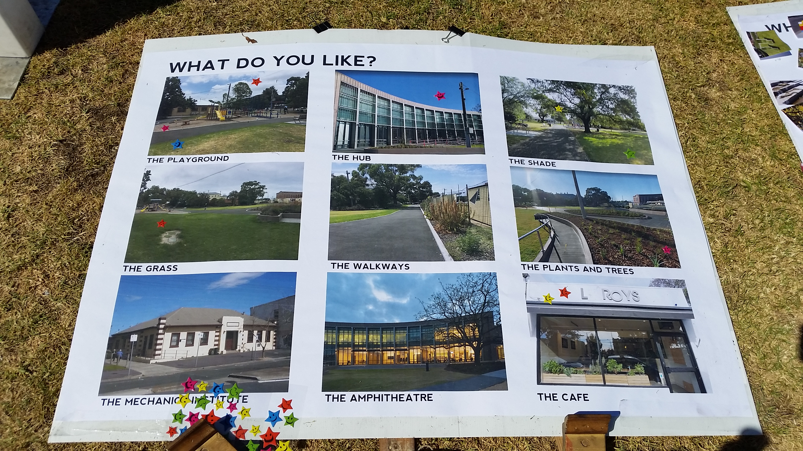
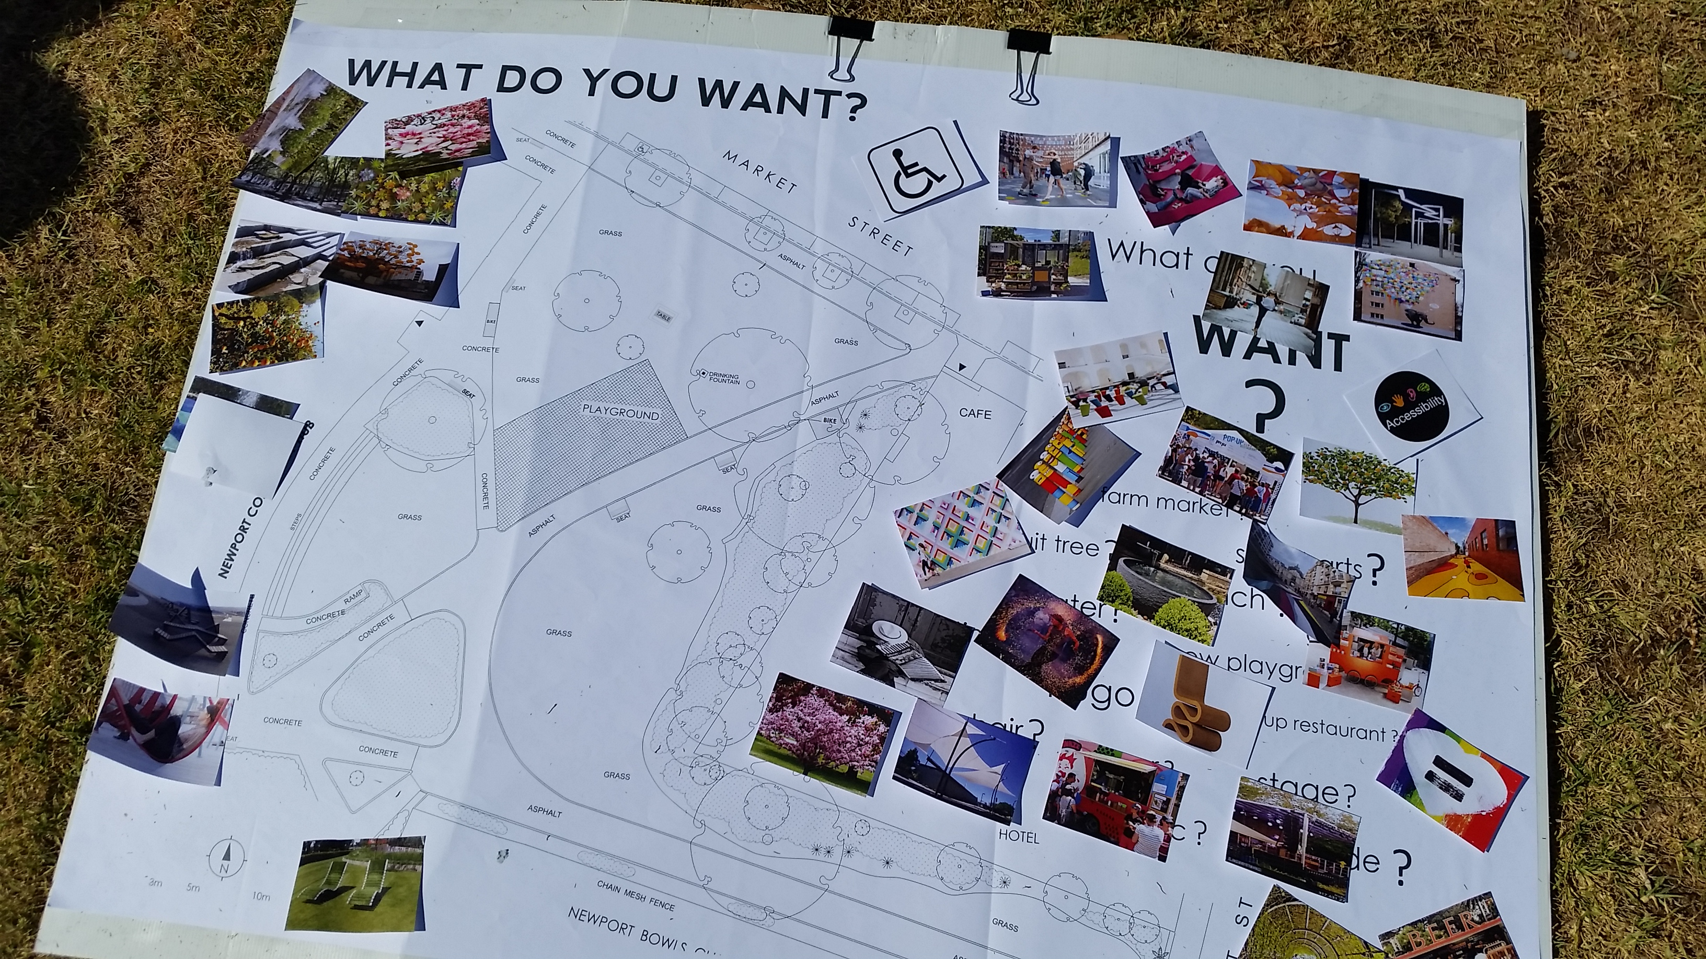
Finding Aspirations: Wishing boards
@ Newport Project, PlaceAgency, 2018.
Notes:
The first was a set of three boards with each board asking a pivotal question;
‘what do you like?’ – seeking to understand what people liked about their park through 9 images of exiting park features which people could vote on using dot stickers.
‘what do you want?’ – aimed at determining what people would like to see in their park, this board featured a map of the park where they could attach images (trees, art, shade, nature play, water fountains, benches, coloured walkways) for purpose of creating a conceptual design map.
‘what do you think?’ – allowed people to write on poster notes for further thoughts and feedback.

Slide 38
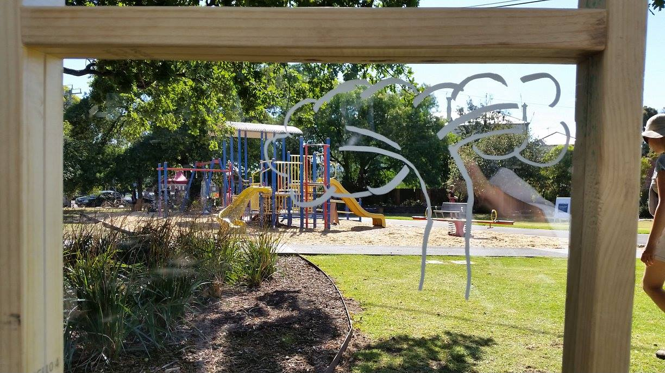
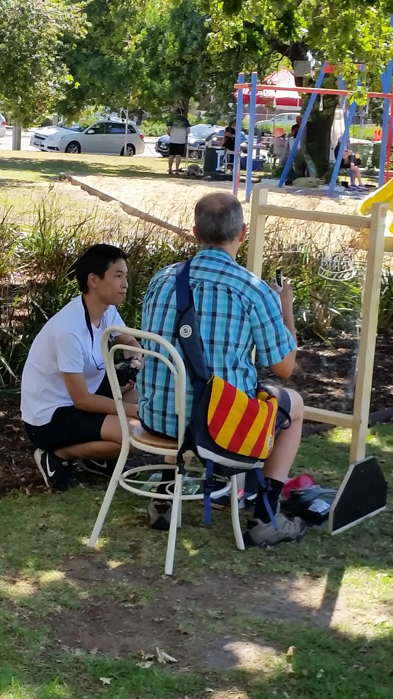
Visualisation techniques: Imaginarium
@ Newport Project, PlaceAgency, 2018.
Notes:
Through applying the concept of community design, the Imaginarium emerged through a perspex panel as a canvas for the community to imagine and visualise. Participants were provided equipment to draw with and the activity facilitator utilised a form to collect data on participants age, whether they were locals or not, other notes and what the participants drew (e.g. trees, playground, shade, music shell & café). Conversations with community members were annotated whilst they were drawing. A total of 16 people participated.

Slide 39
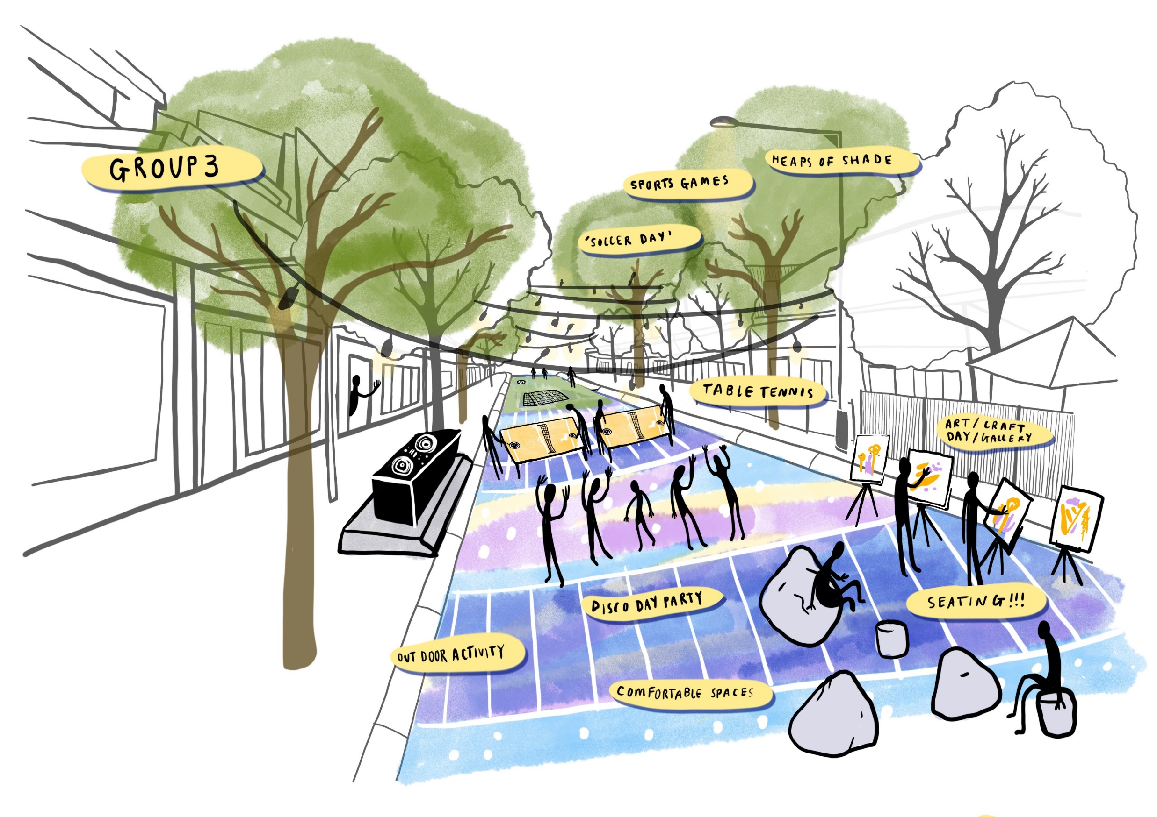
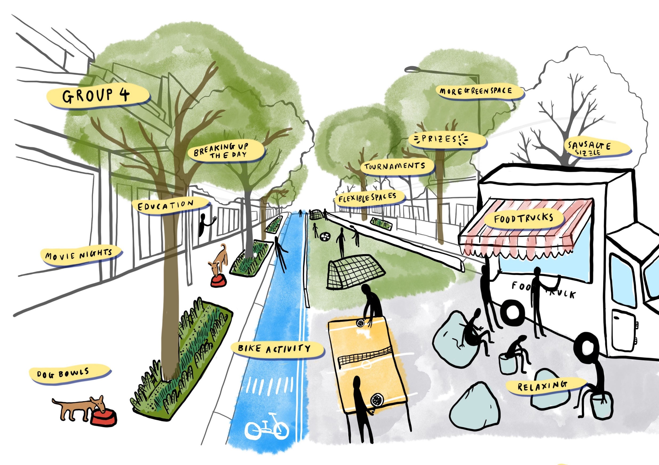
Visualisation techniques: Expert drawers for visualisation

Slide 40
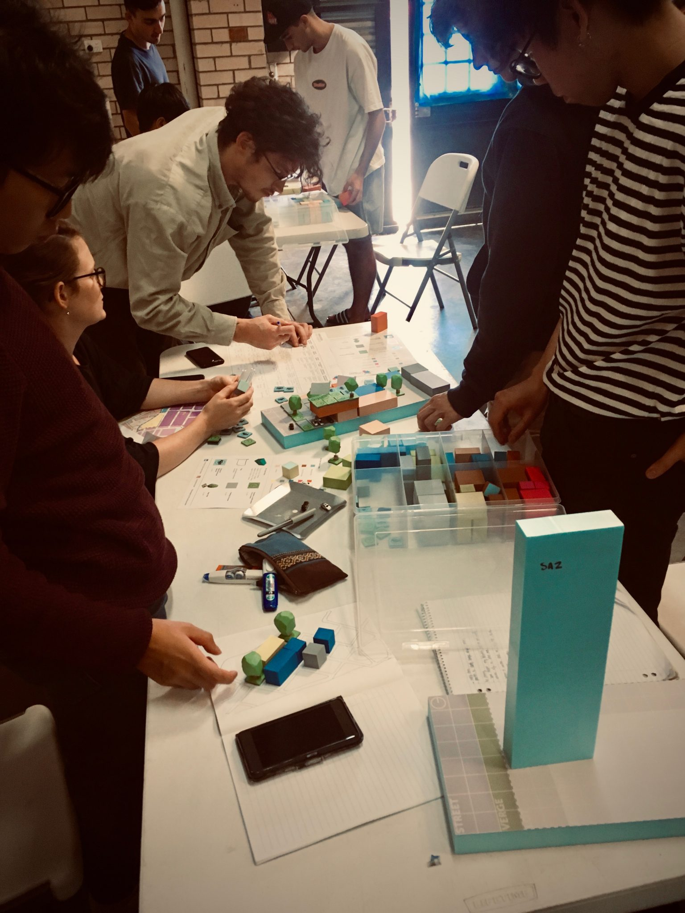
Co-Designing: Through model Making
Students engaging with the models in the Catalyst Creator workshop
Co-Design & Models by Dr Anthony Duckworth | Collaborative Place Design)”
@ Bayswater Industrial area Regeneration, Courtney Babb, PlaceAgency, 2019.

Slide 41
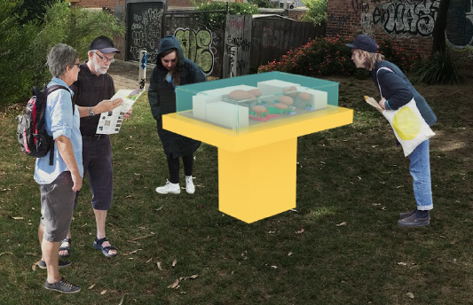
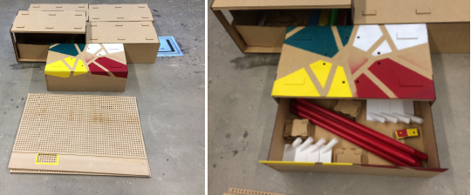
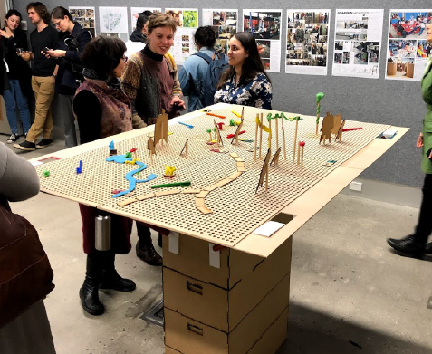
Co-Designing: Through model Making
Modular model Display Stand
Co-Design & Models by Nazanin Moghaddam Tabrizi
@ Place Week Melbourne 2018, PlaceAgency, 2018.
Notes:
Model display stand. Made from modular parts, can be transported to the site easily. The color coded joints
help the user to assemble it easily. So even a young child can do it. All joining parts and model making material
is stored in the storage spaces of the stand.

Slide 42
Other ideas
Digital story telling (see Digital Placemaking Module)
Virtual tools (blogs, twitter etc) (see Digital Placemaking Module)
Music
Citizen science
One off events (e.g. Earth Hour, Walk a Mile in her shoes…)

Slide 43
Lets practice…
1 hr - In small groups (i.e. project teams) define:
What is the purpose of your community engagement process?
Who will you engage? (informed by stakeholder analysis but may be focused to specific demographic as relevant to the project or student ideas)
How would you best engage with them? What are the most appropriate strategies and why?
When would be the best time to engage with your target audience?
Note: this exercise provides a first draft on how to engage with the community of a proposed project. It is expected students will expand and define.
Why are we engaging? What do we want to find out?
Are there questions we want to ask?
How will engagement influence how placemaking unfolds?
Resources: Our readings (including toolkits), and… http://www.communityplanning.net/index.php
Notes:
If the students will have to undergo a real community engagement session, you will probably have details on the timing of the engagement session and use this as a brainstorming exercise for the students to choose from existing techniques or develop their own techniques for engagement.
World Café technique develop and justify engagement strategies uses
We recommend a focus on playful exercises.
If your students are not working on specific projects, here are some scenarios you can use:
Developing new airport runway
Making people over 50 take the bowel cancer screening test
Getting people to plant natives in their back gardens in Adelaide
Building a new development along the Torrens River Linear Park that includes a retail centre and restaurant etc
Stopping people from vaccinating their children
Building a casino on Granite Island
Establishing a new tram line along Norwood Parade into town

Slide 44
Activity 3: Evaluating the community engagement process

Slide 45
Does Community engagement Work?
Community Engagement, Does it work? (2:09 min)

Slide 46
Why evaluating the process?
...is important in order to understand whether or not it is working!
..it is a process of gathering information about the way in which an activity or program of activities is undertaken (process) and the results of the activity or program (outcomes)
The evaluation of community engagement activities can take place
at the project level such as when a one-off community engagement activity is conducted. It can also take place at the program level with the evaluation of a sequence of community engagement activities that contribute to the development or delivery of a government policy, program or service.
Evaluating community engagement in in science, technology and innovation https://www.youtube.com/watch?v=Wm0JnnkYb_Q
Notes:
Evaluation involves comparing aspects of process and outcomes to performance standards or expectations to judge the success of the activity or program, taking into consideration that external factors
may also have had an affect. The results of evaluation are used to inform and improve planning and decision-making about the activity or program, or future similar activities, and to report on practice. Evaluation is also used to develop understanding of the links between actions, context and outcomes in the activity or program. This process can range from: • a small scale evaluation by those conducting and/or participating in the activity or program based on a few key evaluation questions and simple data collection methods such as participant feedback questionnaires, to • a large scale evaluation study conducted by external evaluators utilising multiple methods based on a detailed evaluation framework and project plan.

Slide 47
Benefits of evaluation include...
• improving practice by identifying and articulating lessons and achievements
• contributing to setting best-practice standards and benchmarks helping to build an evidence base for innovative approaches to community engagement
• contributing to engagement capability development by providing
feedback on performance
• presenting opportunities for further citizen involvement in the
evaluation process
• building support for client and community involvement in
government planning and decision-making by providing evidence
of how effective engagement works.

Slide 48
How to: Key evaluation principles
Evaluation should be an integral part of the planning and management of community engagement activities.
Evaluation should be a structured and planned process
The scale and scope of the evaluation should reflect the purpose, audience, and the scale and significance of the community engagement activities.
Evaluation should, whenever possible, be a participatory activity
It is important to undertake an opportunities and risk assessment of all evaluation decisions
Should be formative where possible as well as summative
Involve community where possible
Notes:
Careful consideration needs to be given to evaluation design in situations where: • community engagement is associated with government activities that are highly controversial • problems are already known, or • there are pre-existing tensions between the communities concerned and the government. In particular, it is important to consider: • how the activity of evaluation might raise expectations about improvements • what performance criteria and indicators are politically, culturally and socially appropriate • the time people may have available to participate in an evaluation • the willingness of a community to participate in an evaluation.

Slide 49
Key point to remember...
You are evaluating the community engagement, NOT the project
AND
You can conduct a desk top evaluation or you can add to your data base (in the case of larger evaluations) by the following techniques
Either way using a process or criteria as described above is crucial

Slide 50
Lets wrap up…

Slide 51
Evaluation
SWOT Method
ORID Method
For engagement process that are planned to ensure you understand the limitations
(Strengths) – why was this method chosen, what does it provide?
(Weakness) – What groups are missing, what could be done better, what are the limitations of the approach?
(Opportunities) – what conditions is this strategy taking advantage of? What else can be done?
(Threats) – what are potential areas of tension or conflict?
For engagement process that have been completed
(Objective) – what did we want to do?
(Reflect) – how do we feel about how it went?
(Interpret) – what does this mean? (Synthesis)
(Decide) – what will we do? How will we refine our practice?

Slide 52
Exercise
Lets practice… World Café:
Staying in your small groups (i.e. project teams) the teams will rotate leaving one representative in the table. Within the table:
5 min – the representative will share the engagement strategy created by their team?
20 min – the visiting team (who rotated one table) will perform a SWOT analysis on the strategy highlighting 3-5 characteristics for each quadrant. The following questions can be considered:
What level of engagement does the strategy belong to? Who will you engage? (Arnstein’s ladder)
How fun or clear is the activity?
Commenting on the timing/method, what members of the community are engaged and which ones are accidentally excluded?
Note: If run as a whole group (small groups only), this exercise can give the lecturer space to share facilitation strategies.
Strengths | Weaknesses
X X X X X | X X X X X
Opportunities | Threats
X X X X X | X X X X X

Slide 53
Activity 4: Adapting your process Ethics in Placemaking
Home exercise:

Slide 54
1 hr – Use the slide deck in Ethics, two videos and SWOT feedback to improve the engagement process:
What is the purpose of your Incorporates the feedback from the SWOT analysis
Examines appropriate engagement strategies for Indigenous peoples.
Introduce the idea of welcome to Country and acknowledgement of Country.
Incorporate strategies to deal with conflict
Considers ethical engagement processes (Ethics slide deck).
Notes:
If the students will have to undergo a real community engagement session, you will probably have details on the timing of the engagement session and use this as a brainstorming exercise for the students to choose from existing techniques or develop their own techniques for engagement.
We recommend a focus on playful exercises.
If your students are not working on specific projects, here are some scenarios you can use:
Developing new airport runway
Making people over 50 take the bowel cancer screening test
Getting people to plant natives in their back gardens in Adelaide
Building a new development along the Torrens River Linear Park that includes a retail centre and restaurant etc
Stopping people from vaccinating their children
Building a casino on Granite Island
Establishing a new tram line along Norwood Parade into town

Slide 55
Questions?

