Slide 1
Disclaimer: The following slides were intentionally left text based to allow you to personalise and contextualise with your own images.

Slide 2
Design for Adaptability
These slides are based on material prepared by Palazzo (2019), The University of New South Wales for the Place Agency program for placemaking pedagogy.

Slide 3
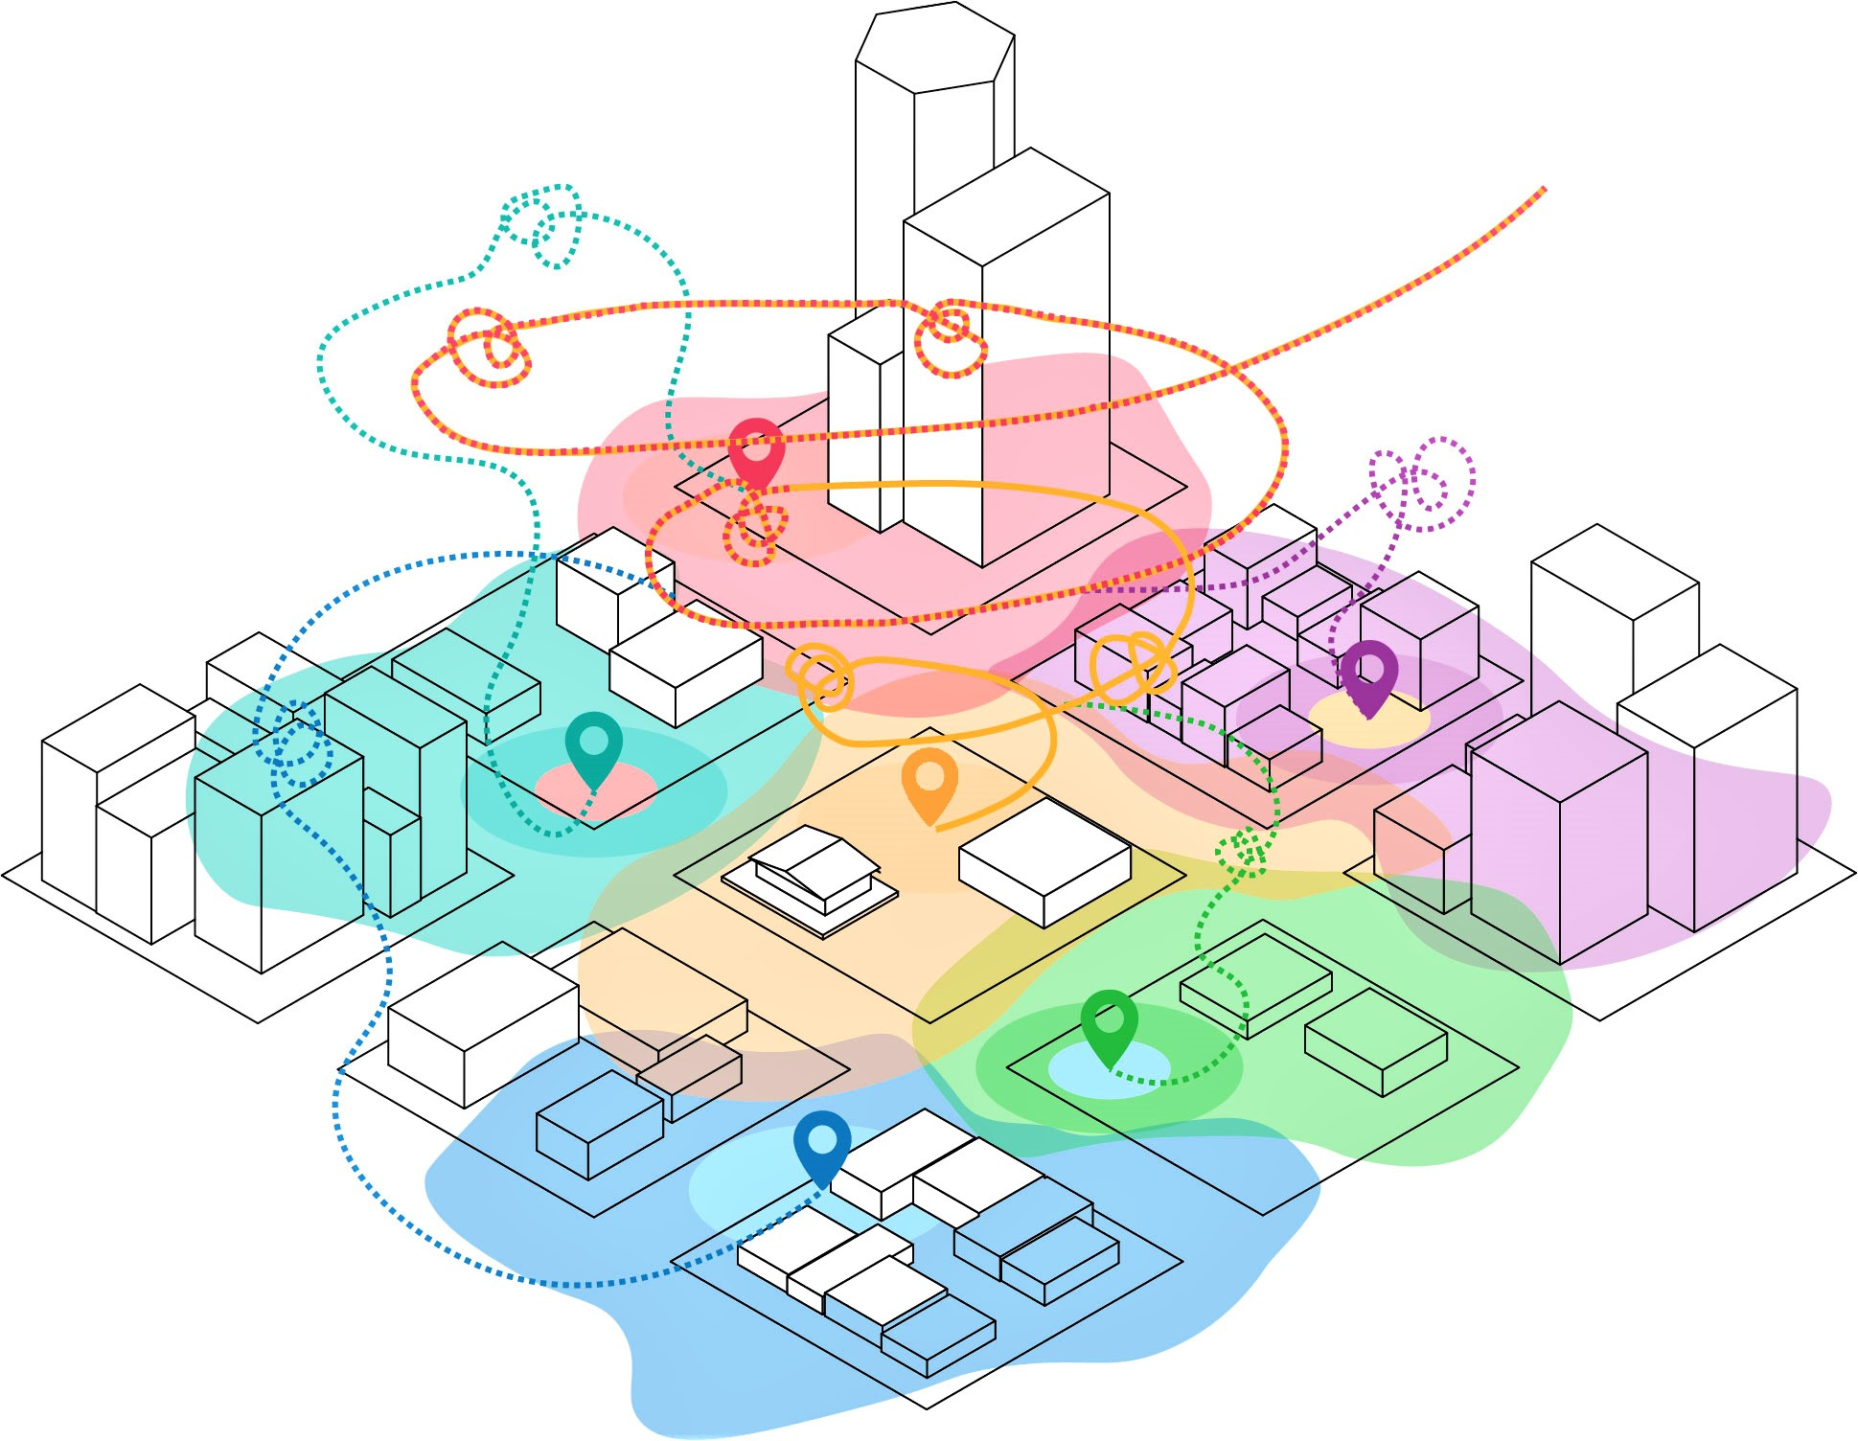
Context: Why do we need adaptable design?
Designing for adaptability includes two aspects:
Product: That the outcomes of the design exercise responds to changing conditions. I.e. adapting to climate change, multiuse areas, etc.
Process: Responding to feedback and creative design thinking to address issues
This module focuses in the adaptable design thinking as relevant for point 2. In placemaking, taking in feedback from the community is critical.

Slide 4
Learning outcomes
Identify the theoretical dimensions of adaptive design
Critically evaluate the theoretical dimensions of adaptive design
Apply the theoretical dimensions of adaptive design to a case study
Develop an appropriate adaptive strategy to respond to a design problem

Slide 5
Outline
Why we need adaptive design
The four strategies of adaptive design
The roleplay on adaptive design
Getting to know your persona
Sharing the urban design scenarios
Listening and interpretative skills development
Applying an adaptive knowledge cycle in an urban design case study
Voting
Negotiating

Slide 6
Our changing socio-ecological systems
Cities are complex socio-ecological systems, shaped over time by the collective effort of their inhabitants in adapting to the geo-physical context. Top down approaches in spatial planning have often overlooked the capacity of the local communities to generate resilient and equitable urban spaces.
On the other hand, urban environments are now rapidly changing, Unpredictable global dynamics, including environmental, economic and socio-demographic transformations.
These changes may refer to:
Climate/Environmental change
Urban densification
Demographic changes and mass immigration phenomena
Economic unpredictability
Notes:
CHANGING CONDITIONS ARE CHALLENGES TO TRANSFORMATION
ECONOMIC FACTORS (Urban processes)
Uncertainty of financial markets, real estate markets and global competition
Unpredictability of programs and policies
The cost of transformation and the lack of resources on the immediate, need of diluting the financial load over time
Lifespan of structures, functions and uses (durability)
Automation of manufacturing processes, new working environments
New and old jobs
ENVIRONMENTAL FACTORS (Urban liveability and urban forms)
Climate change challenges (heat islands, draught, flooding, etc.)
Urban Sprawl ecological costs
Land mosaic and fragments
Urban decay, derelict lands and spaces “in between”
Etc.
SOCIO-CULTURAL FACTORS (Urban uses and users)
Migration flows, new users and cultural perspectives
Unpredictability/flexibility of uses
Underused/underexploited spaces
Overused spaces
Etc.

Slide 7
Why we need an adaptive design approach?
The methods traditionally implemented in space management may no longer be appropriate to places in rapid transformation and demand the introduction of novel theories, strategies, and skills that require to introduce adaptability to change in the management and transformation of urban areas.

Slide 8
The four dimensions of adaptability
In Placemaking and urban design processes adaptability may refer to four distinct and intersected strategies:
Transdisciplinarity
Multifunctionality
Incremental transformation
Resilience
 | Adaptive design strategies | Planning dimensions | Urban places dimensions | Practices
A | Transdisciplinarity | governance | socio-political | Inclusiveness / engagement / co-design / traditional knowledge / open process
B | Multifunctionality | program | functional/technical | Uses / users / integration / coexistence
C | Incremental change | method | temporal/economic | Maintenance / re-use / progressive implementation / process vs. output / iterative learning / adaptive cycles
D | Resilience | performance | environmental | Nature-based / biodiversity / biophilic / regenerative approaches
Source: Palazzo E. (2019), Design for change: an adaptive approach to urban places in transformation, Placemaking fundamentals for the built environment, Hes D. and C. Hernandez editors, Palgrave/MacMillan

Slide 9
Approach A - Transdisciplinarity
The conceptualisation of cities as the result of a combination of countless human decisions over time suggests that the equitable management of public space requires a plurality of perspectives, not just specialists ones, and must include the local inhabitants.
Key themes:
• Co-management and adaptive co-management
• Co-design and co-creation
• Open knowledge system, local knowledge
• Collaborative tools
• Empathy / Flexibility / Inclusiveness
• Acceptance of others’ point of view
• Facilitating capacity to ease conflicts

Slide 10
Approach B - Multifunctionality
Growing urbanization processes have determined an increasing complexity and congestion of cities open space. Higher densities objectives and optimal functionality call for multifunctional approaches to land development in urban areas.
Key themes:
Design for all: age/gender/children friendly design
User friendly design
Responsive design
Design Ergonomics principles
Product adaptability and life cycles
Adaptive reuse
Multifunctional landscapes
Time/use patterns in planning

Slide 11
Approach C - Incremental transformation
The slow and composite processes that generated cities in the past could be reconsidered in contemporary planning discussions on how to manage and develop places gradually according to small scale strategic interventions and incremental transformations.
Key themes:
Urban Acupuncture
Project by points
Decentralised systems
Tactical urbanism
Guerrilla urbanism
Guerrilla gardening

Slide 12
Approach D - Resilience
The understanding of cities as an interdependent system of people and nature has changed the way we approach change in urban areas. Green approaches to urban design support adaptive capacity (the capacity of a systems to reorganize and recover from change and disturbance without changing to other states).
key themes:
Nature based solutions
Ecological infrastructures
Designed ecologies
Understanding natural processes and nature cycles
Ecological dynamics / seasonal changes
Ecosystem services
Biophilic cities

Slide 13
Case studies
A - CO-DESIGNING (Transdisciplinarity): The GreenWay in Inner West Council, Sydney
https://www.greenway.org.au/
B - DESIGN FOR ALL (Multifunctionality): by BIG Bjarke Ingels Group in Copenhagen
http://www.landezine.com/index.php/2013/02/urban-revitalization-superkilen-by-topotek1-big-superflex/
C - URBAN ACUPUNCTURE (Incremental transformation): Urban Acupuncture project in Florence by Studiostudio
http://www.urbanacupuncture.network/tag/florence/
D - A GREEN SPONGE (Resilience): Stormwater park in Qunli, Harbin by Turenscape
https://www.turenscape.com/paper/detail/387.html

Slide 14
Structuring a persuasive proposal
Keep the audience in mind
Consider the potential support and/or opposition such a proposal would attract
Consider how to defend your design proposal
Develop a clear logical line of reasoning
Select evidence to support logic
Critically evaluate content

Slide 15
A successful design proposal presentation needs to
Capture attention
Address needs
Hold attention
Persuade opponent
Deliver a dynamic vision

Slide 16
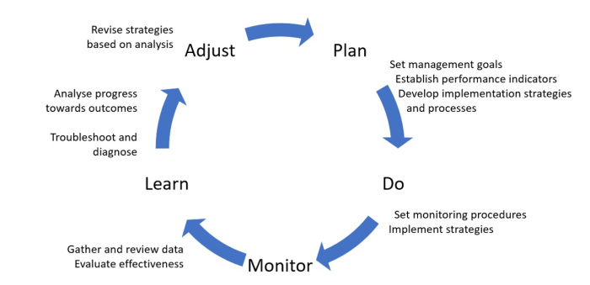
Adaptive Knowledge Cycle

Slide 17
The roleplay on adaptive design

Slide 18
What you should have done from home
Applying the elements of the adaptive design framework to the case study by defining a new urban scenario able to regenerate this urban area, optimise the quality of open space for the public and integrate public transports into the new city scapes. (AT HOME)
Given four different possible urban scenarios (one for each adaptive design strategy) the scope is to agree on just one proposal shared by the whole tutorial class. (IN CLASS)
The activity in class will be structured in four phases:
Role Play (providing feedback)
Applying an adaptive knowledge cycle (Including feedback)
Voting
Negotiating

Slide 19
Getting to know your persona (stakeholder roles)
Hand out different roles:
Council
Design team
Progressive resident
NIMBY
Each role will have various representatives. The roles will shift after each presentation as the presenting team takes the ‘design team’ role.
Students will have a few minutes to get familiarised with the information.
Notes:
When each team presents, the other groups will act as the different stakeholders in the meeting (council members, progressive residents, the NYMBYs) and express their points of view, opposition, concerns etc. as per their role card ‘character’.
The students will have to provide reasons for their POINT of view and to be able to defend their scenario proposal.
There is a rotation of roles for each cycle of the role play, i.e. when a new team presents, the other teams will take on a new stakeholder role.

Slide 20
Role play – 60 mins
Council engagement session to hear four new urban scenarios to regenerate this urban area.
Each team present their scenario (5 min) and receives 10 min of feedback.
Each team if focused only on one element of the adaptive design framework: transdisciplinary, multifunctionality, incremental transformation and resilience
The discussion and feedback may include the following topics:
Community liveability
Water management
Local economic development
Climate change
Energy transition
Human health
Urban ecology and biodiversity
Urban mobility
Food production
Cultural diversity

Slide 21
Capturing feedback.
Type of person | Main points
Council
Design team
Progressive resident
NIMBY
(other?)
The discussion and feedback may include the following topics:
Community liveability
Water management
Local economic development
Climate change
Energy transition
Human health
Urban ecology and biodiversity
Urban mobility
Food production
Cultural diversity

Slide 22
Adaptive knowledge cycle (40 min)
The four “designer teams” discuss a strategy on how to respond to feedback from the audience (25 mins).
How will the feedback impact the design?
Change things on PPT and your A2 poster (sketching, bullet points, etc.)
Each team will have 2-3 min to share how they are responding to feedback.
Convince the audience that you have done the best to ADAPT your proposal to their requirements/comments.

Slide 23
Voting (20 mins)
The four urban scenarios are pinned up in the studio.
Each student is given two stickers. The students circulate, consider each design ‘scenario’ and use the stickers to vote for two designs.
The two scenarios that score the higher number of stickers will be the object of further negotiation.

Slide 24
Negotiation (40 minutes)
The students from each of the proposals now change groups – so if 4 groups of 5 students now it will be 5 groups of 4 students.
You will not seat in a group with members from your own “design team”.
Of the two proposals from the voting stage – negotiate which one your new group thinks is the best – 10 mins
– first each student for 1 minute choose one of the two and write down the main reason.
– Then briefly tell each other which you have chosen and your main reason
– Negotiate/vote as a group which one you will go forward with

Slide 25
Negotiation (40 minutes)
Next work as a group to develop a short report to the class about why you have chosen the project, giving your top reasons – 10 mins
Each group present their final decision for 2 minutes – 10 mins
Out of the five groups recommendation’s the Winner is announced!
Q&A and debriefing – 10 mins.

