Slide 1


Digital Placemaking
These slides are based on material prepared by Hes & Toland (2019), The University of Melbourne and University of Technology of Sydney for the Place Agency program for placemaking pedagogy.

Slide 2
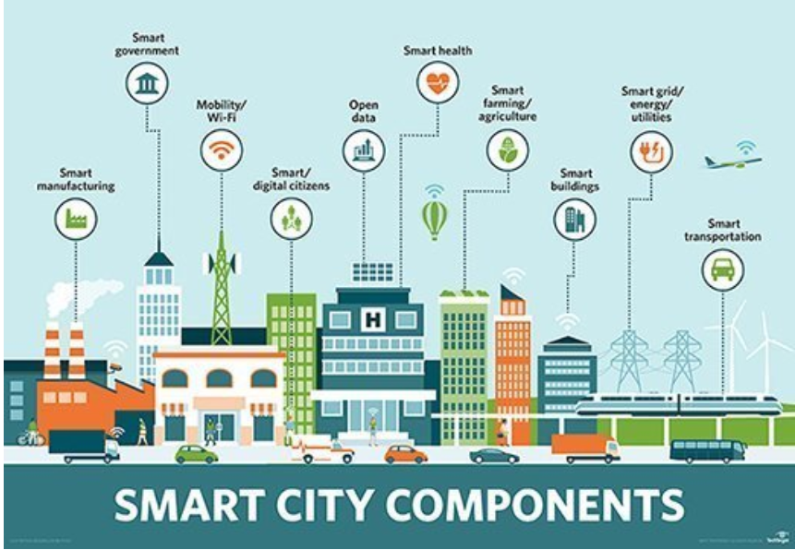
Context:
Where does digital technology fit within placemaking?
Our cities are now highly technological and looking for smart-city options
Big data is collected constantly through our phones, sensors and other technological tools documenting how we move through the city.
44% of teens spend over 5hrs on the Internet (Jovic et al. 2015).
Image from: https://sileotech.com/how-iot-and-big-data-are-driving-smart-traffic-management-and-smart-cities/
Notes:
(Jovic et al. 2015).
The Adolescents and the Internet- the Preliminary Results
The cross-sectional study included 145 subjects (43.4% of whom were female and 56.6% male) whose average age was 16.7 ± 0.46. The examinees attended the Electro-technical school, Agro-chemical school and the Grammar school in Nis.

Slide 3
Objectives
To look at the opportunities of digital technology supporting placemaking through activation and engagement
To look through the readings at case studies and what worked and what did not
To look at digital data collection tools and outcomes to support placemaking decision making
Notes:
With this module, you there are five key learning outcomes
Develop the theoretical foundations of place and placemaking;
Compare placemaking strategies, typologies, scales, relationships, potentials and limitations;
Appreciate the role of interdisciplinarity in placemaking;
Comprehend the different roles of various stakeholders in placemaking towards achieving positive ‘place’ outcomes; and
Explore different case studies in placemaking.

Slide 4
Outline
What is Digital placemaking
Digital Placemaking for storytelling
Digital activation
Digital tools for participatory approach
Digital tools for research data
Neighbourlytics
(a platform providing data and insights on how people use and experience the places where they live and work - https://www.neighbourlytics.com/).

Slide 5
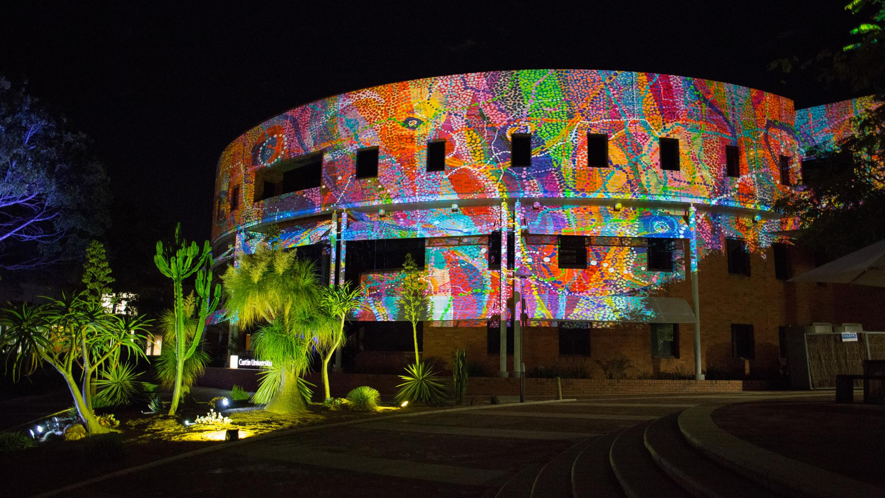

Digital Placemaking
“placemaking practices which place special emphasis on, or are primarily mediated through, digital technologies”
(Toland et al. 2020)
Digital Placemaking, Image by Curtin University

Slide 6
Storytelling
electronic multimedia technologies physically installed or projected in public locations
Research information
Big research databases
Enhancing Participatory Approach
Online tools and strategies for organisation, communication with stakeholders, crowdsourcing, etc.
Information collected by 3rd parties and available online
Digital Activation
Storytelling and Digital Activation
Notes:
Digital technologies used in three key ways:
Storytelling,
Participatory
Research
Extract from book chapter introduction:
Initially, its usage was primarily applied to the use of digital electronic multimedia technologies physically installed or projected in public locations (sometimes also described as media architecture) (Haeusler, et
al. 2012; Tomitsch, 2016; Hespanhol, et al., 2017). Increasingly, however, the term is being used to describe ways in which digital technologies might be used to extend traditional placemaking strategies, such as expanding community engagement or enhancing collaboration and communication amongst stakeholders2 (Latorre, 2011; Aurigi & De Cindio, 2008; Fredericks et al., 2016), as well as
crowdsourcing information and mobilising participation.

Slide 7
Ethics of digital placemaking
Is place or technology leading practice?
Is technology enriching the experience of place? Or leading the experience?
Is digital data collection happening ethically?

Slide 8
Storytelling and Digital Activation
Examples in practice

Slide 9
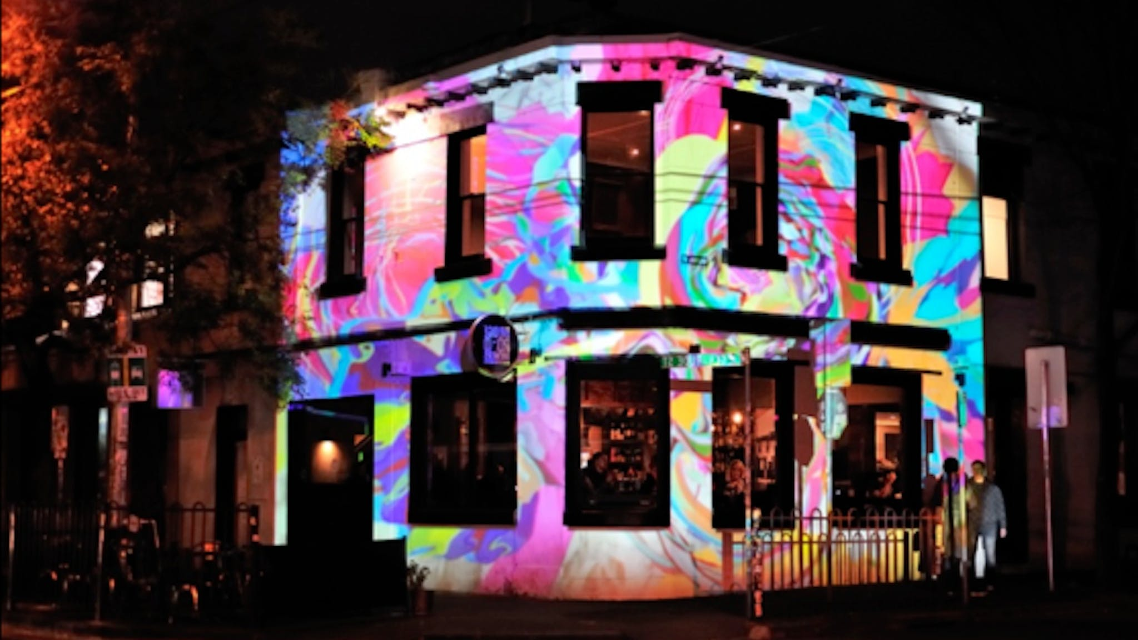
Storytelling: Projection Festivals
White Night, Gertrude Street Projection Festival
Temporal storytelling, making the most of the night.
Website: www.gspf.com.au, 26 July-3 August
Image Credit: www.visitmelbourne.com

Slide 10
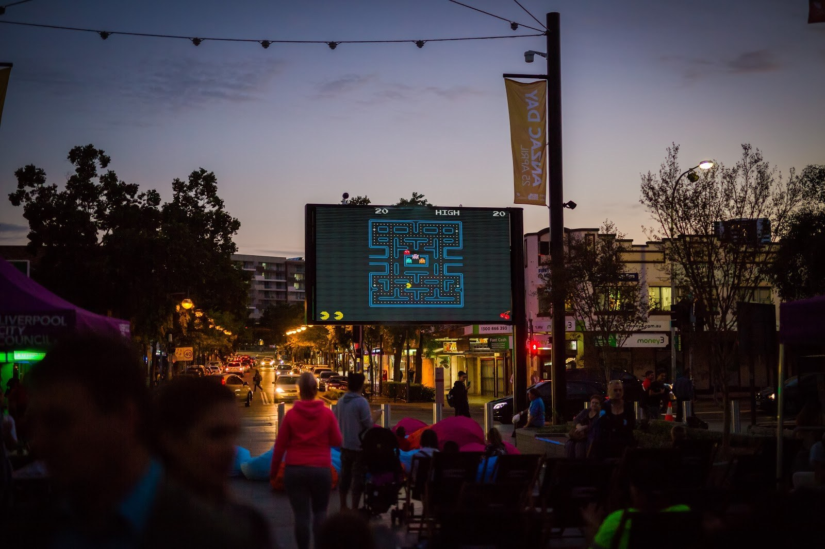
Storytelling: Urban Screens
Image: https://unimelb.placeagency.org.au/2019/05/13/avoiding-digital-disasters-outer-suburbs-placemaking/

Slide 11
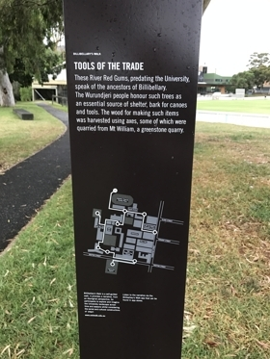
Storytelling: Enriching place experience
Using apps and technology to enrich stories of place…
  Using QR Codes on interpretive signage to tell heritage stories
  Wayfinding
  “Gamifying” place (geocaching)
One example is the Billibellary’s Walk app sharing cultural stories within the University of Melbourne (UniMelb – search in App Store)
Photo by Place Agency, 2018

Slide 12
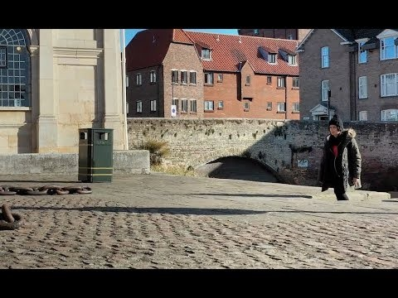
Digital Activation: augmented reality
https://youtu.be/Zu-yGwVKXOk
From - https://calvium.com/8-great-digital-placemaking-projects-around-globe/

Slide 13
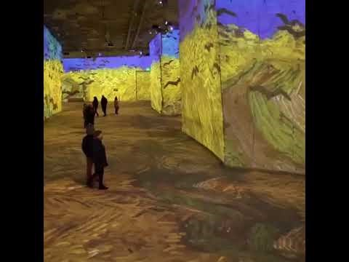
Van Gogh’s 'Starry Night' in a whole new way at the Amsterdam Light Festival
https://youtu.be/yR717ZM-U5M
From - https://calvium.com/8-great-digital-placemaking-projects-around-globe/

Slide 14
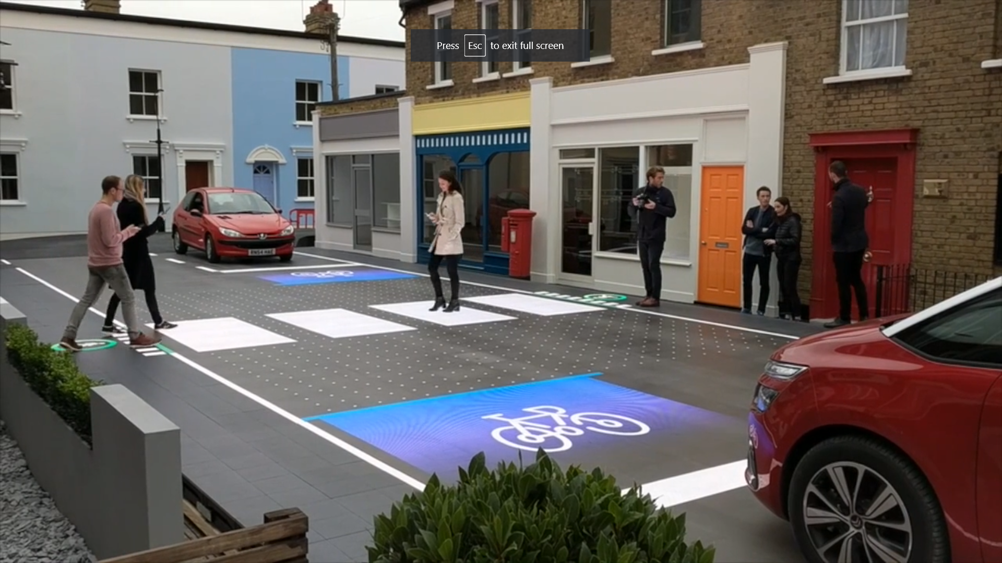
Digital Activation: smart streets
https://vimeo.com/237217992
From - https://calvium.com/8-great-digital-placemaking-projects-around-globe/

Slide 15

Source: https://calvium.com/resources/digital-placemaking/ image ref: Gardens by the Bay, Singapore. Image by Victor Garcia

Slide 16
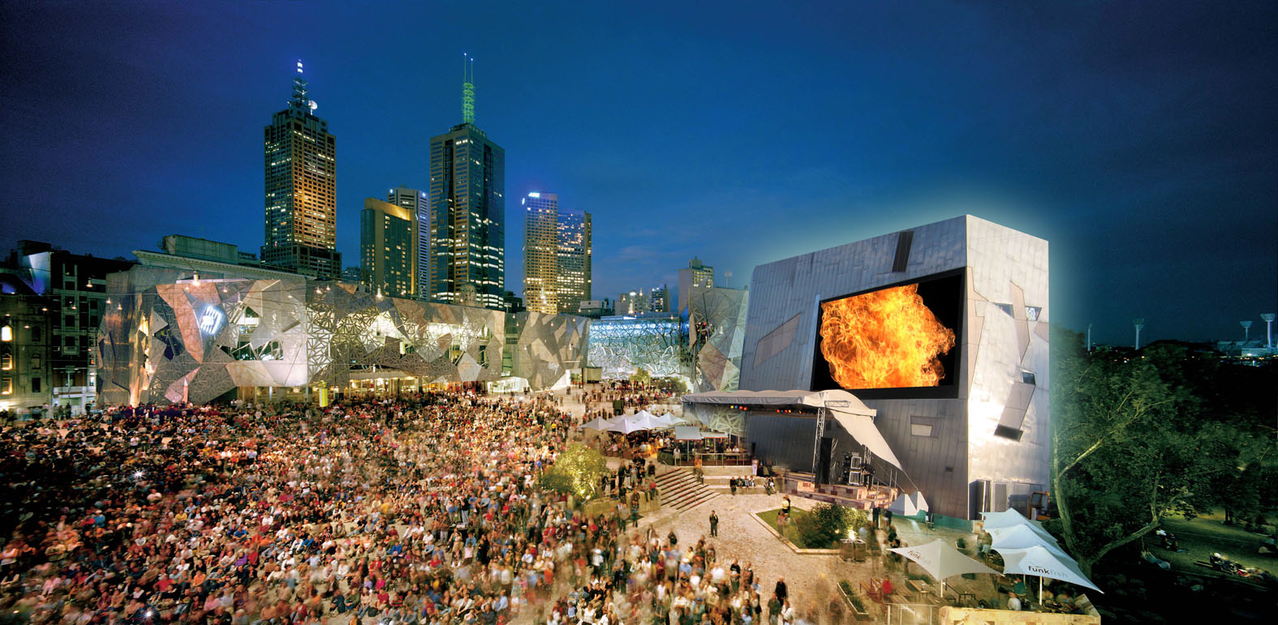
It’s not just the tech
FedSquare – image source: https://www.austrade.gov.au/international/buy/australian-industry-capabilities/building-and-construction/urban-screen-productions

Slide 17
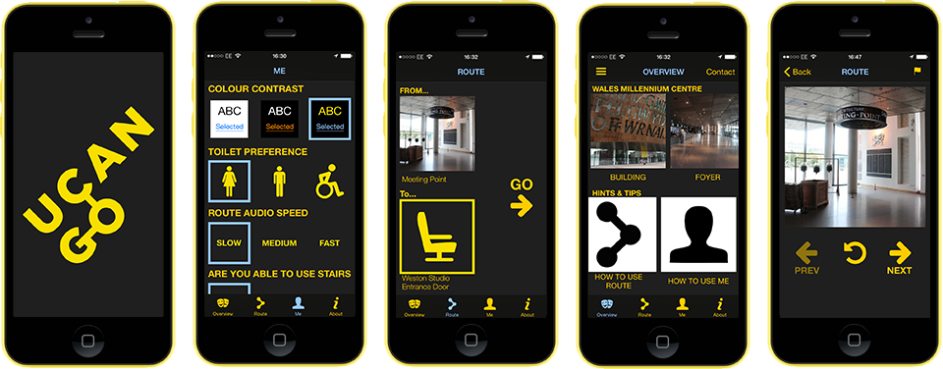
Using phones
Image source: https://calvium.com/resources/digital-placemaking/

Slide 18
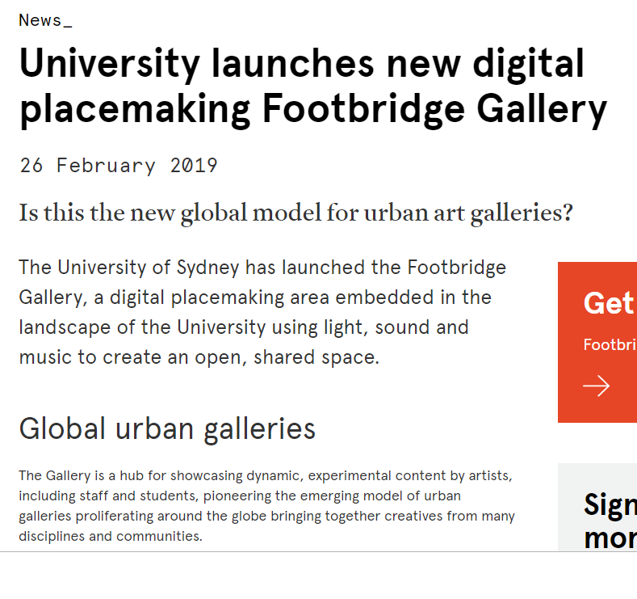

Digital tech meets Indigenous place
“The Footbridge Gallery brings together the work of all its communities – students, staff, alumni, creatives, and residents in adjacent areas – for all of those who feel a sense of place and belonging on these Gadigal lands that have for thousands of years been a gathering and journeying place. The original Blackwattle Swamp – on which this area of the University is built – has important ceremonial and spiritual connections,” said Professor Richard Miles, Pro Vice-Chancellor (Education – Enterprise and Engagement)
https://sydney.edu.au/news-opinion/news/2019/02/26/university-launches-new-digital-placemaking-footbridge-gallery.html

Slide 19
Case study:
Walking Tour
DIGITAL PLACEMAKING FOR COMMUNICATION AND STORYTELLING
by 226 STRATEGIC & COCREATE CREMORNE
Notes:
This story refers to the following set of slides:
Co create Cremorne is a Web developers and Placemaking consultancy who aim to enhance place experience through their work. Amongst other services, their ‘environments’ service refers to their services with interactive signage. Providing legible places that share the local stories.
Their firm is located in Cremorne, Melbourne. Engaging with the local community, they have offered their services pro bono to support the community network: Co create Cremorne.
Cremorne, a small suburb with multiple small local businesses, is facing challenges in the ongoing pressures of a growing city and gentrification. In an effort to rebrand the neighbourhood and identify the things most valued. The newly formed network fist engaged local community with two questions:
What is it that you LOVE about Cremorne?
What do you NEED in Cremorne?
This resulted in a series of small initiatives including street parties for social cohesion, activating an unused space under a bridge, and developing a series of walking tours sharing the stories of place. In particular, these walking tours have added temporary signage to the neighbourhood with the stories of heritage buildings important for the community members. Through digital technologies, the ‘visitor’ can expand their tour to learn about the stories of people who lived and worked there in the past.
The key lesson here is that the digital tools are not opposing face-to-face interactions, but instead, they are supporting the initiatives. The processes applied by the group were not predetermined but emerged from the community and then, they sought ways of expanding through digital tools.

Slide 20
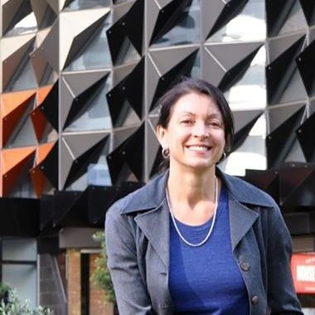

Web developers
Brand designers
Placemakers
  They understand placemaking from a communication lens using signage and digital tools to craft an experience
Helaine Stanley

Slide 21
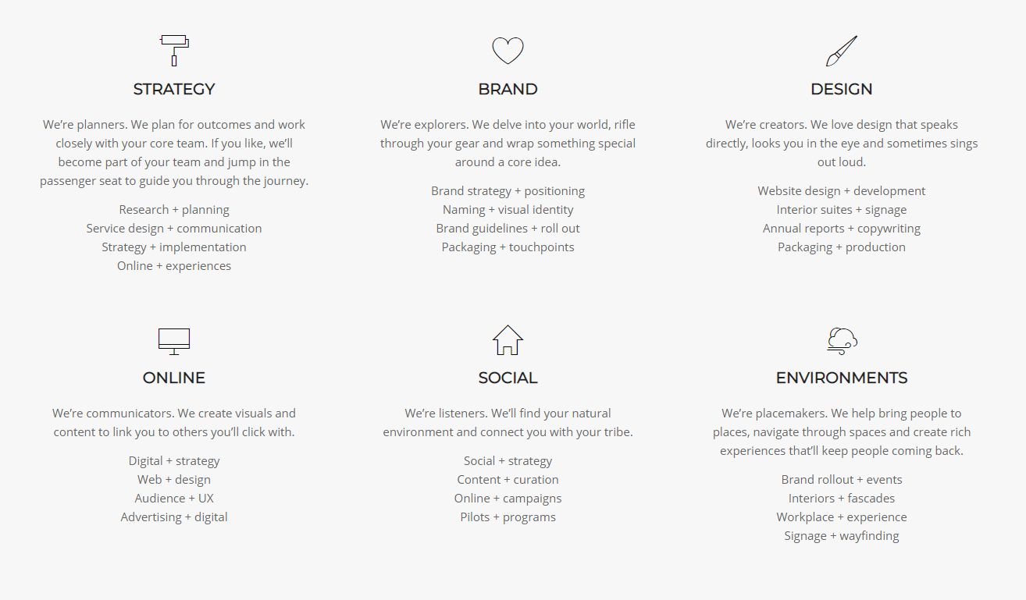

Slide 22

CoCreate Cremorne
http://cocreatecremorne.co/
“community network of people who are helping take forward some community-led and community-generated ideas for common good”

Slide 23
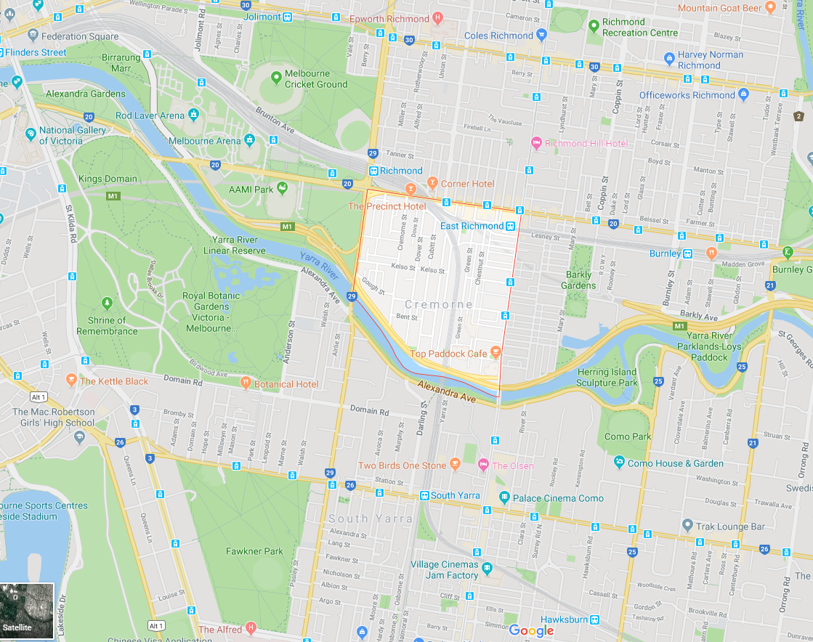
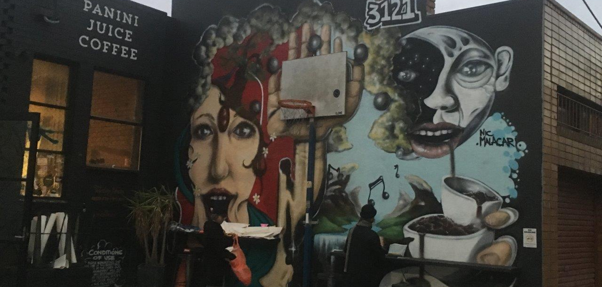
Context
Small suburb
~3600 people
Small businesses

Slide 24
Started in 2016 asking the community:
  What is it that you LOVE about Cremorne?
  What do you NEED in Cremorne?
Industrial past
Mixed-use
Street art
Creative
Walkable
Cafe
Boutique
Community events
Accessibility
The population will double
Communicate
Greenery
Public transport / location
Street light
Entertainment
Party
To know each other
Street art
Public space

Slide 25
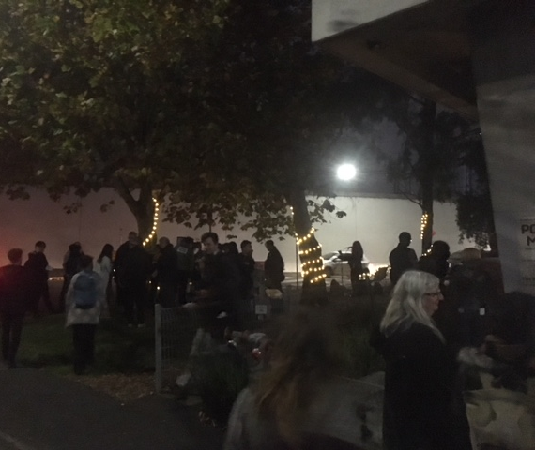
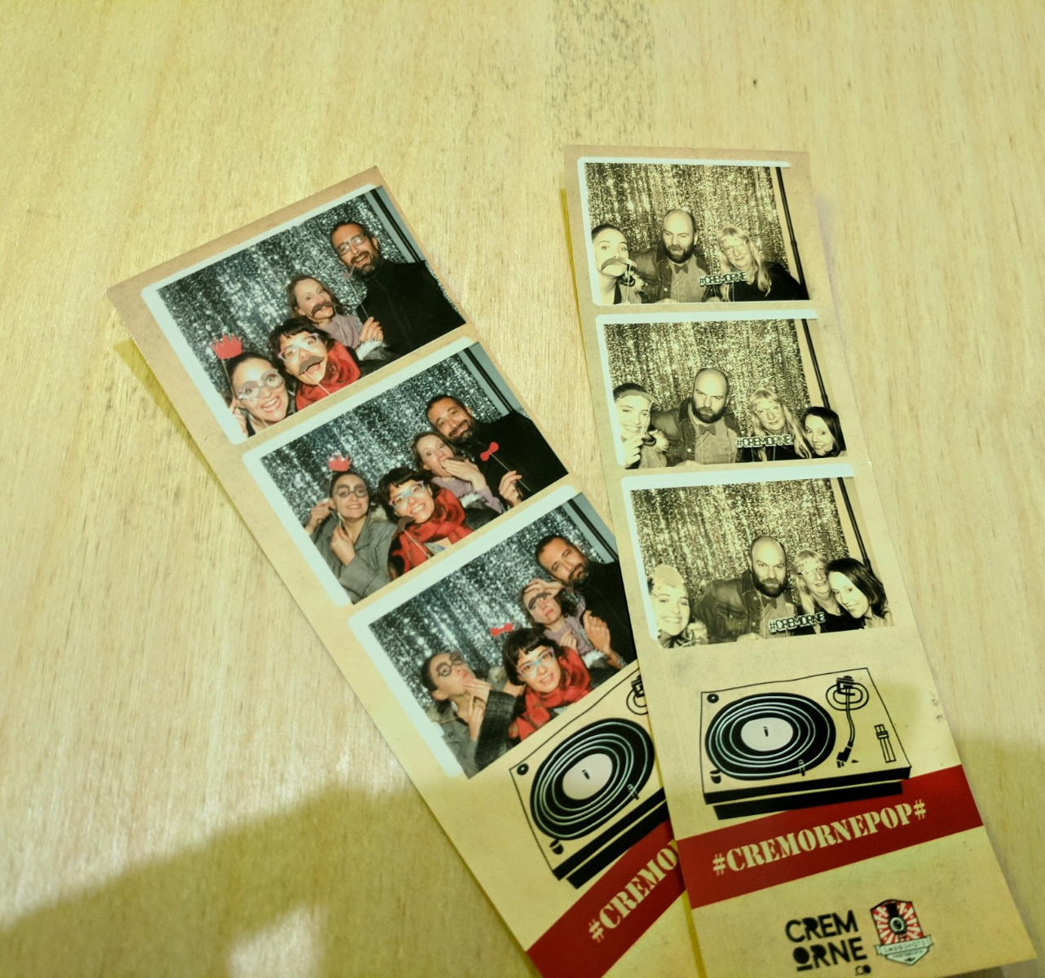
Street Fest
A community party!
Walking tour
Sharing experience
http://cocreatecremorne.co/portfolio/street-fest-cremorne/

Slide 26
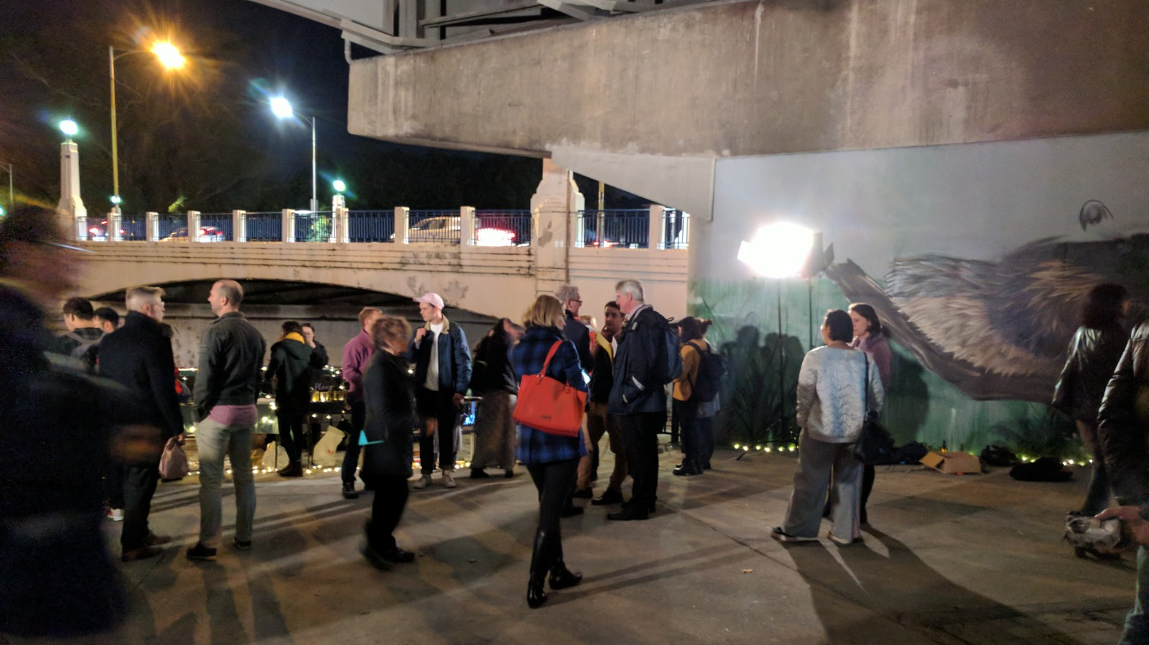
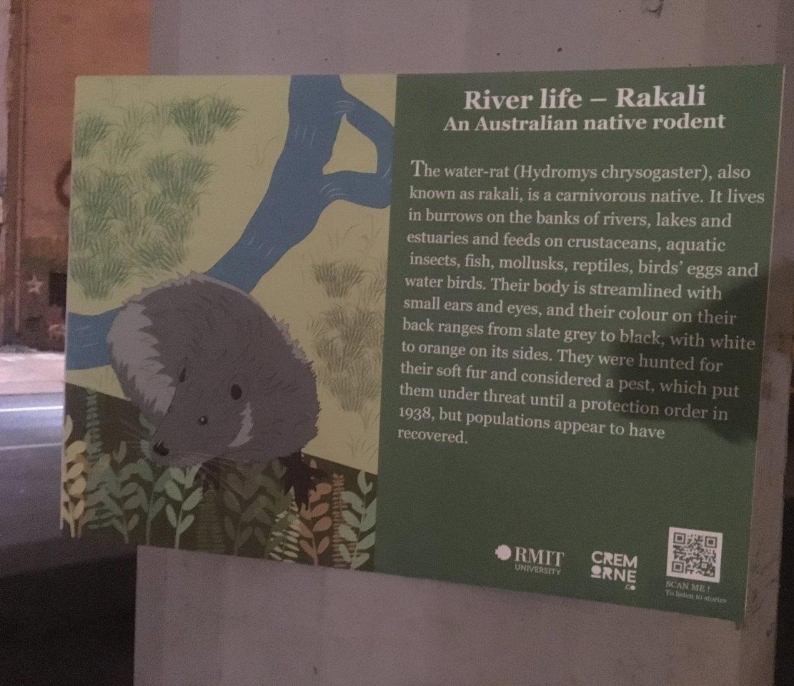
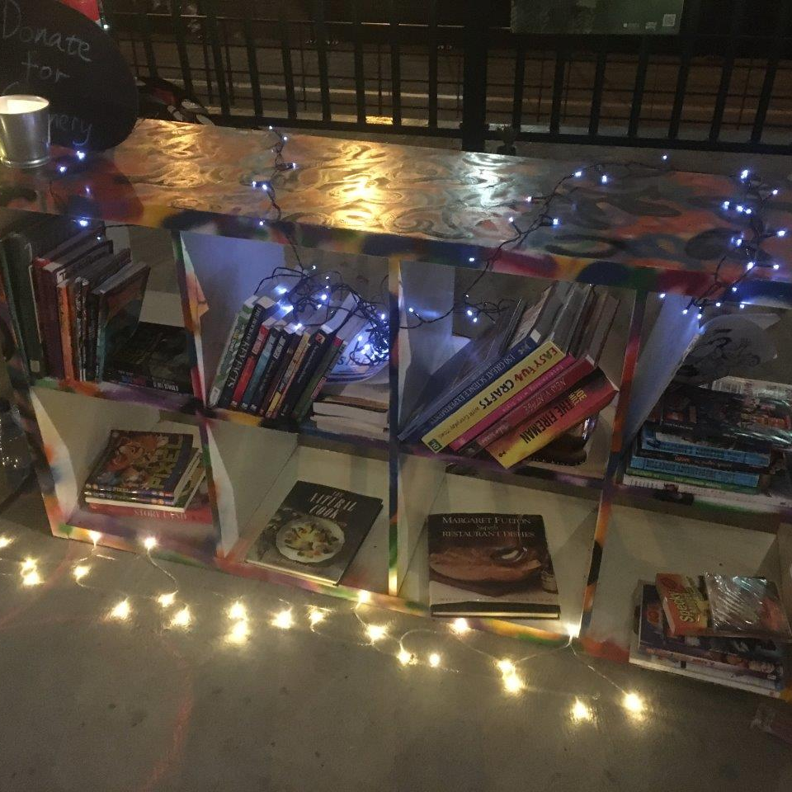
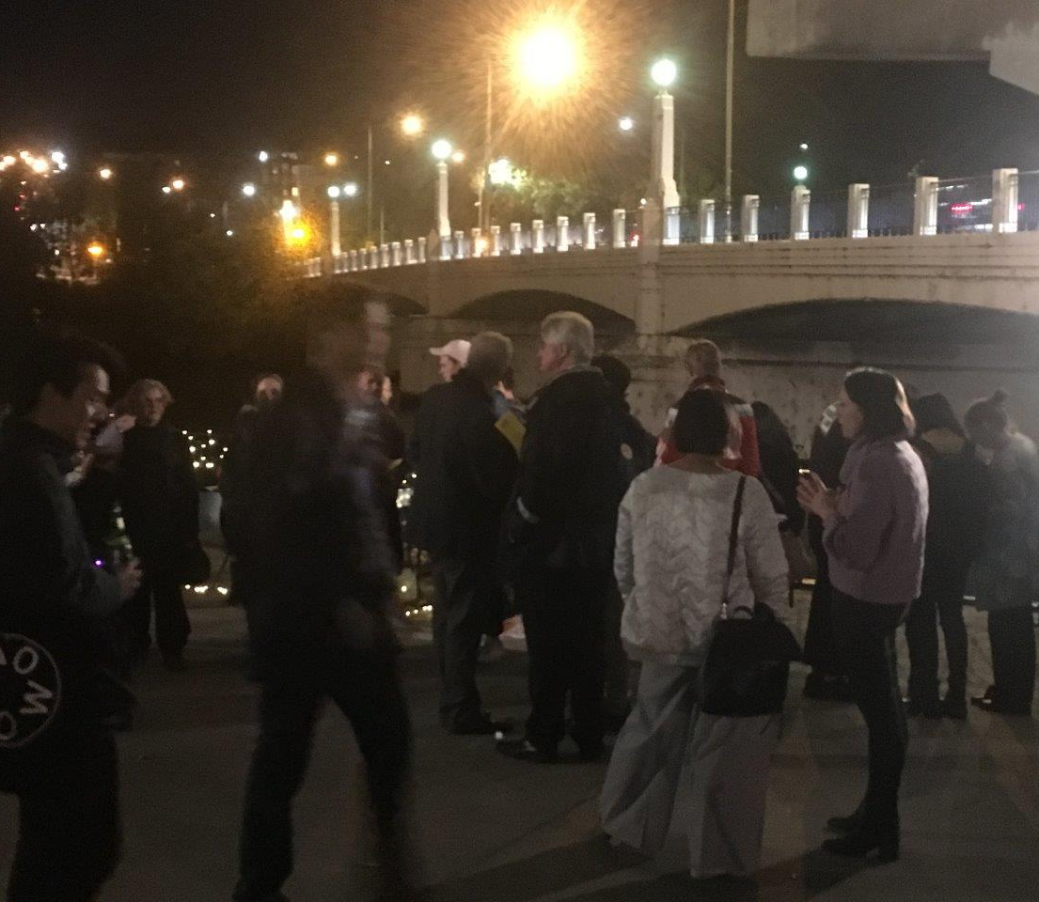
Pop-up market under the street
They have tried multiple ways of activating this site through pop-up market, groups meeting in the weekends, etc.

Slide 27
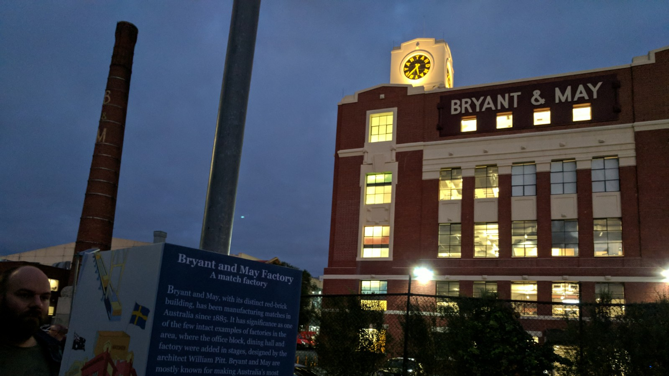
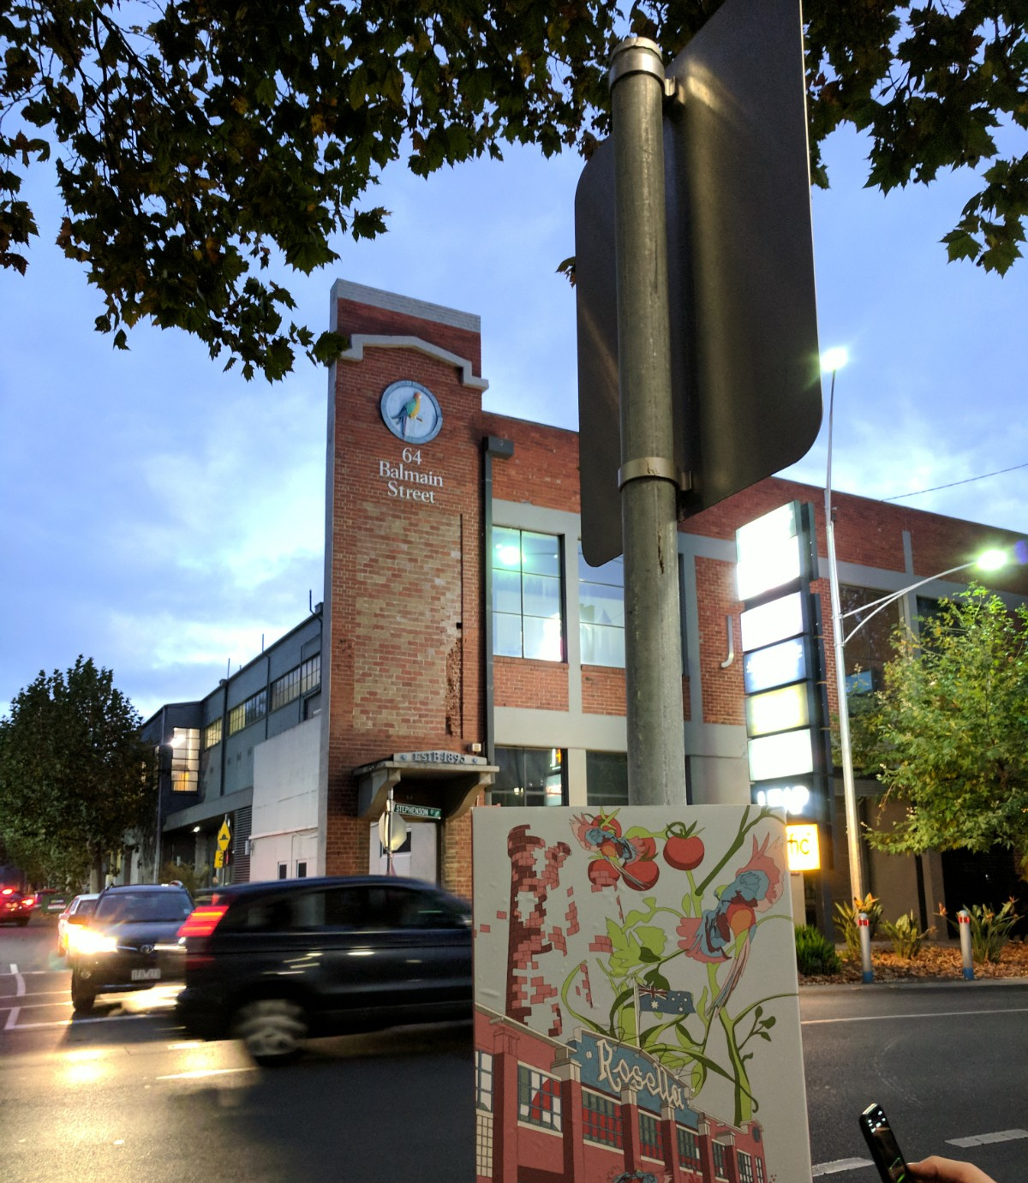
Walking tours
They implemented 6 temporary signs in collaboration with students from RMIT
Currently looking for funding to develop the permanent signs.

Slide 28
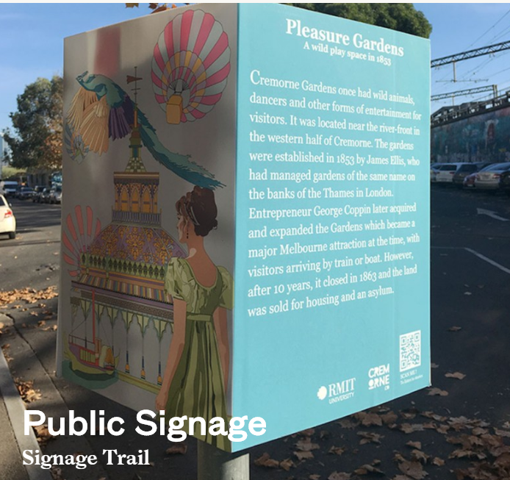
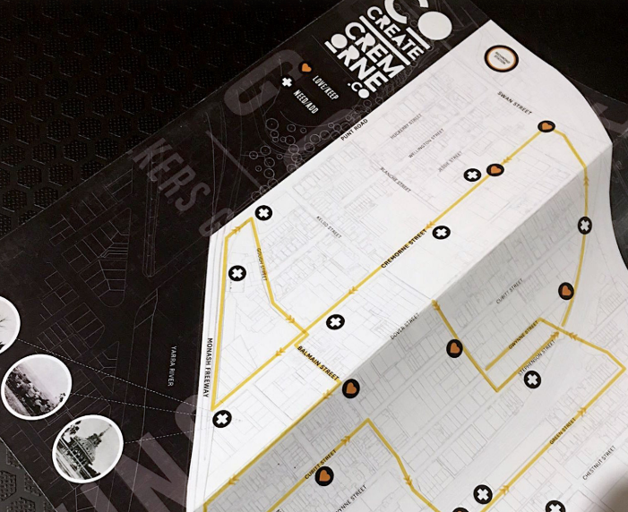

Slide 29
Digital placemaking enhancing Participatory Approach
Tools available

Slide 30
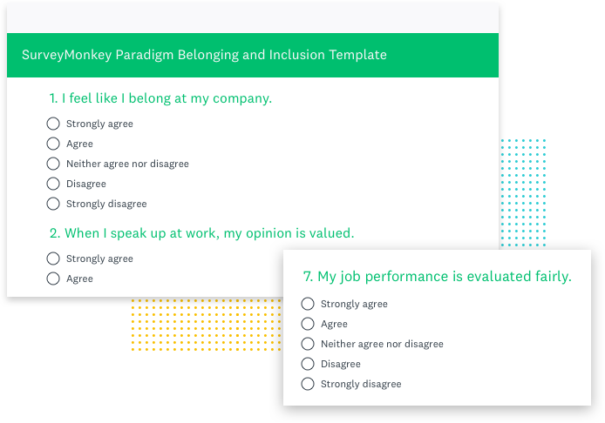
Survey monkey
Tips:
Short
Only critical questions
Some open answer questions with great prompts

Slide 31
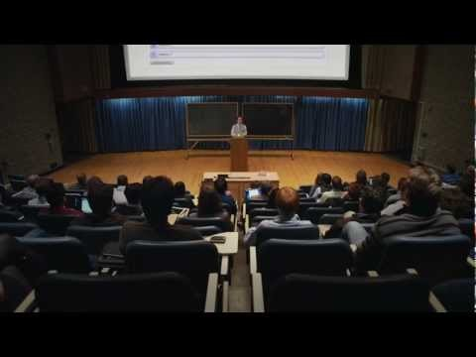
Poll Everywhere
Live outcomes on website, blog or with a group of people.
What things do you need to be careful with… with live feedback?
Quick video : https://www.youtube.com/watch?v=dT3aZ5Ph8e8

Slide 32
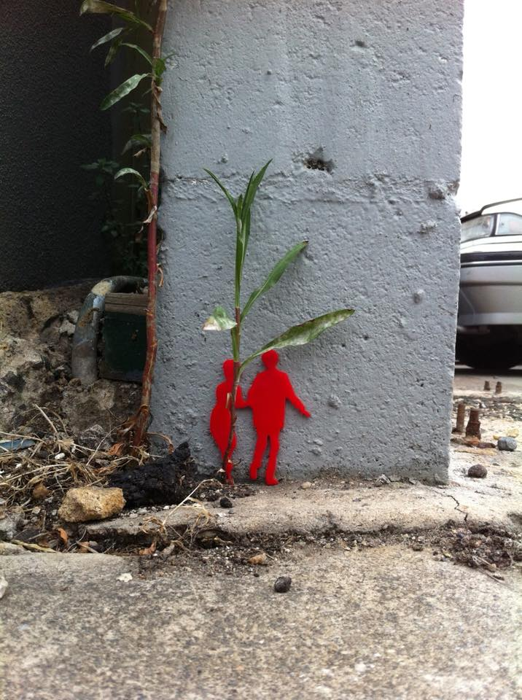

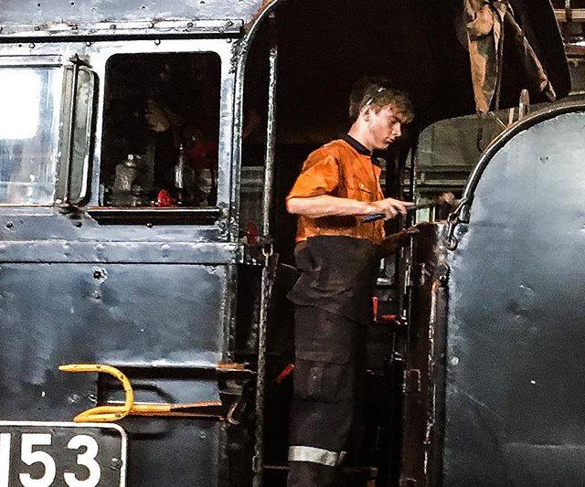
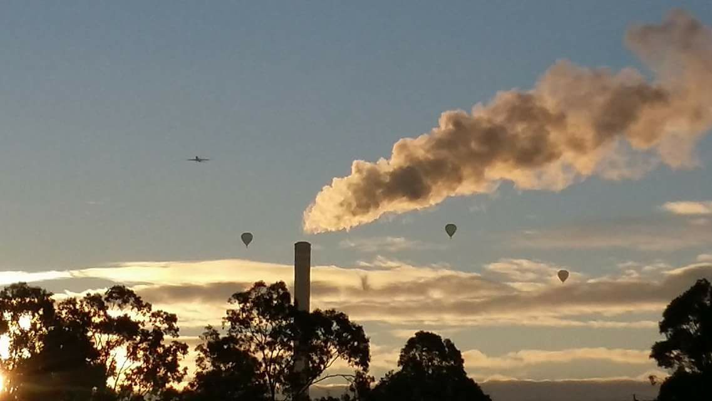
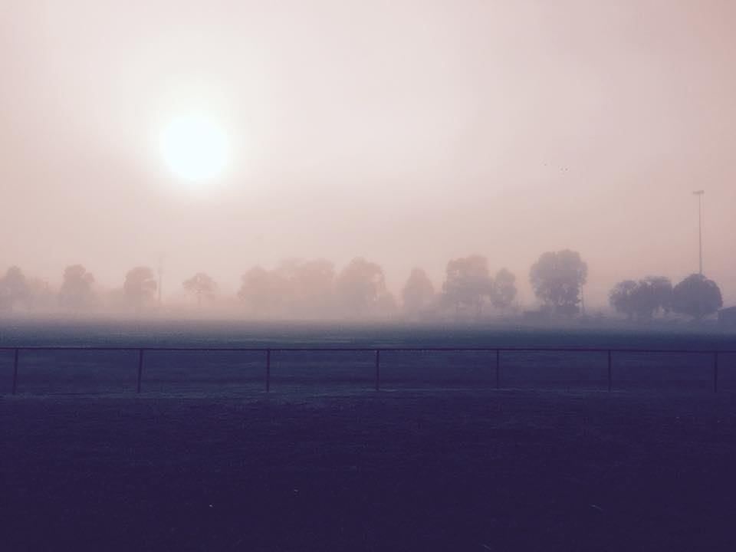
Photos
Newport project
Lessons

Slide 33
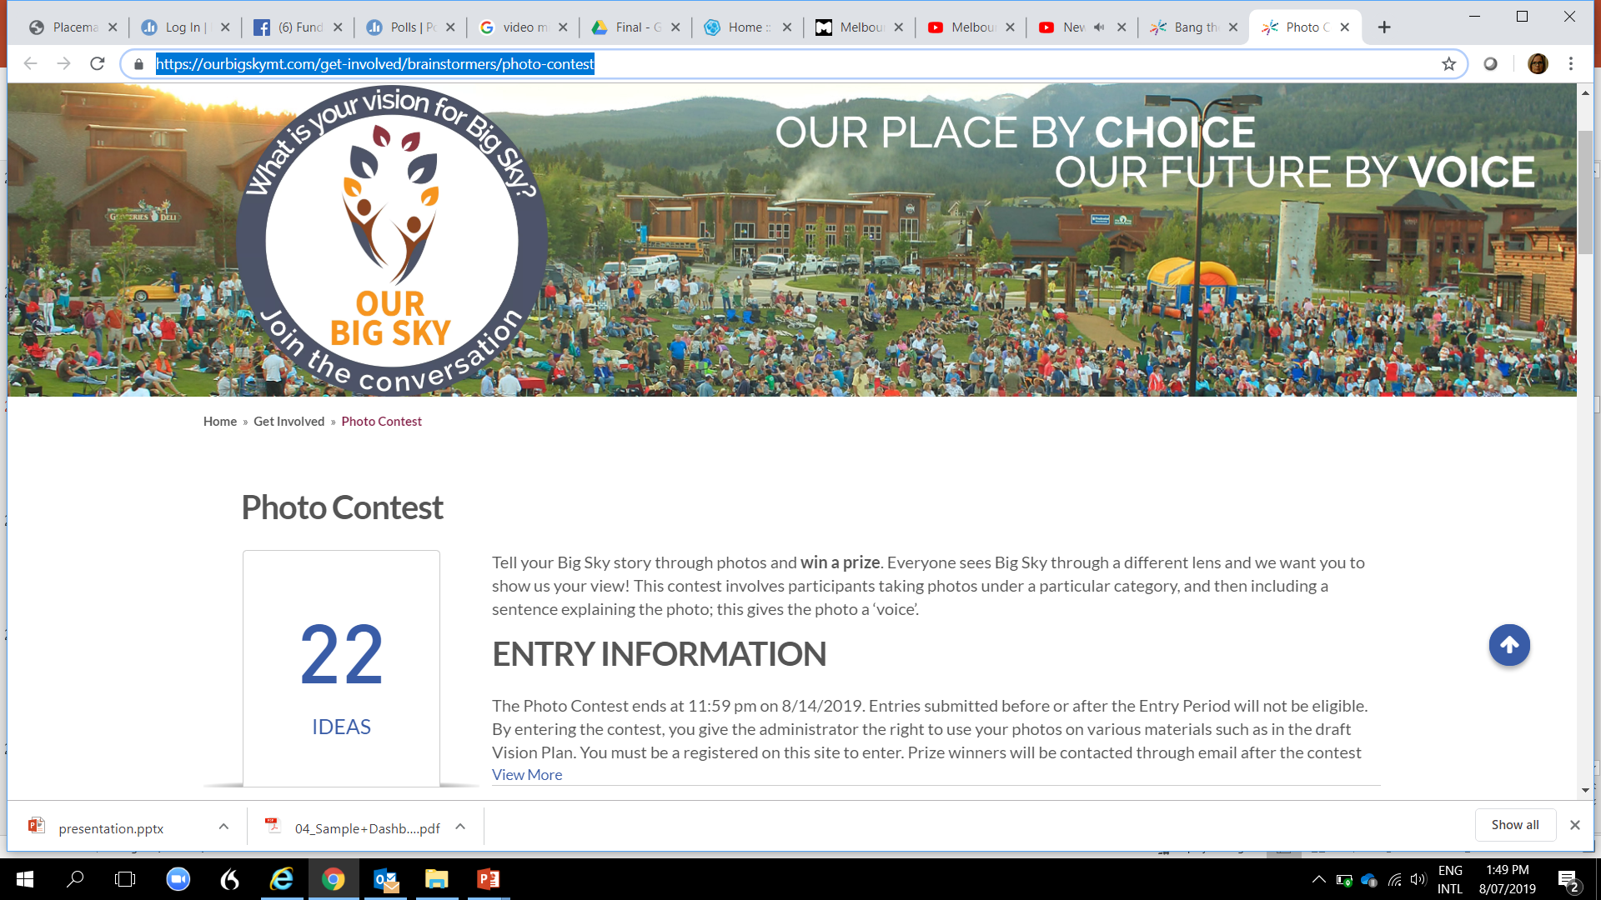
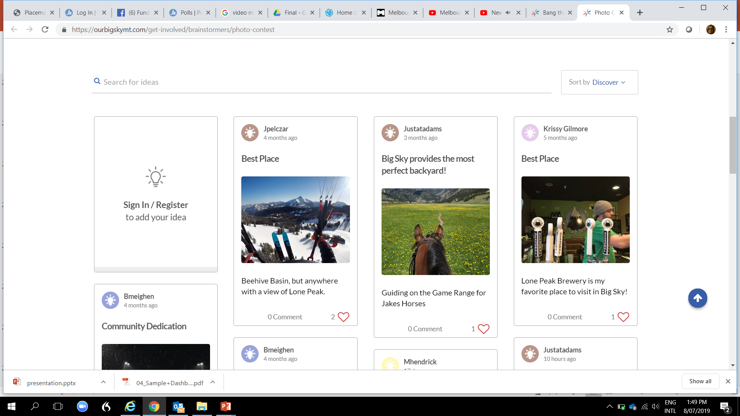
Case study https://ourbigskymt.com/get-involved/brainstormers/photo-contest

Slide 34
Bespoke tools
Developed for organisations such as https://youtu.be/e62JmiCPt7k - https://participate.melbourne.vic.gov.au
Crowdsignal, https://crowdsignal.com/. Online survey tool
Bang the table, https://www.bangthetable.com/ . helps you to hear what your stakeholders have to say about your project by combining tools like surveys, forums, guestbooks, and Q&A sections
Social Pinpoint, http://www.socialpinpoint.com.au/ , combines online engagement with digital mapping so that your stakeholders can provide feedback more interactively. It’s most useful for projects or plans that are dependent on geography and thus can be visualised on a map

Slide 35
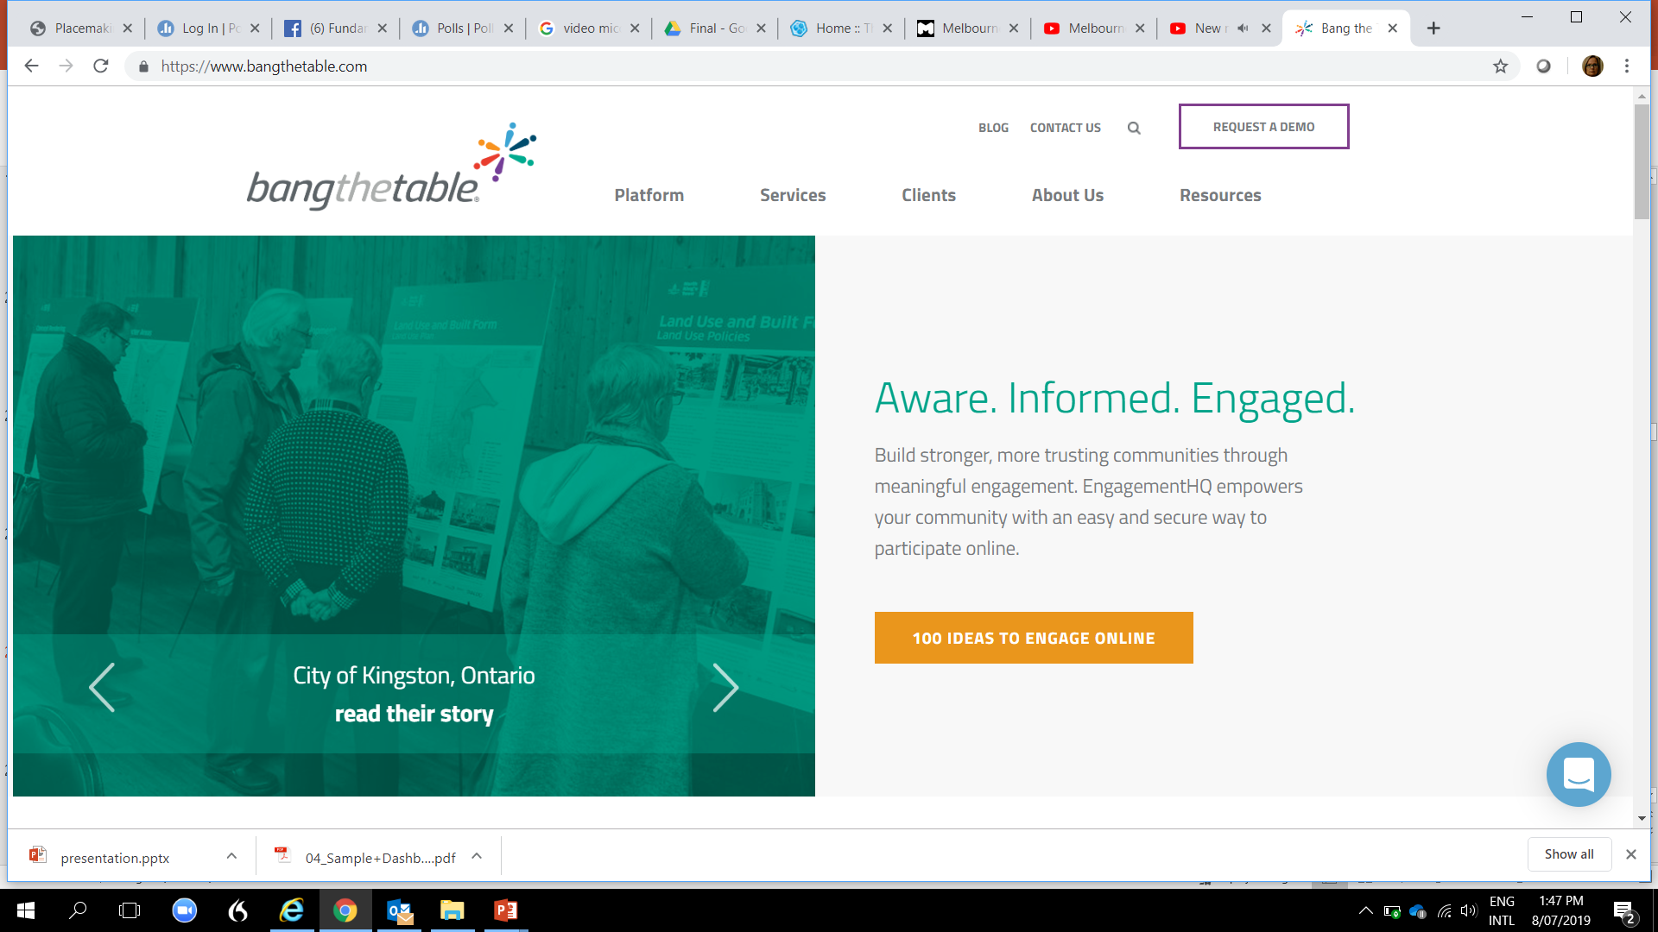

Slide 36
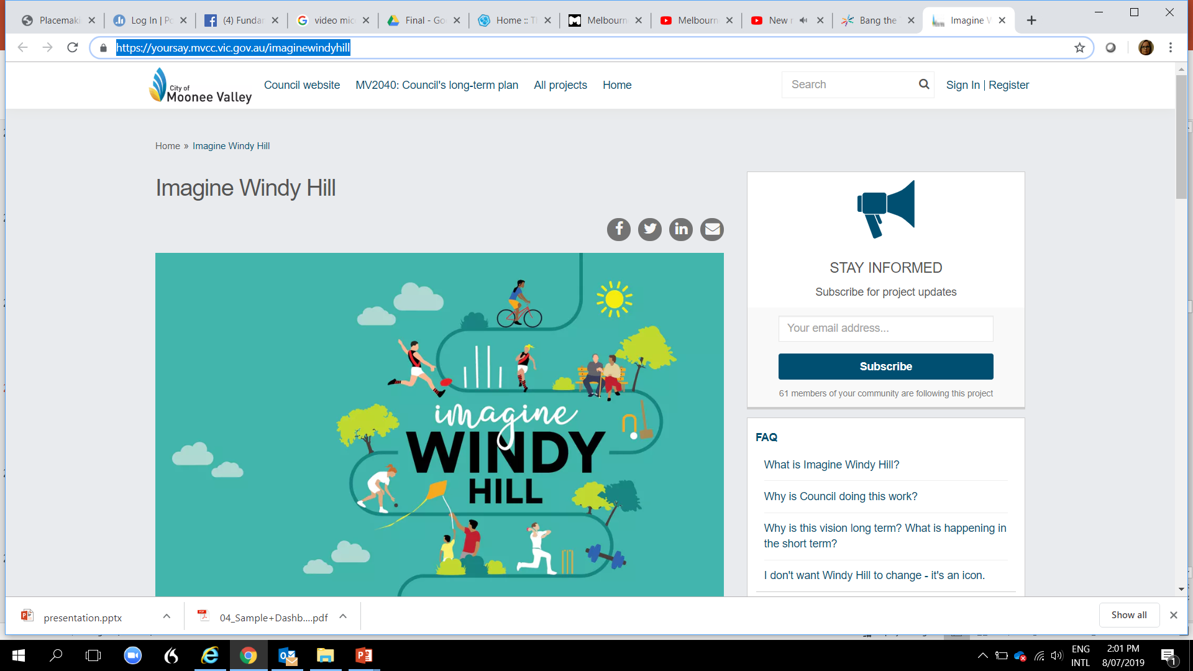
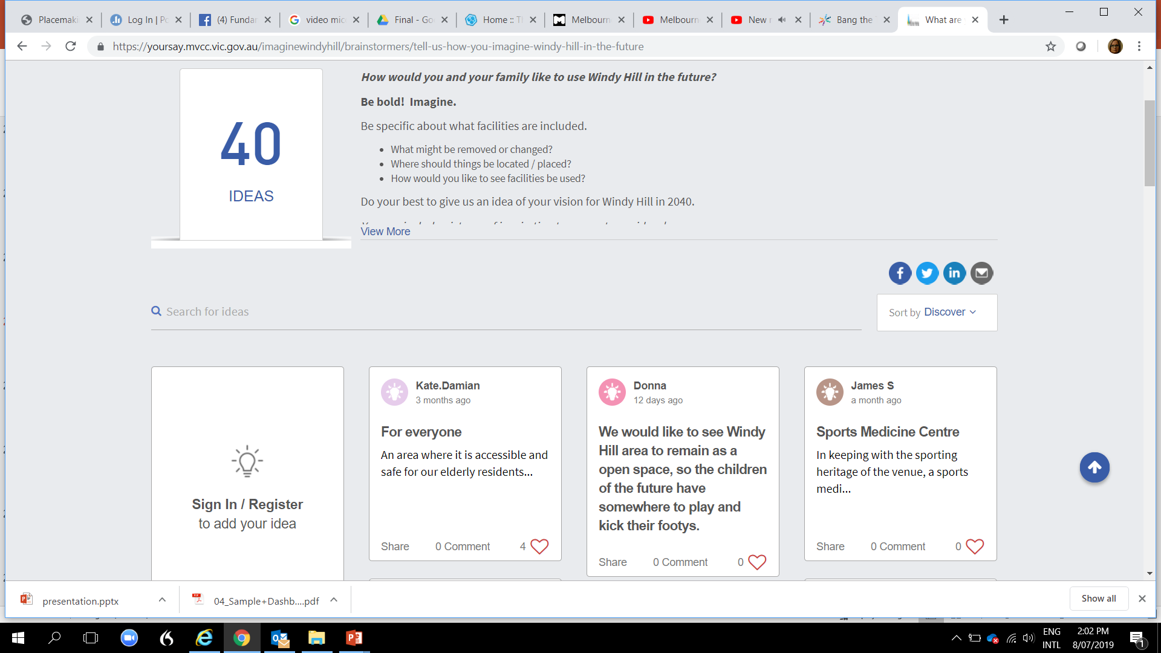
Case study – Windy Hill https://yoursay.mvcc.vic.gov.au/imaginewindyhill

Slide 37
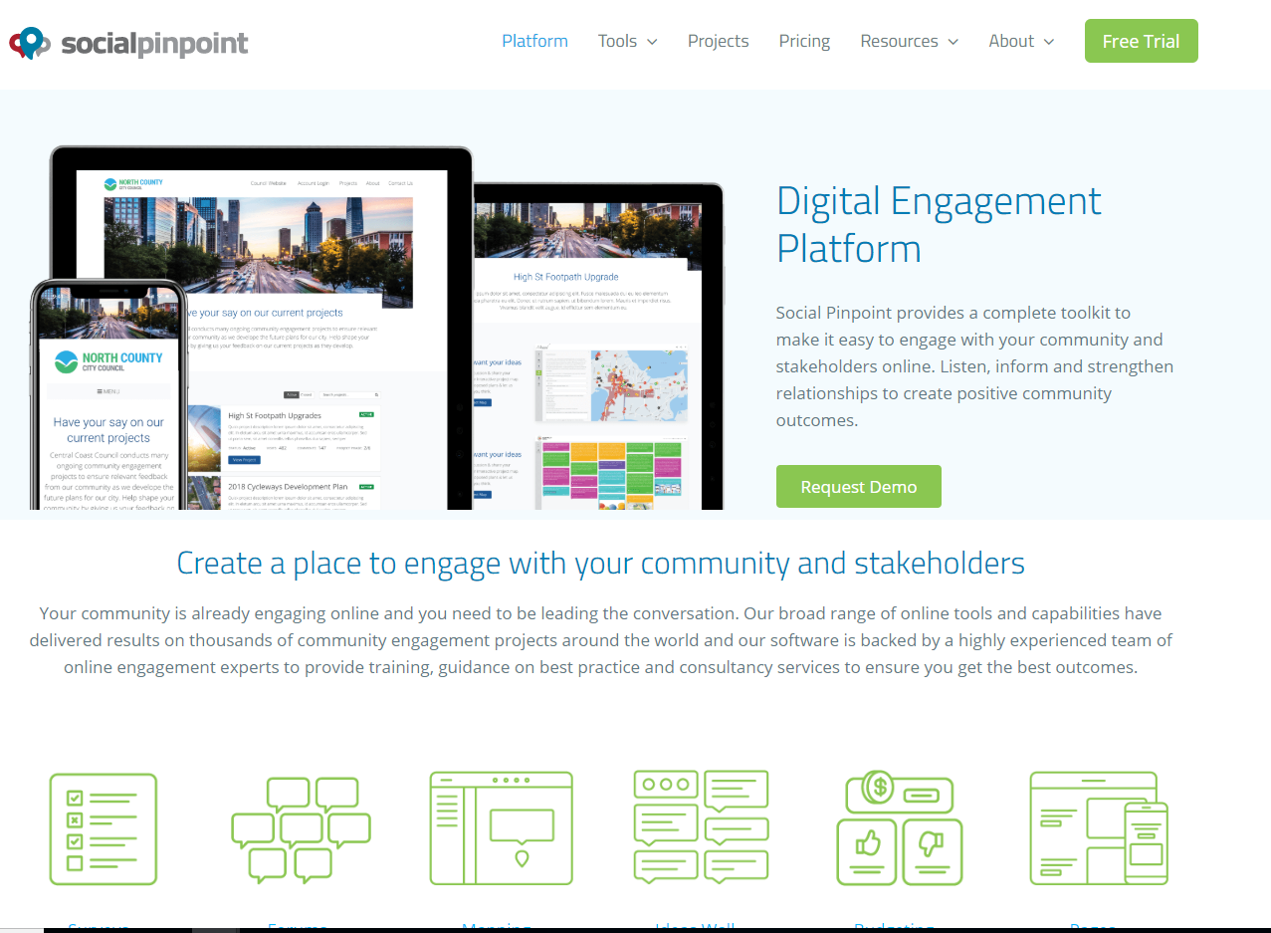
https://www.socialpinpoint.com/product-engagementplatform/

Slide 38
Bespoke tools
Spatial Media, http://www.spatialmedia.com.au/ , specialises in 3D production, with a focus on communicating concepts to your stakeholders.
Harvest Digital Planning, http://harvestdp.com/ and their tool https://the-hive.com.au/, also creates online engagement in the form of surveys. Their approach is to “communicate plans and strategies over the web through meaningful and interesting content.” The surveys are designed to be enjoyable and interactive to encourage richer feedback from stakeholders.
Consultation Manager, https://consultationmanager.com/ , is the one tool that can consolidate all of your online and offline data into a centralised knowledge-base in the cloud.

Slide 39
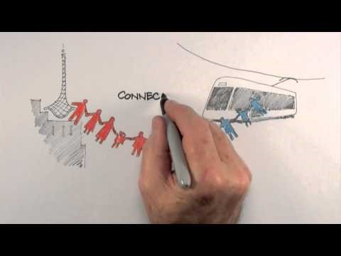
Bespoke tools – create by the Hive
Developed for organisations such as https://youtu.be/e62JmiCPt7k - https://participate.melbourne.vic.gov.au

Slide 40
Digital placemaking – big data and research
Examples in practice

Slide 41

Digital placemaking – data
“While big data can improve our understanding of urban systems, little attempt has been made so far to think about the consequences for design” (Ratti Claudel 2016, p 10)
Image source: https://consultationmanager.com/top5-online-engagement-tools/

Slide 42
Digital data sources we can access…
Australian Bureau of Statistics – Census (four-yearly, last in 2016)
Victorian Government open data sets (a growing trend)
City of Melbourne’s own open data sets
Population Projections (Victoria in Future)
Social media…(what is publicly available)
Case study / place reviews and forums (for example, TripAdvisor)

Slide 43
Limitations of big data
The data will only be as good as how well you can analyse it.
The level of place specificity matters
Social media data in particular, changes too quickly, can make you responsive.

Slide 44
Neighbourlytics
Using big data and social analytics at a neighbourhood level.

Slide 45
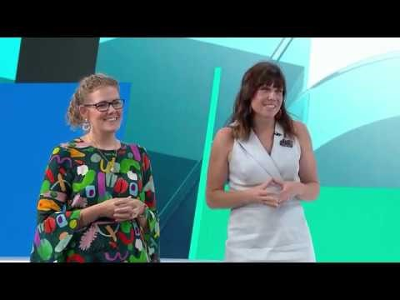
https://www.youtube.com/watch?v=Ubs6BvPHhyE

Slide 71
More videos on Neighbourlytics
5 mins on the background
Silent video on the data you can download
https://www.youtube.com/watch?v=44qrXGMXvkQ
https://www.youtube.com/watch?v=uwr2U0j08Ak

