Slide 1

Place Evaluation
These slides are based on material prepared by Hernandez-Santin C., Hes, D. & T. Beer (2019), The University of Melbourne for the Place Agency program for placemaking pedagogy.

Slide 2
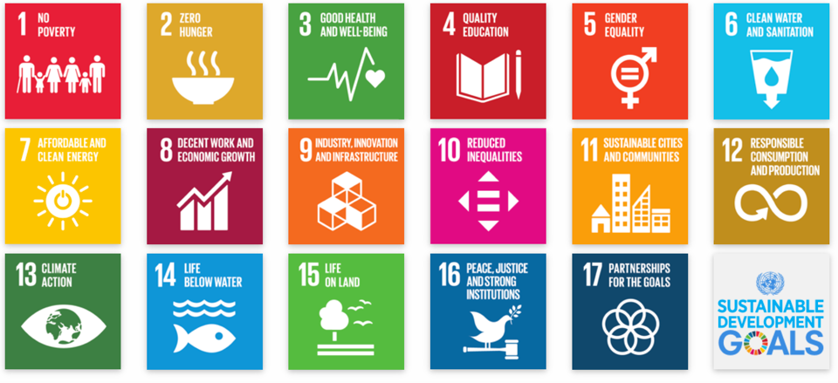
Context:
Why do we need to evaluate?
Observing if a project has achieved intended outcomes
Use evaluation to inform future design and evolution of a place
Understand the tangible and relational outcomes and legacy of a placemaking project
Track progress, build trust, attract investment.

Slide 3
Outline
Why do we need to evaluate places? (10 min)
How are places evaluated? (15 min)
Revisiting the Four dimensions of place (5 min)
The Relational Model for Place evaluation (20-30 min)
  1 self and public/private space,
  2 community and public/private space,
  3 self and community,
  4 public/private space and natural environment,
  5 self and natural environment, and
  6 community and natural environment.

Slide 4
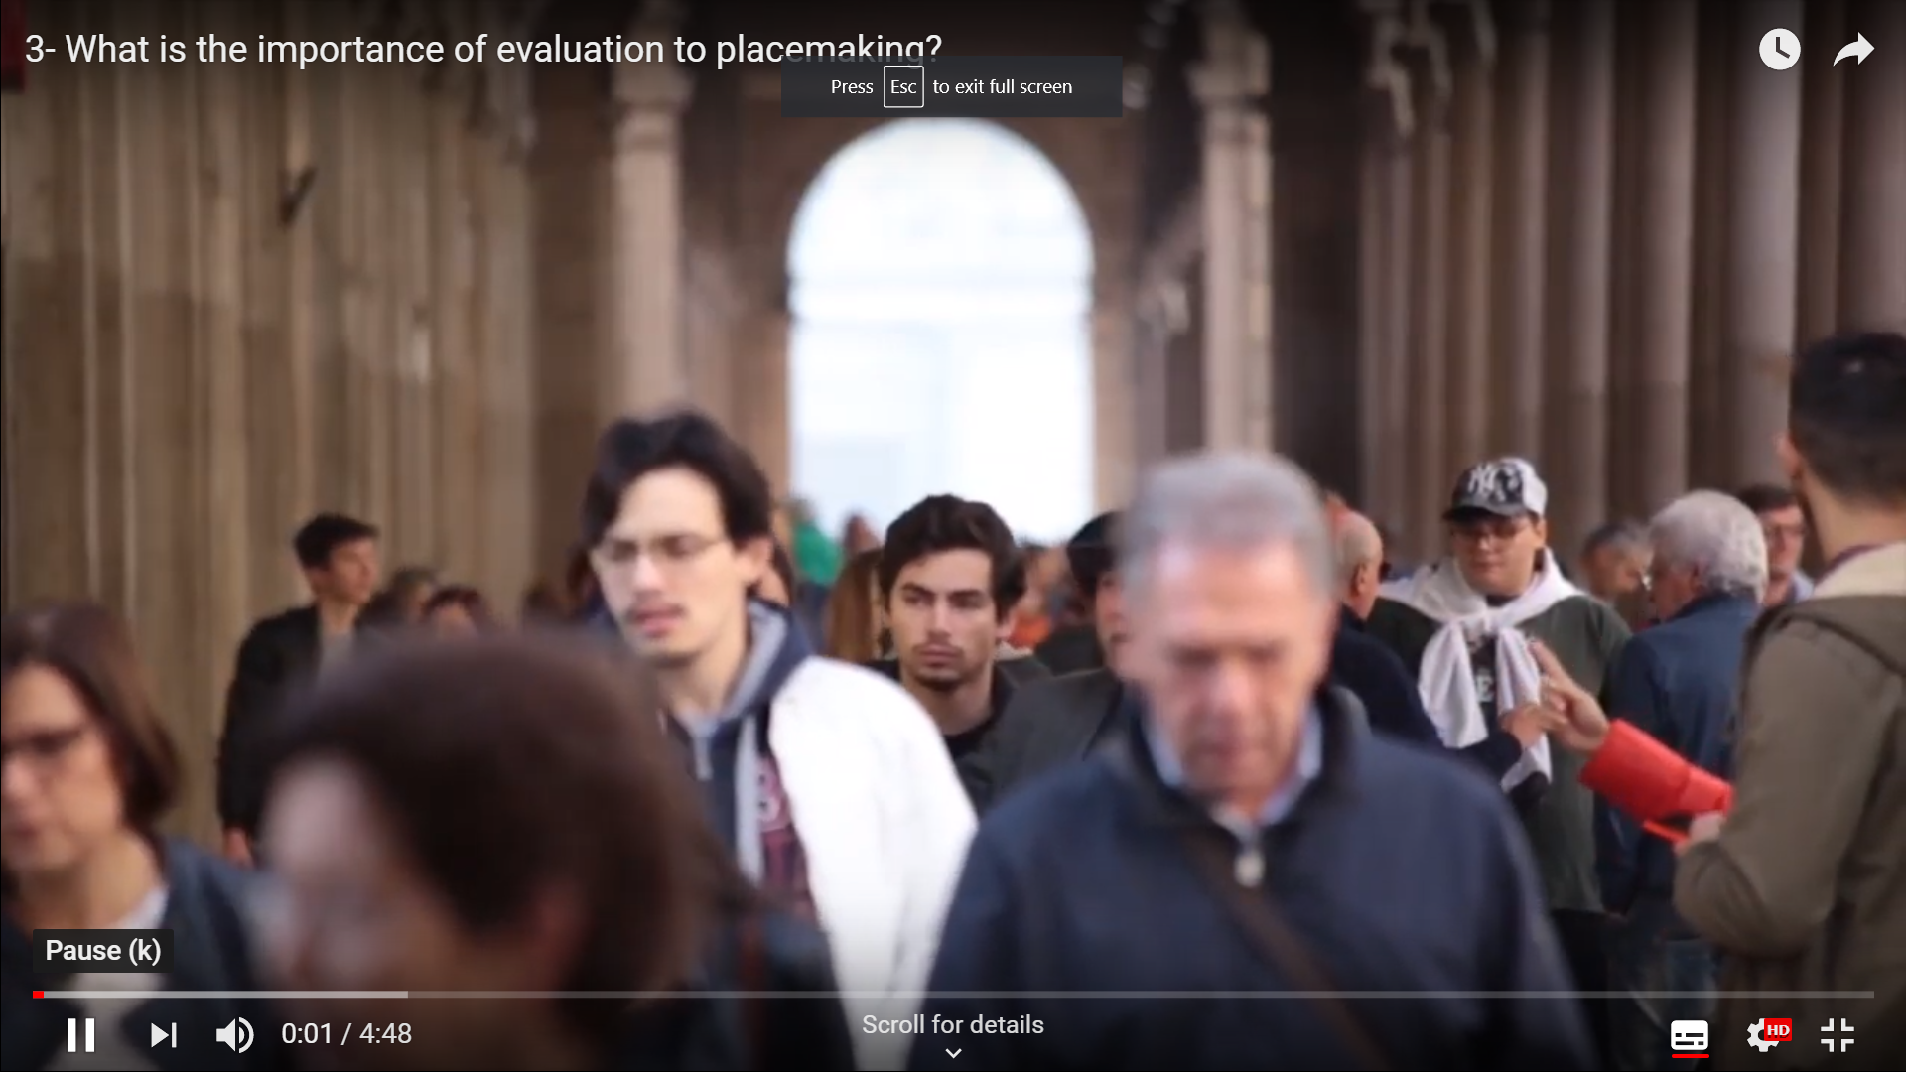
What is the importance of evaluation?
https://youtu.be/ZDh0oAW0QDg

Slide 5
Why do we need to evaluate?
Ability to evaluate how you are going, compare and learn from others and continually inform and evolve the place
To be able to demonstrate outcomes to administrators and budget committees
Ability to communicate to community and stakeholders and the value of activities and investments

Slide 6
Benefits of place
Complexity and how do we measure all of these

Slide 7
Feelings: civic pride, inclusiveness, social Integration, vitality and sociability, sense of belonging, reduced depression
Life quality conditions: reduced accidents, crime and vandalism, improved health, improved wellbeing, aesthetics, recreation benefits, urban resilience
Other: improved educational outcomes
Ecosystem services: resilience, adaptability, improved waterways, reduced heat stress, reduced waste and pollution, cleaner air, increased biodiversity, ecological stewardship (willingness to support sustainable practices)
Increased visitation (footfall and length of visit),
Local businesses: increased revenue, job creation or skill development, reduced public expenditure, increased property value
(Kuo & Sullivan, 2001; Frumkin, 2003; Semenza, March & Bontempo, 2007; Hystad & Carpiano, 2012; Robinson, et al., 2017 and Carmona, 2019)
Notes:
Sense of community, belonging, connection to nature, stewardship, participation and agency.
Increased citizenship reduces costs of maintenance and fixing things
Also means if managed well they can start providing services that the council may not have budget for.

Slide 8
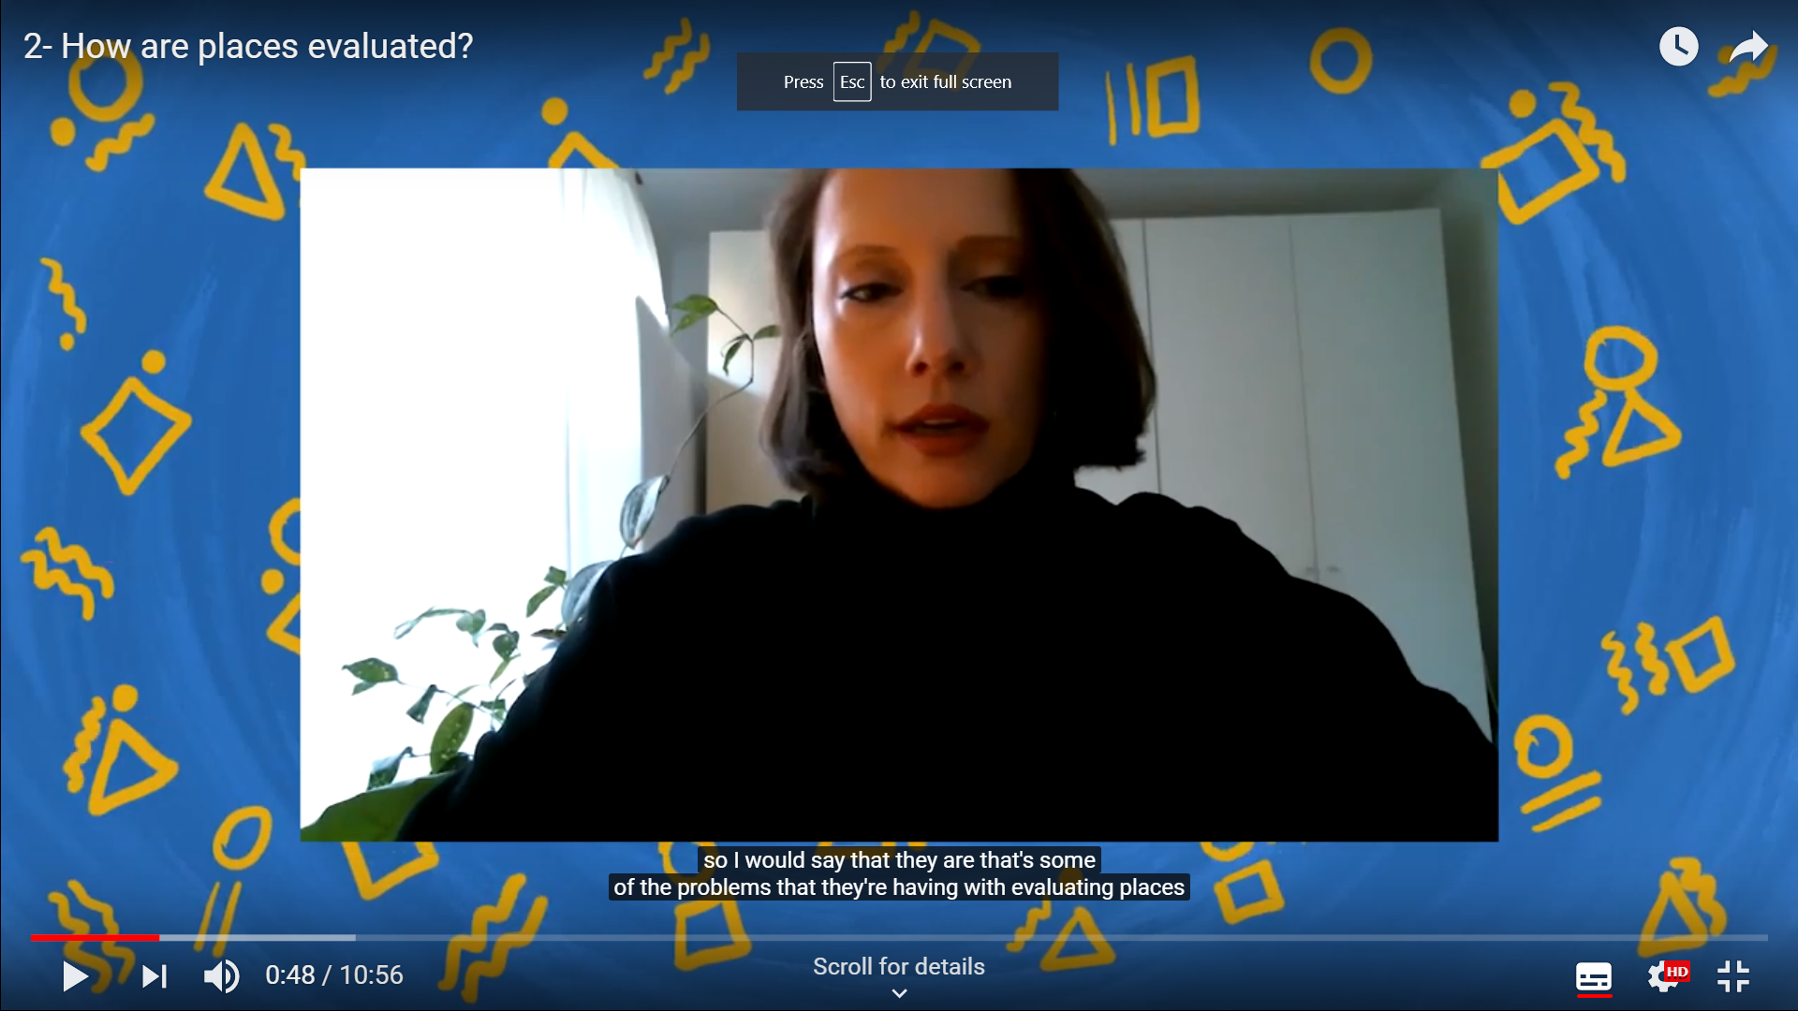
How are places evaluated?
https://youtu.be/29r5I8GnwQc

Slide 9
Definition of the three terms
Input
Output
Outcome
Legacy (impact)

Slide 10
Why do we need to evaluate – limitations
Fragmented – visitation, canopy cover, money spent, attendance, etc.
Each place is unique
Often measuring outputs, not outcomes or legacy
Limitation or absence of ecosystems and the non-human in the ability to evaluate in context of place

Slide 11
So what is the problem with these measures?
Many are done by researchers and are not readily applied in practice;
Many correspond to quantitative ways of evaluating components of place, they do not address if the key relationships of connecting people to place have been achieved.
Many correspond to immediate or medium-term measures. The key social and ecological benefits of place work at a long-term time scale.

Slide 12
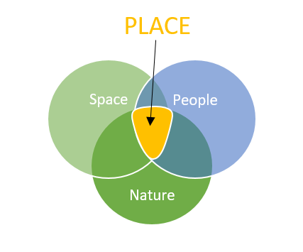
Four Dimensions of Place Framework:
A relationship-based Model
The purpose of placemaking is developing positive relationships between people, space & nature
12

Slide 13
Revisiting the four Dimensions of Place Framework:
A relationship-based Model

Slide 14
Communities
PLACE
Place Attachment
Sense of Place
Sense of Belonging
Conviviality
Space
People
Empowerment
Care for place
Social Inclusion
Social Cohesion
Ecology
Purpose of Placemaking: Connecting People to place through shared meaning and a sense of purpose.
Public or Private
Space
Place Attachment
Self
Care for place
Biophilia &
Place Attachment
Supporting theory
Relationship outcomes
Sought Relationship
Custodianship
Ecological health
Natural Environment
Space
Biophilia
Healthy natural cycles
Ecosystem Services
Connection to nature
Custodianship

Slide 15
The Relational Model for Place evaluation
Evaluating key relationships crafted between the four dimensions of place

Slide 16
The emotional bond between an individual and their meaningful places
Place Attachment

Slide 17
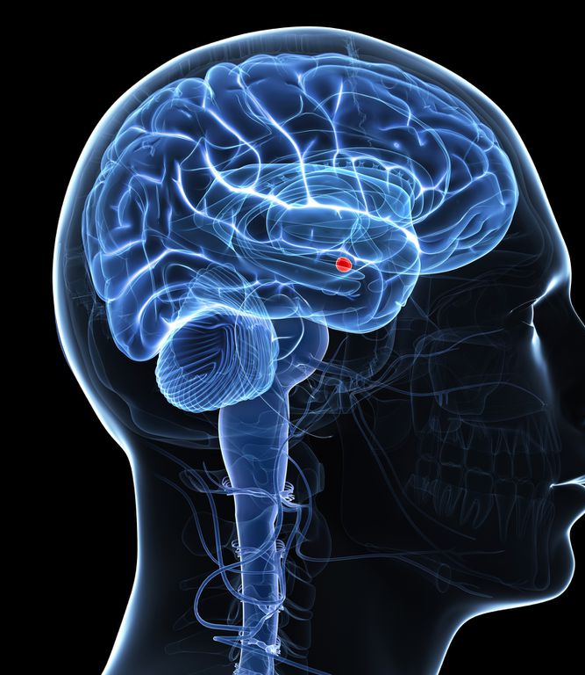
Areas of the brain activated
  Amygdala: where emotion is processed
    Places that are special to us generate a stronger automatic emotional response that is not seen for meaningful objects
  Medial prefrontal cortex (mPFC): where situations are evaluated and determined if they are positive or negative
    places with meaning trigger the processing of positive experiences associated with place
  Parahippocampal: PlaceArea (PPA)
    Activated was significantly higher to meaningful, compared to common places.
National Trust. (2019). Places that make us. Report for the National Trust, Wiltshire, UK; online Retrieved from: https://nt.global.ssl.fastly.net/documents/places-that-make-us-research-report.pdf (accessed 25/02/2019).
Notes:
Amygdala: where emotion is processed - specifically left amygdala which responds to imagery in previous studies. - Places that are special to us generate a stronger automatic emotional response that is not seen for meaningful objects
Medial prefrontal cortex (mPFC) - where situations are evaluated and determined if it is positive or negative. - places with meaning trigger the processing of positive experiences associated with place
Parahippocampal PlaceArea (PPA) - Previous studies have already identified that this region responds preferentially to place, rather than other types of imagery or emotional content. Our analysis found that response in the PPA was significantly higher to meaningful, compared to common places.

Slide 18
Type affective bond: love, pride,
Cognitive process for the bond
(memory, meanings, experience)
Behaviour in place
Agency (stewardship)
Place
Person
Process
Physical characteristics
Social condition
Collective perspectives (culture)
Individual preferences and experience
Scannell, L., & Gifford, R. (2010). Defining place attachment: A tripartite organizing framework. Journal of environmental psychology, 30(1), 1-10.

Slide 19
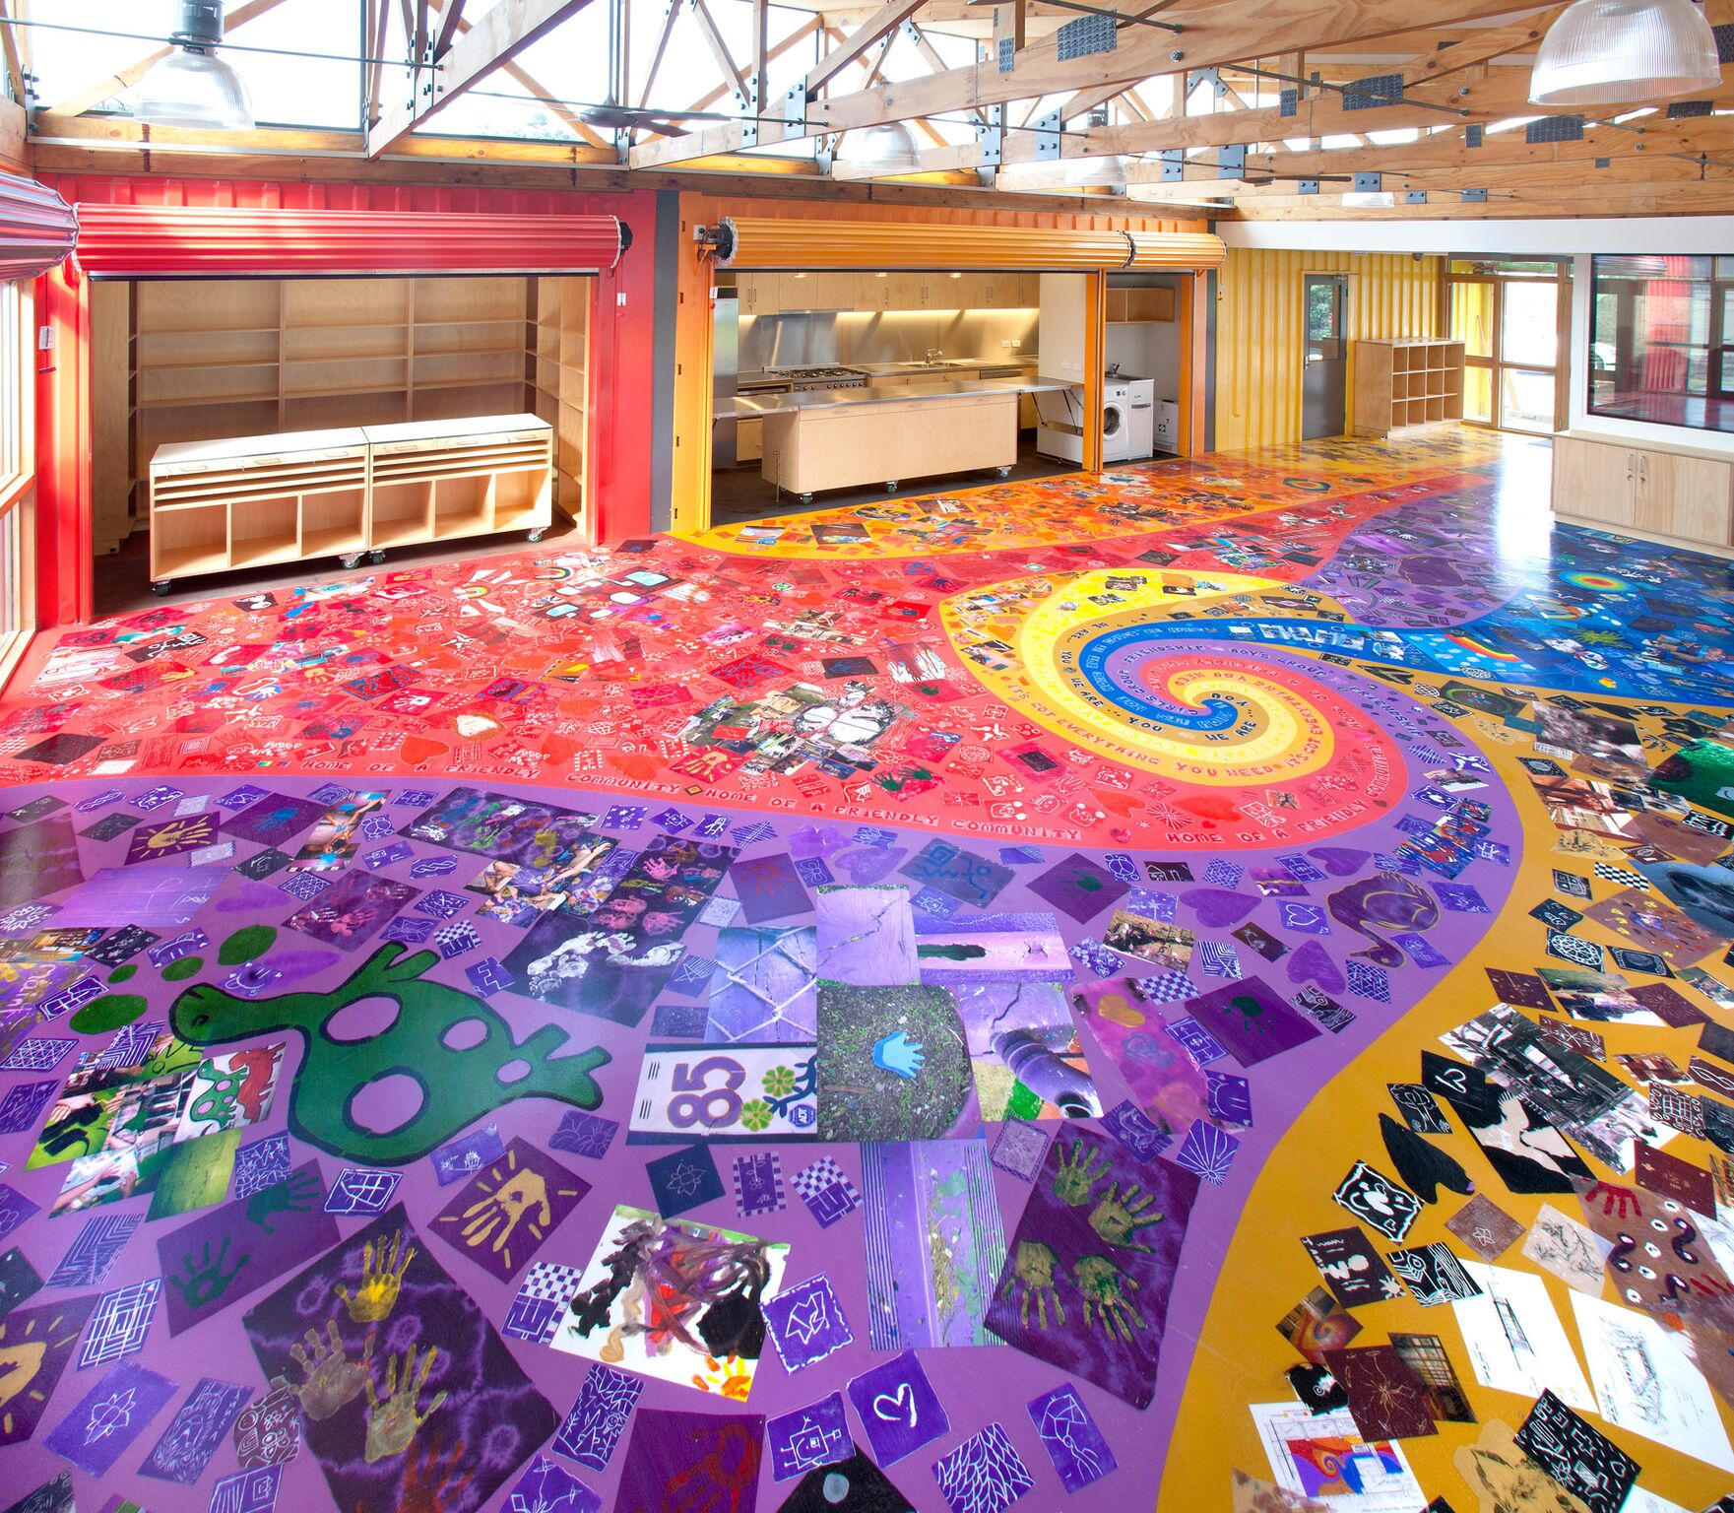
The Venny, Victoria
A story of Co-Creation

Slide 20
How the attachment is formed
4 Simple things to guide biophilic thinking
Connections to their formative years (your memories)
Connection to significant others
Places for the here and now (recent discoveries)
Notes:
42% Connections to their formative years - Connections with these places focus on nostalgia and memories of years gone by. These places have remained a stable force in people’s ever-changing, and sometimes turbulent and stressful, lives. People fondly reminisce
37% Connection to significant others - a place is meaningful because of its link to a significant other. Their connections are formed through a shared experience with family members, friends or partners.
41% Places for the here and now - recent discoveries which are enjoyed and appreciated. more likely to be rural places (32%) than other types of connection, such as a park or nature reserve (7%) a lake or canal (5%) or a beach (4%).

Slide 21
Affective bond between an individual and the collective group (their people)
Sense of Belonging

Slide 22
Difference between two terms
Sense of Attachment
Sense of Belonging
Relationship with a physical space
Results in: higher mental wellbeing and active citizenship
Characterised for affective feelings of:
  Pride
  Nostalgia
  Security, sense of safety
  Stewardship
Relationship with groups of people
Results in: higher mental wellbeing
Characterised for feeling:
  Acceptance (your individuality is respected)
  Inclusion (Part of a group)
  Sense of community (commonalities and conviviality)

Slide 23
An ecosystem where the structure and its function is behaving naturally, it is resilient and capable of self-renewal.
Ecological Health and Integrity

Slide 24
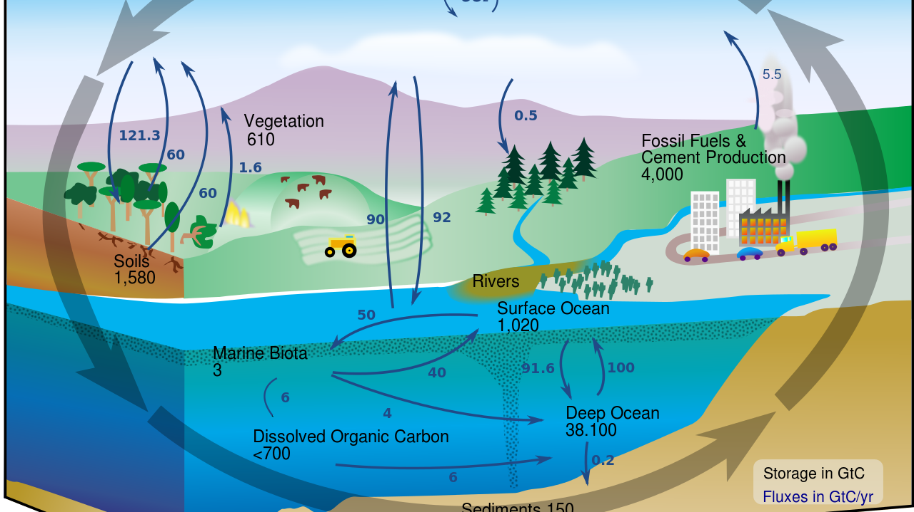
Environmental Cycles
Air Cycle
  Carbon
  Phosphorus
  Oxygen
  Nitrogen
Water Cycle
Soil Cycle

Slide 25
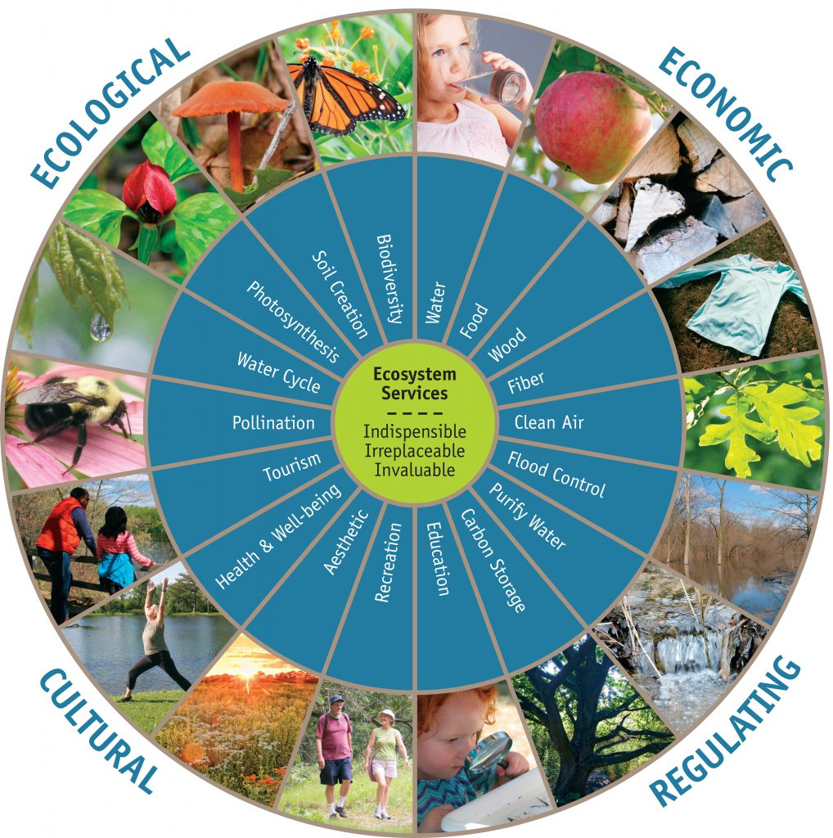
the benefits that an ecosystem provides to humans
https://winnebagoforest.org/homepage-articles-archive/ecosystem-services/

Slide 26
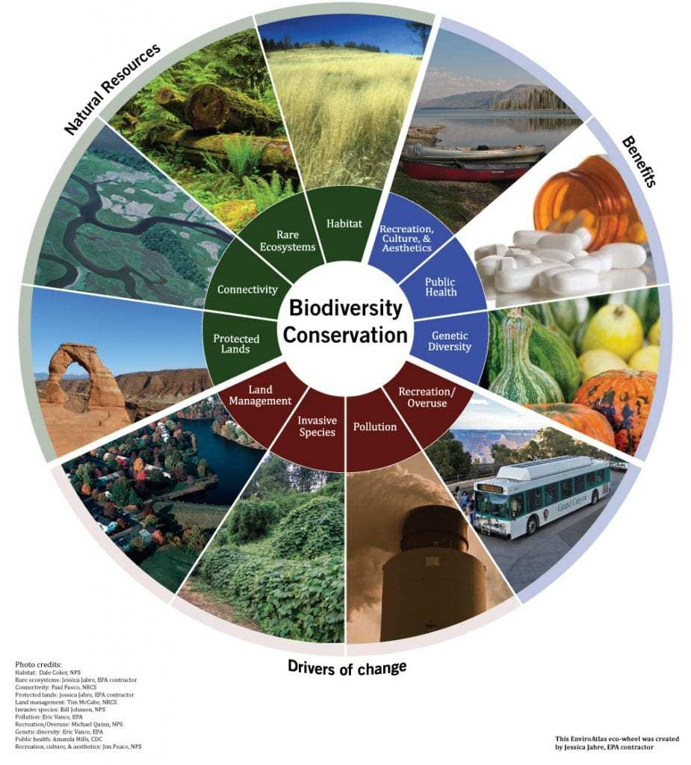
In ecology, we use indicator Species
https://www.innovationtoronto.com/2016/07/biodiversity-falls-below-safe-levels-globally/

Slide 27
“the innately emotional affiliation of human beings to other living organisms”
Biophilia
Edward O. Wilson

Slide 28
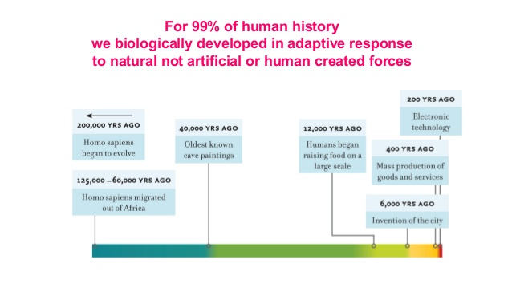
Source: http://www.slideshare.net/UKCIP/beauty-or-biophilia

Slide 29
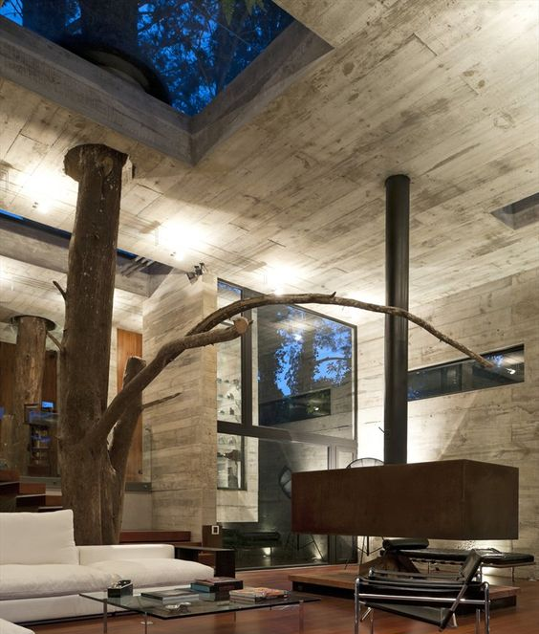
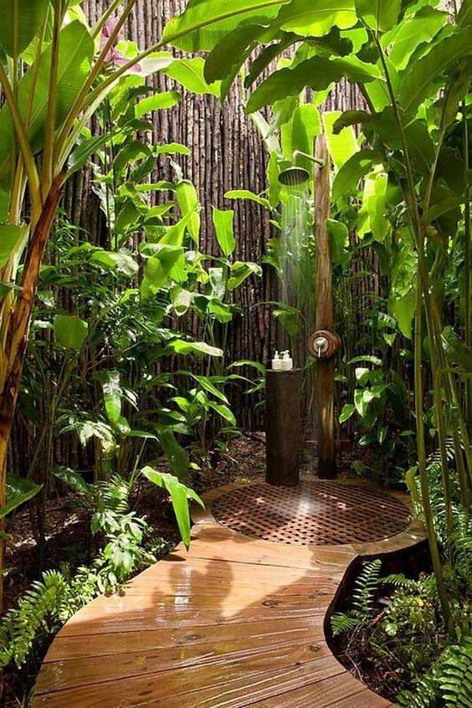
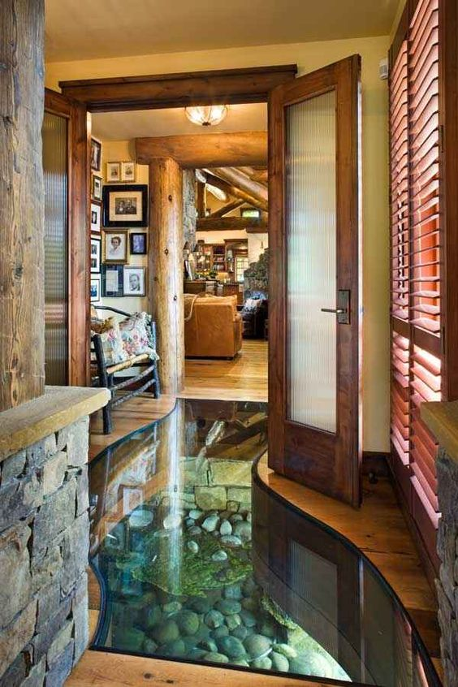
Biophilic Design
Design approach that incorporates the positive experience of nature within built environment.
Capable of evoking an emotional connection to place through unconscious love for other living forms.
https://es.pinterest.com/pin/142004194480770478/
https://es.pinterest.com/pin/154459462199280721/
https://es.pinterest.com/pin/154952043409540627/

Slide 30
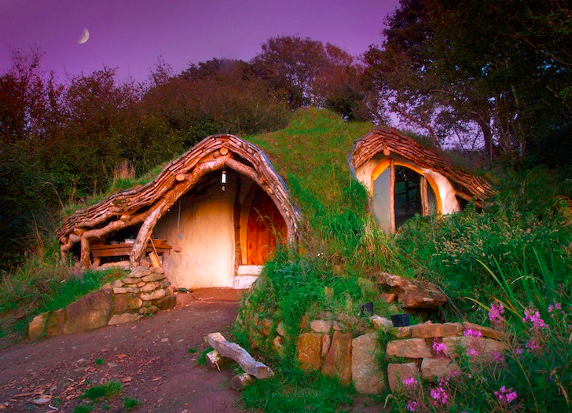
Low Impact Woodland Home (Hobbit home)
Wales
By Simon Dale.
Completed in 2011
http://inhabitat.com/extraordinary-off-grid-hobbit-home-in-wales-only-cost-3000-to-build/olympus-digital-camera-54/
Notes:
http://www.simondale.net/house/why.htm
virtually no visual or environmental impact on the surrounding landscape. Using locally-sourced and natural materials taken from the nearby woodlands
locally-gathered oak thinnings, the retaining walls and foundations were made from stone and mud, and straw bales were used to insulate the floor, walls, and roof.
The interior walls were finished off with breathable lime plaster which has a much lower embodied-energy footprint than cement, while all of the flooring, finishings, windows, plumbing – virtually everything inside – was re-purposed from discarded scrap materials. A wood burner heats the home, and an ingenious system that pipes cool air in from underground keeps the family refrigerator at an optimum temperature. A skylight fills the small home with natural light, water is sourced from a nearby spring, and solar panels provide all of the electricity the Dales need

Slide 31
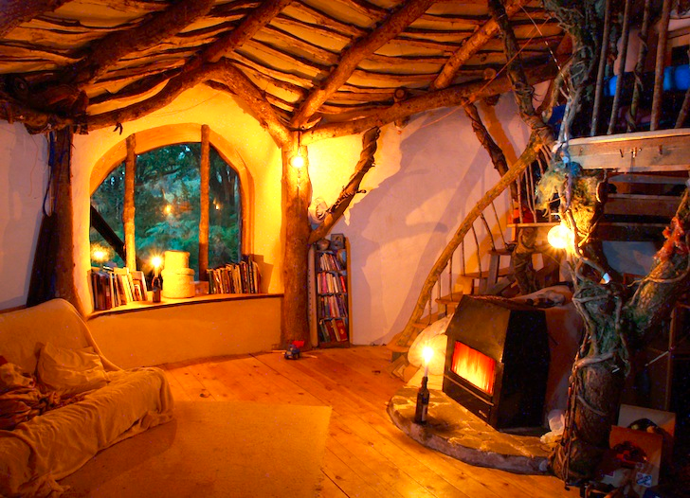
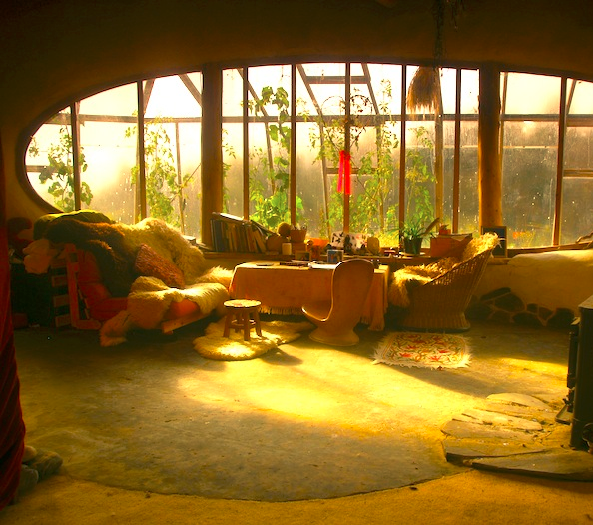
http://inhabitat.com/extraordinary-off-grid-hobbit-home-in-wales-only-cost-3000-to-build/olympus-digital-camera-54/

Slide 32
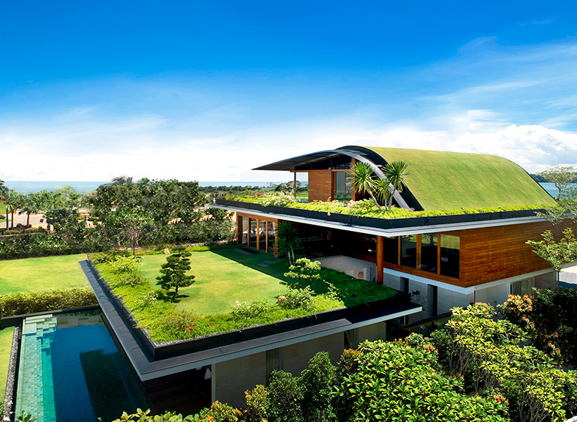
Meera Sky Garden
Singapore
by Guz Architects
Completed in 2010
http://guzarchitects.com/#
Notes:
http://www.archdaily.com/112766/sky-garden-house-guz-architects
interaction with gardens and greenery at all levels
solid wall to each side neighbour to provide privacy where possible, while creating a central light and stair well which would funnel the sea breeze through the centre of the building.

Slide 33
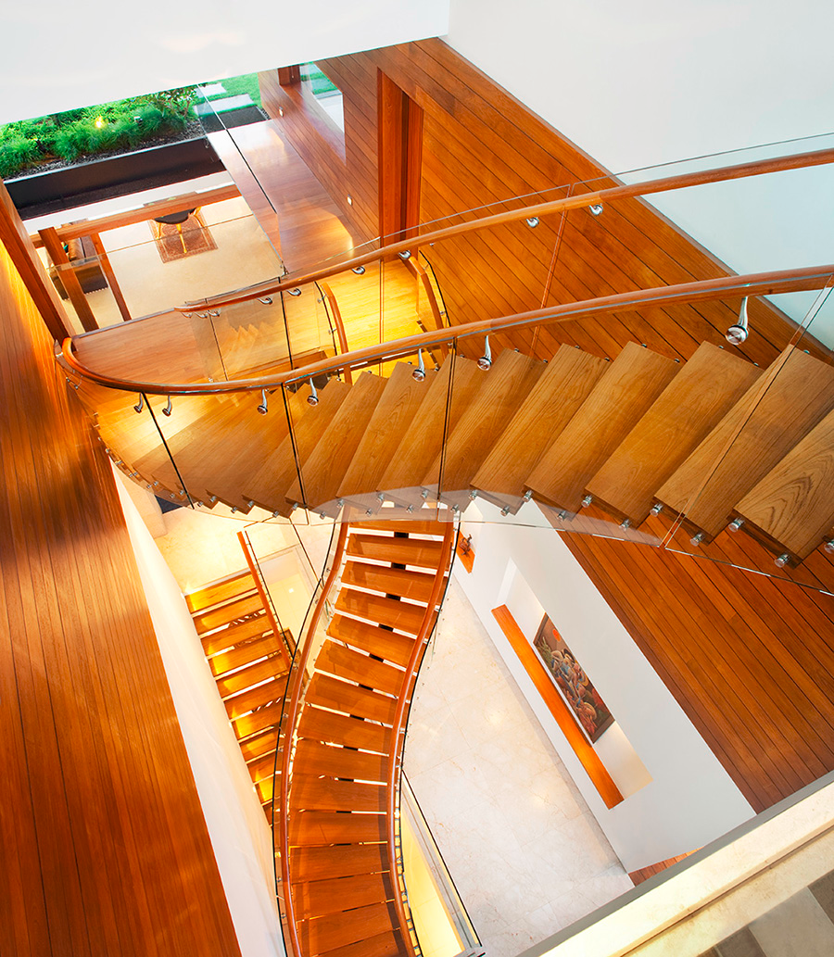
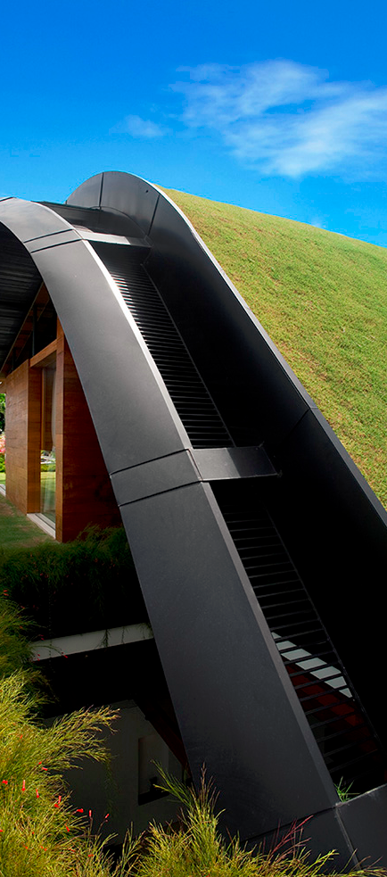
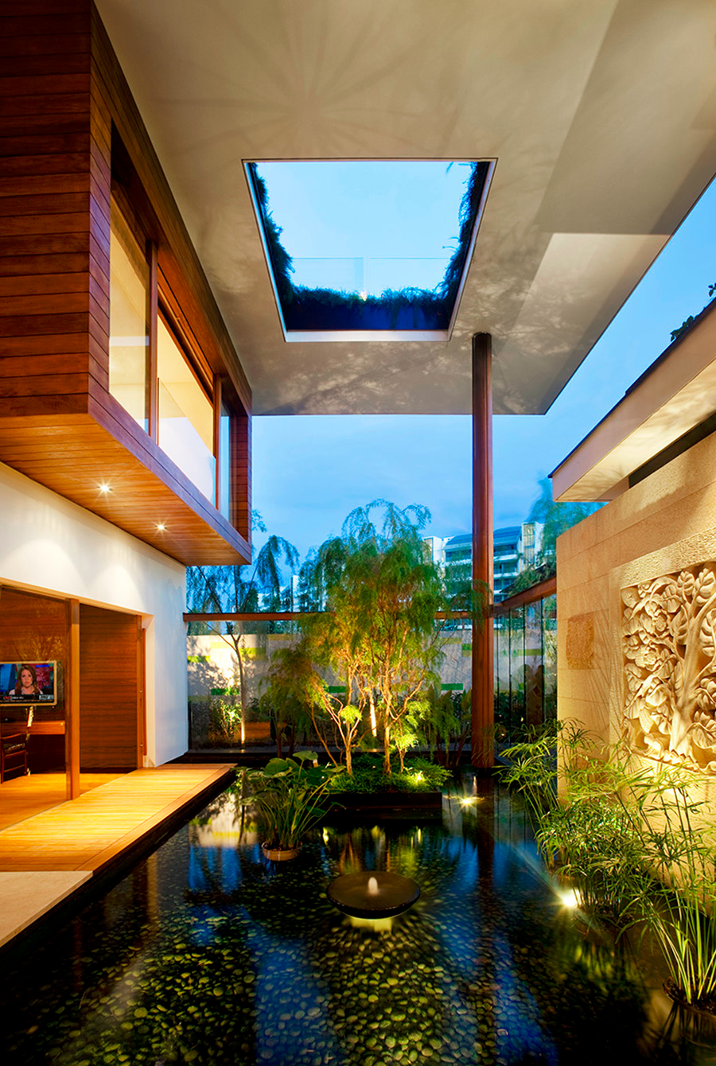
http://guzarchitects.com/#

Slide 34
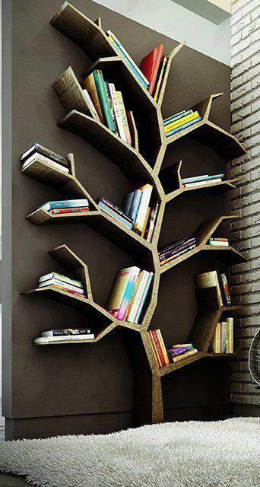
Biophilia lead thinkers
Roger S. Ulrich
E. O. Wilson
William D Browning, Catherine O. Ryan, Joseph O. Clancy
Stephen R. Kellert
Advocates well-being benefits from nature
3 dimensions
14 Attributes
1st defined the concept
Biophilic Design Theory
6 dimensions
70 attributes
https://es.pinterest.com/pin/31032684913459969/

Slide 35
Temperature and airflow variation
Connection with natural systems
Non-rhythmic sensory stimuli
Non-visual connection
Visual connection
Water
Daylight
Patterns of biophilic design
Natural analogues
Nature of the Space
Nature in the Space
Forms and Patterns
Material connection
Complexity and Order
Prospect
Refuge
Mystery
Risk

Slide 36
4 Simple things to guide biophilic thinking
Connect to place
Connect to local nature
Connect to history
Connect to climate
To connect people to place and they will love and care for it and be healthier and more effective parts of the place.

