Slide 1
Disclaimer: The following slides were intentionally left text based to allow you to personalise and contextualise with your own images.

Slide 2
Place Evaluation - Tutorial
These slides are based on material prepared by Hernandez-Santin & Hes (2019), The University of Melbourne for the Place Agency program for placemaking pedagogy.

Slide 3
Activity 1: Starting from values for place evaluation

Slide 4
Rating Place – Starting from values
What are the values of place?
What do places have in common?
Based in social equity, deep engagement process, meaning and memories, places people at the centre, etc.
What makes a place unique?
Clear identity (distinctive)- for one area it might be creativity, for another sustainability, yet a third might prefer geometric morphologies. Character of the buildings, histories and narratives of place
The Rating Place (project in development) takes a 'black box’ to answer these questions in collaboration with Australia industry, government and communities.
Is developed a set of cards acting as a brainstorming tool to identify the values as understood by a particular area.
It helps you match the values with the existing tools and metrics that will best address these.
Notes:
Rating Place is a project proposal where universities and practitioners will collaborate to create a Place Rating Tool informed by the industry. This project proposes to take a 'black box' approach of embracing uncertainty to develop an innovative tool which measures the outputs, outcomes and long-term legacy of a project through the lens of 'place' and the relationships occurring within it. The second stage of the project (after securing further funding) will apply these tool to real-world case studies and explore its ability to transform the design process and the organisation and communities themselves.

Slide 5
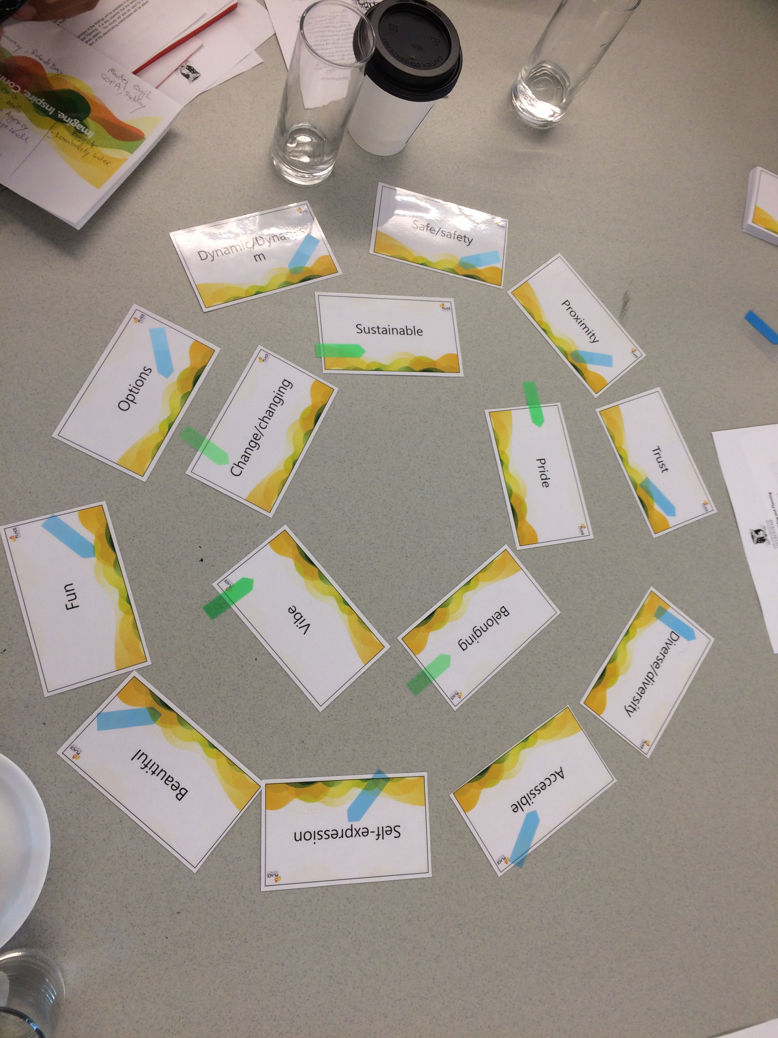
Using the deck of cards provided, break down the group into pairs and divide the cards evenly.
10 min - Each pair will look though their cards, and identify the ‘values’ of place that are relevant to placemaking (‘common place values’) or relevant for their case study (place-specific values). Place the cards in the centre of your team
25 min – The team will look through the values at the centre of the table and choose the top 5 values. Discuss how the ‘values’ in your framework are defined.
Notes:
This exercise requires one deck of cards per team and the students to be working on an ongoing case study.
If the class is not working on a case study, one can be provided specifically for the exercise.
Provide a strategy

Slide 6
What did we achieve with this exercise?
In a very quick fashion, this exercise asks you to reflect not on the revenue sought but on the values that are sought by the placemaking initiative relevant to the case study. It opens up a discussion on what we should measure, how it is defined and why it is relevant to the place discourse.
With this exercise, your team has effectively created the draft framework for your assignment.

Slide 7
Activity 2: Existing Evaluation Measures

Slide 8
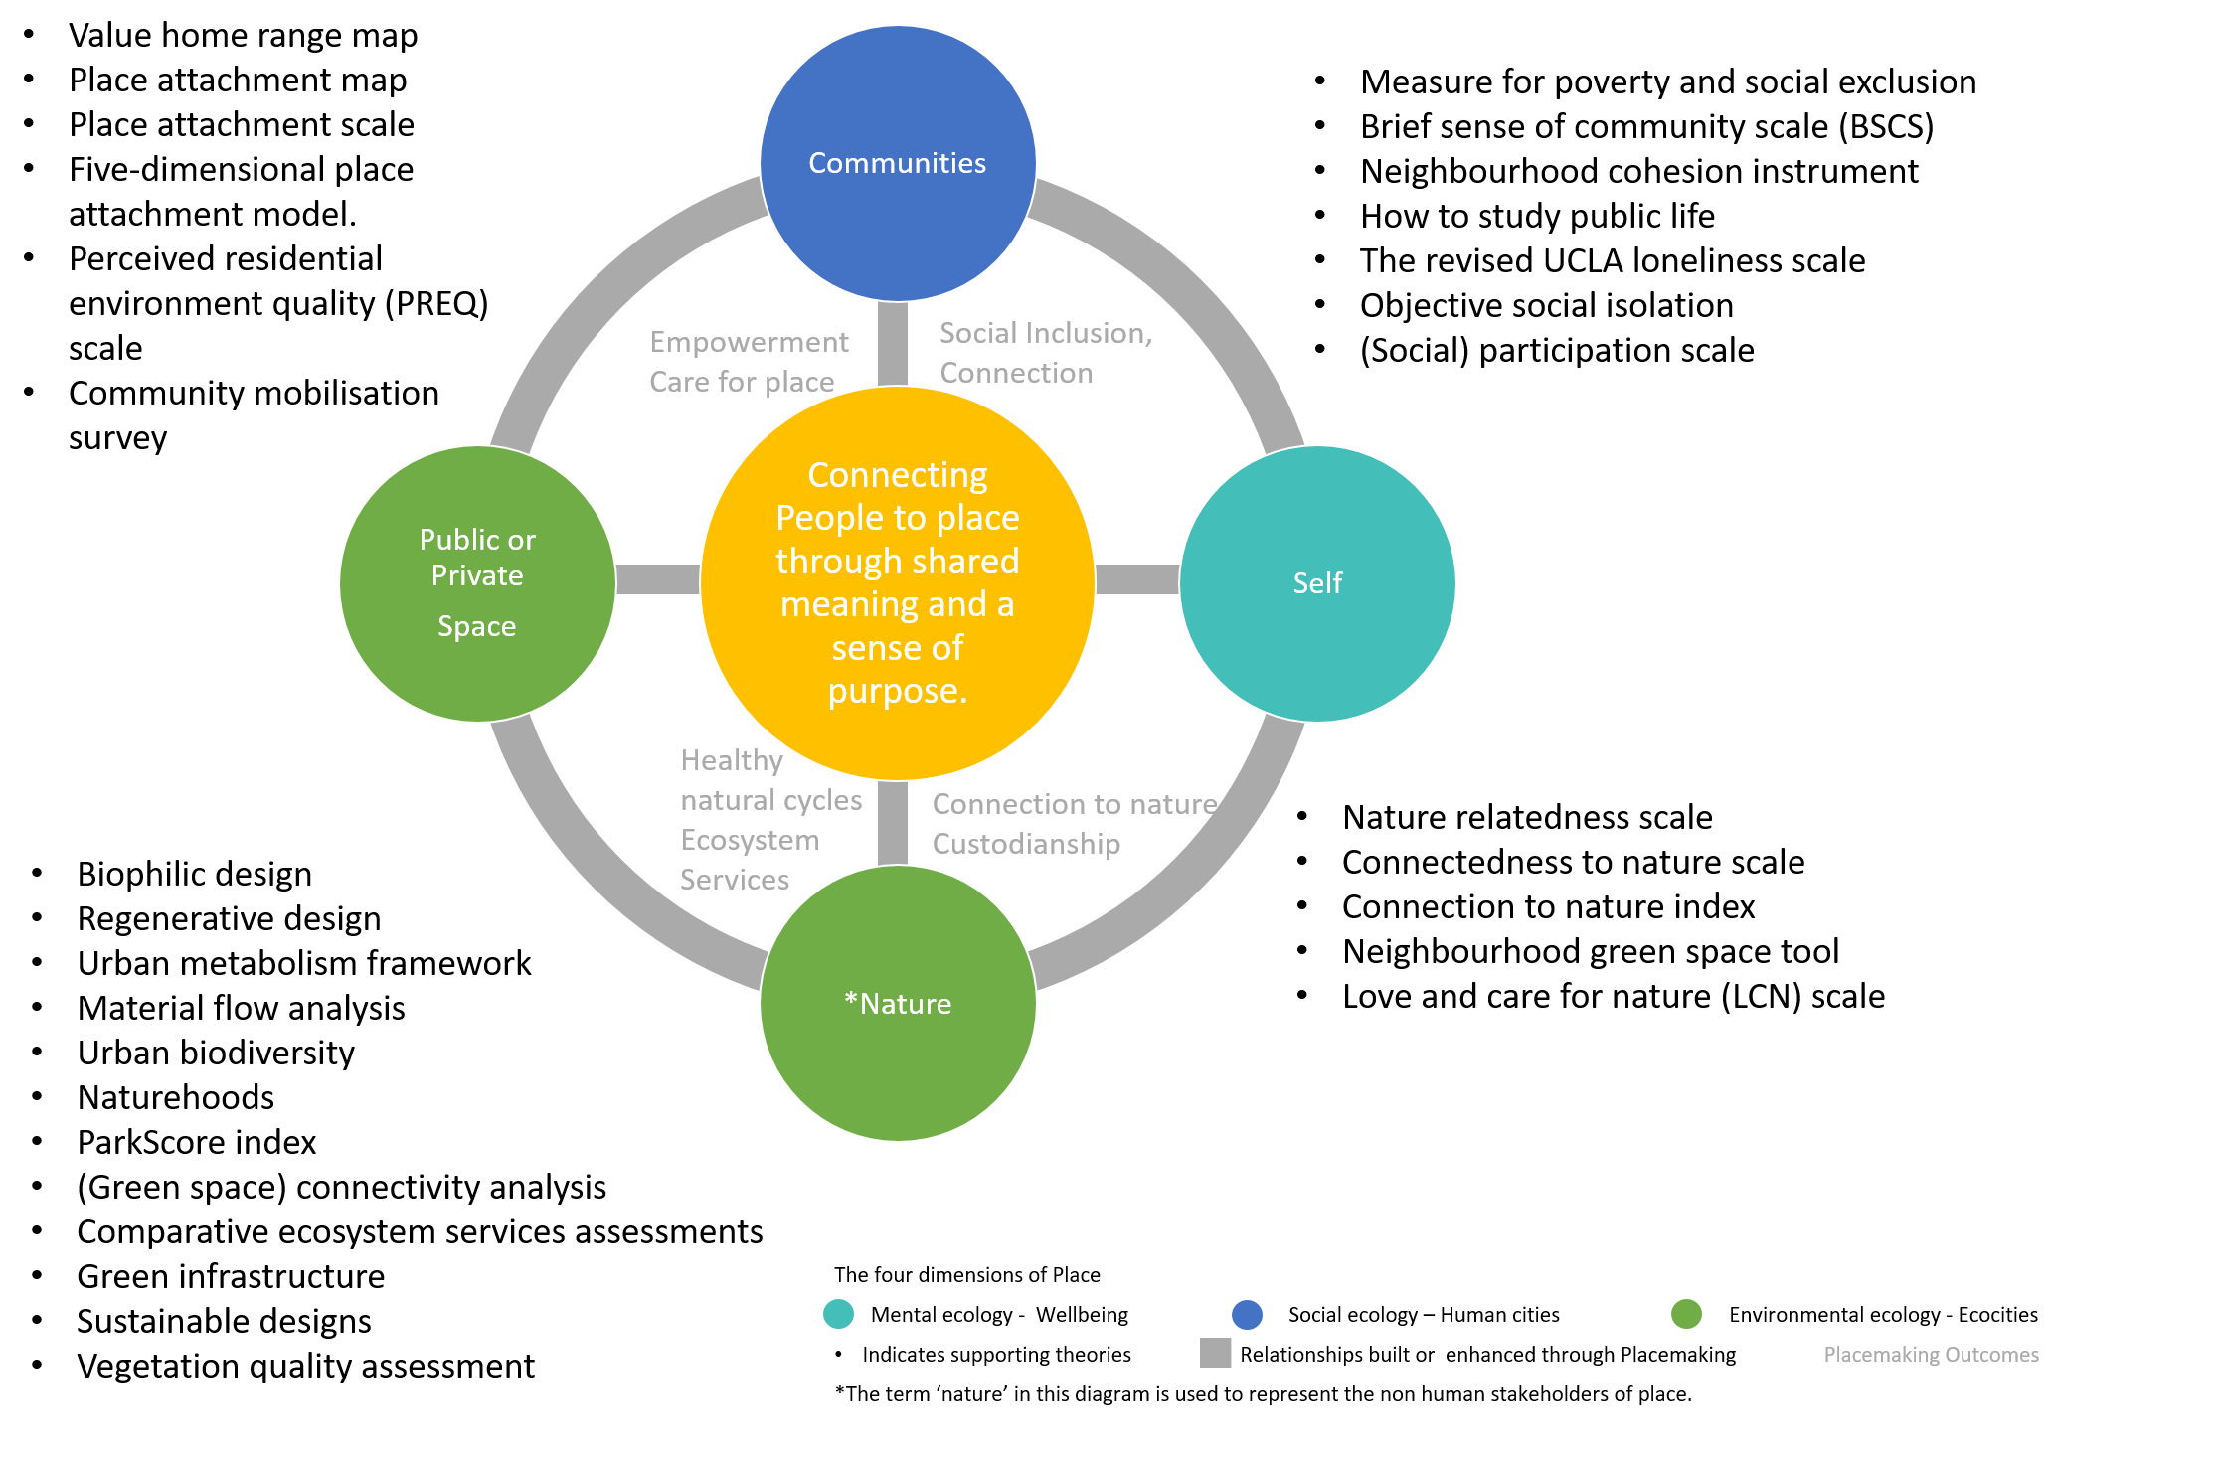
Activity 2: Existing Evaluation Measures
Part 1: Working in small groups, share information on available tools by presenting the slide deck created.
Part 2: Mapping out the tools in the relational model (see image)
Part 3: Whole group discussion
Key insights
Limitations of existing tools
Potential of evaluation for ongoing evolution

Slide 9
What did we achieve with this exercise?
This exercises ask you to reflect on what exactly is being measured by different tools and critically assess the ability of those variables and indicators to effectively assess place and the relationships that we are looking for.
By focusing on a single tool, each team member has deeper knowledge about one tool and can use it for discussion. Moreover, by working as a group, the live database now contains a large number of tools and indicators summarised for inspiration for your assessment task.

