Slide 1
Disclaimer:
The following slides were intentionally left text based to allow you to personalise and contextualise with your own images.

Slide 2
Economics of place
Sipe, N., Darchen, S. & L. Johnson
These slides are based on material prepared by Sipe, N., Darchen, S. & (2019), The University of Queensland for the Place Agency program for placemaking pedagogy.

Slide 3
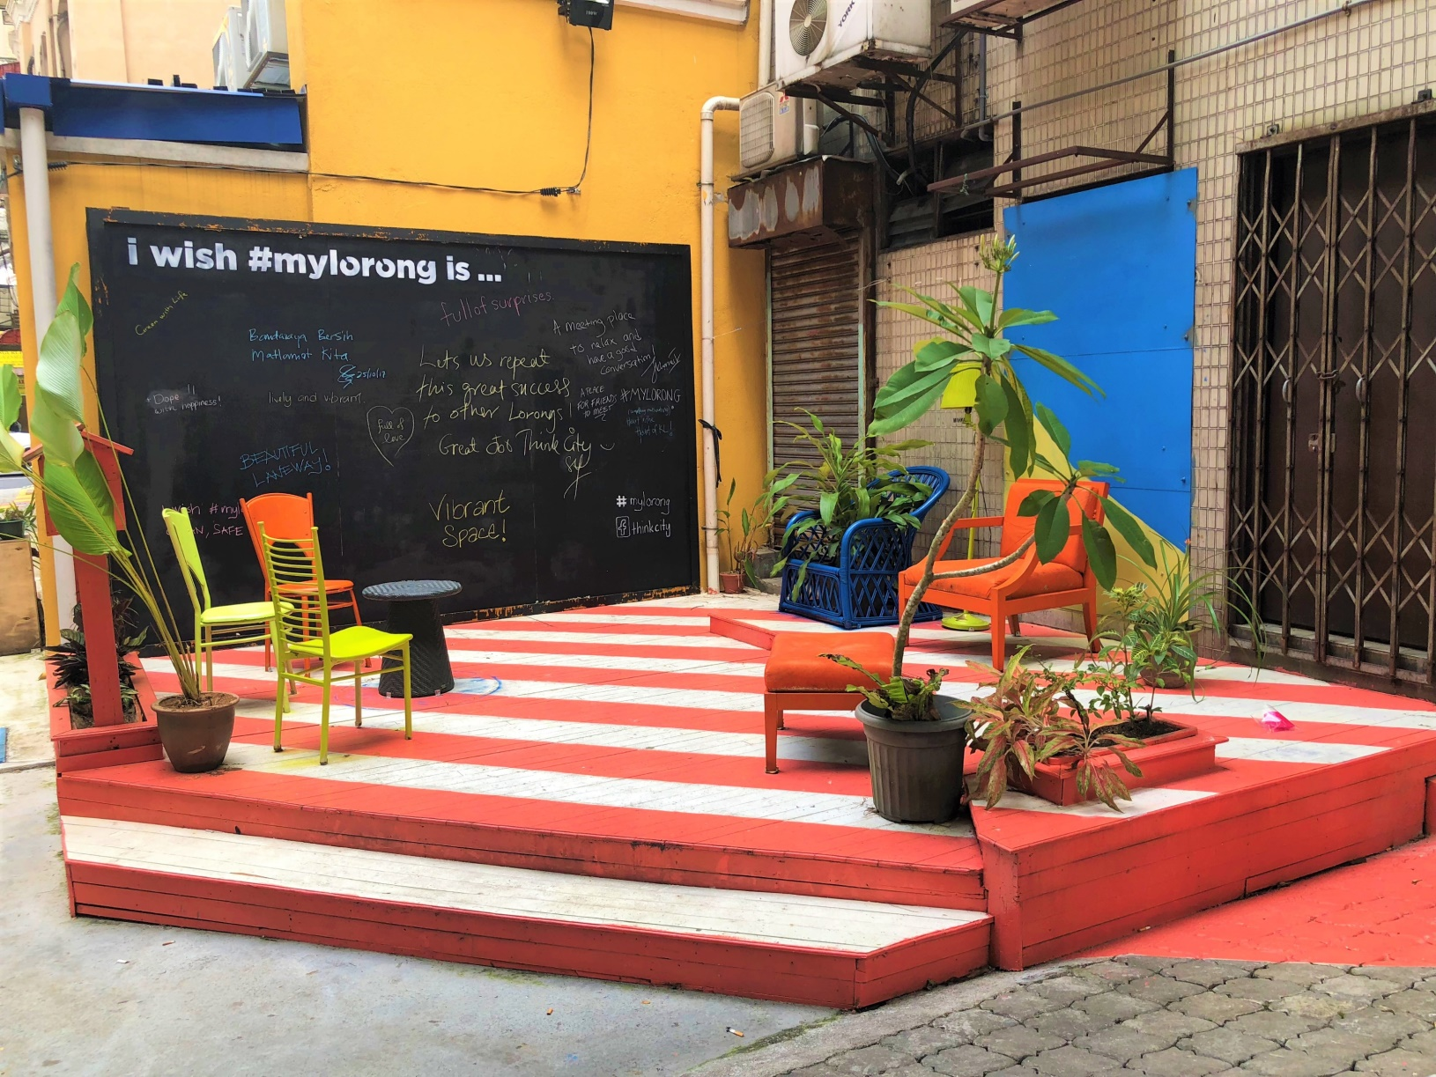
Context:
Where does economic evaluation fit in place?
Getting a basic handle on economic concepts is important to communicate with other industries and gather support for place.
Creating budgets and justifying cost vs. benefits
Estimating economic benefits
Evaluating economic return of place initiatives.

Slide 4
Learning outcomes
Recall information about the economics of placemaking (remember)
Explain key ideas or concepts about the economics of placemaking (understand)
Use information in a new way to demonstrate an enhanced understanding of the economics of placemaking (apply)

Slide 5
Outline
The teaching of this module is based on a specific case study used to exemplify the different concepts important for economic analysis of place
Types of economic benefits
Cost-Benefit Analysis
Economic Modelling
Willingness to Pay
Financial Analysis
Business case

Slide 6
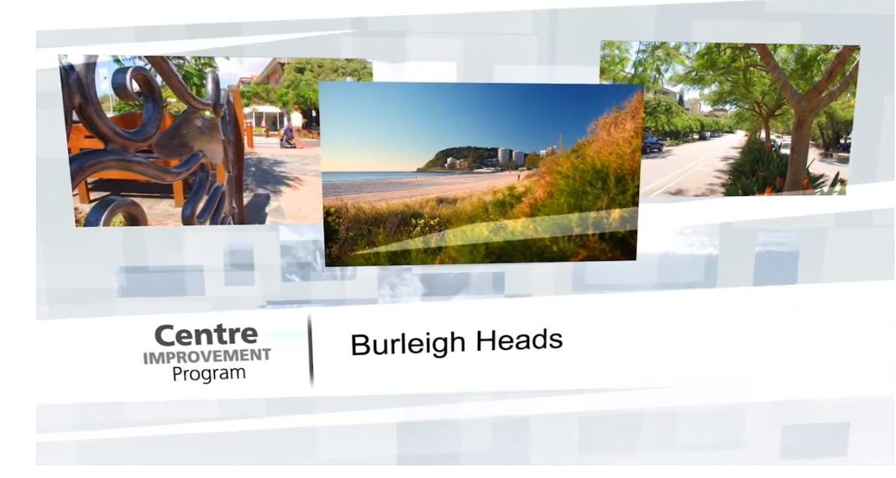
A case study showcasing some economic benefits
Example of Centre Improvement Program (CIP) Centre Improvement Program (CIP) (Gold Coast) https://www.youtube.com/watch?v=9USTbR5dCG4&feature=share&list=PLA4_LYmvEt2a8fY6GhFvmCgMAqBonYBW0

Slide 7

Types of economic benefits
Increase in rent paid to landlords
Increase in wages for local workers
Increase of trader profit

Slide 8
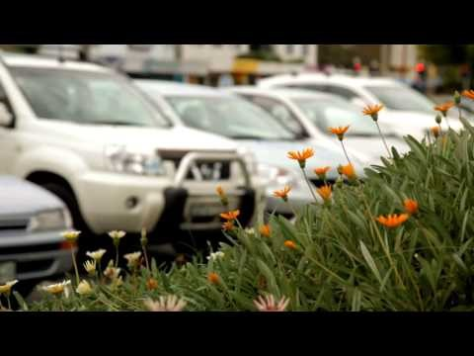

Slide 9
Economic benefits - Burleigh Heads (0.20)
In the 10 years since the program was first undertaken in Burleigh Heads the total return to the community for the CIP at the three identified centres is approximately 13 times greater than the size of the initial investment. This indicates a strong community benefit. The overall benefit of $80 million4 includes:
An increase of $17 million in rent paid to landlords.
An increase in $16.7 million of trader profit.
An increase in wages for local workers of $42.2 million.
Notes:
Move to second 20 of video to see video specifically on Burleigh Heads

Slide 11
Economic benefits - Paradise Point 4:45
In the 6 years since the program was undertaken, Paradise Point has a total return to the community that is approximately 5 times greater than the size of the initial investment. Given the time frame this indicates a modest community benefit. The overall benefit of $17.7 million includes:
an increase of $3.9 million in rent paid to landlords
an increase in $3.2 million of trader profit
an increase in wages for local workers of $9.6 million
Notes:
Move to minute 4:45 of video to see video specifically on Paradise Point

Slide 13
Economic benefits - Chevron Island (9:05)
In 2 years of implementation (Chevron Island) return to the community 2.2 times greater than the size of the initial investment.
Increase of $1.64 million in rent paid to landlords
Increase in $770, 000 million of trade profit
Increase in wages for local workers of $1.7 million
Notes:
Move to minute 9:05 of video to see video specifically on Burleigh Heads

Slide 14
Keeping a main street Thriving through renewal
Placemaking
Done by CoDesign Studio
Kept main street thriving through revitalisation – street, curbs, water, etc.
Continual activation
Curation of activities
Involvement of the guilds around the area to be part of the activity

Slide 15
Key concepts – for economics
Cost Benefit Analysis
Economic Modelling
Willingness to Pay
Financial Analysis
Business case

Slide 16
Cost benefits analysis
Cost-benefit Analysis (CBA) or alternatively Benefit-cost Analysis (BCA)
A systematic method of examining a project’s costs and benefits.
Shown as a single number: either as the project’s overall benefits minus the costs; or as the ratio of the benefits to costs.
Benefit – common metric and common way to calculate
Negative – all costs and benefit needs to be measurable in $...

Slide 17
Cost benefits analysis – decisions you need to make
when to conduct the CBA;
what are the most appropriate things to measure;

Slide 18
Cost benefits analysis – e.g.

Slide 19
Cost benefits analysis – decisions you need to make
when to conduct the CBA;
what are the most appropriate things to measure;
how to best quantify them and sourcing the appropriate data; what timeframe;
what time period to use; and
what spatial area to use in measuring the impacts.

Slide 20
Economic modelling what you need to know to commission it
Looking at other projects to assess what could be possible for our project
You make an educated guess of the extent of the benefits
Usually you build your report with a summary of the expected benefit with evidence linking back to projects from which you have the figures – it is like precedent building in design

Slide 21
Cost benefits analysis – e.g.

Slide 22
Willingness to pay – key concepts to keep in mind
This tool is based on survey information where individuals are asked the maximum amount they would pay for a product.
In the case of a placemaking project, the product could be how much they would be willing to pay for a certain amenity.
Direct - The direct method involves asking individuals through an open-ended questionnaire
Indirect - asking an individual their willingness to pay from a number of product alternatives as well as a “none” option.
- Not as reliable and has a lot of bias and

Slide 23
Willingness to pay – key concepts to keep in mind
This tool is based on survey information where individuals are asked the maximum amount they would pay for a product.
In the case of a placemaking project, the product could be how much they would be willing to pay for a certain amenity.
Direct - The direct method involves asking individuals through an open-ended questionnaire
Indirect - asking an individual their willingness to pay from a number of product alternatives as well as a “none” option.
- Not as reliable and has a lot of bias and

Slide 24

PARTICIPATORY BUDGETTING
https://vimeo.com/162743651

Slide 25
Financial analysis – who benefits
Understand who benefits and who covers the costs, not just total
This helps with the final plan for budgeting for the place managers and government

Slide 26
Cost benefits analysis – e.g.

Slide 27
Business case
This is the document that backs up what approach you have used to justify your estimates
CASE STUDY - https://www.pps.org/projects/business-plan-for-madisons-public-market
Next slides from: https://www.slideshare.net/RWVentures/economic-placemaking-how-to-develop-a-neighborhood-business-plan-71100473

Slide 28
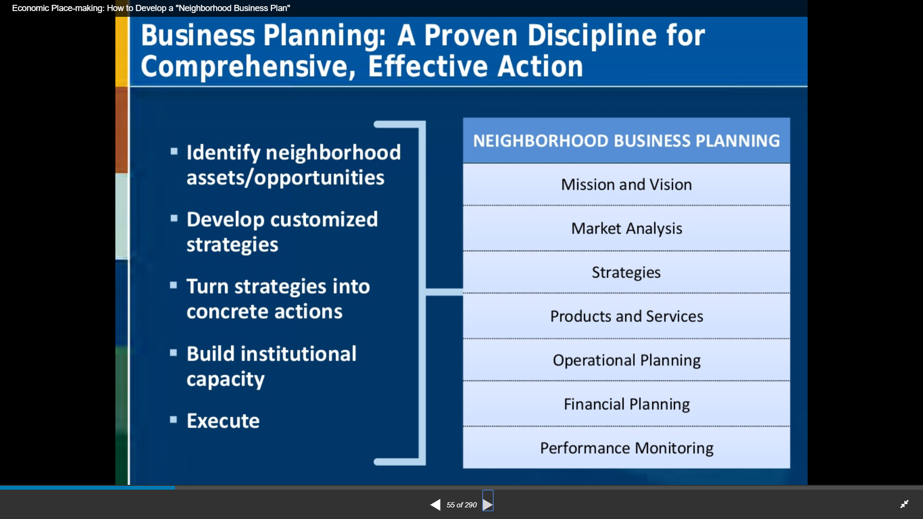

Slide 29
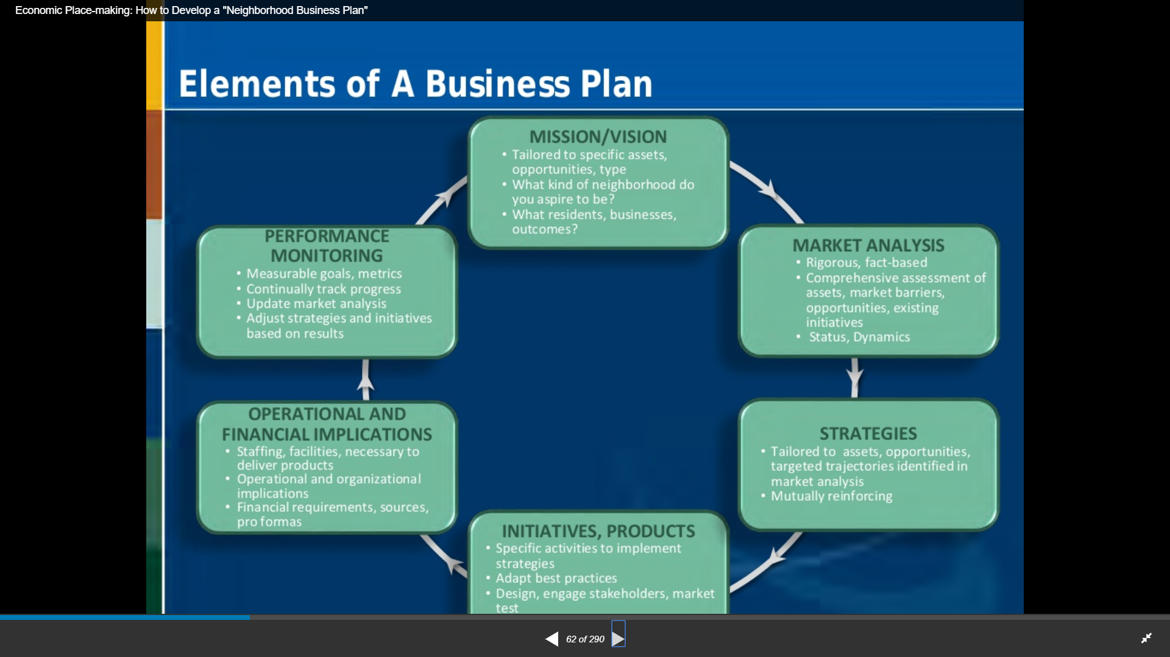

Slide 30
The problem with economic evaluation
You are guessing you do not know what will evolve
You can’t measure in $ the things that many people love, what gives them joy and what helps them thrive
We don’t measure ecological or social capital well because of their complexity
… how do you measure 60,000 years of indigenous knowledge, time with you family, a sense of a place, sunshine, a lovely dinner with friends.. Time to be healthy, learn and think…

Slide 31
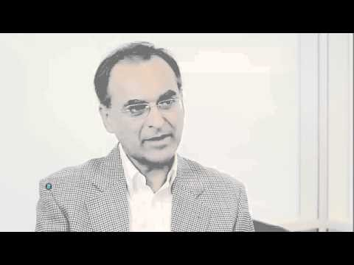
https://youtu.be/0OGOmpEeDcw

