Slide 1
Disclaimer: The following slides were intentionally left text based to allow you to personalise and contextualise with your own images.

Slide 2
Economics of place
Sipe, N., Darchen, S. & L. Johnson
These slides are based on material prepared by Sipe, N., Darchen, S. & (2019), The University of Queensland for the Place Agency program for placemaking pedagogy.

Slide 3
Good places and their attributed benefits

Slide 4
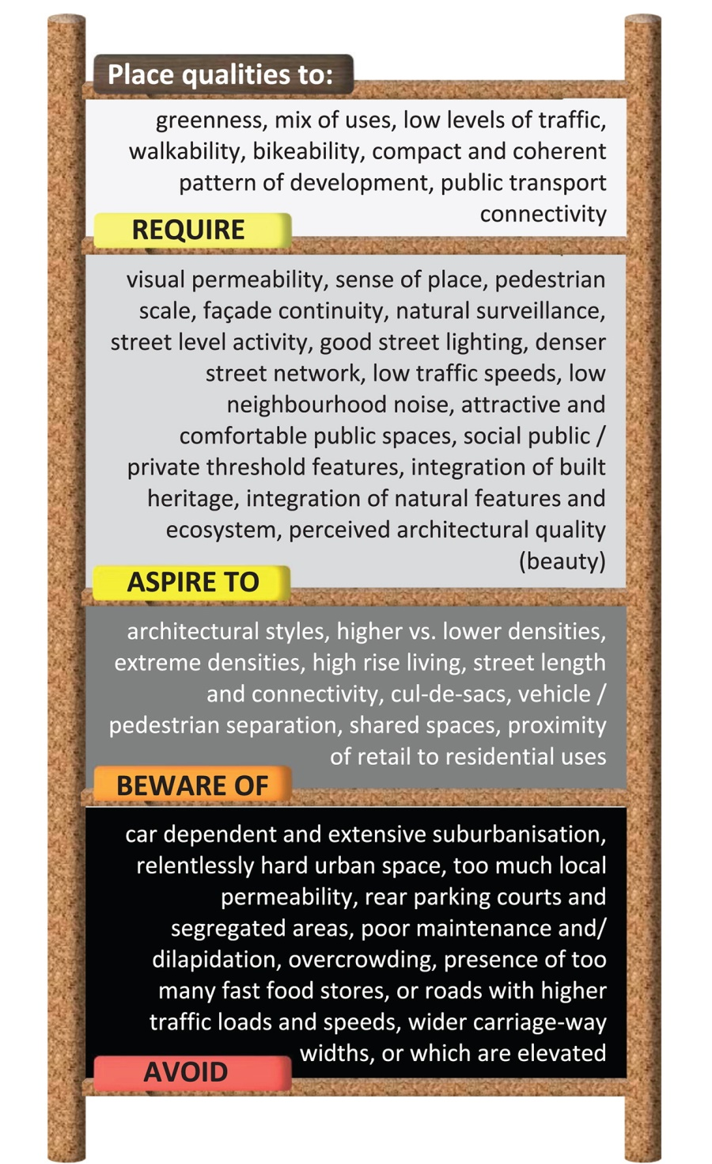
Good places or ‘high-quality’ places are defined by Carmona (2019) as areas where the design attributes provide benefits for one of four policy areas health, social, economic and environmental.
Some place qualities to encourage are present in the image on the left.

Slide 5
What type of benefit is most prominent (if any) in our study area: health, social, economic and environmental?
What can we infer from this evidence / or lack of evidence of good place in our study area? Here in the place qualities diagram do we find these attributes of our area?
How does walkability compare to surrounding neighbourhoods and other areas with similar demographics?
What are new opportunities for placemaking that you may have missed before?

Slide 6
What do places cost?

Slide 7
Calculate a budget for your proposal
Document tangible materials as well as in-kind donations (i.e. recycled materials, volunteer hours, etc)
Be as precise as possible and be ready to justify the price of your project.

Slide 8
Quantifying the economic benefits

Slide 9
Estimate economic return of your project
You can use either cost-benefit analysis or economic modelling
1-2 pages long – succinct yet persuasive
Summary of the proposal and expected benefits,
Costs (inputs – based on the previous exercise)
Identify scale, key stakeholders and economic benefits on medium and long-term timescales. Incorporate at least one healthy, social or environmental feature (in detail
http://buildingqueensland.qld.gov.au/frameworks/
https://publicsector.sa.gov.au/documents/developing-business-case/

