Slide 1
Leadership
These slides are based on material prepared by Mackintosh, L. (2019), The University of Notre Dame for the Place Agency program for placemaking pedagogy.

Slide 2
Objectives of this module
To increase your understanding of:
the leadership models, and the leadership skills that support placemaking;
your role in effectively facilitating placemaking in dynamic and complex situations
In order to
Recognise strategies to lead placemaking teams and stakeholders through the different stages of placemaking
Understand that diverse values and ethical positions exist, and that a common understanding is required.
Identify tools and strategies for effective communication with complex stakeholder groups and design teams.

Slide 3
Image: Projects for Public Spaces https://www.pps.org/article/grplacefeat
Notes:
This slide could be adjusted to suit the context in which this presentation is being given, using theories of placemaking and/or tools used by others

Slide 4
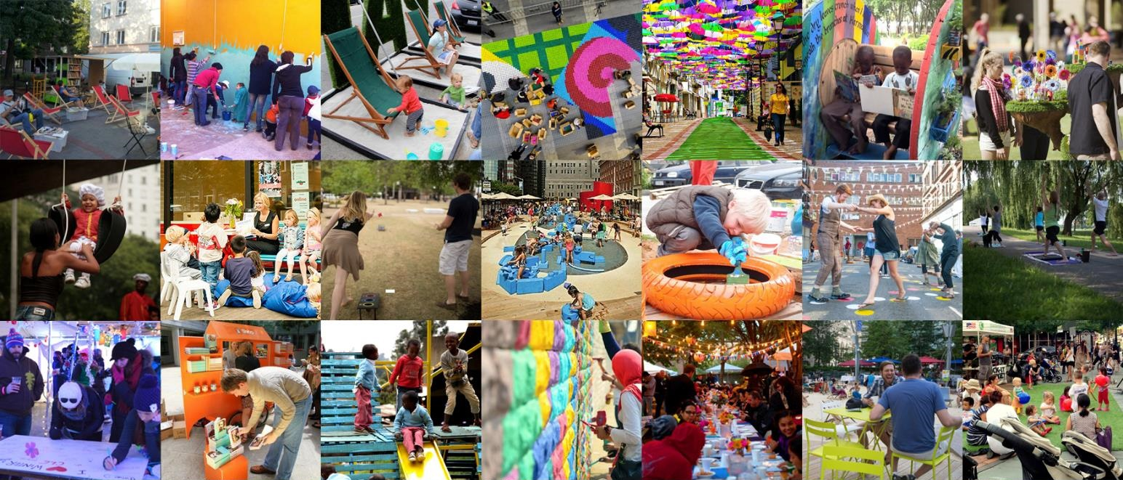
What… is place in learning environments?
A selection of interventions and projects from around the world.
Image: Projects for Public Spaces https://www.pps.org/article/lighter-quicker-cheaper
Notes:
This slide could be adjusted to suit the context in which this presentation is being given, using examples from other presenters, or local case studies

Slide 5
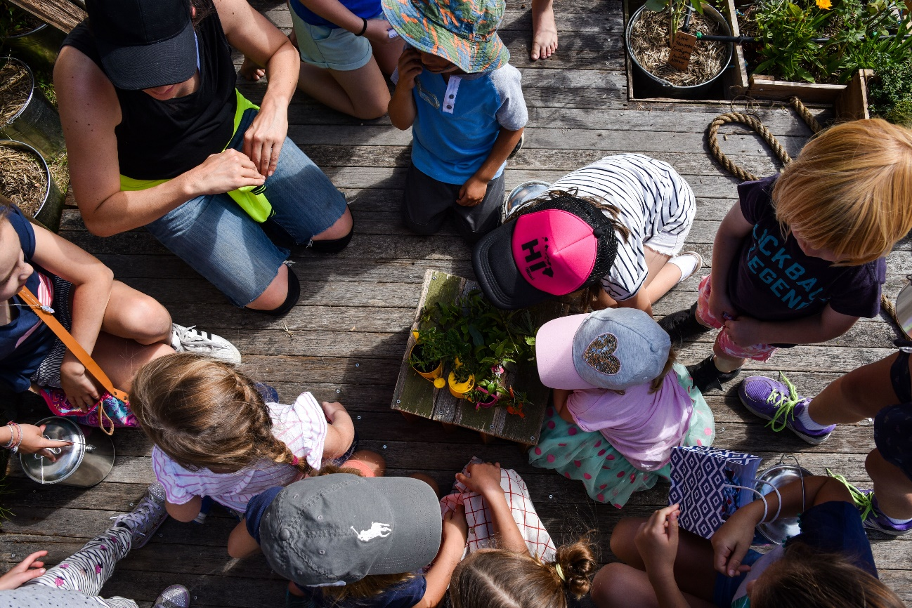
What are the roles in placemaking?
the stakeholders
Designers / design consultants
Development / Campus Managers
Community representatives
Local government / regulators
the roles
Team leader
Team member
Active participant
Passive observer

Slide 6
A self-reflective approach
This module is about understanding how you can be a responsive leader, and understanding the different people and places of each project.
How does your understanding of placemaking inform your leadership approach?
How to you respond to the different types of players and experts?
What is it about different projects that would require a different leadership approach?

Slide 7
So first… a moment to reflect
Instructions | Time | Objective of the exercise
What kind of leadership roles did you seen in the case studies presented? | 5 mins | This exercise enables students to build on recent learning

Slide 8
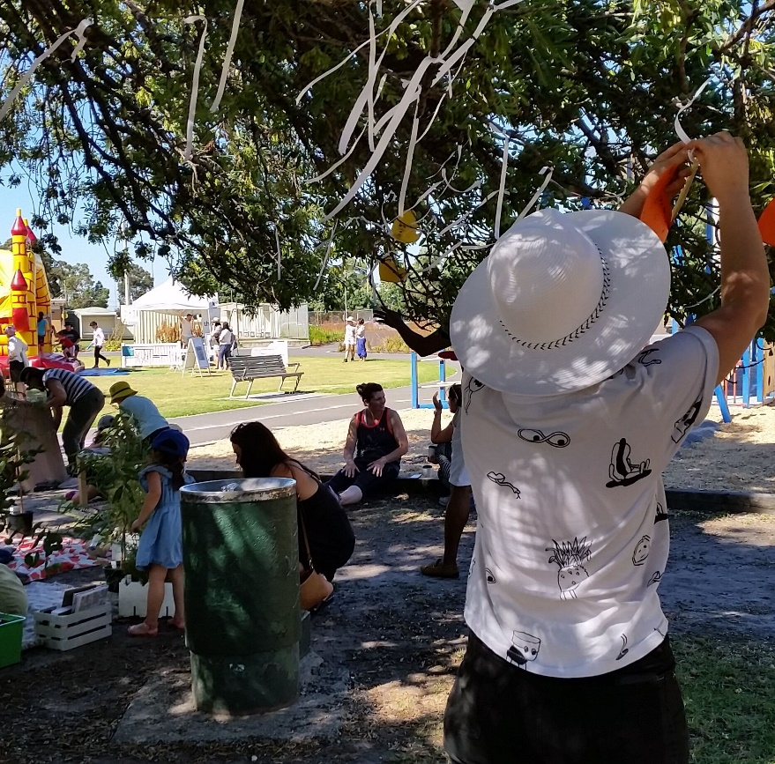
Different understandings of leadership
Position – something someone is ..
“The leadership of the organization is made up of six members.”
Skill – something someone has …
“She demonstrates strong leadership.”
Activity – something someone does …
“The group engaged in leadership.”
What is your understanding of leadership in placemaking?

Slide 9
Leadership or Management?
 | LEADERSHIP | MANAGEMENT
Time focus | Long-term | Short-term
Goals (Northouse, 2007) | Envisioning and creating change Influencing others | Reducing chaos Completing tasks Mastering routines
Functions (Kotter, 2001) | Providing direction Aligning people Envisioning Motivating and inspiring people | Planning and budgeting Staffing Organizing controlling
Nature of relationship (Rost, 1991) | Influence relationship Reciprocal | Authority relationship Top-down
Table 1: Leadership and Management
Source: Agard (2011)

Slide 10
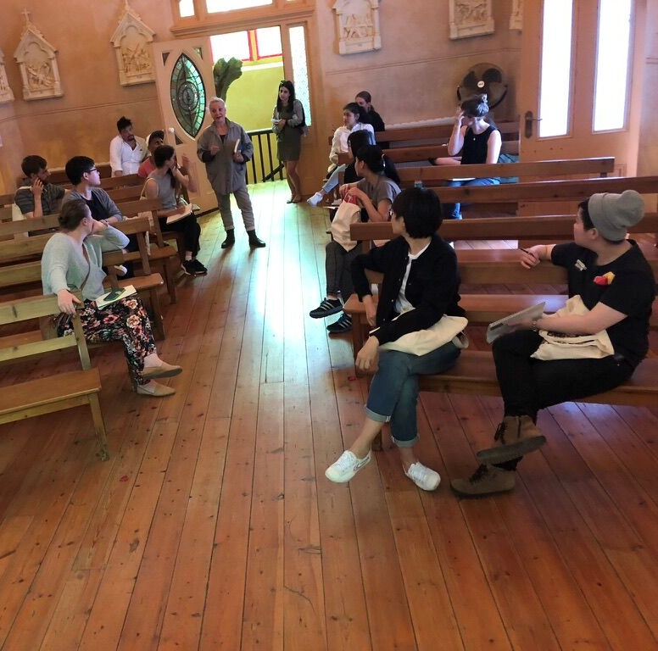
Leader V’s Leadership
Leader a Position or Person
Can only a leader do leadership?
Leaders do not always engage in leadership.
You don’t need to be a leader to engage in leadership.
All members (of an organization) are capable of being leaders.
Notes:
Notes to discuss with Lara.
Sorry, I’m not sure what has happened to the formatting here.

Slide 11
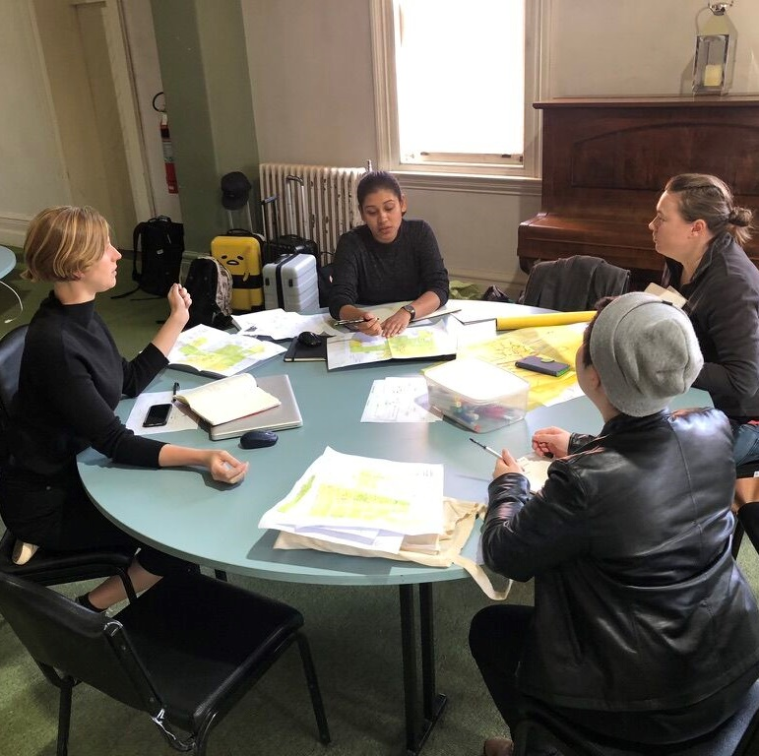
Leader V’s Leadership
Leadership an activity
A process of complex interaction
The context is dynamic and ambiguous.
Environmental factors are interconnected
There is a strong emphasis on change.
Notes:
Notes to discuss with Lara.
Sorry, I’m not sure what has happened to the formatting here.

Slide 12
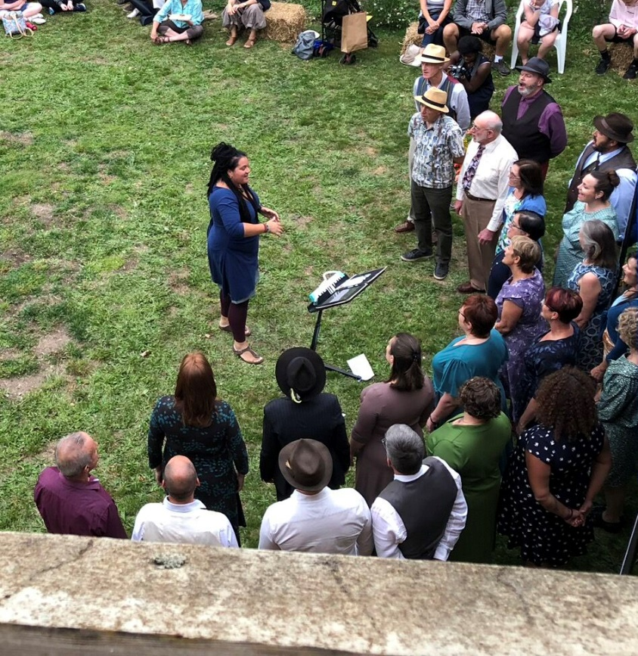
Traditional Theories of Leadership
A leader must have certain leadership traits
Intelligence, determination, integrity, sociability, self-confidence, masculinity and dominance.
(Northouse, 2007)
There are specific leadership styles or behaviours
Doesn’t account for differences in context, situation, organisation / social groups. (Agard, 2011)
Leadership is the unidirectional personal influence of the leader on the followers
Traditionally, leaders are active; followers are passive
(Winkler, 2010)

Slide 13
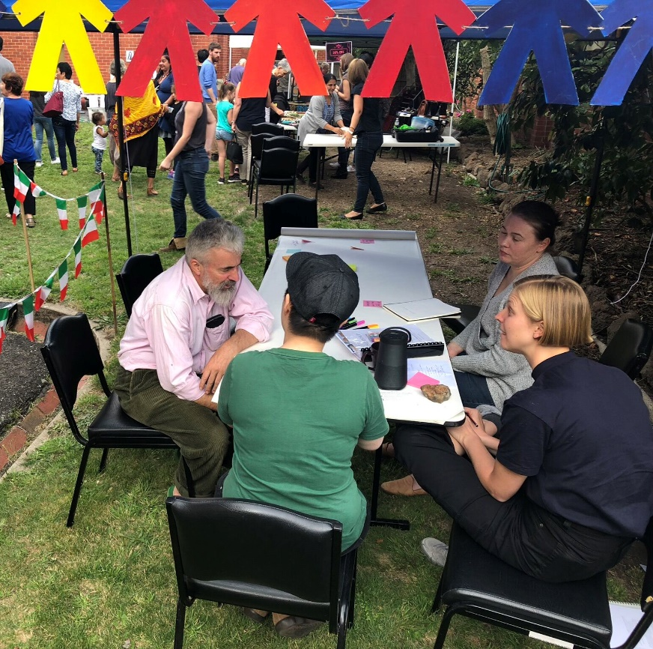
Contemporary Theories of Leadership
This module adopts a contemporary leadership theoretical research, in which you will:
Explain leadership approaches
(not prescribe certain traits in individuals)
Describe typical behaviour guided by subjectively perception
(not objectively, in terms of given values i.e., economic performance)
Present why certain behaviour occurs in certain contexts
(not assume socially pre-determine formal hierarchies) (Winkler, 2010)

Slide 14
In my experience
Instructions | Time | Objective of the exercise
What kind of leadership roles did you seen in the case studies presented? | 5 mins | This exercise enables students to build on recent learning
Consider the different roles of leadership
As an engaged member of a community
As an observer of placemaking activities
As a researcher, examining case studies
As an emerging placemaking practitioner

Slide 15
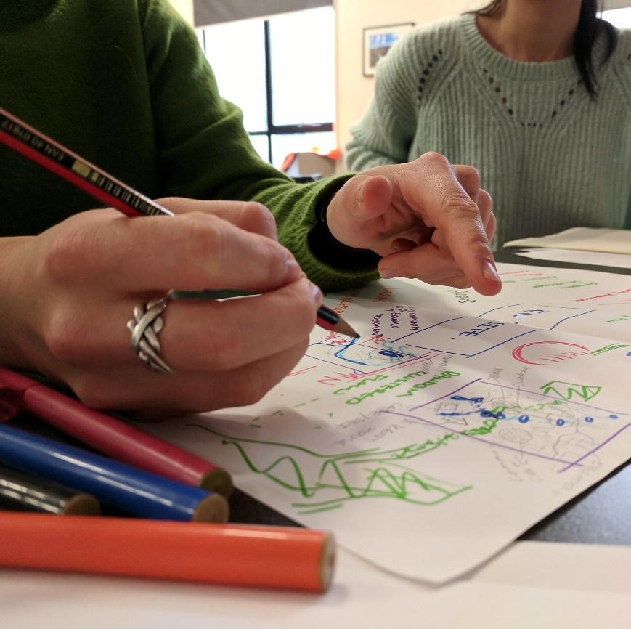
Leadership in Complex Organisations
A formal process of intentional leadership
Assigning leadership responsibility through devolved and delegated mechanisms – a process coordinated from the top and rolled out across the organisation
OR
An emergent processes of collaborative and informal leadership
where individuals, groups and teams willingly take on responsibility and generate new ideas and initiatives.
Everyone has a part to play.

Slide 16
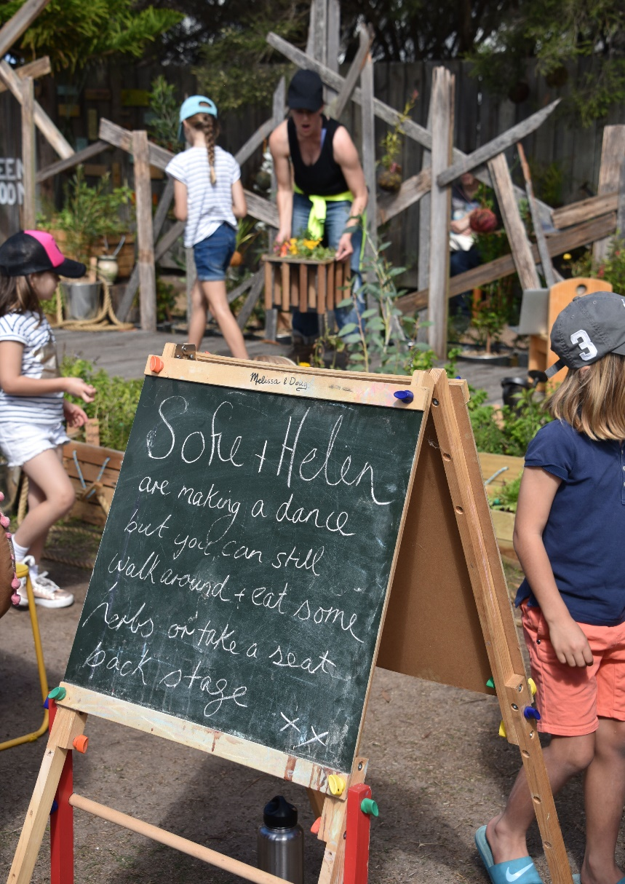
Distributed Leadership Approach
The Distributed Leadership approach
Leadership is an emergent property of a group of individuals
There is openness to the boundaries of leadership
Varieties of expertise are distributed across the many, not the few
Distributed Leadership is
dynamic, relational, inclusive, collaborative and contextually situated
Requires a systems wide perspective
Transcends organizational levels, roles and boundaries

Slide 17
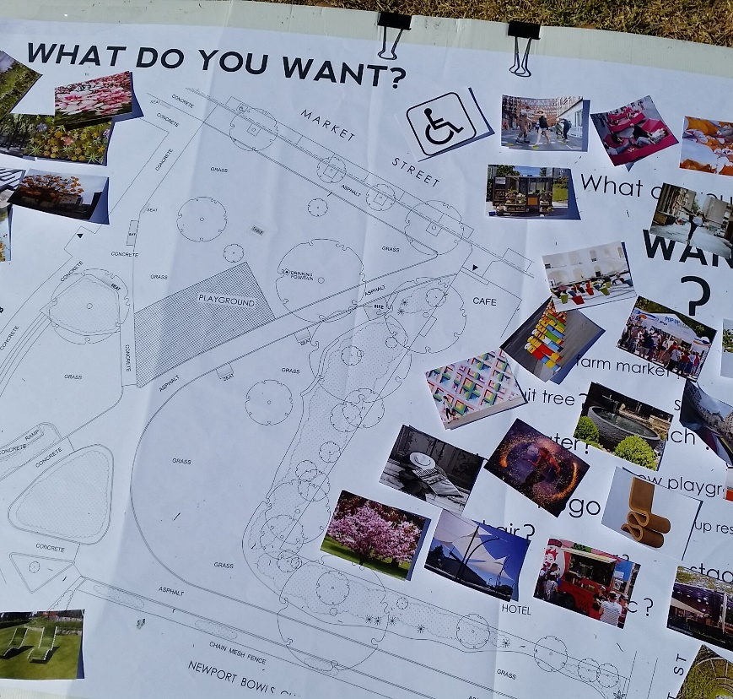
Distributed Leadership Outcomes
beyond economic performance
Leadership - too complex and important to leave to a small group of individuals
Decision making authority is devolved or delegated via formally designated channels
Committees seen as a systematic sharing of leadership, where joint decisions are made
Collaborative behaviour is correlated with control of resources i.e. financial devolution is central to shared or distributed leadership

Slide 18
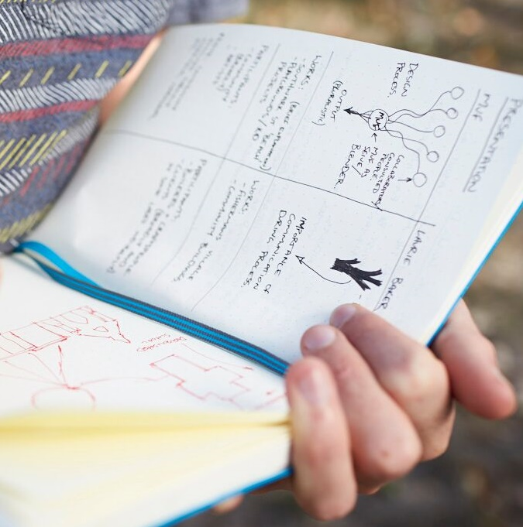
Leadership in Placemaking
Recognise the elements of leadership that shape practice, make change
Systems, processes, structures - formal and informal
Addresses key aspects that influence, and are influenced by, leadership
The handling of budgets and resources
Forums for communication and participation
Opportunities for reward and recognition
Accommodate different roles for leadership and stakeholders
Top-down, bottom-up and horizontal
There is a leadership role for everyone in placemaking

Slide 19
Exercise
Instructions | Time | Objective of the exercise
What are the leadership approaches for the project are you currently working on? This could include negotiation strategies, communication guidelines, consultation activities being developed or implemented. | 5 min | This exercise encourages students to reflect on their own experiences and assumptions
Divide into pairs. Describe a current project / experience, and the other will summarise the project, identifying a key problem or potential. Then swap | 5 mins each | This exercise helps develop communication skills
Identify a leadership strategy appropriate for the other person’s project. Swap and discuss. | 10 mins | This exercise raises awareness of letting go and withholding judgement

Slide 20
Discussion
What action did you take to help your partner to understand your project correctly?
When explaining your strategy to your partner, what steps did you take to engage them in this solution?
How did it feel to have a solution provided for your project?

Slide 21
Wrap Up
What assumptions were challenged in these exercises?
How has your understanding of other stakeholders changed?
What changes can you make to your own ways of thinking?
As a placemaker? As a member of a community?
When you visit placemaking sites in the future, how will you ‘see’ things differently?

Slide 22
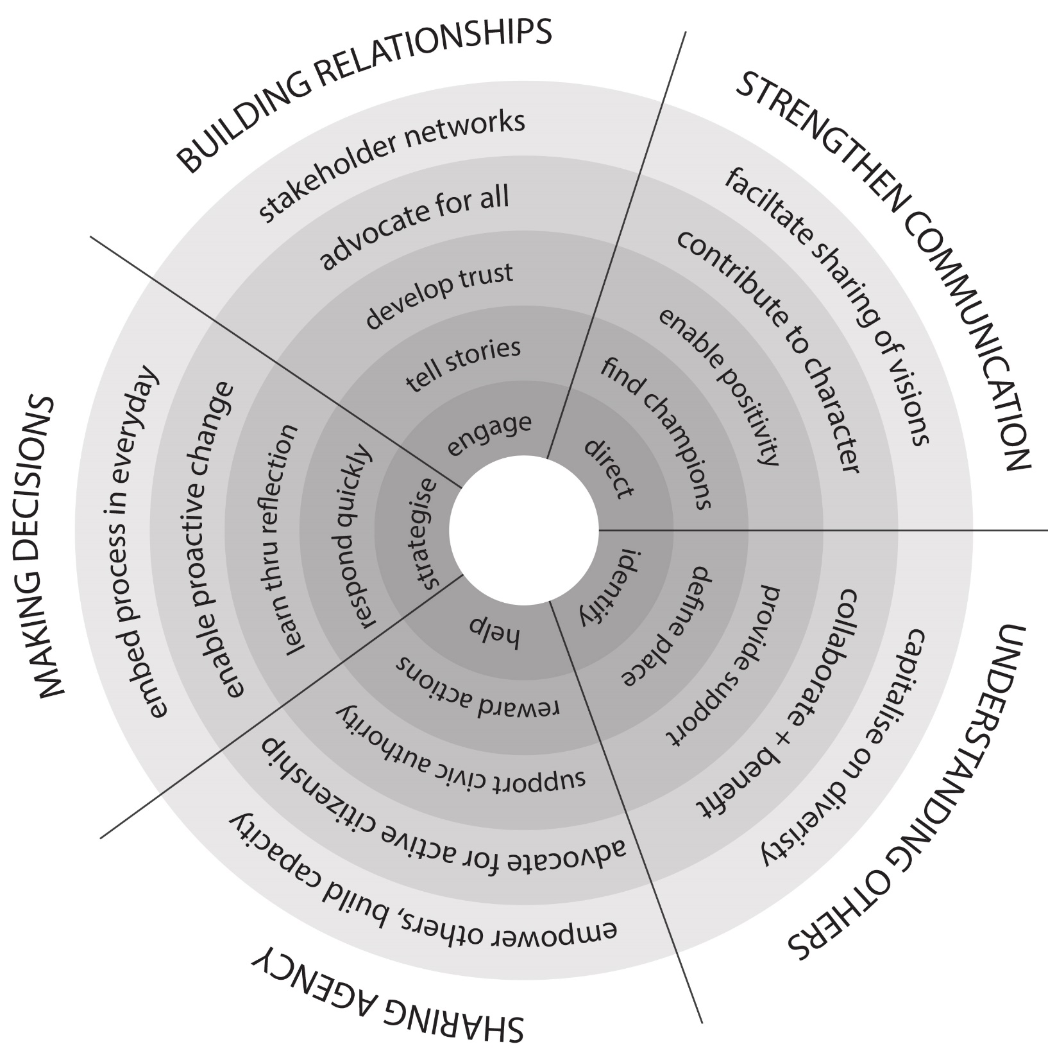
Leadership In Placemaking Reflective Tool
Source: Mackintosh (2019). Please contact lara.mackintosh@nd.edu.au

Slide 23
Further reading
Agard, K. (ed.) (2011). “Progressive Leadership: Models and Perspectives for Effective Leadership” In Leadership in Nonprofit Organizations: A Reference Handbook. SAGE Publications, Inc.
Bolden, R., Petrov, G., & Gosling, J. (2009). Distributed Leadership in Higher Education: Rhetoric and Reality. Educational Management Administration Leadership, 37(2), 257-277.
Kotter, J. P. (2001). What leaders really do. Best of HBR Breakthrough Leadership, 3–11.
Northouse, P. G. (2007). Leadership: Theory and practice (4th ed.). Thousand Oaks, CA: Sage.
Seemiller, C. and Murray, T., (2013). The Common Language of Leadership in Journal of Leadership Studies vol. 7, no. 1. University of Phoenix. Pp33-45
Rost, J. C. (1991). Leadership for the twenty-first century. Westport, CT: Praeger.
Winkler, I. (2010). Contemporary leadership theories : enhancing the understanding of the complexity, subjectivity and dynamic of leadership. Berlin. Springer

