Slide 1
Disclaimer: The following slides were intentionally left text based to allow you to personalise and contextualise with your own images.

Slide 2
Leadership in Placemaking
These slides are based on material prepared by Mackintosh, L. (2019), The University of Notre Dame for the Place Agency program for placemaking pedagogy.

Slide 3
Activity 1: Self-reflection

Slide 4
Activity 1: Self-reflection
What do I already know about placemaking negotiation and communication? (5 min)
What do I already know about leadership approaches? (5 min)

Slide 5
Activity 2.A: Problem statement

Slide 6
Activity 2.A: Problem Statement
Identify an issue you are having for your project (it can be around creative thinking for the project, stakeholder management or within the group) - 5 min
Divide into pairs and describe current issue, the second person records the details of your issue – 5 min each.
Identify appropriate leadership strategy for the other person’s project and discuss – 10 min

Slide 7
Activity 2.A: Problem Statement
Discuss - 10 min
What action did you take to help your partner to understand your project correctly?
When explaining your strategy to your partner, what steps did you take to engage them in this solution?
How did it feel to have a solution provided for your project?

Slide 8
Activity 2.B: Roleplay

Slide 9
Activity 2.B: Roleplay
Break up into groups of 3. Work through scenarios presented:
Stakeholder roles: placemaker, stakeholder, observer, recorder/note taker
The recorder presents their observations on how the group behaved
Repeat

Slide 10
Activity 2.B: Roleplay
Discuss – 10 min
What action was taken to help the other to understand the project correctly?
When explaining the planned action to the other party, what steps did you take to engage them in this
solution?
How did it feel when the action was presented? By the placemaker? By the stakeholder?

Slide 11
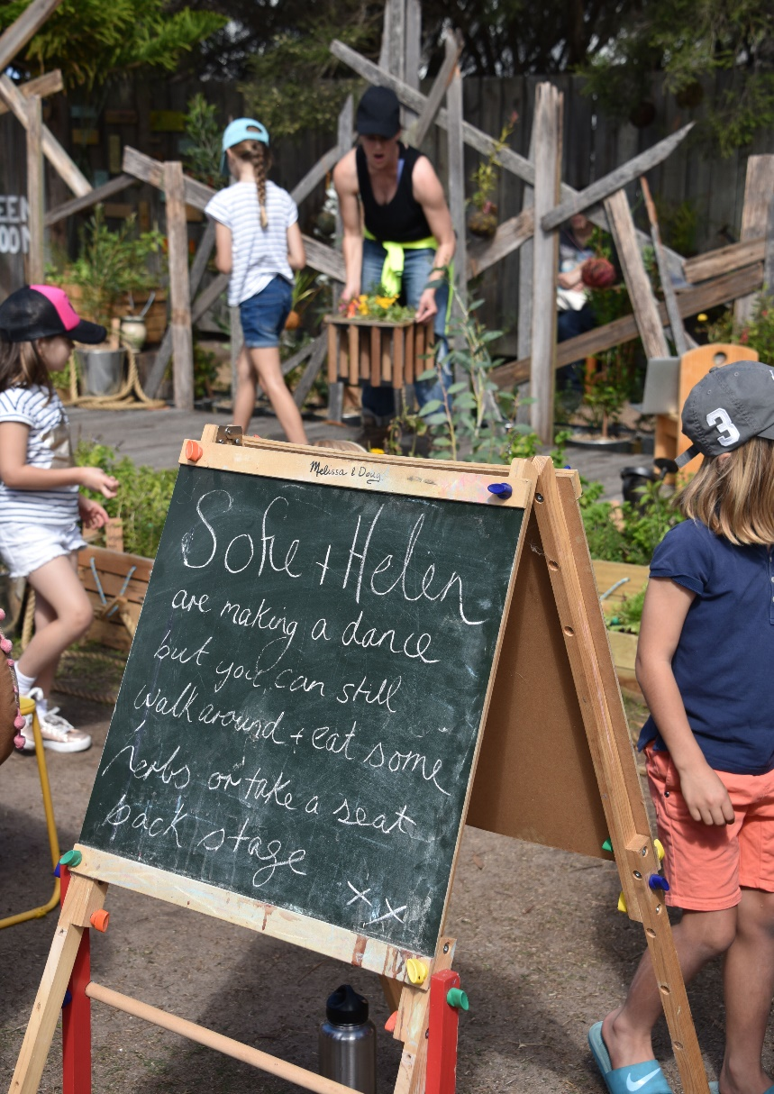
Distributed Leadership Approach (revisiting)
The Distributed Leadership approach
Leadership is an emergent property of a group of individuals
There is openness to the boundaries of leadership
Varieties of expertise are distributed across the many, not the few
Distributed Leadership is
dynamic, relational, inclusive, collaborative and contextually situated
Requires a systems wide perspective
Transcends organizational levels, roles and boundaries

Slide 12
Activity 3: Placemaking simulation

Slide 13
Activity 3: Placemaking simulation
The remaining students are evenly spread across the 5 placemaking elements (people, process, product, program place), according to their focus / area of interest. – 5 min
Stakeholders of each element come together to determine a common position – 5 min
The placemaking team moves along the pathway, stakeholders explain their positions and the leadership team responds – 20 min

Slide 14
Discuss – 10 min
Describe the successful strategies that resulted in a common position.
Identify some of the challenges faced by the leadership team.
What action was taken by the leadership team and / or stakeholder groups to enable a successful
outcome?
What were some of the barriers? What supported success?

