Slide 1
Disclaimer: The following slides were intentionally left text based to allow you to personalise and contextualise with your own images.

Slide 2
Governance Power and Empowerment
Toland, A., Kinniburgh, J., Z. Horn & J. Hopkins
These slides are based on material prepared by Toland, A., Kinniburgh, J., Z. Horn & J. Hopkins (2019) for the Place Agency program for placemaking pedagogy.

Slide 3
Placemaking is political…
… because it involves people, power and contest
It changes the status quo
It involves questions of who gets what, and how (distributive)
It inevitably influences narratives of space
It influences how people interact with place – particularly around public value.
It is (often) concerned with public space and the commons.
Who gets what? Whose voices are amplified? Whose stories are told? Whose interests/agendas are being furthered? Are there opportunities for compromise?

Slide 4
Learning outcomes
Upon completion of this module students will be able to:
understand the structures, processes and jurisdictions determining the production of place
identify relevant mechanisms for exerting influence and affecting change
distinguish between top-down and bottom-up interests and their respective claims to power
describe power relations in a visual manner

Slide 5
Outline
Governance, government structures, processes (15 min)
Mini case study – exercise (20 min)
Leveraging governance
Power dynamics - top-down and bottom-up approaches
Advocacy and activism

Slide 6
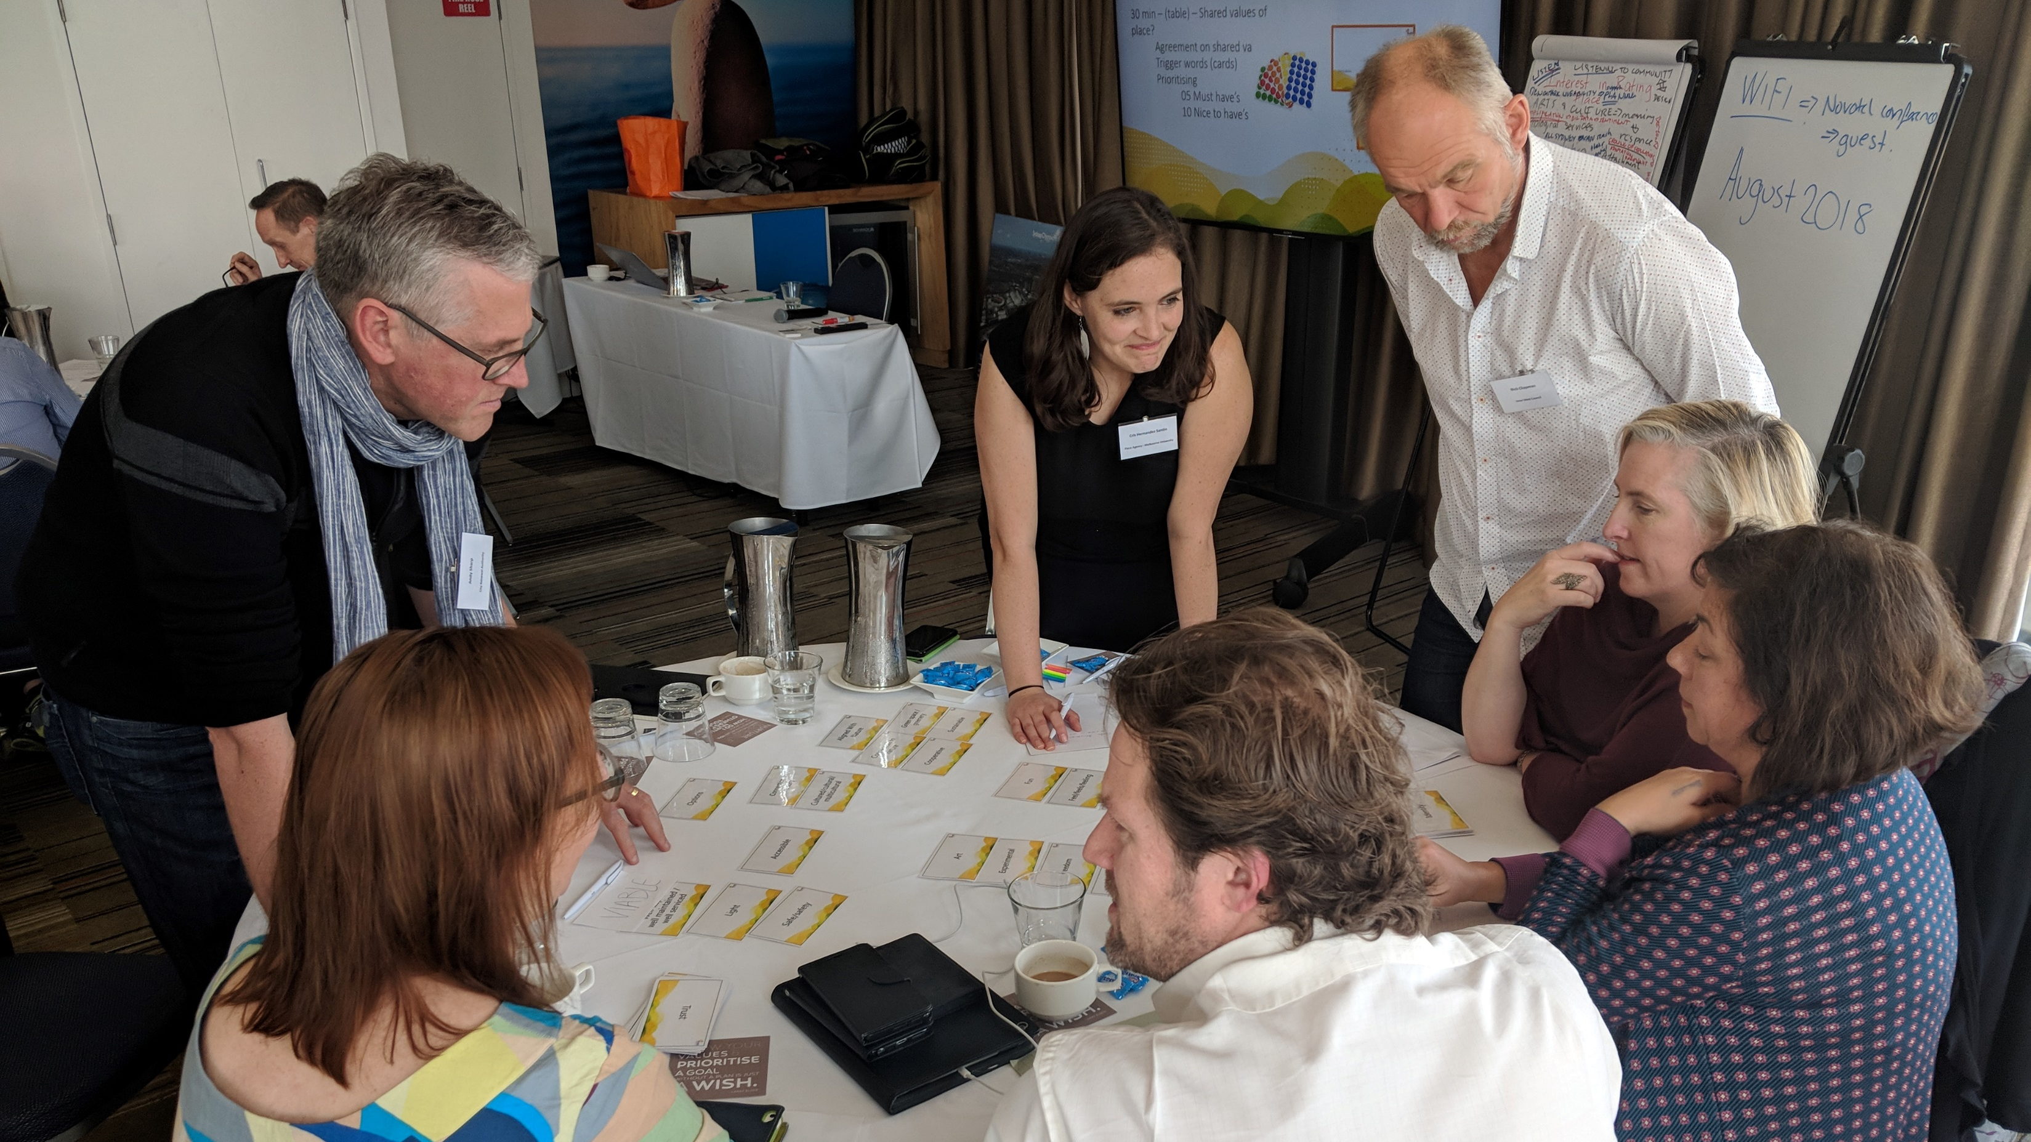
"Governance involves interaction between the formal institutions and those in civil society. Governance refers to a process whereby elements in society wield power, authority and influence and enact policies and decisions concerning public life and social upliftment.”
https://www.gdrc.org/u-gov/work-def.html

Slide 7
Governance is a network of relationships between government, community and market actors engaged in decision-making.
Governance is characterised by:
Informal and formal relationships between networks of actors. Institutions are important
Relationships that are characterised by power
Openness, transparency, integrity
GOOD GOVERNANCE
Performance
Collaboration
World Economic Forum
weforum.org

Slide 8
‘Governance structure’
‘Governance structure’ describes the arrangement of formal and informal mechanisms that shape and conduct activities of steering and coordinating interventions and actors towards objectives; place-shaping; and providing finance for the former two tasks.

Slide 9
include actions of visioning, planning, design, development, management, and maintenance of the space
‘Place shaping’ is an act of multiple actors and stakeholders (beyond the public body) whose motivations, attitudes, and interests are different and perhaps contradictory (Carmona, 2014). .
must understand how ideas of development are imagined and passed from design to development and to management; how resources are marshalled; and how management works during the shifts in political and economic conditions (Adams & Tiesdell, 2013; Healey, 2010); and
require an analysis of power, authority and stakeholders’ relations

Slide 10
Stakeholder groups
Three broad groups of stakeholders with distinctive institutional interest and perception are civil society (individual or groups), the public sector (e.g. local government), and the private sector (Healey, 2010; Tiesdell & Adams, 2011) – specific roles are transient, changeable, and may overlap

Slide 11
Relationships and place governance
How can these groups foster or inhibit placemaking activity?
-Regulation?
-Facilitation?
-Resources?
-Privatisation?
-Getting “out of the way”?
-Direct involvement?
Local Government/public sector
Interests (in place and placemaking activity)
Resources
Social capital
Spheres of influence
Power – and how it can be wielded
Place
Private sector (developers/owners)
Communities
Interests (in place and placemaking activity)
Resources
Social capital
Spheres of influence
Power – and how it can be wielded
Interests (in place and placemaking activity)
Resources
Social capital
Spheres of influence
Power – and how it can be wielded

Slide 12
Governance tools
Formal tools can be either defined through actors' relative collaboration and consensus or by the institution in power.
Informal tools are those indirect means of governance that stakeholders other than formal government bring in (Salamon & Elliott, 2002).
E.g. Community values, aspirations, and attachments are all part of informal governing tools (Manzo & Perkins, 2006)
Top-down vs. bottom-up

Slide 13
Activity
An area with lack of public space for social activities
An intersection – A community group wants to paint and activate for social bonding
Pair and share:
Community Perspective
Local Government Perspective
What would you do here?
(5 minutes)
Notes:
Refer to Share it Square Case study

Slide 14
Discussion
What I have heard from the room…
(10 minutes)

Slide 15
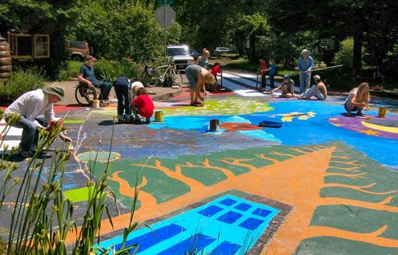
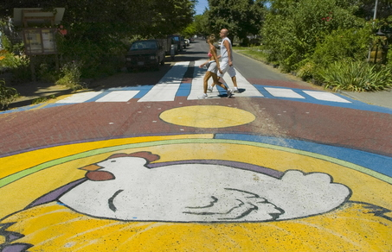
Case study analysis: Share-it Square
Notes:
Refer to share it Square case study.

Slide 16
Methodologies for leveraging power to impact positive change to place
Subverting government regulations to make change
Highlighting government structures to streamline approvals & decision making
Operational governance driving community ownership of public asset
Freeing government constraints
Site specific governance structures defining ongoing operations and behaviour
Santiago Cirujeda Guerilla Architecture Al Jazeera video documentary & article: https://www.youtube.com/watch?v=674N2SnaAfs
Teddy Cruz Ted Talk: https://www.ted.com/talks/teddy_cruz_how_architectural_innovations_migrate_across_borders?language=en
Sydney Opera House https://www.smh.com.au/video/video-entertainment/video-entertainment-news/thats-the-biggest-billboard-in-sydney-mate-the-chaser-20181008-58nld.html
Duisburg-Nord Joern Langhorst (2014) Re-presenting transgressive ecologies: post-industrial sites as contested terrains,Local Environment, 19:10, 1110-1133, DOI: 10.1080/13549839.2014.928813
Holzmarkt, Berlin The Guardian: The party city grows up: how Berlin's clubbers built their own urban village: https://www.theguardian.com/cities/2017/apr/30/berlin-clubbers-urban-village-holzmarkt-party-city

Slide 17
Government structures, processes and jurisdictions
Through the discussion of the 5 case studies looked at in the preparatory work think about the

Slide 18
Discussion
Why did Santiago Cirujeda Guerrilla Architecture subvert government regulations to make change and what were the outcomes?
Notes:
You can choose to give the groups 10 mins to discuss and come up with something for each one or you could run through these as a quick review in the lecture

Slide 19
Discussion
What were the reasons and benefits of the government streamlining approvals & decision making in the Teddy Cruz case study?
Notes:
You can choose to give the groups 10 mins to discuss and come up with something for each one or you could run through these as a quick review in the lecture

Slide 20
Discussion
What were the key lessons and benefits from operational governance driving community ownership of public asset the Sydney Opera House?

Slide 21
Discussion
What were the key lessons and benefits from freeing government constraints: Duisburg-Nord?

Slide 22
Discussion
What were the key lessons and benefits from the site specific governance structures defining ongoing operations and behaviour: Holzmarkt, Berlin?

