Slide 1
Disclaimer:
The following slides were intentionally left text based to allow you to personalise and contextualise with your own images.

Slide 2

Project implementation
Darchen, S. Johnson, L. Sipe, N. & W. Rowe
These slides are based on material prepared by Darchen, S. Johnson, L. Sipe, N. & W. Rowe (2019), The University of Queensland for the Place Agency program for placemaking pedagogy.
Notes:
Governance: the arrangements that manage and deliver places with the ideal being governance systems that allow for deep engagement and co-creation processes with the people who live and experience the place (the dweller). The power dynamics are explained in more detailed in the ‘systems in place agency’ module
Stakeholders: creating a clear map of who is involved in the project, their interests and values assigned to place and roles in delivering said place
Resources: Strategies employed to fund and find the resources for the project. Please note here that it is important to consider the hours of volunteers in the project as when they are community-led, placemaking projects often lack funding but enjoy the passion of active citizens enacting change in their places. Long -lasting and robust projects rarely come from a position of having small funding.
Timeline: there are two ways to understanding the timeline. In the most literal sense, it is the time it takes between the initial idea and the project competition as well as the things that happen through that time that may challenge or support the project realisation. In the second sense, we refer to the importance of the temporal-framing of the place and how, under the iterative making and remaking of places, it is important to maintain an ongoing timeline mapping out how the constellations of place experiences and meanings change through time.
Maintenance: The maintenance of the place is an important point to consider in the implementation framework. It includes elements such as, what will the programming or curation of place will be (place-keeping strategy), the resources needed to up-keep the initiative functioning well, and how the place will continue to remain relevant and responsive to the temporal-framing of place and its history.

Slide 3
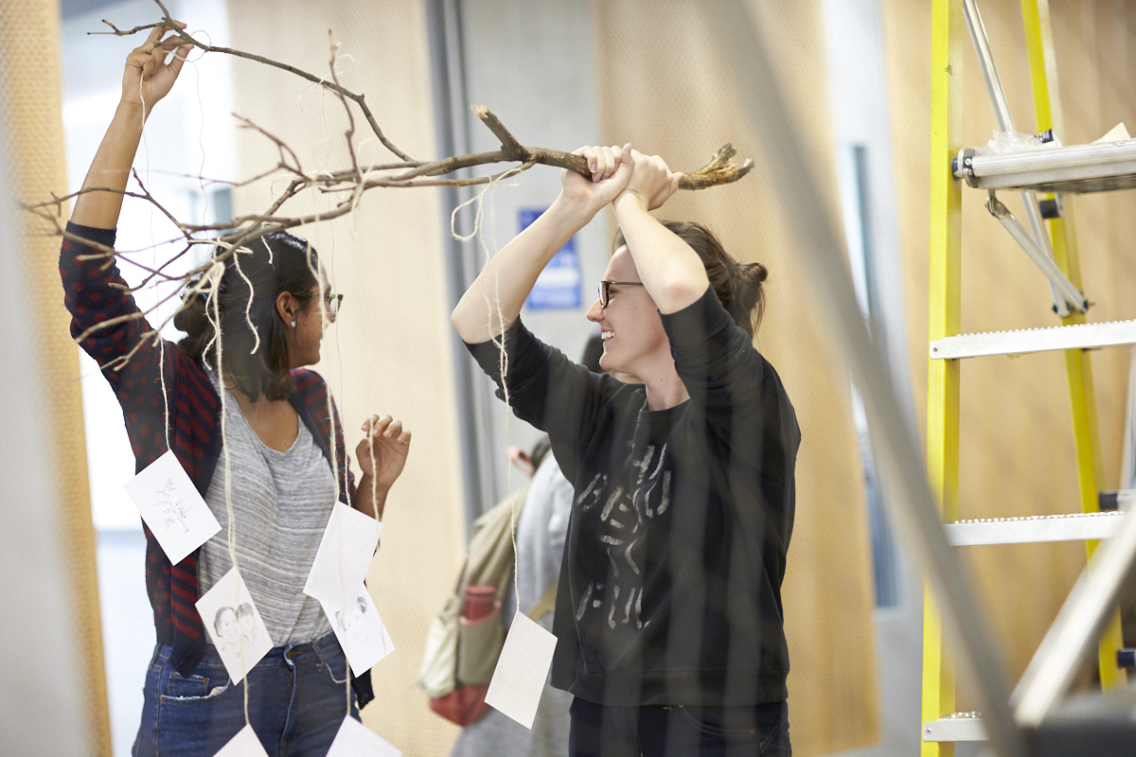
Context:
Why talking about project implementation in placemaking?
Making Projects Real
Placemaking looks different at each scale
scale, timeline, risks resources and power are seen as key elements of implementation
Addressing challenges for implementation.
PlaceAgency, 2018.
Notes:
Inviting people to take action and actively shape their environments means that we have to be ready to deliver projects that are realistic and working within the constraints faced by the system you are embedded in. Every project is different and it will face different challenges.
This module focuses on the Implementation of Place-Making. Students will be exposed to examples of place‐making interventions/projects happening at different scales.
The concepts of scale, timeline, resources and power are seen as key elements of implementation. Students will learn about those concepts through examples of place making projects implemented at different scales.
The expertise of “place-makers” (through videos) is used as a learning tool for students to understand the challenges associated to the implementation of a placemaking projects. Implementation can only be taught through the analysis of case studies, thus the very practical approach for this module.

Slide 4
Learning outcomes
Understand key concepts associated to the implementation of place making (timeframe, risks, etc.)
Explain key ideas or concepts (timeframe, scale, risks) about the implementation of place
Use information in a new way to demonstrate enhanced understanding of the implementation of place making – build a business case and engage stakeholders

Slide 5
Outline of this Lecture
Placemaking at different scales
A project implementation framework for placemaking
Case studies of the implementation framework in action

Slide 6
A project Implementation Framework
Governance, Stakeholders, Resources, Timeline and Maintenance
(Relevant for the Process / Product / Program)

Slide 7
A good implementation framework is the difference between a placemaking project (resulting in meaningful places for all), or a ‘fake’ project (where you have used as branding or have not placed social equity as a priority).
There is not a single way to get projects off the ground. But implementation strategies consider:
  Governance
  Stakeholders
  Resources
  Timeline
  Maintenance
Suggested space for an image
Credits for image
Notes:
In previous modules we have talked about what a place is and what success feels and looks like.
In particular, there are three definitions to remember at this stage:
Placemaking: process to increase the capacity and capability of the people to invest a place with meaning (Place Agency, 2017). To achieve places where
Place-wash: saying it is good when it isn’t
Used primarily for advertising
Place-masking: – saying you have done placemaking when you haven’t – (Fincher et al., 2016)
social equity is not identified as a priority for the project
Catering for future ‘ideal’ residents, not existing one
prioritize economic development while socio-spatial equity becomes secondary (or even irrelevant) in the process, resulting in gentrified neighborhoods
Gentrification: the process of renovating a district so that it conforms to middle-class taste, pushing out the non-conforming. It closes down opportunities for those in economically vulnerable positions.

Slide 8
Governance
Suggested space for an image
How are decisions made?
“Governance is considered here as site-specific and mutable, with the actions (and systems) of governance determined by the actors involved. Governance is process-led, active and usually sustained beyond (and outside) political terms of office” (Hopkins 2020).
Flexible governance systems that allow the dweller to be a co-creator work best. Depending on the regulatory system in place, a placemaking project can take different forms.
Credits for image
Notes:
Governance: the arrangements that manage and deliver places with the ideal being governance systems that allow for deep engagement and co-creation processes with the people who live and experience the place (the dweller). More challenging projects often have complex power dynamics
The power dynamics are explained in more detailed in the ‘systems in place agency’ module however, critical to this is understanding who the decision-makers are and how open or willing they are to include other people in the process.

Slide 9
Stakeholders
Stakeholder type | Examples of their interests in place
State Government | Provide design guidelines, identify places of interest for development / preservation, etc.
Local Government | Duty to care for public, enforce planning regulations etc. High number of responsibility with low budget. Looking to harness active citizenship.
Developers | Interest in attracting business, branding, attracting investment.
Designers | Create ideas, spatial mapping, implementation of projects to achieve place.
Business owners | Enhance the profile of the area and attract business (Active local economy)
Residents | Desire to experience high-quality places, that evoke memories, meaning and culture.
Visitors | Have an authentic experience of place
How is involved, how and what are their interests?
Most effective project:
Include the voices of the dweller
Respond to the values of the place.
Understand the different interests and values paced to the project
Knows hot to communicate with different stakeholders based on their interests.
Notes:
Stakeholders: creating a clear map of who is involved in the project, their interests and values assigned to place and roles in delivering said place. Most effective project include the voices of the dweller through co-designing processes where the results respond directly to the values of the place.

Slide 10
Timeline
Suggested space for an image
When does this place/meaning exist?
“Iterative, the process is often not linear and straightforward. It can be incremental, sequential, cyclical, parallel, or holistic”
(Mateo-Babiano & Lee 2020).
Two key ways of understanding the timeline:
The project from start to finish and encompassing the different iterations.
Temporal framing: ongoing timeline mapping out how the constellations of place experiences and meanings change through time (Zhang 2018)
Credits for image
Notes:
Timeline: there are two ways to understanding the timeline. In the most literal sense, it is the time it takes between the initial idea and the project competition as well as the things that happen through that time that may challenge or support the project realisation. In the second sense, we refer to the importance of the temporal-framing of the place and how, under the iterative making and remaking of places, it is important to maintain an ongoing timeline mapping out how the constellations of place experiences and meanings change through time.

Slide 11
Resources
Suggested space for an image
Including monetary and voluntary, what resources and opportunities are available?
“Great public spaces do not have to be design-heavy, multi-million dollar projects situated in city centers. In fact, sometimes the most exciting spaces are low-key, low-cost, and in the most unexpected locations” (PPS, 2016).
Long-lasting and robust projects generally have substantial funding. The Lighter, Quicker, Cheaper approach is most effectively used as temporary activations while the longer-projects take flight.
Credits for image
Notes:
Resources: Strategies employed to fund and find the resources for the project. Please note here that it is important to consider the hours of volunteers in the project as when they are community-led, placemaking projects often lack funding but enjoy the passion of active citizens enacting change in their places. Long -lasting and robust projects rarely come from a position of having small funding.

Slide 12
Maintenance
Suggested space for an image
How are places kept relevant?
“Place-keeping relates to what happens after high-quality places have been created. It means maintaining and enhancing the qualities and benefits of places through long-term management.” (Dempsey & Burton 2012).
Thinking about the systems in place and resources needed to keep a place relevant and responsive to its changing nature.
Credits for image
Notes:
Maintenance: The maintenance of the place is an important point to consider in the implementation framework. It includes elements such as, what will the programming or curation of place will be (place-keeping strategy), the resources needed to up-keep the initiative functioning well, and how the place will continue to remain relevant and responsive to the temporal-framing of place and its history.

Slide 13
Placemaking at different scales
Small scale: These are project acting at a street level. They are generally small projects that require a smaller number of people and are more flexible.
Medium scale: It can include whole street activations, markets or shopping centres.
Large scale place making: projects acting at a whole of community scale and large-scale infrastructure including planned communities. Complex projects, long timeframes, and multiple stakeholders involved.
Public Projects
Large-scale Placemaking
Small-scale Placemaking
Private Projects
POWER DYNAMICS
SIZE
Notes:
Small scale: These are project acting at a street level. artist-led placemaking, laneways, etc. They are generally small projects that require a smaller number of people and are more flexible. Examples of this include the Chris Trotter art installation in Brisbane.
Medium scale: It can include whole street activations (i.e. pop-up park, parklet day), markets or shopping centres. Examples of this include Time Square (NY), Point Cook pop-up park and the SCIP Program
Large scale place making: projects acting at a whole of community scale and large-scale infrastructure including planned communities. These include greenfield and brownfield developments. In general terms, they are projects of a high level of complexity, long timeframes, major investments and multiple stakeholders. Examples of this include the Gold coast light rail (QLD), Brisbane metro, and Brolga Lakes.

Slide 14
Case studies:
The implementation framework in action

Slide 15
Disclaimer:
The following case studies are explained in the book chapter
Darchen, S. et al. (2020), Project implementation, In D. Hes and C. Hernandez‐Santin (Eds) Placemaking fundamentals for the built environment. Palgrave Macmillan we have placed them here to use as basis but encourage you to find case studies specific to your area.

Slide 16
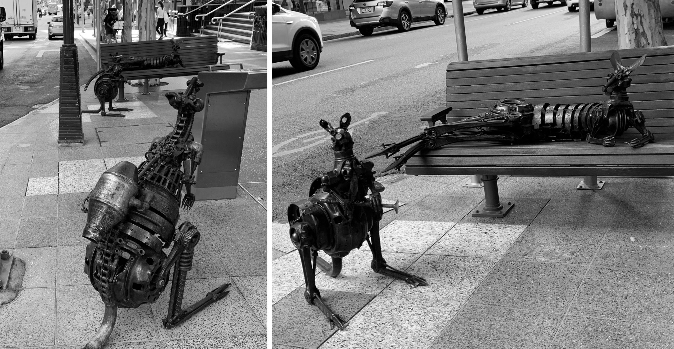
Small Placemaking Project
Public art by Chris Trotter, George Street, Brisbane, Queensland
“regarded for their playfulness and appeal … motivation as bringing wildlife to the city in a shared space to signify the importance of sharing the environment, even in fast-paced urban locations” (Darchen et al. 2020)
  Resources: fully funded by City of Brisbane through competitive tender
  Timeline: 9 months from concept to installation. Streets were closed
  Maintenance: clear responsibilities lie with City of Brisbane.
City Roos, Brisbane. Project by Chris Trotter. Photos by Neil Sipe

Slide 17
Medium-scale Placemaking Project
Centre Improvement Program (CIP), Gold Coast, Queensland.
Revitalisation project of multiple main streets in Gold Coast. Significant economic benefit beyond the main street (13times higher than investment). Specific strategies varied at each street.
  Governance and stakeholders: Actions primarily to improve benefit for local business owners. Local government consults local owners to gather design ideas. Program led by seven professionals.
  Resources: 50-50% by local government and business owners.
  Timeline: Program running for 10 years. Individual street projects take about 6-8 months.
  Maintenance: Shared maintenance.
Suggested space for an image
Credits for image

Slide 18
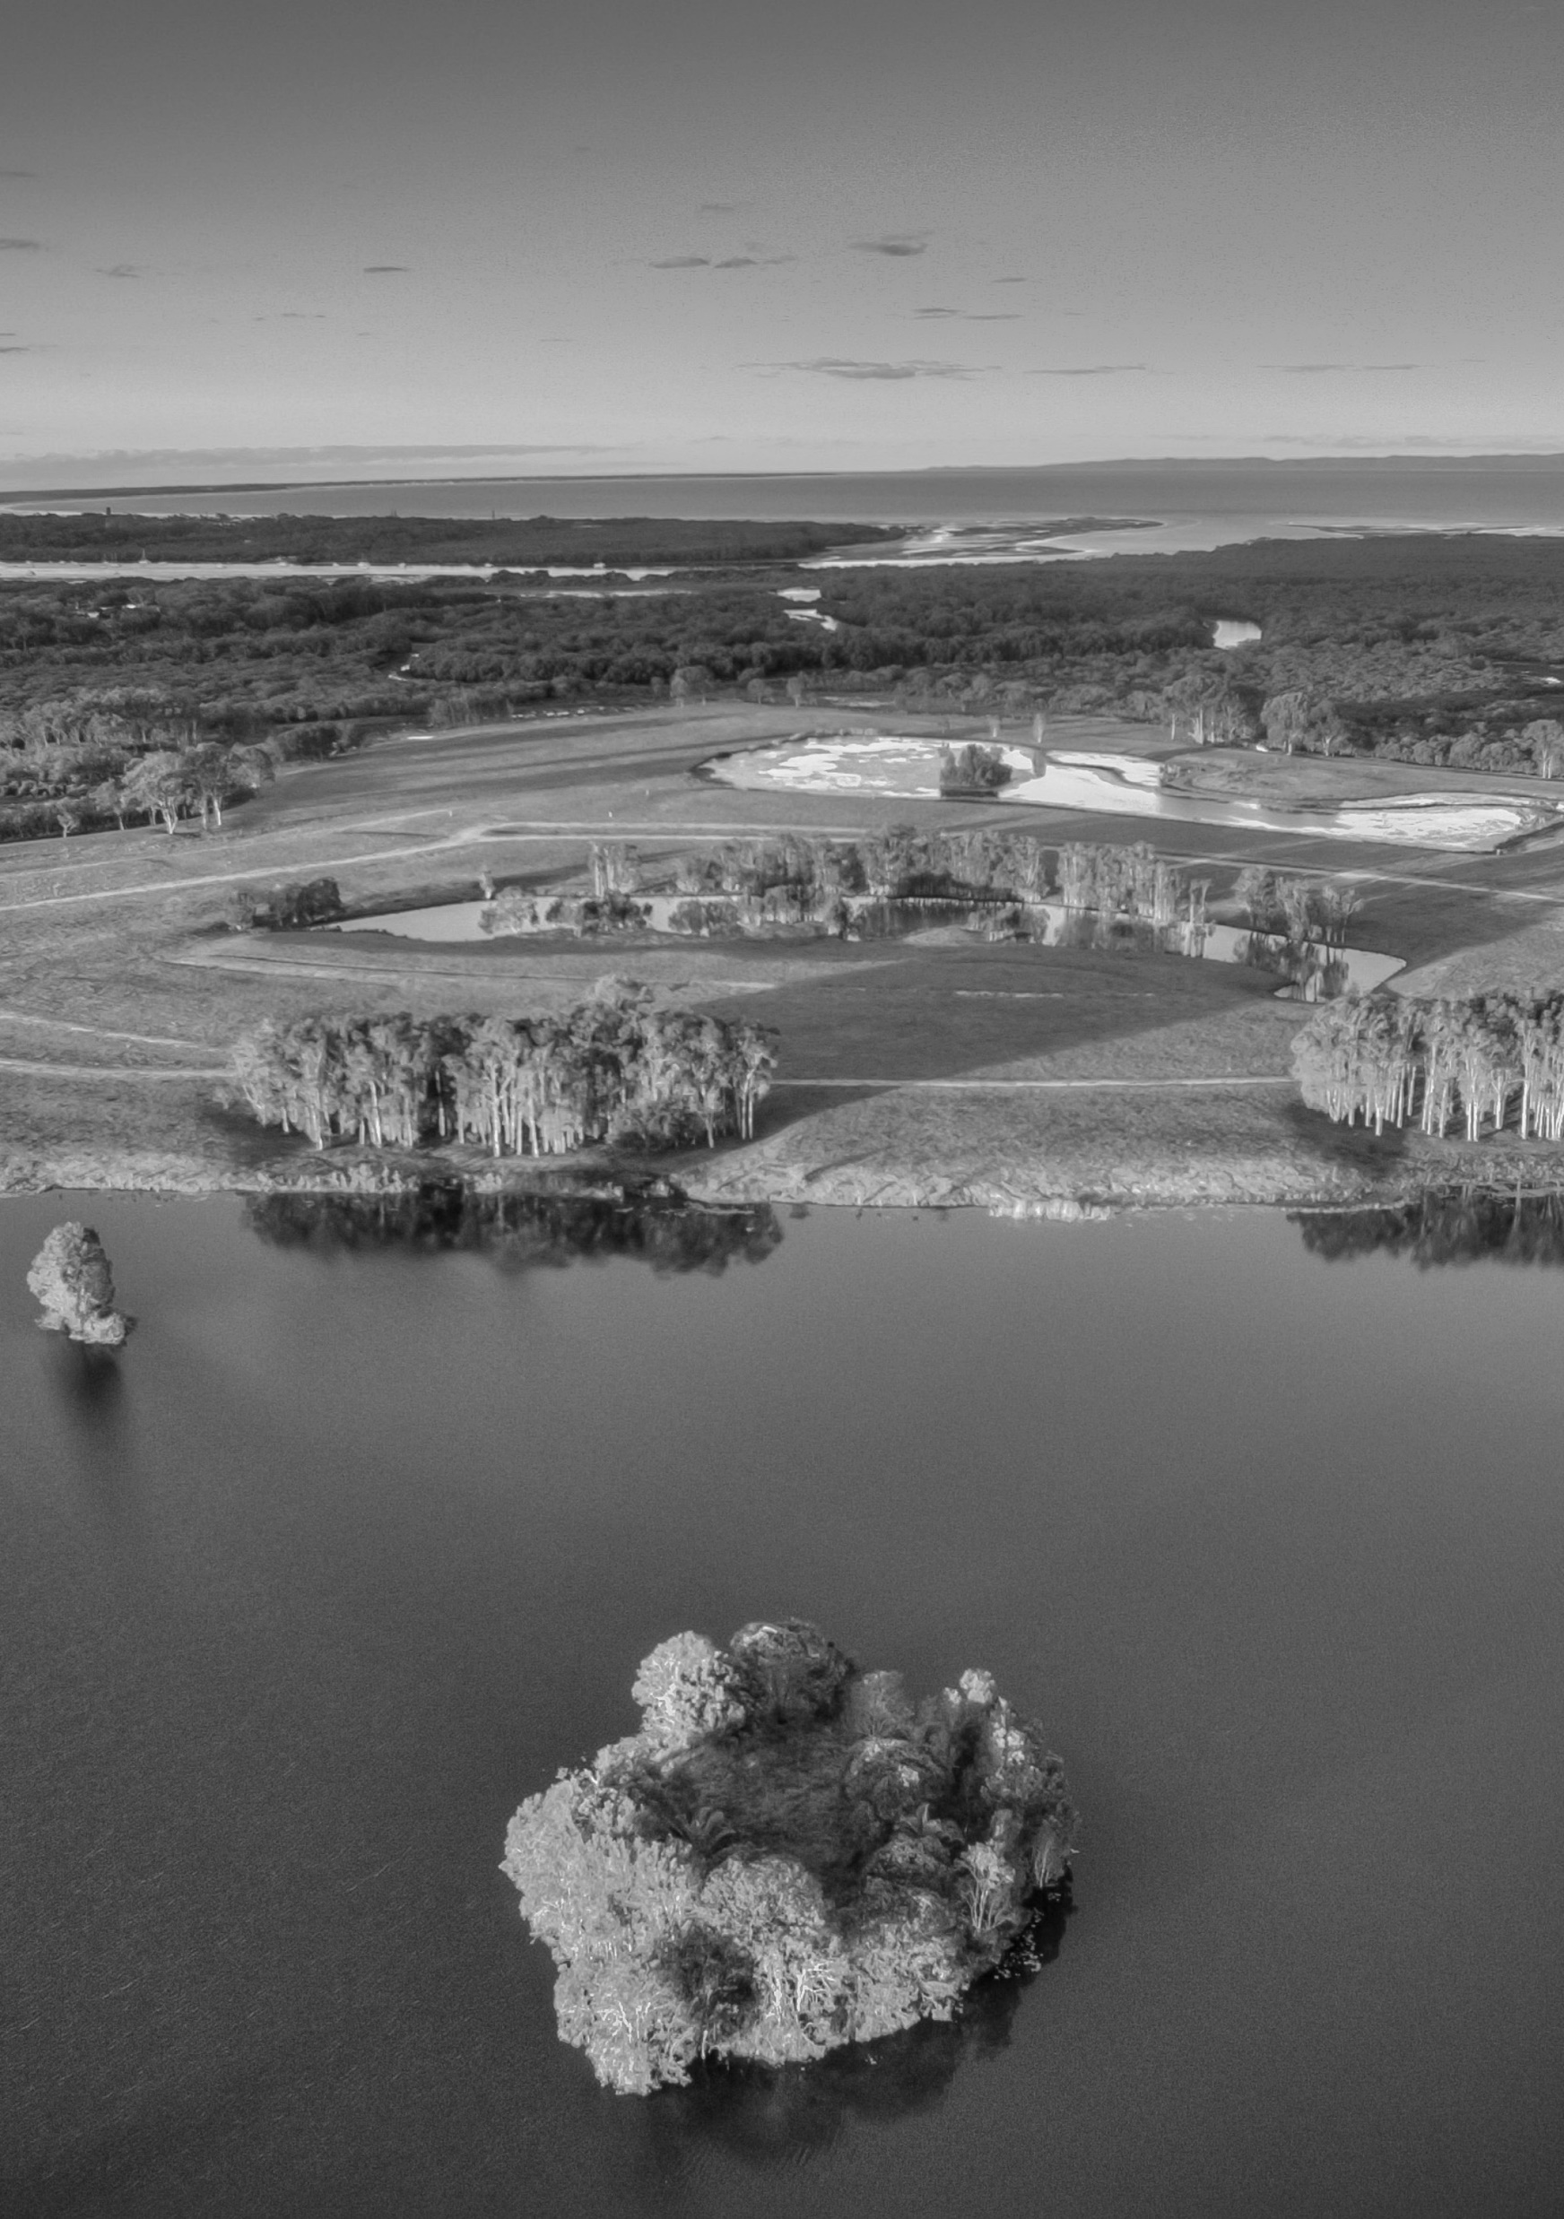
Large Placemaking Project
Brolga Lakes sustainable community, John Mongard Landscape Architects and Eco Urban.
Sustainable Development for 1,000 residents in future low-density residential neighbourhood.
71ha rehabilitated for wildlife
  Governance: Thinktank studio as a forum for future ideas. Developed through community title ownership to allow community governance over communal areas.
  Stakeholders: A research hub in collaboration with University of Queensland mapping out values of people buying property in the area.
  Resources: Private.
  Timeline: 7 years and counting. 2 years of placemaking focused urban design.
  Maintenance: Responsibilities will lie with community buying into the site and Birdlife Australia.
Brolga Lakes Wetland Photo by Eco Urban 2018

