Slide 1
People in Place: Placemaking Fundamentals
These slides are based on material prepared by Mateo-Babiano, Lee, & Hernandez-Santin (2019), The University of Melbourne for the Place Agency program.

Slide 2
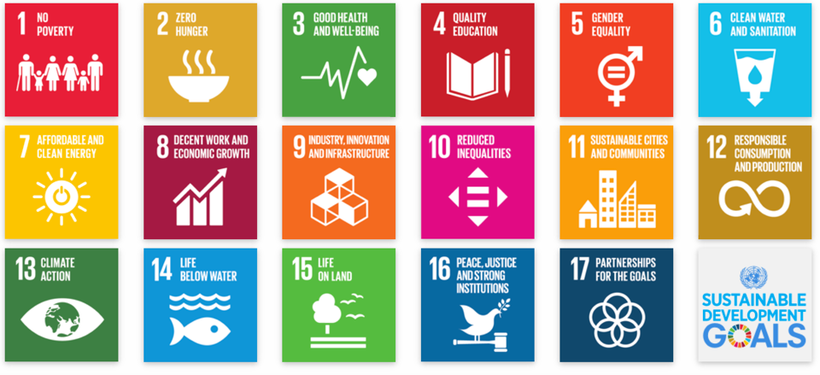
Context: Where does placemaking fits in the sustainability goals?
11 Sustainable Cities and Communities
Enhance inclusive and sustainable urbanization
Enhance participatory planning and management
Invest in green and accessible public spaces, for all but specially for people in vulnerable situations.
Notes:
The Sustainable Development Goals are the blueprint to achieve a better and more sustainable future for all. They address the global challenges we face, including those related to poverty, inequality, climate, environmental degradation, prosperity, and peace and justice.
Goal 11 of the Sustainable Development Goals confirmed by the United Nations 2030 Agenda for Sustainable Development supports the concept of Sustainable Cities and Communities to ‘address the global challenges we face, including those related to poverty, inequality, climate, environmental degradation, prosperity, and peace and justice. Making safe, accessible and enjoyable places for people is critical to sustainable city living and working’ (UN, 2017, paragraph 1).
To support the strengthening and endurance of place-based strategies in an increasingly urbanised world, where space is ever more at a premium, Goal 11’s principles promote inclusivity, sustainability, participation and investment in urban planning and management. It specifically supports accessibility for the vulnerable and minorities, for people of all ages through sustainable programmes for more liveable urban environments, based on balancing ecological, cultural and economic programmes that will deliver real on-the-ground benefits to communities.
The New Urban Agenda (NUA), adopted after the United Nations sponsored Habitat 3 meeting in Quito in 2006, seeks to provide a road map towards the provision of basic services for everyone (UN Habitat, 2018). The NUA prompts us to ask, how can place-based thinking, alongside ecosystems knowledge, support open space and public place agendas for the city? In part, the answer is to improve urban planning and design, finance and support, yet it also proposes greater regulation and rules-based approaches. It is up to planners and designers to embrace the principles and values of place thinking to devise programmes cognisant of community and the dynamics of physical, environmental, social, political and economic change. The types of actions necessary to support place-based thinking and beneficial outcomes must embrace new opportunities to reduce inequality and discrimination and be respectful of peoples’ rights to open space, programmes for cleaner and more resilient cities in the face of more intensive climatic and population forces, energy efficient with reduction in pollutants and waste and supportive of greening initiatives alongside effective water supply and conservation programmes.

Slide 3
Learning outcomes
Develop the theoretical foundations of place and placemaking;
Compare placemaking strategies, typologies, scales, relationships, potentials and limitations;
Appreciate the role of interdisciplinarity in placemaking;
Comprehend the different roles of various stakeholders in placemaking towards achieving positive ‘place’ outcomes; and
Explore different case studies in placemaking.
Notes:
With this module, you there are five key learning outcomes
Develop the theoretical foundations of place and placemaking;
Compare placemaking strategies, typologies, scales, relationships, potentials and limitations;
Appreciate the role of interdisciplinarity in placemaking;
Comprehend the different roles of various stakeholders in placemaking towards achieving positive ‘place’ outcomes; and
Explore different case studies in placemaking.

Slide 4
Outline
What is place? Why Placemaking? (10 min)
Types of placemaking (10 min)
The 5 P framework (15 min)
Elements for success, a summary (5 min)
Key definitions: Differences between place, place wash, place masking, place keeping (10 min)
Point cook and design challenge: Project brief. (10-15 min?)

Slide 5
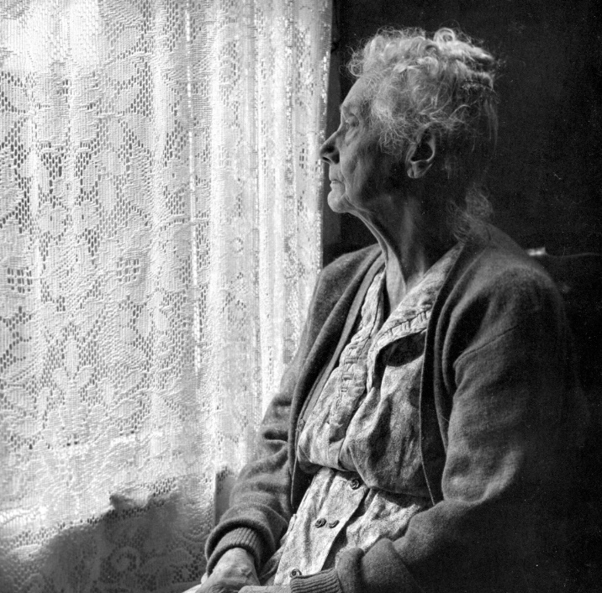
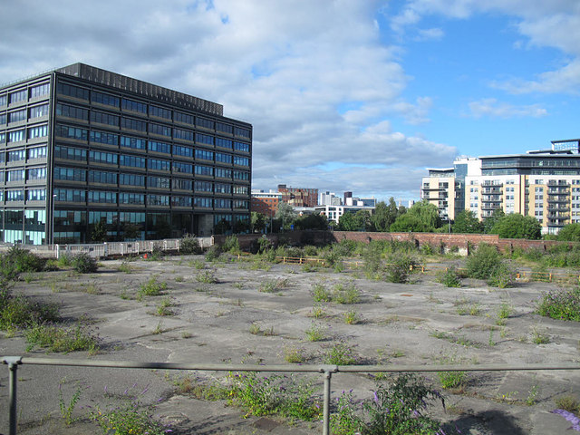
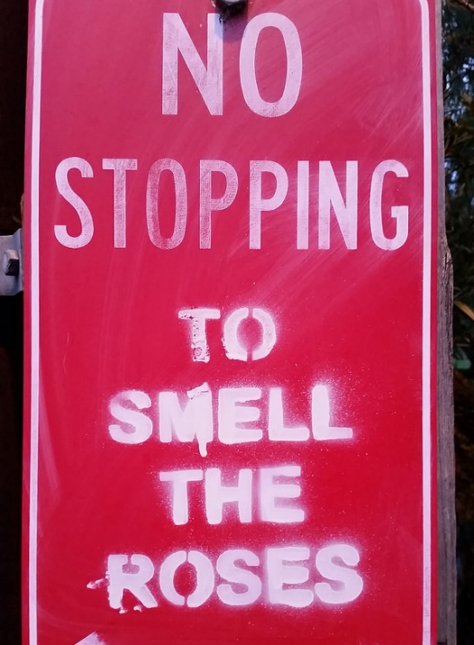
What we have…
Loneliness Unused Spaces Regulations
Notes:
Loneliness can affect people at any point, but is more common among two key groups: older individuals aged 75 and above and, perhaps surprisingly, young people aged 15–25.
risk of loneliness among young people who were renting and who did not feel a sense of belonging to the local area
one in eight young people aged 16–25 reported a very high intensity of loneliness.
Loneliness is commonly understood as an emotional response to the perceived mismatch between the amount of personal contact a person wants and the amount they have. In the UK, the Campaign to End Loneliness intensifies the focus to identify two types of loneliness: individual and social.
Individual loneliness occurs when a person is missing someone special such as a partner or close friend with whom they had a close, emotional bond.
Social loneliness refers to the absence of a social network made up of a wide group of friends, neighbours and colleagues.

Slide 6
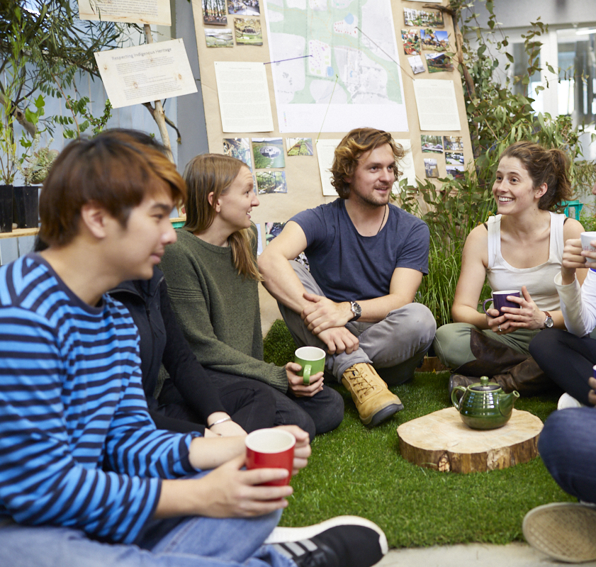
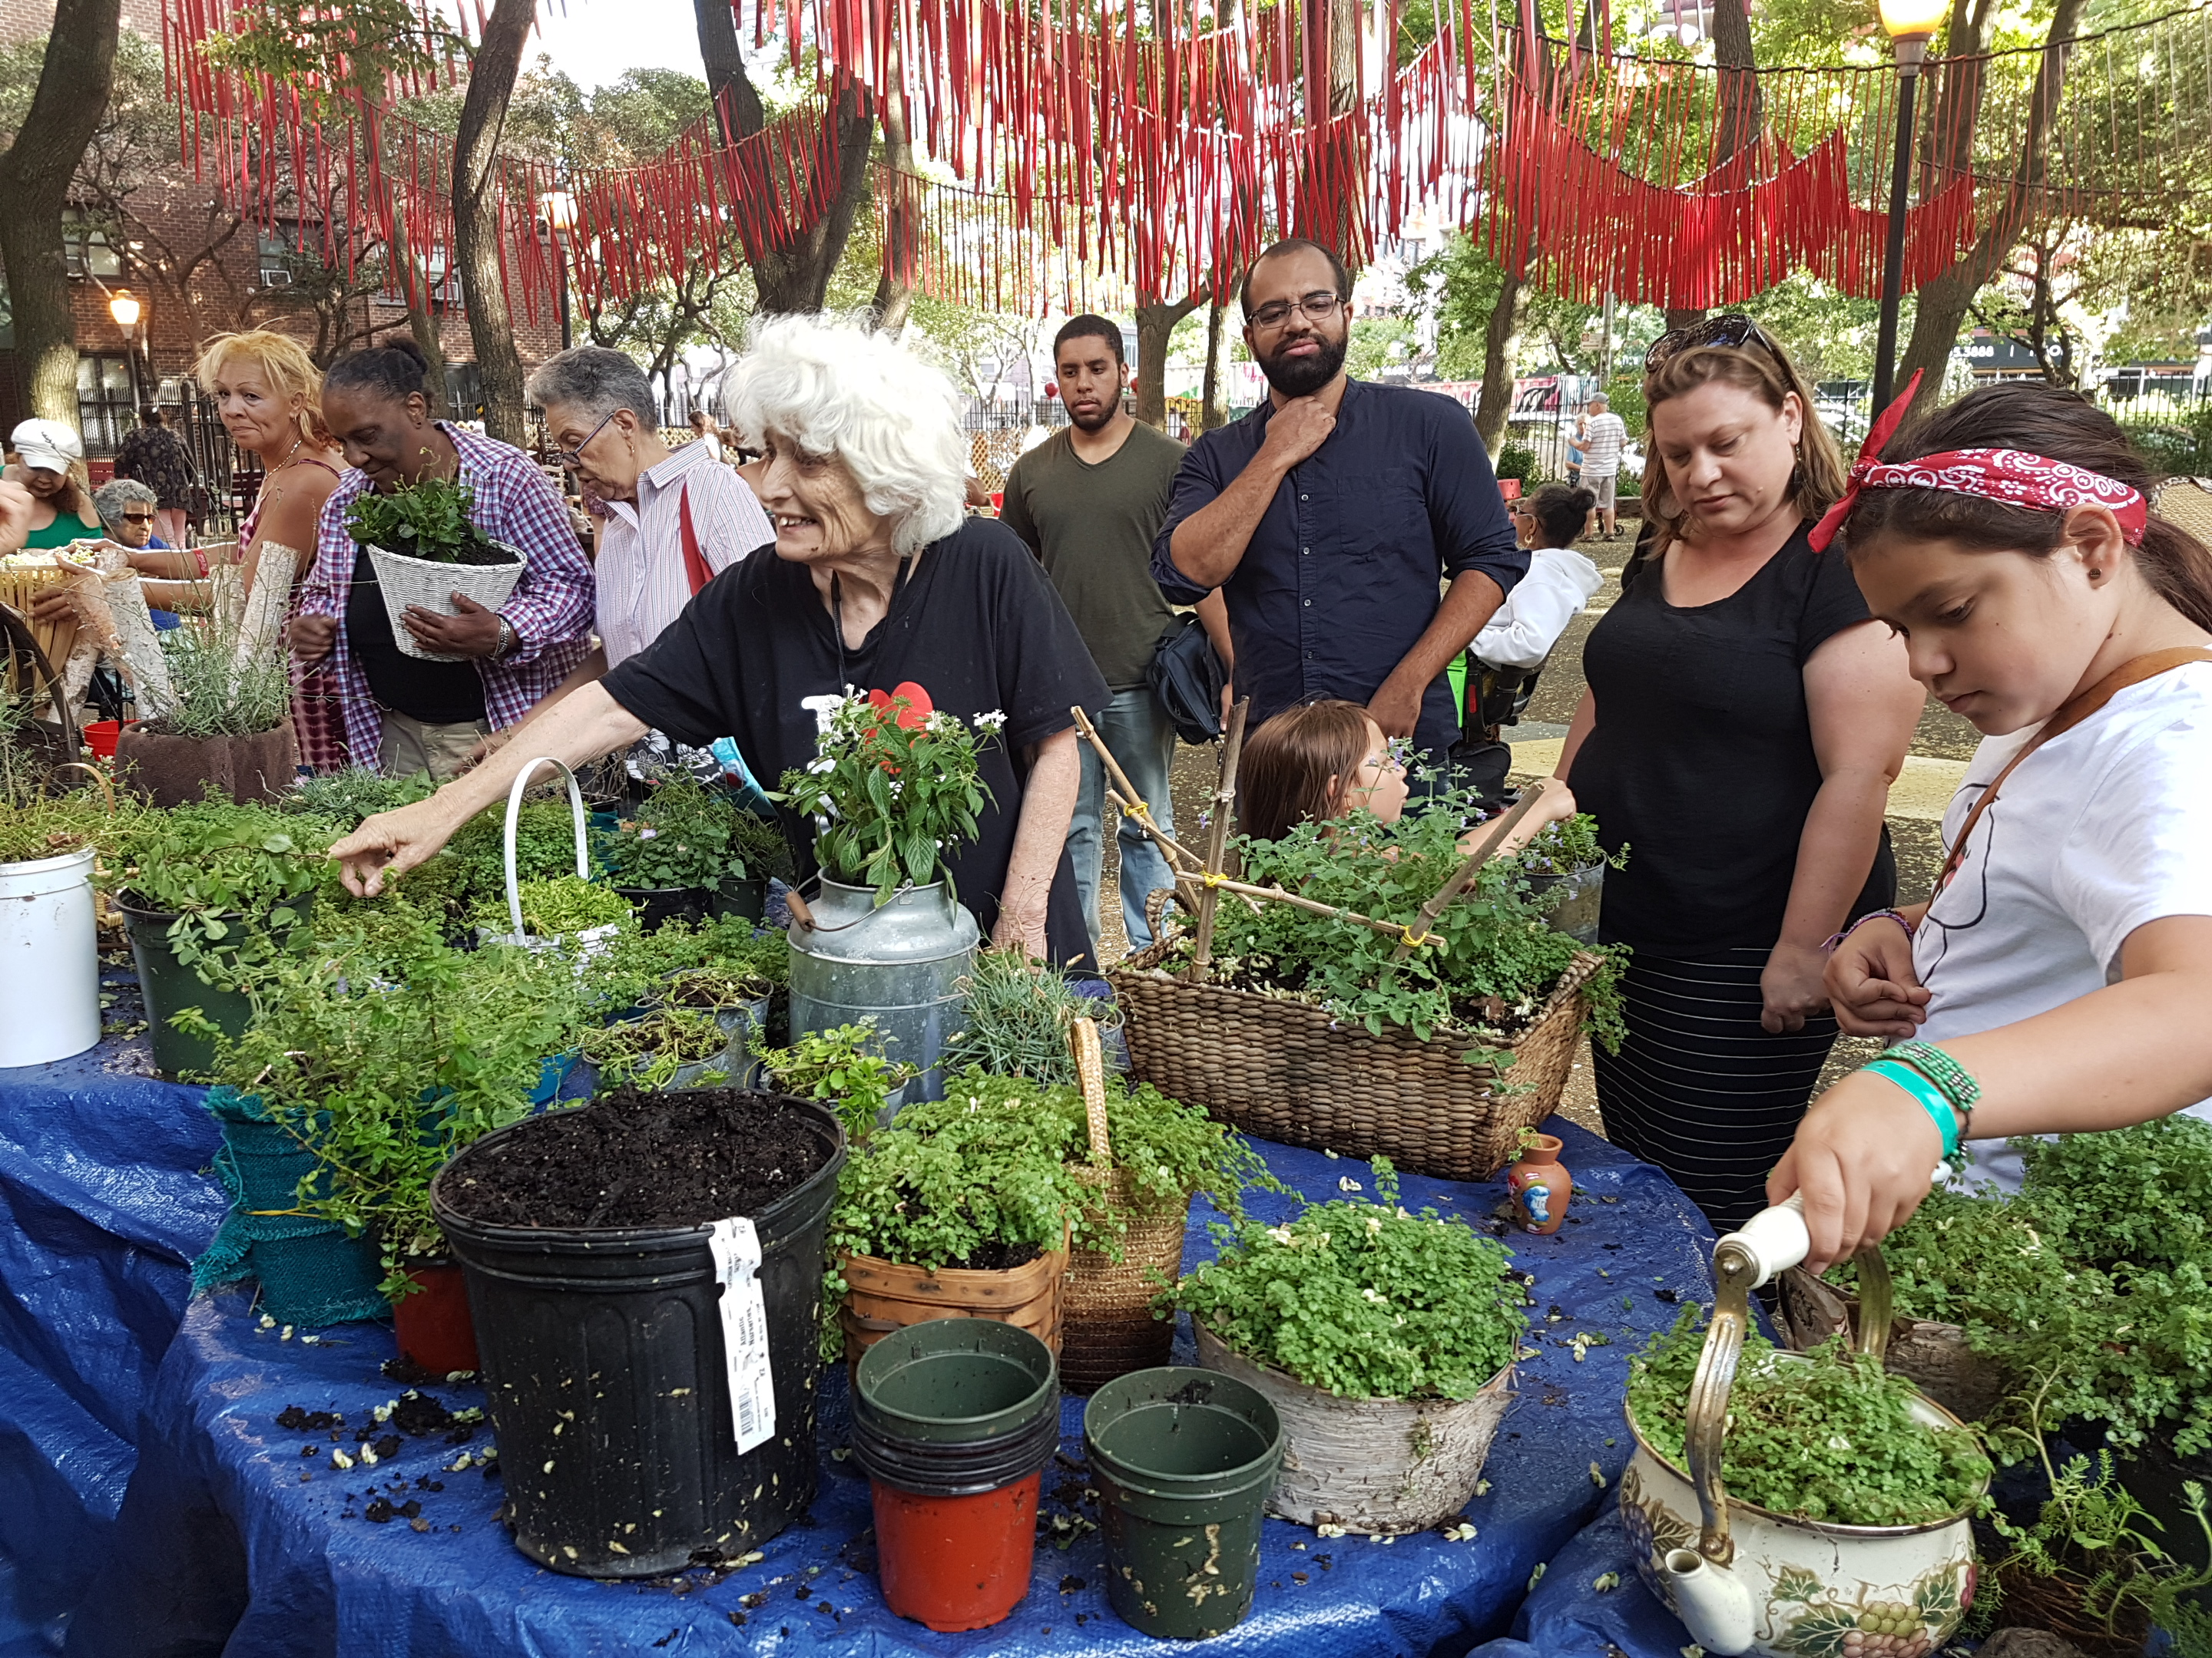
What we want…
PlaceAgency, 2018.
The Living Stage, NY, 2017.
PlaceAgency, 2018.

Slide 7
On Place and Placelessness
If place is somewhere, then placelessness is anywhere
Place
Placelessness
‘Space defines landscape where space combined with memory defines place’ (Lippard, 1997).
Differentiated by values, qualities, stories (Relph, 2008)
Seeks social equity
Place fuses culture and environment, activity and sharing (Relph, 2008)
Place corresponds with community and locality across scale;
sites of inclusion as much as they are sites of resistance (Friedmann, 2007).
Could be anywhere
Inequality (Relph, 2008)

Slide 8
What is place?
PLACE
House vs home
Space
People
Notes:
When thinking about place, the best metaphor to describe it is through the difference between a house (the walls) and a home (where you want to stay, rest, have people over, it is your space, you feel comfortable and you feel ownership).
In literature, the concept of place is often understood as the intersection between the individual(s) and the space. Where this intersection is created by an emotional connection (place attachment).

Slide 9
PLACE
Improving the quality of life by creating high quality places where people want to live, work and spend their time (Wyckoff 2014)
It does so by engaging in a process to enable citizens to take an active participation in the conception, creation and experience of ‘place’ (Schlebusch 2015)
Space
People
Ecology
Notes:
However, when looking for definitions of placemaking and its purpose, there are two key things that come out:
-It seeks to improve quality of life
-It takes welcoming people in the process…
When thinking about what it takes to improve

Slide 10
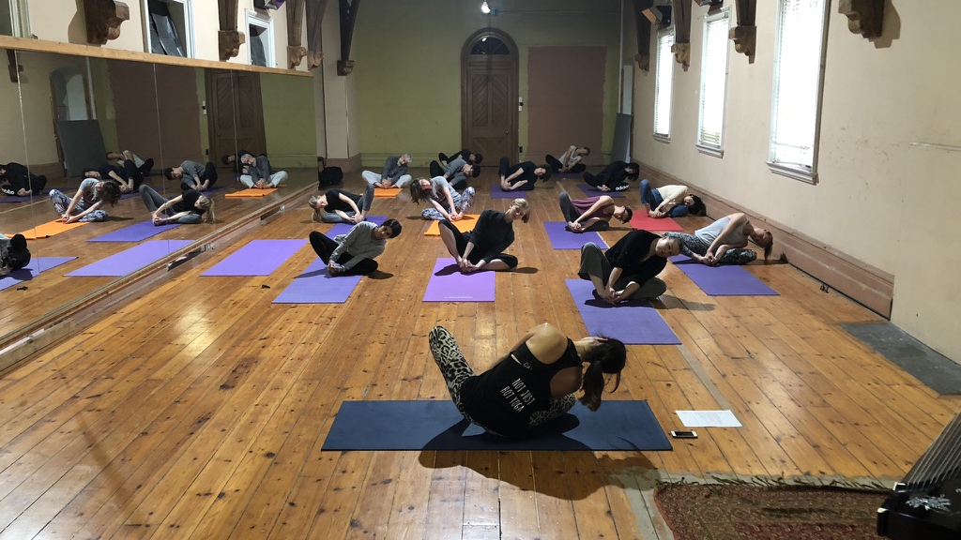
Place
“constellation of meanings and appropriate behaviors that define an experience in a social setting”
(Trudeau 2016).
It is perceived, conceived and lived (Lefebvre 1996)

Slide 11
How do we support places?
Placemaking is a way of shaping the places that we love to ensure that we give them meaning
Why?
To Connect People to Place through shared meaning and a sense of purpose
The Living Stage, NY, 2017.

Slide 12
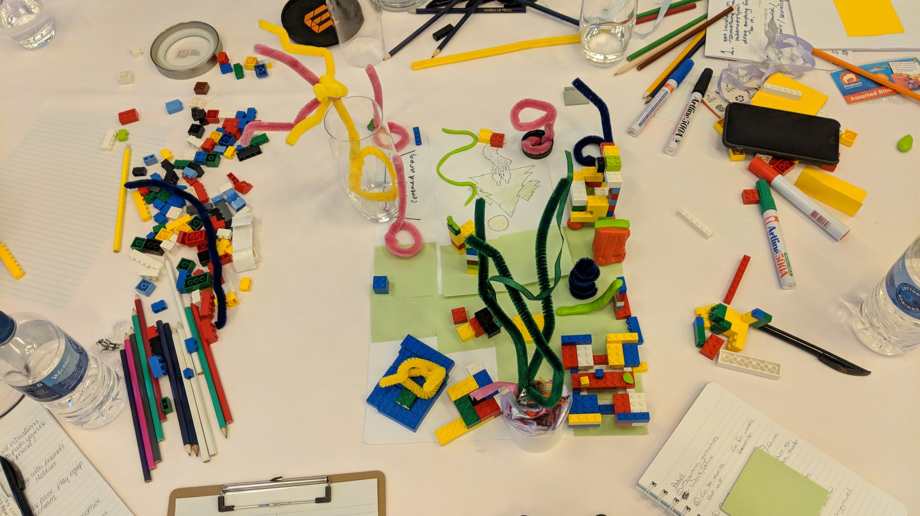
Placemaking
process to increase the capacity and capability of the people to invest a place with meaning
(Place Agency, 2017).

Slide 13
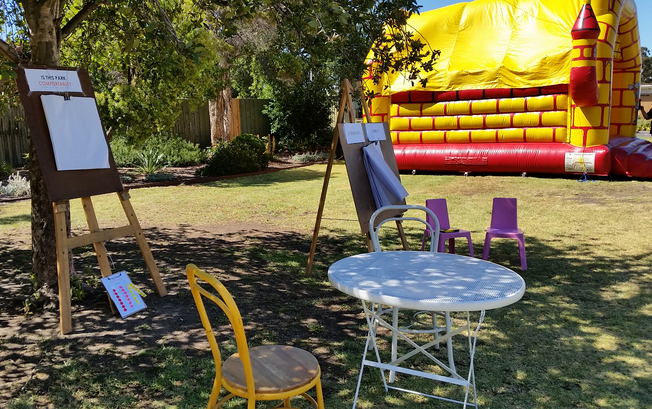
It is a process… “We can enjoy a place, but only by taking part in its processes can we meaningfully connect to it” (Day 2012)
Participatory
B) form of engagement in itself:
Notes:
A) Finding ways to incorporate the voice of the community into different projects. Encouraging active citizenship.
B) When the activity is fun, engaging it can simultaneously help people connect with each other, (Chapter 14 of People for the Built environments on the art of engagement provides various examples of art installations used to share narratives of the place from the perspectives of different artists or members of the community

Slide 14
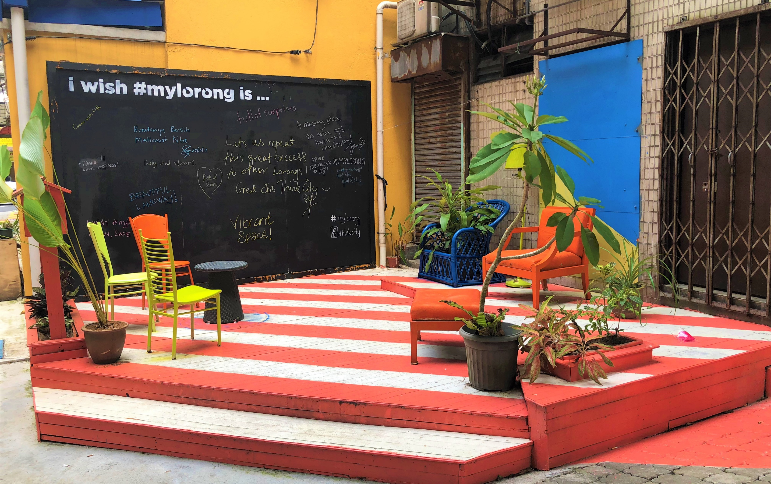
Is a product…
C) Tangible outcomes permanently or temporarily modifying the physical attributes of a space
D) Narratives of place that don’t modify the physical attributes of place but shift perceptions

Slide 15
Benefits of placemaking

Slide 16
Feelings: civic pride, inclusiveness, social Integration, vitality and sociability, sense of belonging, reduced depression
Life quality conditions: reduced accidents, crime and vandalism, improved health, improved wellbeing, aesthetics, recreation benefits, urban resilience
Other: improved educational outcomes
Ecosystem services: resilience, adaptability, improved waterways, reduced heat stress, reduced waste and pollution, cleaner air, increased biodiversity, ecological stewardship (willingness to support sustainable practices)
Increased visitation (footfall and length of visit),
Local businesses: increased revenue, job creation or skill development, reduced public expenditure, increased property value
(Kuo & Sullivan, 2001; Frumkin, 2003; Semenza, March & Bontempo, 2007; Hystad & Carpiano, 2012; Robinson, et al., 2017 and Carmona, 2019)
Notes:
Sense of community, belonging, connection to nature, stewardship, participation and agency.
Increased citizenship reduces costs of maintenance and fixing things
Also means if managed well they can start providing services that the council may not have budget for.

Slide 17
Challenges of placemaking

Slide 18
Placemaking “is political and challenging, it can be used as a quick fix and it can be fake if there is no empowerment. Placemaking should be strategic and multi-disciplinary. It should involve skills such as brokering and negotiating. It should be dynamic and synergistic when subversive actions change the processes”.
(Carolyn Whitzman, personal communication, Feb 17, 2019)

Slide 19
Main criticisms
Place masking – saying you have done placemaking when you haven’t – (Fincher et al., 2016)
social equity is not identified as a priority for the project
Catering for future ‘ideal’ residents, not existing one
prioritize economic development while socio-spatial equity becomes secondary (or even irrelevant) in the process, resulting in gentrified neighborhoods
Gentrification: the process of renovating a district so that it conforms to middle-class taste, pushing out the non-conforming. It closes down opportunities for those in economically vulnerable positions.
Place wash – saying it is good when it isn’t
Used primarily for advertising
Notes:
Should define the key terms here

Slide 20
5P model: A Place Agency framework
People, Process, Product Program, Place Evaluation

Slide 21
Places in the Making: Strategies
Placemaking as an empowering strategy
Placemaking as a governance strategy
Placemaking as an acupuncturing strategy
Placemaking as a reclaiming strategy
Placemaking as an experiential strategy
Placemaking as a place-storytelling strategy
Placemaking as a capacity-building strategy
Notes:
The 5P Framework encourages people to begin by asking what the key purpose of the initiative is. The slides has a couple purposes as seen in many different case studies.
Starting from the purpose, each P has different building blocks that can be used to encourage

Slide 22
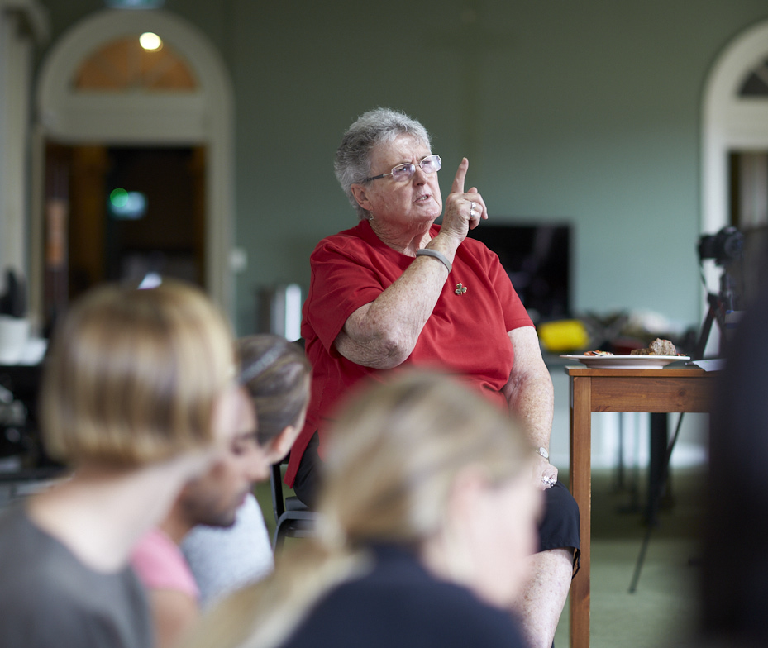
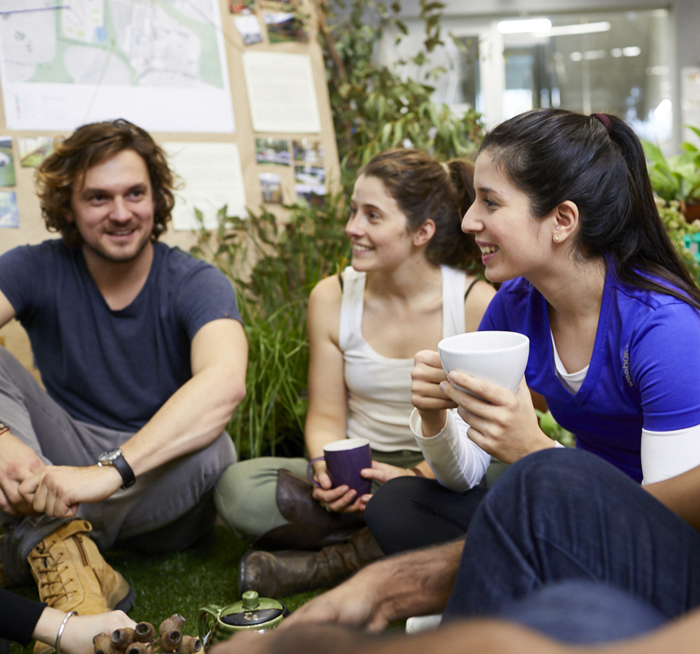
People
Meaning for Who?
Based on Leadership, Engagement and the correct identification of the needs and opportunities in the community.
Explore place-based change,
Give agency through dynamic, democratic, and collaborative process;
Strengthen relationships with self and others; and
Strengthen sense of belonging, connection to place (built and natural)
PlaceAgency, 2018.
Notes:
An exercise to understand the different way in which people relate to the place by understanding their needs, aspirations, experiences, culture and relationships. People are considered active agents of place.
One lesson that we would like to impart is that the physical aspects of the built environment--although critical to a place's success--should be viewed alongside, and perhaps even secondarily, to the creation of a welcoming social or cultural space. But of course, welcoming to you might mean and understood in a different way from someone with a different cultural background.
Who are the people? What role do they play? How can we work with them to support relationship building?
Trigger change: create a setting in which wider community involvement is encouraged to explore place-based change,
Give Agency: facilitate a platform to empower community members to voice and discuss their perspectives of place in a dynamic, democratic, and collaborative process;
support pathways to create and strengthen relationships with self and others; and
help strengthen their connection with the places they (the community) share (see for example PPS, 2008), including both relationships with the built and the natural environment.

Slide 23
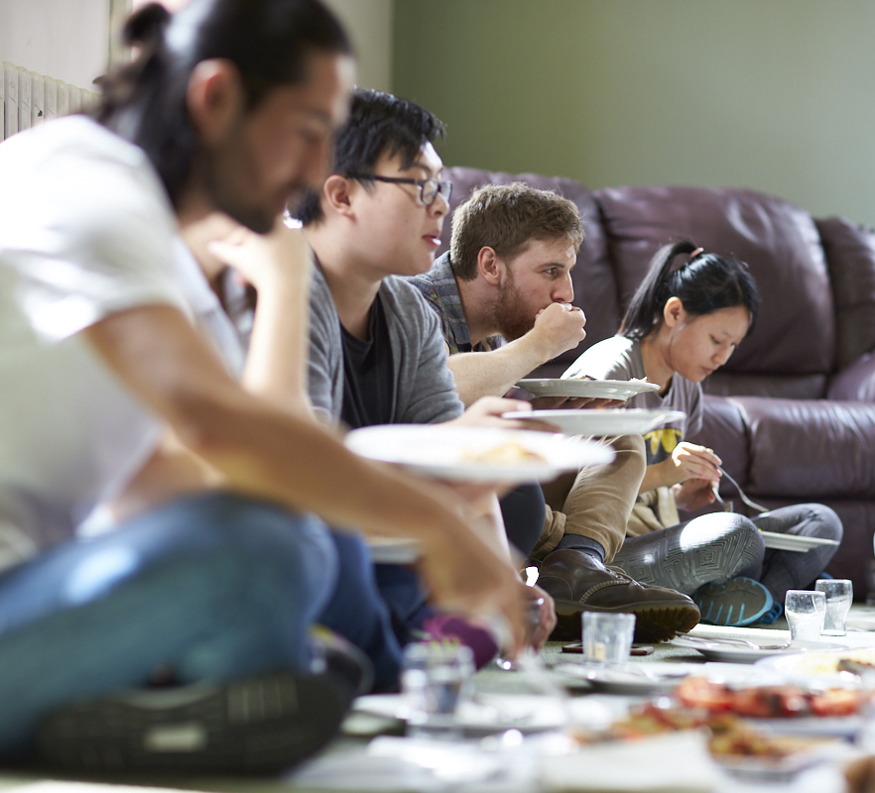
Community
“a group of people with diverse characteristics who are linked by social ties, share common perspectives, and engage in joint action in geographical locations or settings”
(MacQueen et al. 2001).
PlaceAgency, 2018.

Slide 24
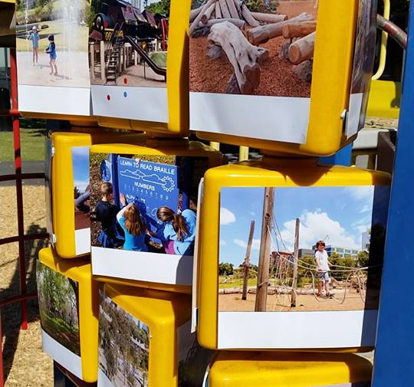
Process
Search for connection through participation
Best through ‘design-with’ approach
Bottom up: mobilizing community
Assets based: uses local knowledge
Purpose driven: clear vision
It is dynamic, democratic, iterative, futures-focused
PlaceAgency, 2018.
Notes:
A ‘design-with’ exercise where the key role of the placemaker is to create a good environment for communication and empowerment. The process should allow the community to lead, will use local knowledge, respond to local perspectives and have a clear focus. It is collaborative, dynamic, responsive to changing conditions and develops strategies for place-keeping.
What are the processes that we can underpin different ways we relate and engage with community?
Bottom-up, it employs ways of mobilising people from the grassroots to lead change. It is a process which encourages involvement, engagement and codesign with and by the community. In Chapter 3, Community Engagement, Nursey-Bray describes different modes to engage with and by community.
Assets-based, it capitalises upon and taps into local community assets, wisdom, inspiration and potential to shape the physical and relational characteristics of neighbourhoods, towns, cities, or regions (Kretzmann & McKnight, 1996), drawing from local residents, associations and community groups, including its material resources, and respecting the unique qualities of each location and cultural mores (Potter, 2012). A methodology to incorporate Indigenous perspectives of place is found in Chapter 4, where Foster and Kinniburgh offer new ways of spatially encountering first peoples knowledge of site within a colonial context.
Purpose-driven, placemaking is undertaken for a specific purpose. The next section in this chapter, “Places in the Making: strategies and case studies”, details the different purposes communities have in transforming places or undertaking specific placemaking.
As a unique or a series of cooperative activities delivered within a given timeframe and finite resource, placemaking is a dynamic, democratic and iterative future-focused process.
Dynamic, activities do not finish when the place is built but continue to prepare the ‘people’ to proactively respond to place-based change.
Democratic, providing agency to people to shape the places they love. The shaping of places can take on different approaches to suit different situations and conditions. For instance, activities may be small-scale, short-term experiments or large-scale strategic processes involving formal to informal practices and interactions.
Iterative, the process is often not linear and straightforward. It can be incremental, sequential, cyclical, parallel, or holistic. For instance, the process can start by identifying the key issues of place drawn through multiple ways of listening to different voices beyond those traditional methodologies of observation - street life studies”, household surveys in communities, or towards posing a great question about place, and to gaining local ideas to aid the design thinking processes.
Futures-focussed, approaches that best respond to present and future challenges. While futures-focussed, the tactics can both be reactive to quickly respond to a place-based issue as exemplified from PPS (2007)’ ‘Lighter, Quicker, Cheaper (LQC)’, or proactive towards the shaping of places for multiple futures, including anticipating the arrival of a population yet to emerge. Places must be co-designed and envisioned as flexible, adaptable and sustainable environments, with long-term positive impact to the community.

Slide 25
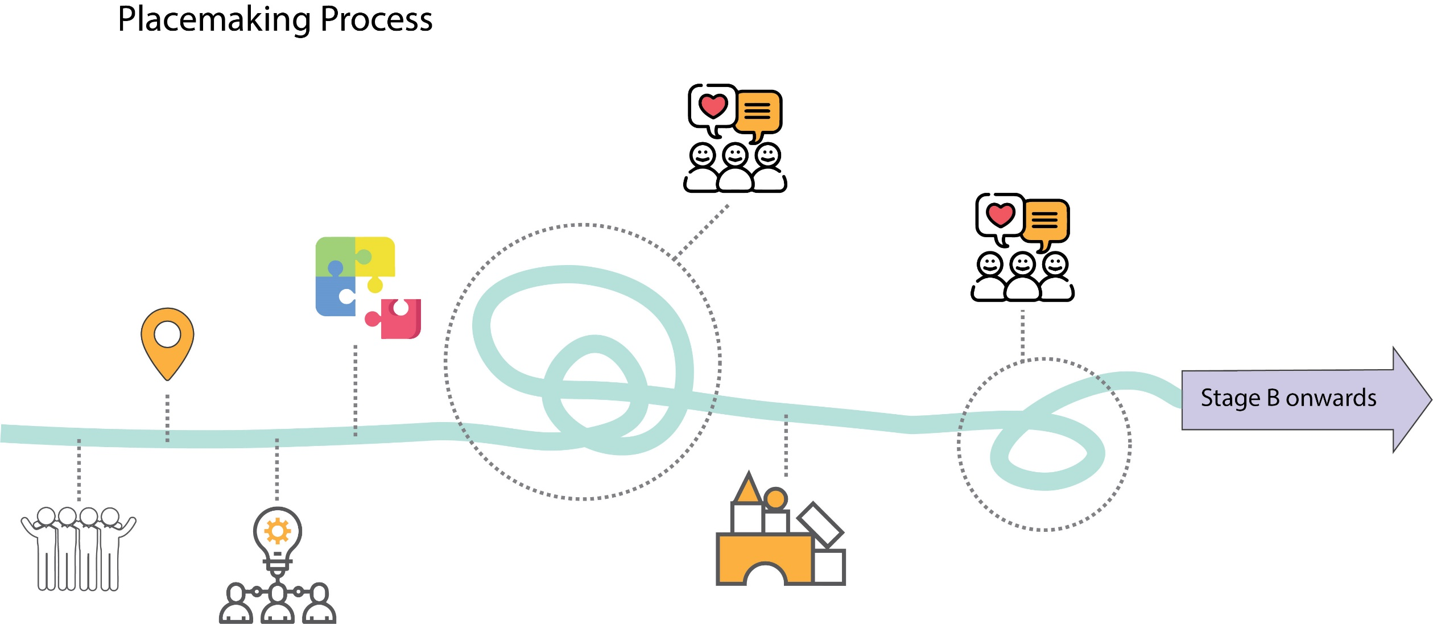
Placemaking
Feedback
Feedback
Design
Placemaking Project Location
Community
Collective Idea
Notes:
When thinking about a placemaking process, there is ideally a deep-engagement process that initiates the idea. That is to say, you don’t come in with an agenda but really spend time listening to the people and welcoming what emerges.
Next slide… shows the iterative nature of the process, you need quick feedback loops where the idea is refined.
If you are looking for a permanent change in the built form, you will then use small-scale interventions that prototype the intervention, learn from and inform the detailed design proposal.
If you are looking for a temporary intervention you implement your intervention.

Slide 26
Placemaking Process
Feedback
Feedback
Design
Placemaking Project Location
Community
Collective Idea

Slide 27
Placemaking Process
Feedback
Feedback
Design
Design
Placemaking Project Location
Onwards with planning
Community
Prototype
Collective Idea

Slide 28
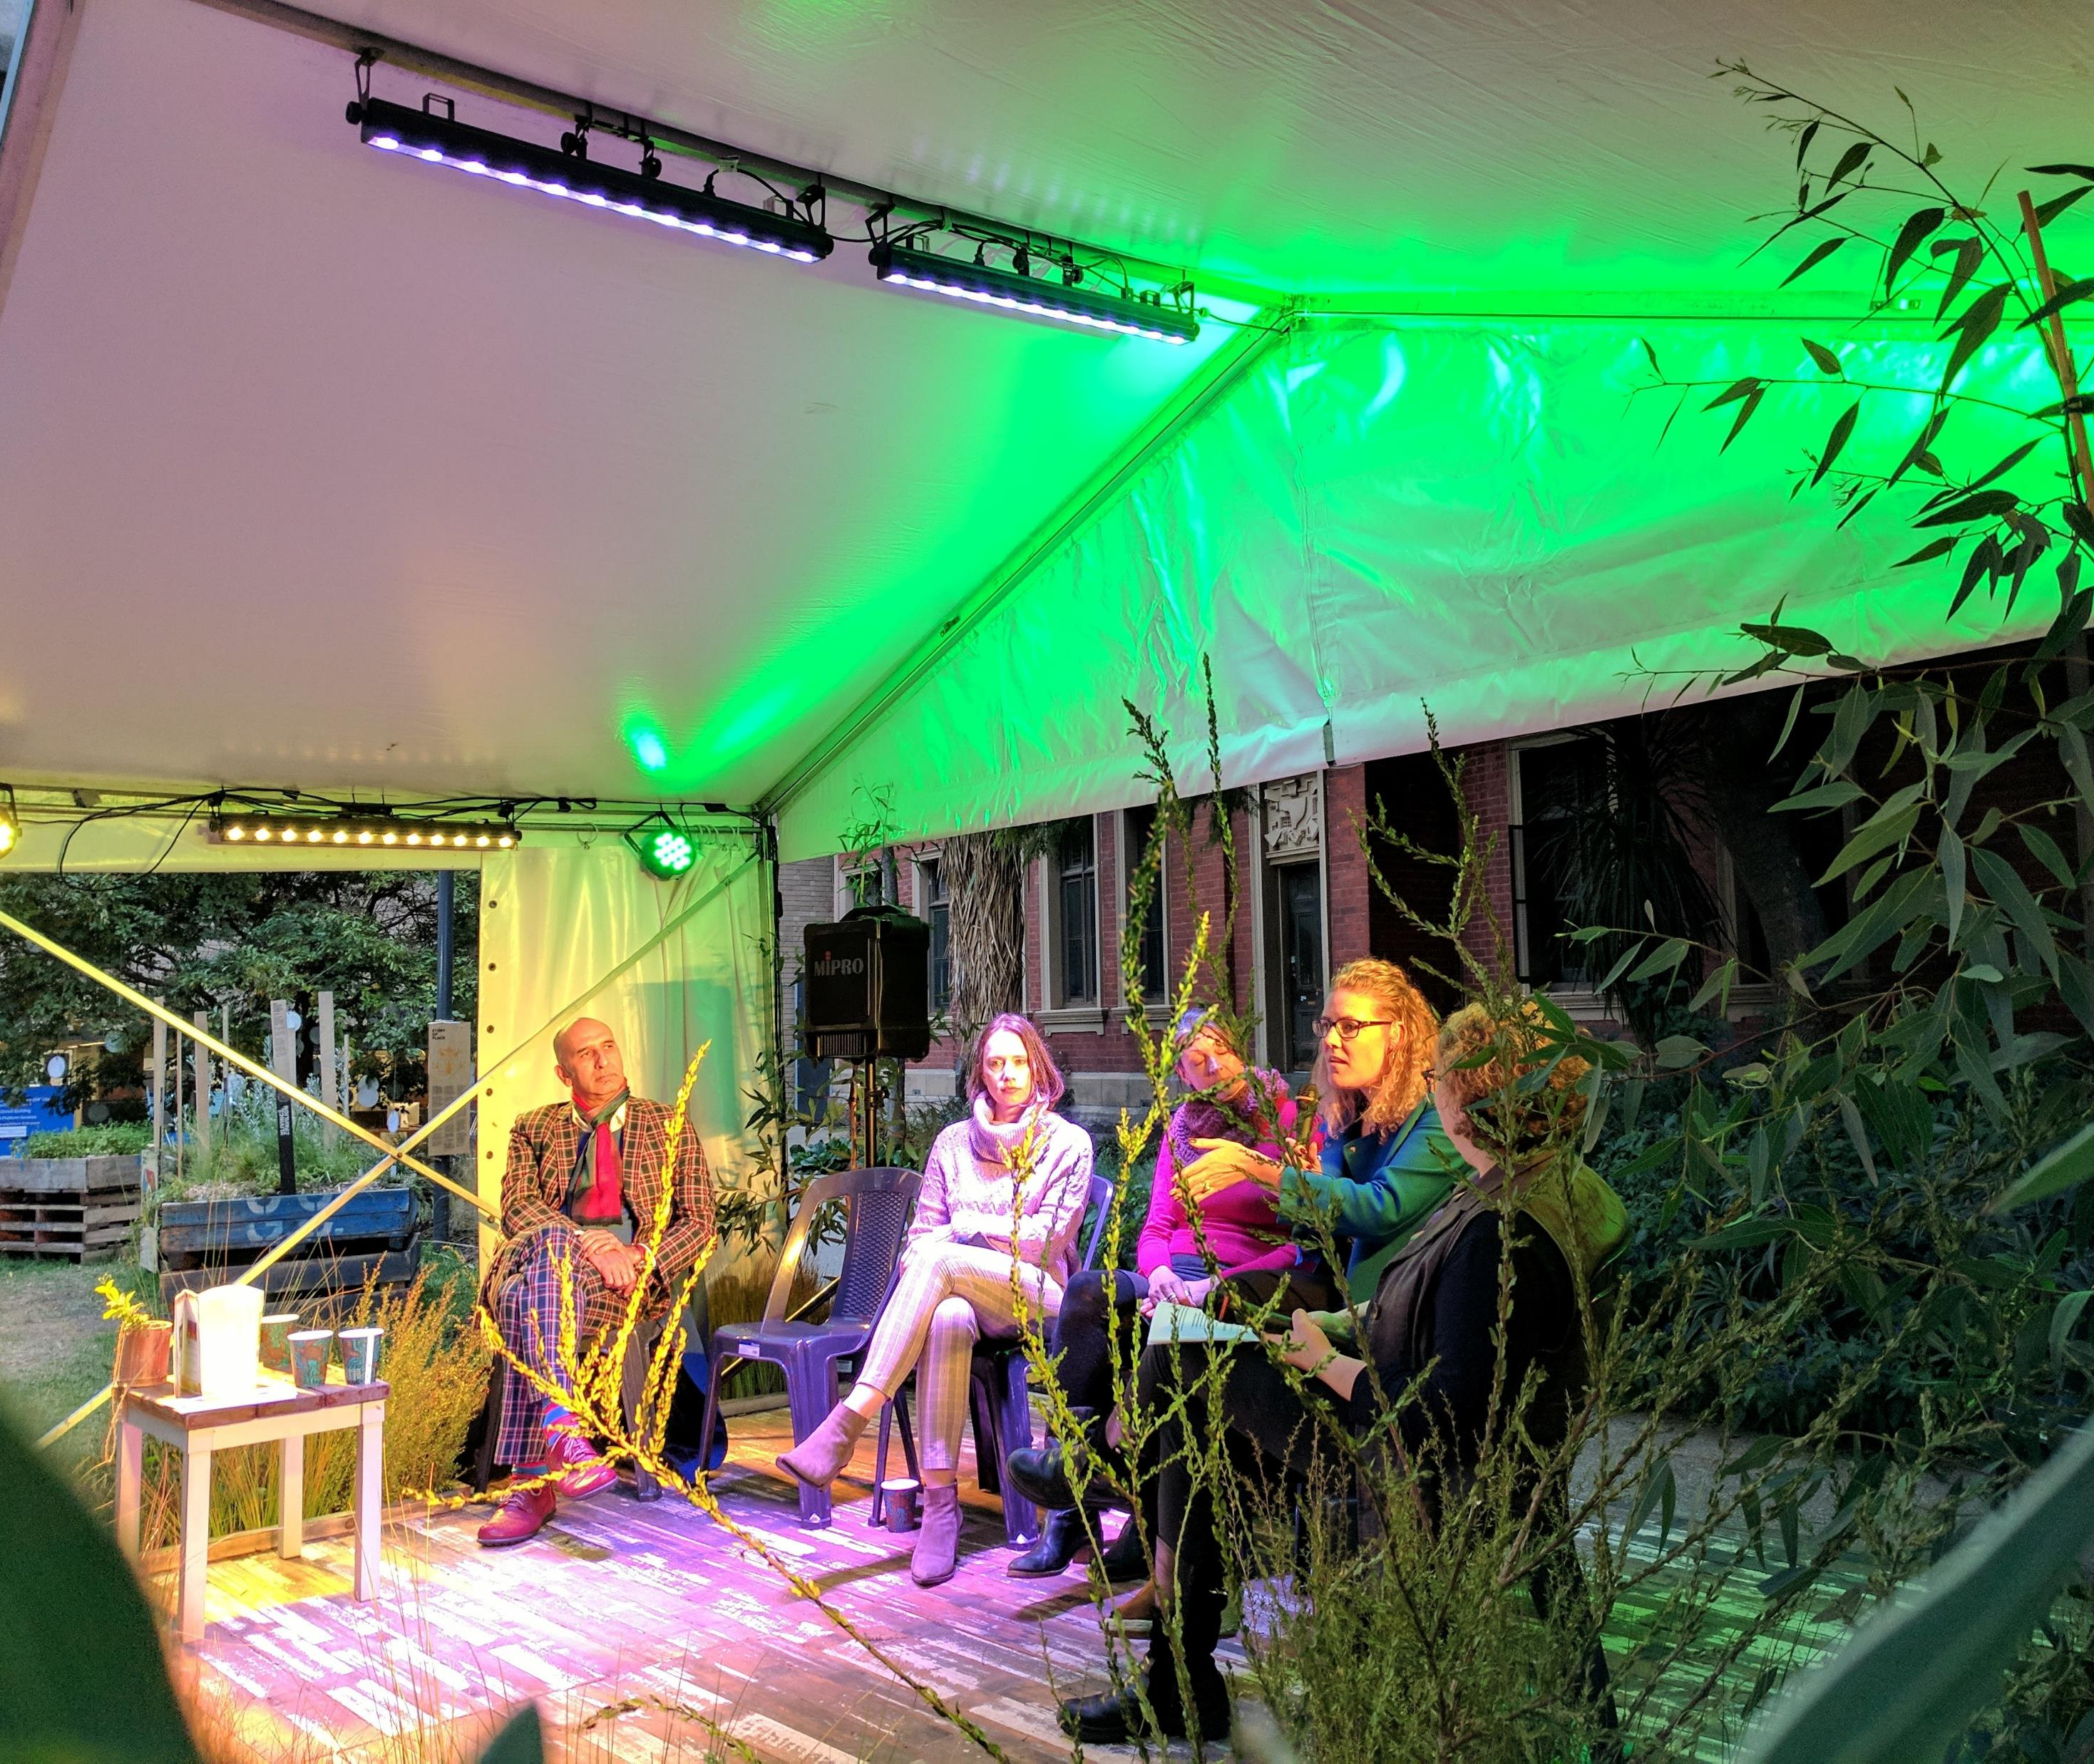
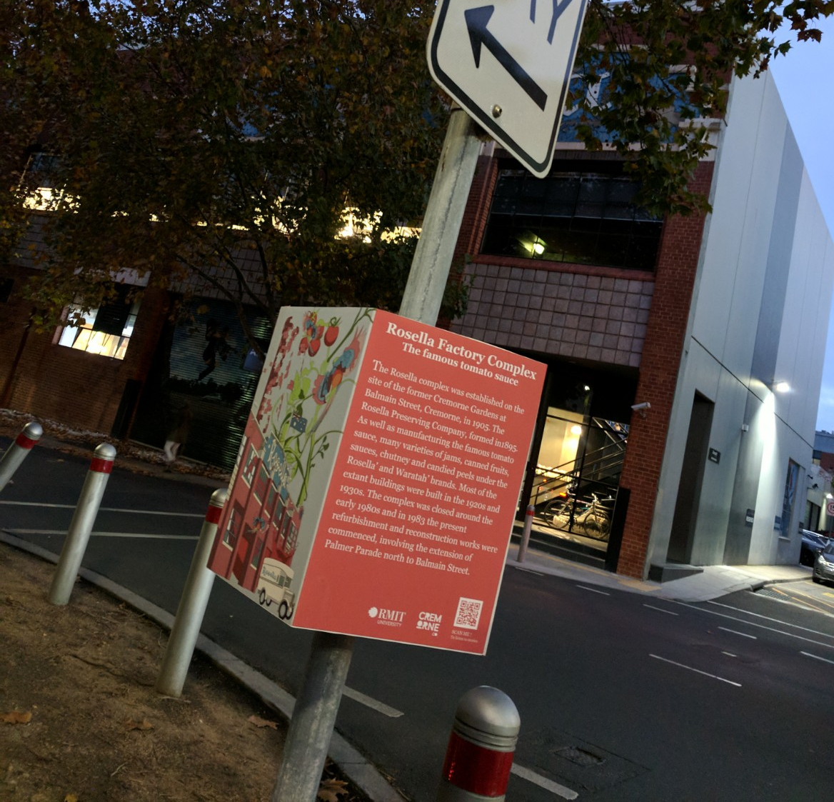
Product
Resulting physical outcome of the project
Different scales (and time)
Physical outcomes
Relational outcomes
Multidimensional benefits and impact to the wider community
PlaceAgency, 2018.
Notes:
At what scale is it most effective to achieve transformative change?
The tangible outcomes of the project. They can be products of any scale, comprise temporary changes in the urban fabric (i.e. art exhibition, events) or permanent ones (i.e. redesign of the main street). It can also be a soft product (i.e. sharing a place narrative through walking tours).
An output manifesting at different scales. It can be large-scale intervention, medium-scale neighbourhood placemaking events, street scale pop-ups or a community capacity-building design thinking workshop.
The physical outcomes of the production of space, hence, tangible. ‘Tangible’ assets are temporal or fixed. When fixed, it can be a short-, medium- or long-term place implementation or installation that was designed in step two. For instance, designs, strategies or plans, or the implementation of forms of art, festivals and celebrations.
Its relational outcomes to enhance social environments in forms that strengthen people’s connections to and use of place, hence, these take on intangible forms. Intangible assets are reflected in increased awareness to place advocacies, stronger community bonds (i.e. social cohesion), igniting the love of place (topophilia) and extends this love to expressing the importance of nature (biophilia) (Tuan, 1974; Kellert & Wilson, 1995).

Slide 29
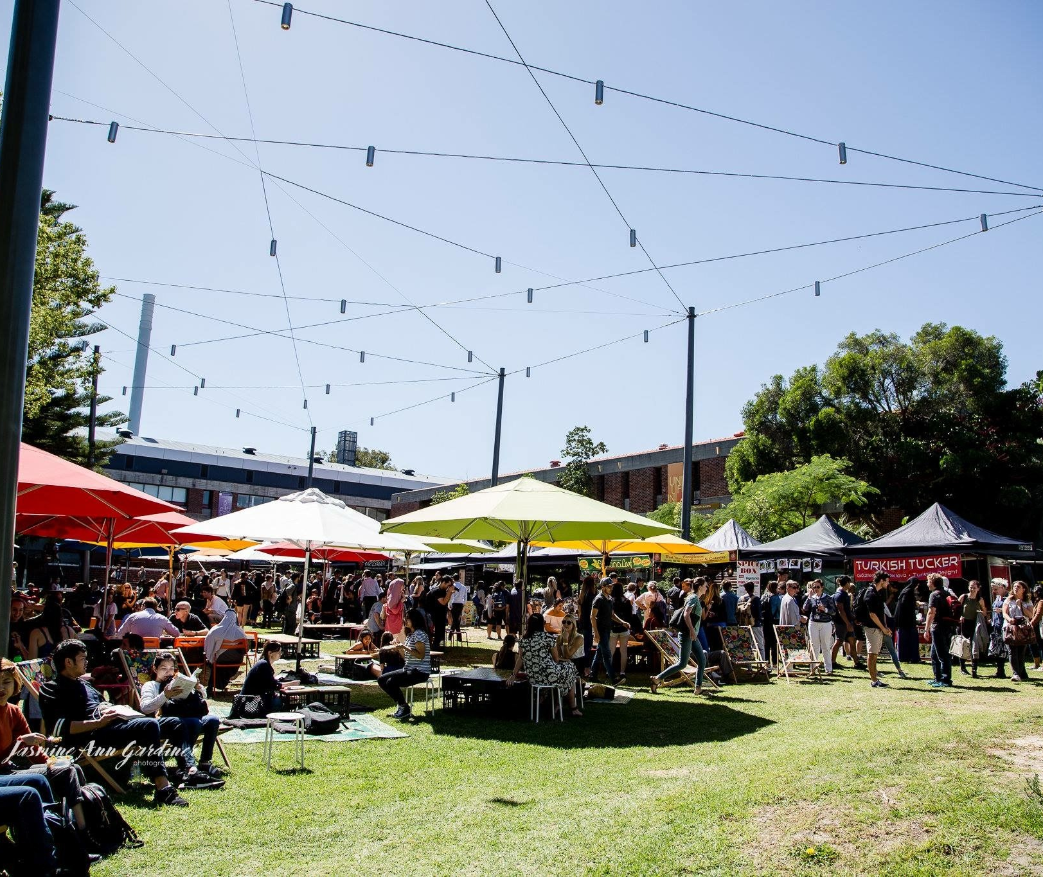
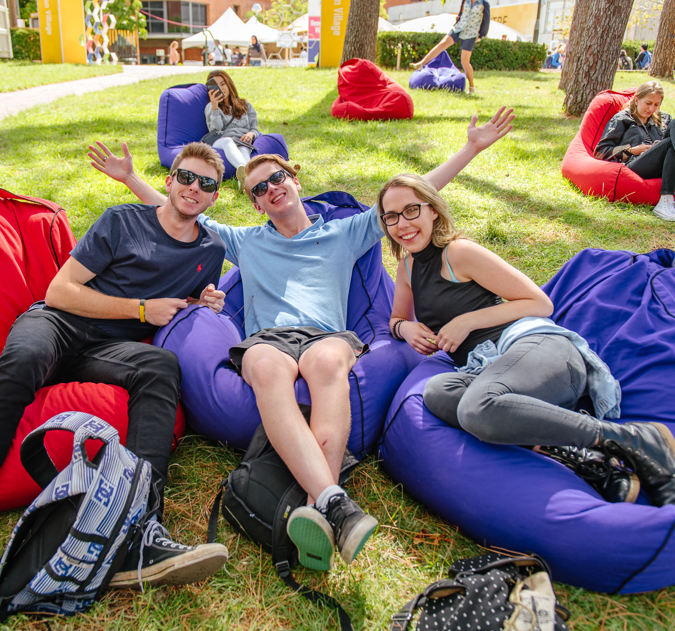
Program
How do we ‘live’ or ‘experience’ the place?
Based on flexible use of space, management, governance.
Requires active participants, managers and resources for medium-long timeline
‘Place-keeping’ strategies for ongoing re-engagement to retain social, economic, and environmental benefits and retain relevance.
PlaceAgency, 2018.
Notes:
We are addressing a complex problem. We should consider systems approach to addressing the
Place-keeping mechanisms used as ‘glue’ for the ongoing emotional connection to place. It includes management and maintenance considerations as well as place activation initiatives. Meaningful activities based on local needs and interests that enhance the experience of place are encouraged. se issues and challenges.

Slide 30
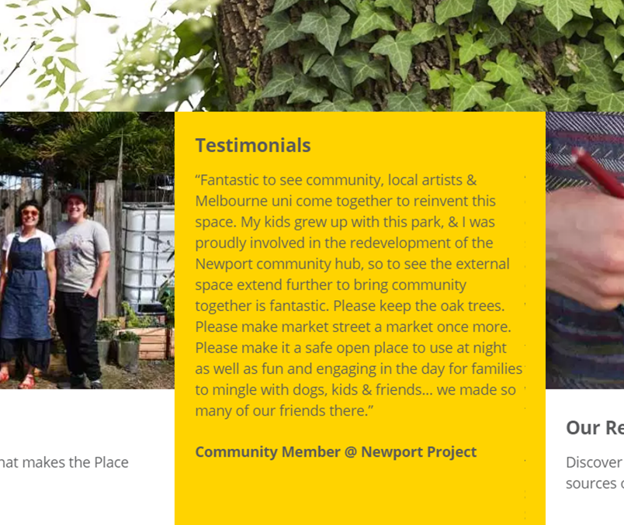
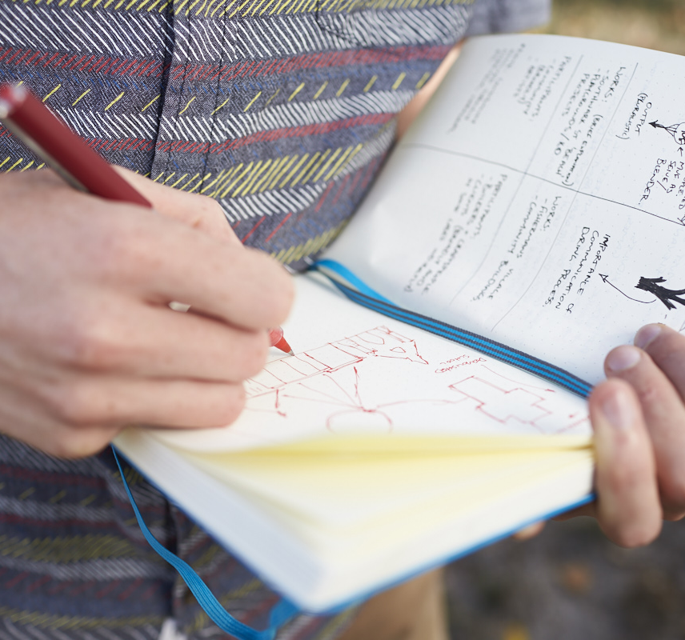
Place Evaluation
How do we learn from this project for the iterative process?
Not normally done as it can eat the budget but encouraged for best practice because:
Assess progress
Identify moments to adapt
Demonstrate benefits
Helps evolution

Slide 31
Communities
PLACE
Place Attachment
Sense of Place
Sense of Belonging
Conviviality
Space
People
Empowerment
Care for place
Social Inclusion
Social Cohesion
Ecology
Purpose of Placemaking: Connecting People to place through shared meaning and a sense of purpose.
Public or Private
Space
Place Attachment
Self
Care for place
Biophilia & Place Attachment
Supporting theory
outcomes
Sought Relationship
Custodianship
Ecological health
Natural Environment
Space
Biophilia
Healthy natural cycles
Ecosystem Services
Connection to nature
Custodianship
Notes:
This diagram is more fully explained in the place evaluation module. At this stage, the diagram is simply used to showcase that,
given that the purpose of placemaking is developing emotional connections between people and place,
and that we have the built environment, natural environment and people that can represent each individual as well as the community,
there are four different dimensions of place
thus, the key intention of placemaking is supporting relationships between the different dimensions. When these relationships exists, there are emotional and behavioural outcomes
We encourage using these relationships for evaluation

Slide 32
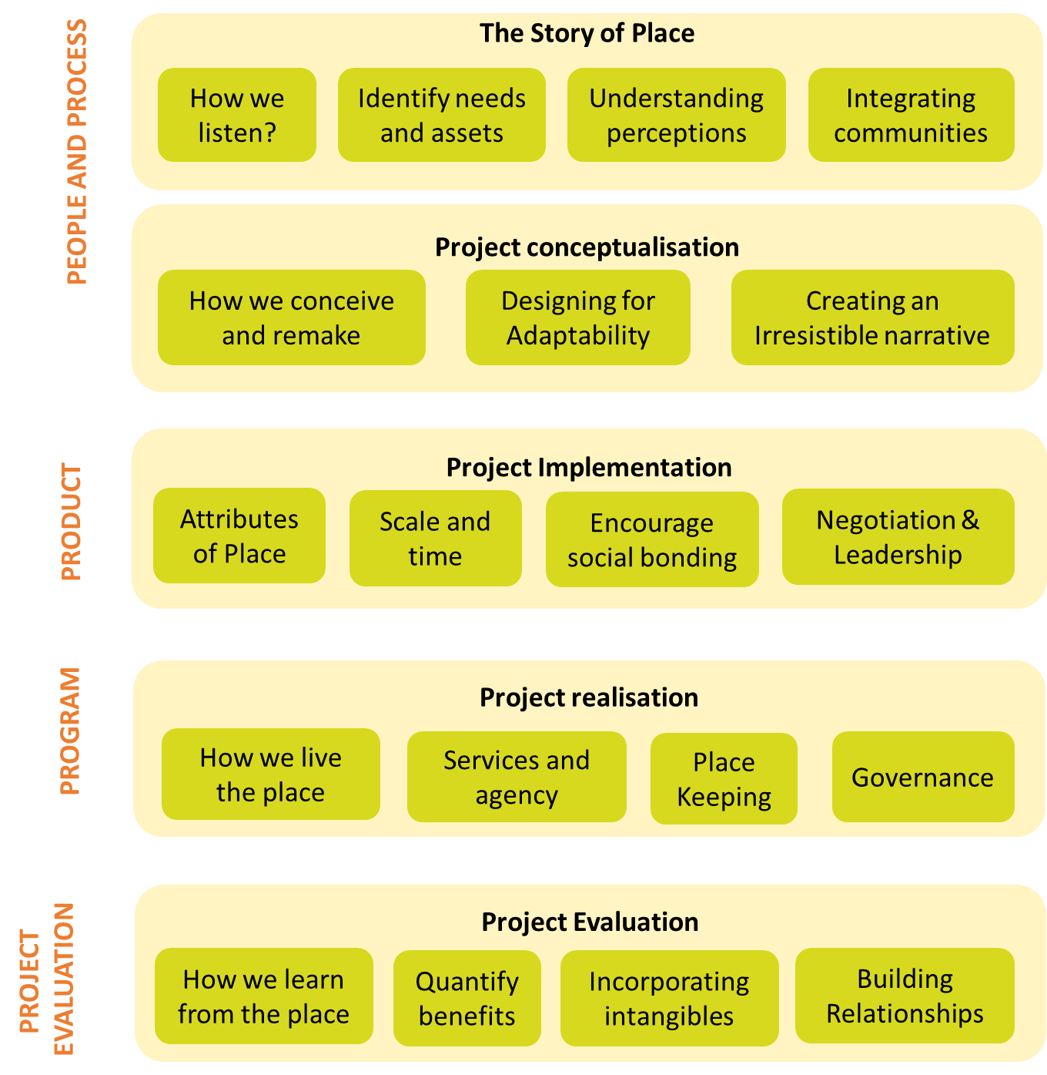
Notes:
The 5 p framework, has different sub elements important for it.
If you are using all the modules, these sub elements come into paly at the different modules.

Slide 33
Different ‘placemaking strategies

Slide 34
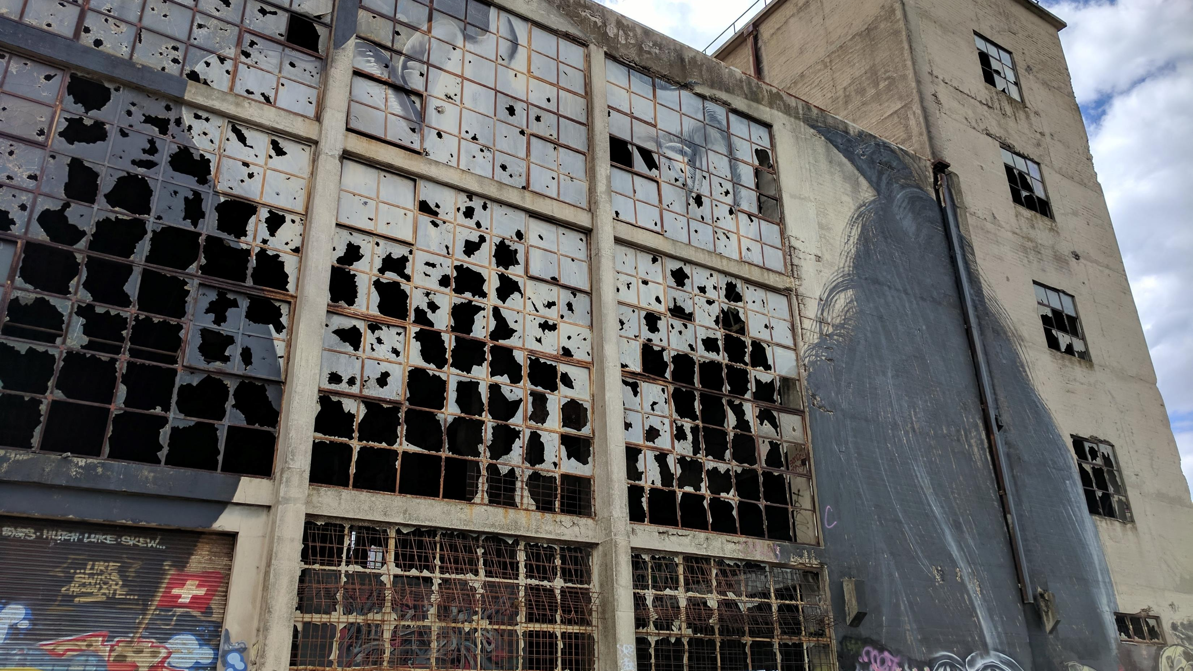
Creative Placemaking
“partners from public, private, non-profit, and community sectors strategically shape the physical and social character of a neighborhood, town, city, or region around arts and cultural activities”
(Markusen and Gadwa, 2010)
Cris Hernandez-Santin, 2018. Pivot City Innovation District

Slide 35
Las Palmitas Mexico
Piano Stairs – The fun theory
Notes:
In las palimtas, while the artists were commissioned to do the painting project,
Based the design in the concept of wind, where Pachuca (the state where this community is located) is known in Mexico as ‘the windy city’
They actively asked the neighbourhood their favourite colours
In the Piano stairs theory, they wire the stairs with sound to encourage people to use them. It was extremely effective, however, it does have limitations, what happens after the novelty goes away? Do people retain the new behaviour? This speaks towards the importance of programming and curation to find new ways to keep the process engaging.

Slide 36
Approach
Community-led, artist-led or top-down
Purpose
reactivation of public and private spaces
Benefits
Challenges
partnerships, gentrification, evaluation, maintenance, funding, etc.
attracting people, improved local economy, public safety, celebration of place and culture, pride, fun, learning, etc.
Cris Hernandez-Santin, 2018. Street art at Singapore.

Slide 37
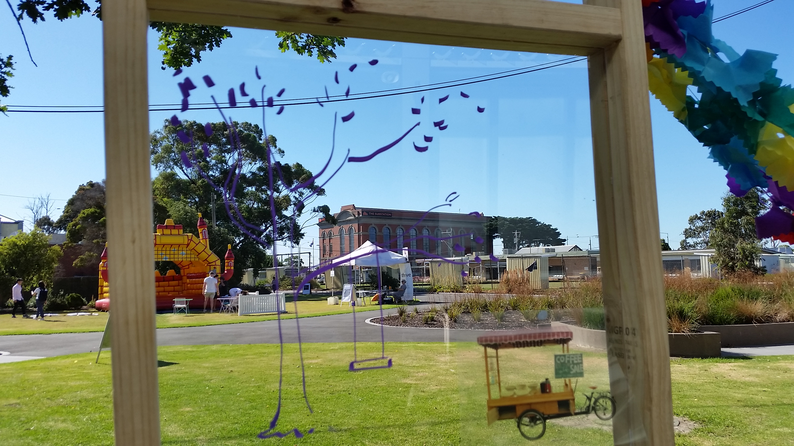
Strategic Placemaking
“deliberate, often phased approach to change that begins with a short term commitment and realistic expectations that can start quickly (and often at low cost).”
(Wyckoff, 2014)
Dominique Hes, 2018. Newport Project

Slide 38
Approach
Usually top-down and strategically choosing key sites (notes, main streets, etc). Large scale
Purpose
Key target initiative towards enhancing one or more aspects of livability and life quality. Adaptability and revitalization of an area.
Benefits
Challenges
Community buy-in fluctuates depending on how inclusive the project is, place keeping strategy,
Enhancing life quality: walkability, green places, mixed-use land use, etc. Can use cyclic events. User attraction.
Cris Hernandez-Santin, 2019. The Living Pavilion

Slide 39
Tactical Placemaking (Tactical Urbanism)
brings together tactical urbanism and Lighter, Quicker, Cheaper approach as ways of testing ideas before making financial commitments.
(Wyckoff, 2014)
PlaceAgency, 2018. Regenerating Sustainability Expo

Slide 40
Approach
Community-led, small scale temporary activations = ‘Lighter, quicker, cheaper (PPS.ORG). Includes Guerrilla Urbanism, pop-ups and city repair
Purpose
Testing ideas and project trials in small and quick ways for incremental change.
Benefits
Challenges
Community buy in fluctuates depending on how inclusive the project is, place keeping strategy,
Understanding what elements of a project have most potential. Quick strategies for social connection
PlaceAgency, 2018. Regenerating Sustainability Expo

Slide 41
Regenerative Placemaking (Regenerative Development)
Process off integrating regenerative development and placemaking by: incorporating ecosystem perspectives into place, supporting positive socio-ecological relationships and applying temporary interventions to identify best ways forward towards the coevolution of the place

Slide 42
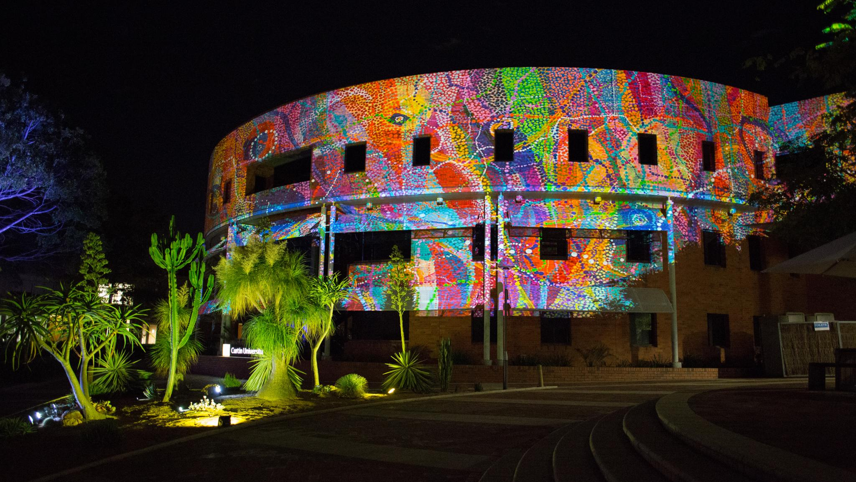
Digital Placemaking
“placemaking practices which place special emphasis on, or are primarily mediated through, digital technologies”
(Toland et al. 2020)
Digital Placemaking, Image by Curtin University

Slide 43
Key to success?
Main takeaways to achieve long-term benefit

