Slide 1
Disclaimer: The following slides were intentionally left text based to allow you to personalise and contextualise with your own images.

Slide 2
People in Place - Tutorial
These slides are based on material prepared by Mateo-Babiano, Lee, & Hernandez-Santin (2019), The University of Melbourne for the Place Agency program for placemaking pedagogy.

Slide 3
Activity 1: Transdisciplinary in Place

Slide 4
What did we learn from the videos?
What disciplines/roles do the speakers come from?
What values did they place around the term?
What is Place and Placemaking? (4min)
Place Making: (7:04)
Transform Your City With Tactical Urbanism (8:23)
https://youtu.be/D9U7oERZRnI

Slide 5
What is trans-disciplinarity
multidisciplinary
Disciplines working together in an additive manner (working in silos for common goal)
Interdisciplinary
Works to integrate more than one branch of knowledge. (works across the boundaries of discipline)
Transdisciplinary
Disciplines work together and transform each other. (holistic approaches transcending more than one branch of knowledge)
https://youtu.be/y7cN8NW0ZEs
Willie Caldwell (2015) Multi/Inter/Trans – disciplinary, What’s the Difference?
Mittelstrass, J. (2011). On transdisciplinarity. Trames, 15(4), 329-338. Retrieved from:
http://www.pas.va/content/dam/accademia/pdf/sv99/sv99-mittelstrass2.pdf accessed 19/06/2019
Notes:
multidisciplinary is an adjective that describes, “combining or involving several academic disciplines or professional specializations in approach to a topic or problem.”
Interdisciplinary is an adjective that describes, “of or relating to more than one branch of knowledge.”
Transdisciplinary is also an adjective that describes, “relating to more than one branch of knowledge.”
Source:
Willie Caldwell (2015) Multi/Inter/Trans – disciplinary, What’s the Difference? November 23, 2015. Retrieved from: https://blogs.lt.vt.edu/grad5104/multiintertrans-disciplinary-whats-the-difference/
accessed 19/06/2019

Slide 6
Trans-disciplinarity
Creating a holistic – ‘yes and’ – outcome
AND
Transforming yourself by being involved

Slide 7
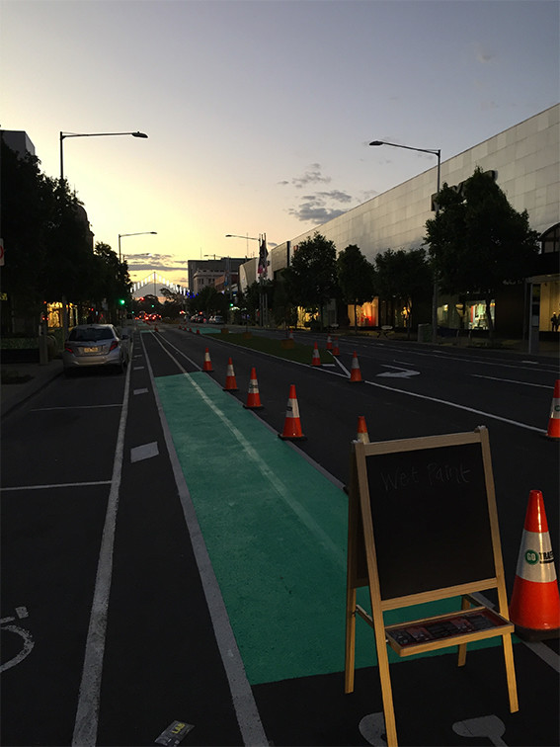
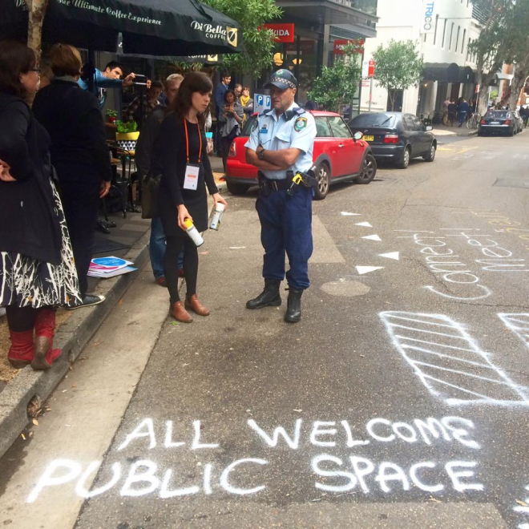
Why is this important
Let’s re – look at why placemaking has failed – images from https://www.linkedin.com/pulse/place-breaking-5-our-best-placemaking-fails-lucinda-hartley :
Almost getting arrested
When community came with pitchforks
Not outsourcing
When no one showed up
When we got too creative

Slide 8
Why is this important - The negative aspects
Gentrification
Place wash
Place masking
….
Yet in all cases, it is not the placemaking that is advocated for in this book, that of engaging all stakeholders with the development of their place. Many occur because of the complex system that is a place and working on the improvement of the amenity of the place (see for example Blokland, 2009; Peck, 2005 and 2010; Sarimin & Yigitcanlar, 2012; Solnit, 2014; and, Stehlin, 2016).
Needs holistic solutions

Slide 9
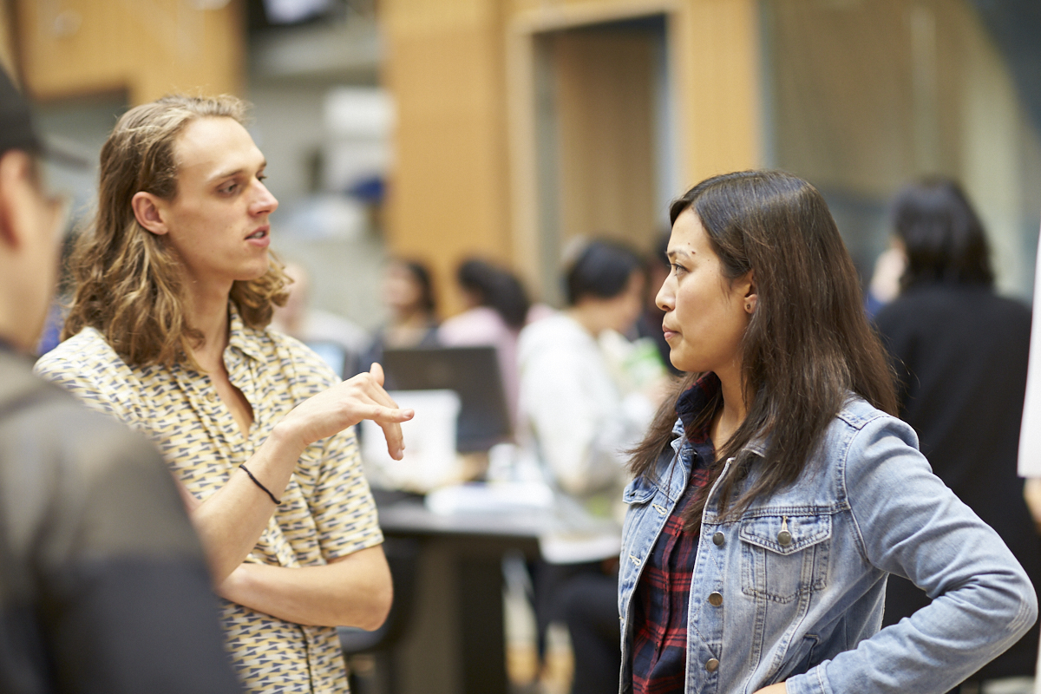
Part 1:
Option A: If students are from different disciplines.
2-3 min - Silent reflection
What is your discipline? And what does it contribute to placemaking?
What can you bring to the group to help them learn and understand your discipline?
10 min – Share
Option B: If students are from the same disciplines.
2-3 min - Silent reflection
What is your discipline? And what does it contribute to placemaking?
What is your background and how does it affect your perspective on place and placemaking?
What language do you speak?
Have you lived in another country?
What jobs do you do when you aren’t at the university?
What are your main hobbies?
10 min – Share
Notes:
This exercise requires one deck of cards per team and the students to be working on an ongoing case study.
If the class is not working on a case study, one can be provided specifically for the exercise.
Provide a strategy

Slide 10
Part 2: Cognitive differences. Rearrange the room to have space to move or move outside of the classroom
Each person is good at different things and prefer certain ways of working
Each person will not be as good at others in the same things, however, it is critical to think differently and have a team that encourages each other to move beyond their comfort zone.
10 min - Get into groups according to how you like to work – in 4 corners of the room:
the ideas person (light bulb),
the organiser (square),
the detail person (triangle)
and the steady worker (turtle)
Note: this exercise can be used for group making for the large group assignments.
Notes:
This exercise requires one deck of cards per team and the students to be working on an ongoing case study.
If the class is not working on a case study, one can be provided specifically for the exercise.
Provide a strategy

Slide 11
What working with people with different cognitive skills gives a project:
Great innovation
Greater idea generation
Great discussion
Ability to develop more robust options
Ability to connect to a wider audience

Slide 12
Activity 2 – Risks and benefits of Placemaking

Slide 13
Risks: What can we add?
Place masking – saying you have done placemaking when you haven’t – (Fincher et al., 2016)
social equity is not identified as a priority for the project
Catering for future ‘ideal’ residents, not existing one
prioritize economic development while socio-spatial equity becomes secondary (or even irrelevant) in the process, resulting in gentrified neighborhoods
Gentrification: the process of renovating a district so that it conforms to middle-class taste, pushing out the non-conforming. It closes down opportunities for those in economically vulnerable positions.
Place wash – saying it is good when it isn’t
Used primarily for advertising
Notes:
Should define the key terms here

Slide 14
Start with risk – each student write down one thing they think this risk is and why it occurs – 1 minute
Discuss as a group for 5 minutes – choose what you believe are the two main causes and impacts of the risk
Discuss as a group – 5 mins – how you can minimise the risk
Choose a person to speak for the group and present to the class

Slide 15
Benefits: What can we add?
X
X
X
Notes:
Sense of community, belonging, connection to nature, stewardship, participation and agency.
Increased citizenship reduces costs of maintenance and fixing things
Also means if managed well they can start providing services that the council may not have budget for.

Slide 16
benefits – each student write down one thing they know about this benefit – why it occurs, or a case study, or something they read – 1 minute
Discuss as a group for 5 minutes – choose what you believe are the two reasons for the benefit and its impacts
Discuss as a group – 5 mins – how you can maximise this benefit
Choose a different person to speak for the group and present to the class

Slide 17
Activity 3: Case Study

Slide 18
Case study
This case study will form the back bone of your learning.
This will give you the tool to connect the theory you are learning to real life practice

Slide 19
From the supporting case studies, ask students to regroup themselves based on the case studies that they read before the session.
20 min – Case study discussion:
What was the most interesting thing that you got out of the case study?
What type of placemaking this case study is this? (see image on the right)
What were the key benefits achieved by this case study? Why do you think these benefits emerged?
What were the key risks they case study has?
What were the critical elements to the success of this project?
15 min – Whole group discussion: Each group to give a 2 min summary of the case study while adding their case study into the map (image on the right)
Legacy of this type of placemaking strategy
X
X
X
Regenerative Placemaking
Creative Placemaking
Comms Placemaking (branding-storytelling)
Digital Placemaking
Strategic Placemaking
Tactical Placemaking
Green placemaking
Legacy of this type of placemaking strategy
X
X
X
Case Study B
Case Study A
Case Study D
Case Study C
Legacy of this type of placemaking strategy
X
X
X

Slide 20
Option 2: Introduction to case study
PPT of case study
If your students will be working in a specific case study and they have not yet learned about it, you can use this time instead to share information about the site of their project.

Slide 21
https://youtu.be/3_JOTiyzH1k

