Slide 1
Nature in place
These slides are based on material prepared by Bush, Hernandez-Santin & Hes (2019), The University of Melbourne for the Place Agency program for placemaking pedagogy.

Slide 2
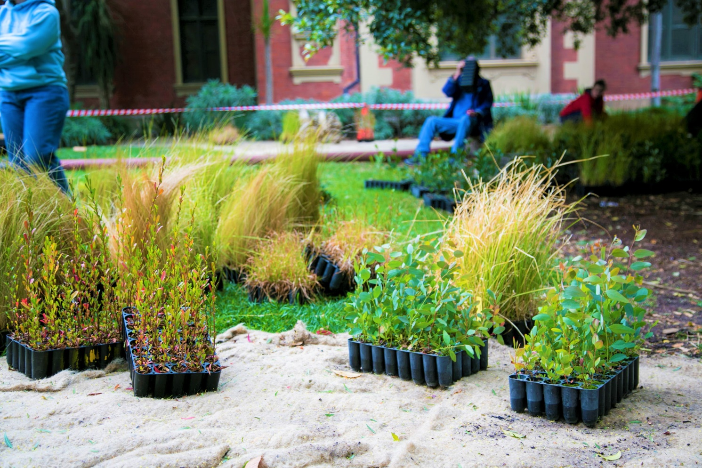
Context: Where does nature fit in place?
Places are both built and natural. Nature provides multiple benefits to
Wellbeing
Health
Healthy ecosystems
Critical component of our sense of place.
Embedding nature into our areas can foster stewardship of the Biosphere

Slide 3
Learning outcomes
Understand the implication of the natural environment of a sense of place
Develop a compelling narrative as to why nature, or the non-human, needs to be integrated into placemaking
Develop an approach with their stakeholders to integrate elements of the natural environment into the placemaking process

Slide 4
Outline
Green space benefits
Connecting with nature, biophilia and sense of place
Stewardship and custodianship
Nature in placemaking
Case studies

Slide 5
But first, defining nature
How do you define NATURE?

Slide 6
But first, defining nature
My definition (for the purpose of today’s discussions):
“the physical world collectively, including plants, animals, the landscape”

Slide 7
But first, defining nature
My definition (for the purpose of today’s discussions):
“the physical world collectively, including plants, animals, the landscape”
Green space, biodiversity
Passive element
Active participant

Slide 8
Green space benefits

Slide 9
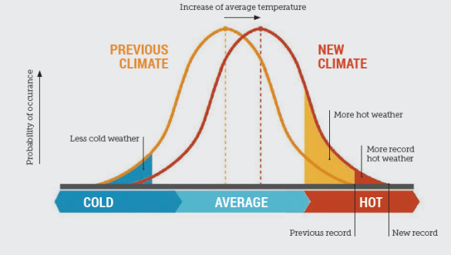
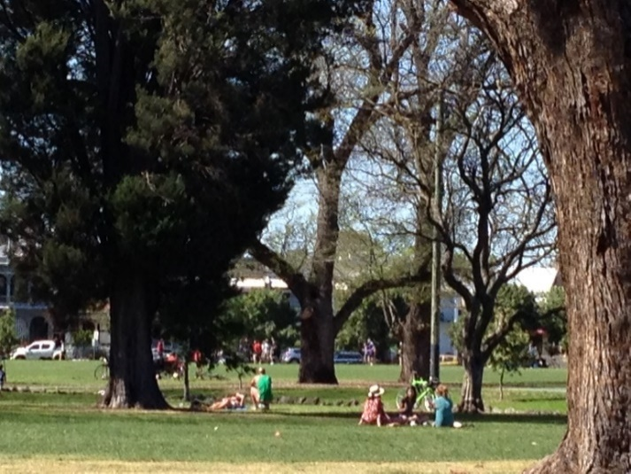
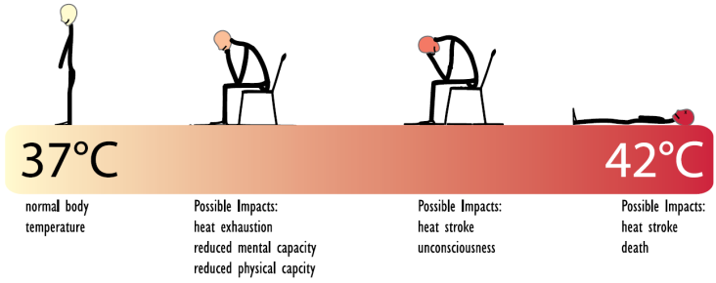
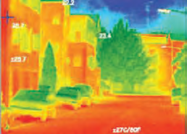
Green space functions and benefits
Wellbeing
Biodiversity
Water quality and quantity
Urban heat mitigation
Source: Steffen et al 2014
Source: Vic CES 2012
Source: City of Melbourne 2013

Slide 10
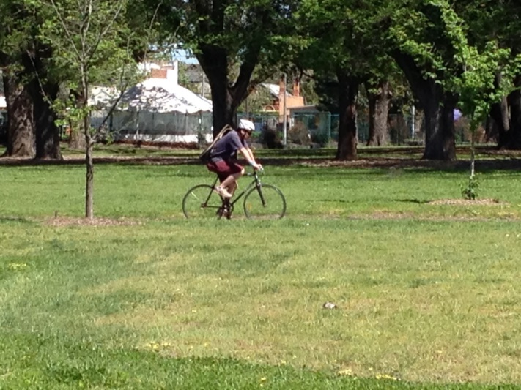
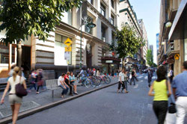
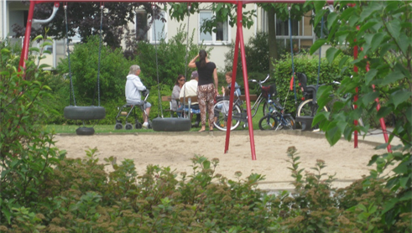
Green space functions and benefits
Wellbeing
Biodiversity
Water quality and quantity
Urban heat mitigation
Active transport
Social cohesion

Slide 11
Green space benefits as ‘ecosystem services’

Slide 12
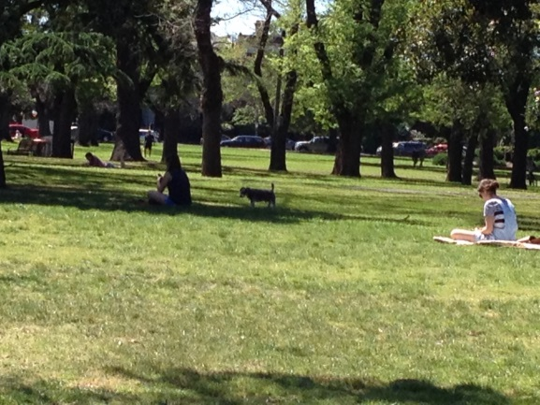
Urban ecosystem services
Urban ecosystem services:
Regulating: air quality, cooling, water quality and quantity
Provisioning: food, water, materials
Supporting: habitat
Cultural: mental and physical health and wellbeing, social interaction and cohesion, recreation and tourism, sense of place
Kendal, D., Lee, K., Ramalho, C., Bowen, K., & Bush, J. (2016). Benefits of urban green space in the Australian context. A synthesis review for the Clean Air and Urban Landscapes hub of the National Environmental Science Program. CAUL: Melbourne

Slide 13
Connecting with nature, biophilia and sense of place

Slide 14
Biophilia
Bio: biology, biodiversity
-philia: love
Biophilia: “the urge to affiliate with other forms of life” E.O.Wilson
Fink, H. S. (2016). Human-nature for climate action: nature-based solutions for urban sustainability. Sustainability, 8(3), 254. doi:10.3390/su8030254
Kellert, S. R., & Wilson, E. O. (Eds.). (1993). The biophilia hypothesis. Washington, D.C.: Island Press.
Lin, B. B., Egerer, M. H., & Ossola, A. (2018). Urban gardens as a space to engender biophilia: evidence and ways forward. Frontiers in Built Environment, 4. doi:10.3389/fbuil.2018.00079
Littke, H. (2016). Becoming biophilic: challenges and opportunities for biophilic urbanism in urban planning policy. Smart and Sustainable Built Environment, 5(1), 15-24. doi:10.1108/SASBE-10-2015-0036
Wilson, E. O. (1984). Biophilia. Cambridge, MA: Harvard University Press.

Slide 15
Biophilia
Human affinity with the natural environment & other living things;
Innate connection with nature
“the introduction of nature into human spaces [cities and urban areas] is all the more critical to abate the human–nature disconnection” Fink 2016, p. 8
Fink, H. S. (2016). Human-nature for climate action: nature-based solutions for urban sustainability. Sustainability, 8(3), 254. doi:10.3390/su8030254
Kellert, S. R., & Wilson, E. O. (Eds.). (1993). The biophilia hypothesis. Washington, D.C.: Island Press.
Lin, B. B., Egerer, M. H., & Ossola, A. (2018). Urban gardens as a space to engender biophilia: evidence and ways forward. Frontiers in Built Environment, 4. doi:10.3389/fbuil.2018.00079
Littke, H. (2016). Becoming biophilic: challenges and opportunities for biophilic urbanism in urban planning policy. Smart and Sustainable Built Environment, 5(1), 15-24. doi:10.1108/SASBE-10-2015-0036
Wilson, E. O. (1984). Biophilia. Cambridge, MA: Harvard University Press.

Slide 16
Green spaces and sense of place
Sense of place and place attachment
Perceptions of safety and of belonging

Slide 17
Green spaces and sense of place
Sense of place and place attachment
Perceptions of safety and of belonging

Slide 18
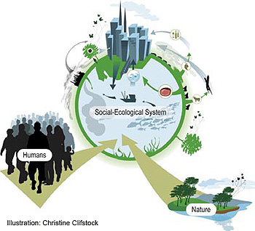
Social-ecological systems
Social-ecological systems are complex, dynamic, multi-scale, and adaptive
Human are part of social-ecological systems
http://www.albaeco.com/sdu/36/htm/main.htm

Slide 19
Social-ecological systems
Include
biophysical aspects,
mental activities,
across many scales
http://www.albaeco.com/sdu/36/htm/main.htm

Slide 20
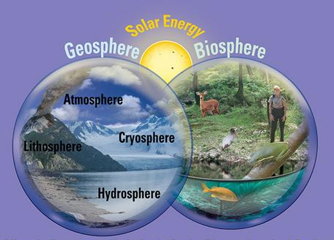
Social-ecological systems
Biophysical:
Global cycles (water, nitrogen, carbon, etc)
Soil
Water
Air
Plants
Animals (including humans)
https://serc.carleton.edu/earthlabs/carbon/index.html

Slide 21
Social-ecological systems
Mental activities
think, create, innovate
motivations, cultural norms
plan, learn, think and have values above survival

Slide 22
Stewardship and custodianship

Slide 23
Sense of place
Place
the intersection of nature, social relations and meaning
Sense of place:
Meanings (stories and symbols) and
Attachment (emotional bond) to particular places
Masterson, V. A., Enqvist, J. P., Stedman, R. C., & Tengö, M. (2019). Sense of place in social–ecological systems: from theory to empirics. Sustainability Science, 14(3), 555-564. doi:10.1007/s11625-019-00695-8
Masterson, V. A., Stedman, R. C., Enqvist, J., Tengö, M., Giusti, M., Wahl, D., & Svedin, U. (2017). The contribution of sense of place to social-ecological systems research: a review and research agenda. Ecology and Society, 22(1). doi:10.5751/ES-08872-220149
Raymond, C. M., Kyttä, M., & Stedman, R. (2017). Sense of place, fast and slow: the potential contributions of affordance theory to sense of place. Frontiers in Psychology, 8(SEP). doi:10.3389/fpsyg.2017.01674

Slide 24
Stewardship
care, knowledge and agency for the environment (Enqvist et al. 2018)
“action in pursuit of sustainability” (West et al. 2018)
reciprocal relationships between human and non-human life
‘sense of place’ as a source of the care that emerges for place
Elmqvist et al. (2013). Stewardship of the biosphere in the urban era. In T. Elmqvist et al (Eds.), Urbanization, biodiversity and ecosystem services: challenges and opportunities. A global assessment (pp. 719-746). Dordrecht: Springer.
Enqvist, J., West, S., Masterson, V. A., Haider, L. J., Svedin, U., & Tengö, M. (2018). Stewardship as a boundary object for sustainability research: linking care, knowledge and agency. Landscape and Urban Planning, 179, 17-37. doi:10.1016/j.landurbplan.2018.07.005
West, S., Haider, L. J., Masterson, V., Enqvist, J. P., Svedin, U., & Tengö, M. (2018). Stewardship, care and relational values. Current Opinion in Environmental Sustainability, 35, 30-38. doi:10.1016/j.cosust.2018.10.008

Slide 25
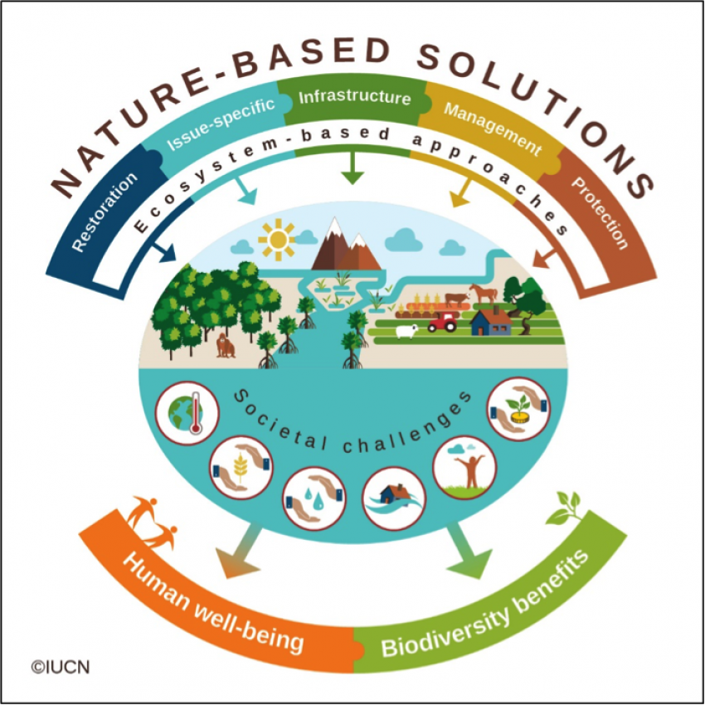
Designing urban green spaces
Shifting the assumptions about the functional elements in smart cities:
Nature-based solutions
Designing places where people want to live, not just buildings that meet design checklists

Slide 26
Nature in placemaking

Slide 27
Placemaking
Placemaking 5 Ps | Nature in place
People: Map the values, patterns & uses | Social-ecological systems: Identify the community’s perspectives on the place’s social-ecological values, ecology & nature
Process: Design (with) place interventions | Habitat and biodiversity: Apply Biodiversity sensitive urban design principles (Garrard et al. 2017) BSUD principles: Retain and restore habitat; Facilitate species dispersal; Minimize anthropogenic disturbance; Recover ecological processes; Promote positive human-nature interactions
Product: implement the place intervention
Program: maintain and manage the place for the long term | Adaptive governance: Develop adaptive & participatory governance for long term maintenance & management
Place evaluation: monitor and evaluate | Nature stewardship: Monitor and evaluate the nature in the place intervention; connect to the wider social-ecological context; build stewardship and maintain social-ecological relationships

Slide 28
Nature in placemaking
Placemaking 5 Ps | Nature in place
People: Map the values, patterns & uses | Social-ecological systems: Identify the community’s perspectives on the place’s social-ecological values, ecology & nature
Process: Design (with) place interventions | Habitat and biodiversity: Apply Biodiversity sensitive urban design principles (Garrard et al. 2017) BSUD principles: Retain and restore habitat; Facilitate species dispersal; Minimize anthropogenic disturbance; Recover ecological processes; Promote positive human-nature interactions
Product: implement the place intervention
Program: maintain and manage the place for the long term | Adaptive governance: Develop adaptive & participatory governance for long term maintenance & management
Place evaluation: monitor and evaluate | Nature stewardship: Monitor and evaluate the nature in the place intervention; connect to the wider social-ecological context; build stewardship and maintain social-ecological relationships

Slide 29
Nature in placemaking: step 1
Social-ecological systems: Identify the community’s perspectives on the place’s social-ecological values, its ecology & nature

Slide 30
Nature in placemaking: step 1
Social-ecological systems: Identify the community’s perspectives on the place’s social-ecological values, its ecology & nature
Think about
Nature reflection
Place ecology and nature identity
Interrelatedness of systems

Slide 31
Nature in placemaking: step 2
Habitat and biodiversity: Apply Biodiversity sensitive urban design principles
Retain and restore habitat
Facilitate species dispersal
Minimize anthropogenic disturbance
Recover ecological processes
Promote positive human-nature interactions

Slide 32
Nature in placemaking: step 2
Habitat and biodiversity: Apply Biodiversity sensitive urban design principles
Retain and restore habitat
Facilitate species dispersal
Minimize anthropogenic disturbance
Recover ecological processes
Promote positive human-nature interactions
Think about:
Become a spokesperson for an element of nature

Slide 33
Nature in placemaking: step 3
Adaptive governance: Develop adaptive and participatory governance systems to maintain and manage the place for the long term
building the communities’ skills, agency and confidence

Slide 34
Nature in placemaking: step 4
Nature stewardship: Monitor and evaluate the nature in the place intervention; connect to the wider social-ecological context; build stewardship and maintain social-ecological relationships

Slide 35
Nature in placemaking: step 4
Nature stewardship: Monitor and evaluate the nature in the place intervention; connect to the wider social-ecological context; build stewardship and maintain social-ecological relationships

Slide 36
Nature in placemaking: step 4
Nature stewardship: Monitor and evaluate the nature in the place intervention; connect to the wider social-ecological context; build stewardship & social-ecological relationships
Think about
Assess the health of the vegetation
Choose some ‘indicator’ species on which to focus attention
Keep records
Monitor the social as well as the ecological elements
Share your data - Learn from each other
Maintain a view on the longer term

Slide 37
Case studies

Slide 38
Nature in placemaking: case studies
From the (very!) temporary, to the semi-permanent to the long term, ongoing

Slide 39
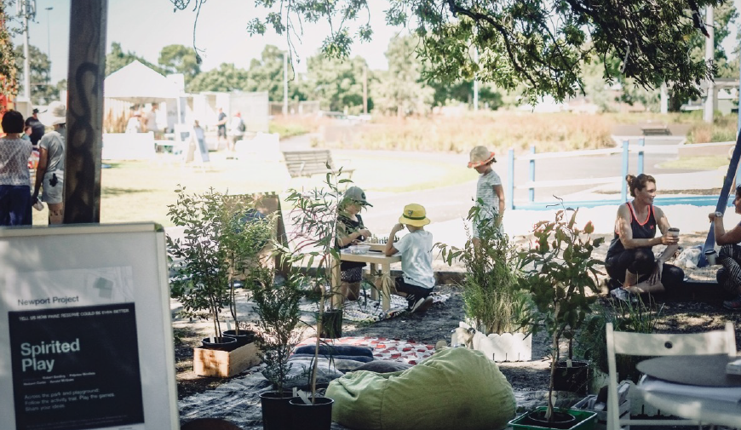
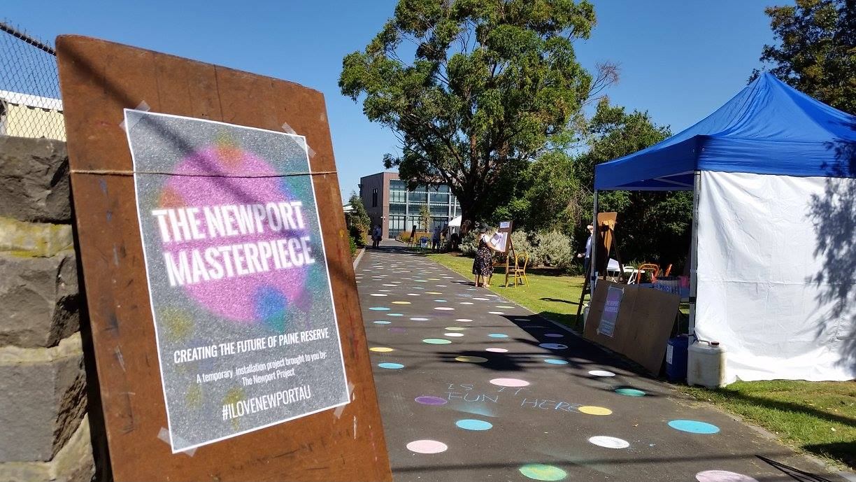
Nature in placemaking: case studies
Newport placemaking: ½ day

Slide 40
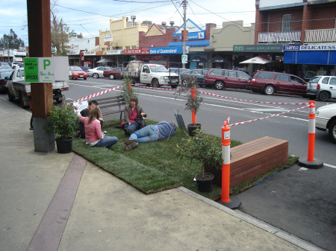
Nature in placemaking: case studies
PARK(ing) day:
1-2 days
http://www.victoriawalks.org.au/PARKing_Days/

Slide 41
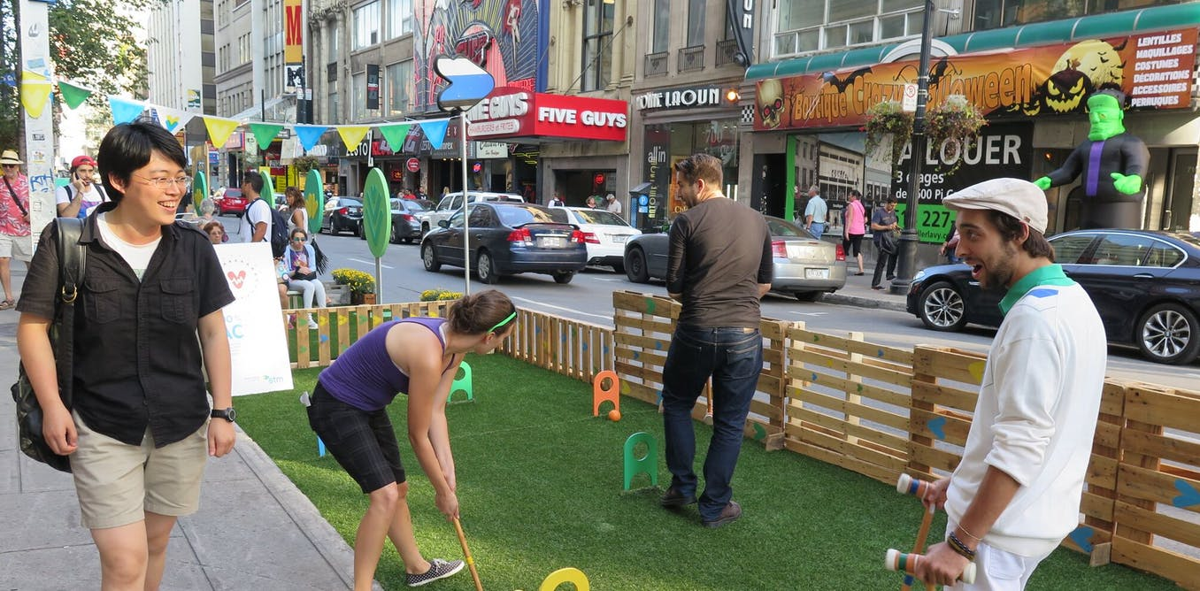
Nature in placemaking: case studies
PARK(ing) day:
1-2 days
https://theconversation.com/a-day-for-turning-parking-spaces-into-pop-up-parks-65164

Slide 42
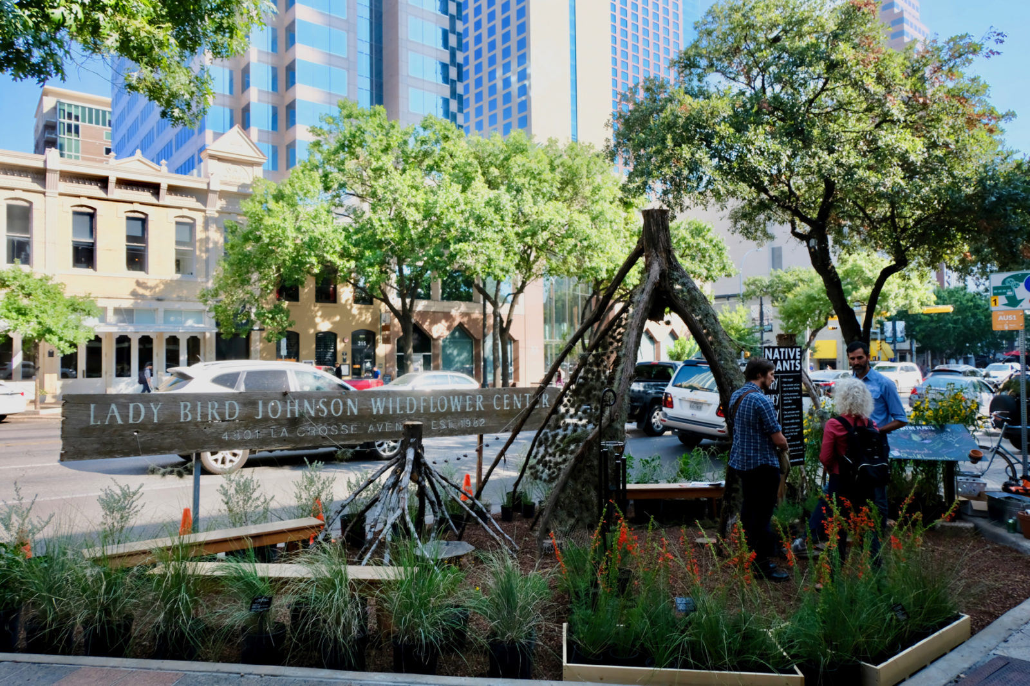
Nature in placemaking: case studies
PARK(ing) day:
1-2 days
https://austin.towers.net/spotted-austins-parking-day-makes-parking-spaces-public-on-congress/

Slide 43
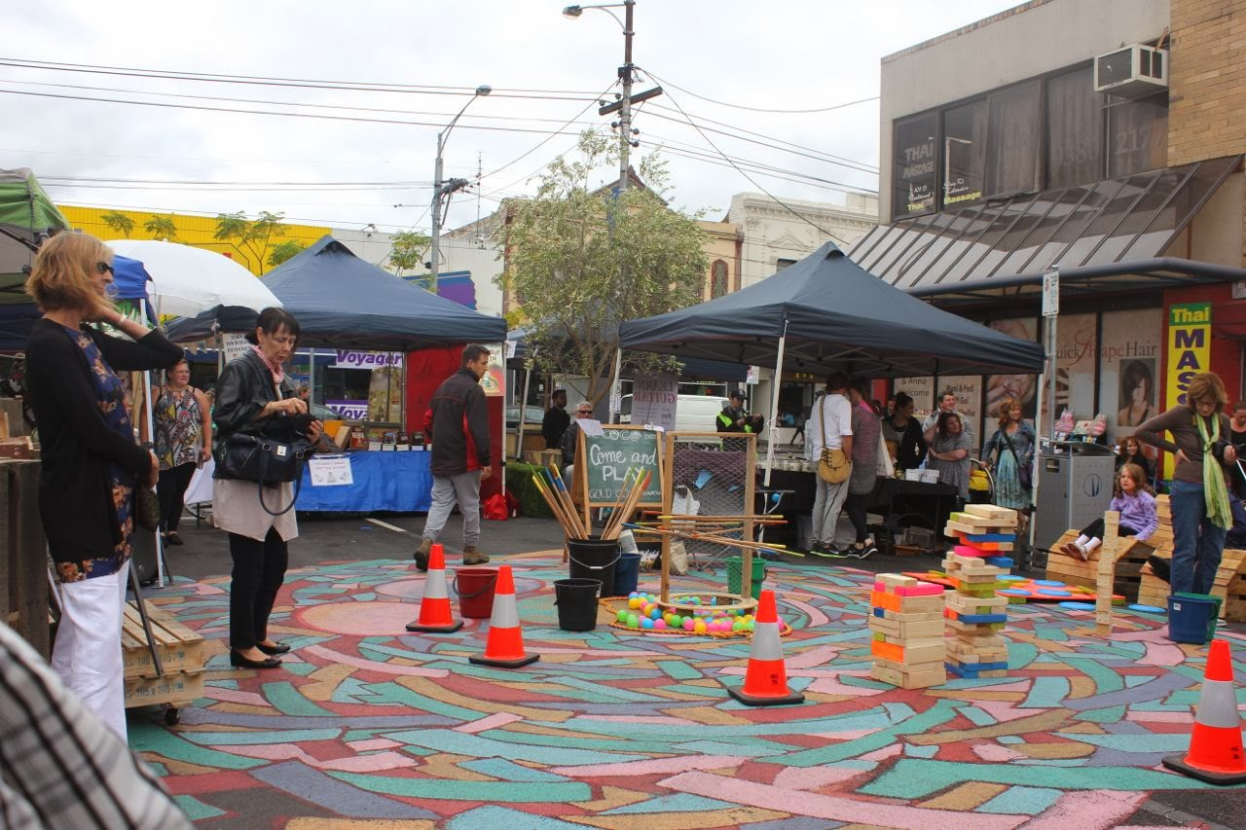
Nature in placemaking: case studies
Pop up parks:
A few weeks - months
https://www.morelandfoodgardensnetwork.org/2014/04/can-you-spare-3-mins-to-help-make.html

Slide 44
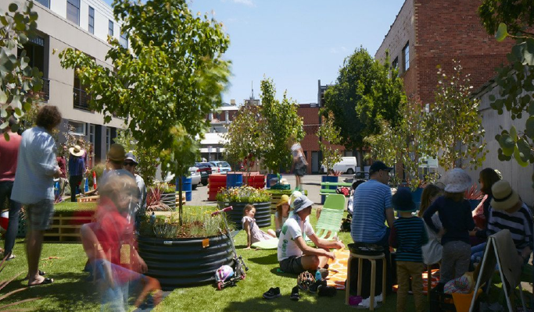
Nature in placemaking: case studies
Pop up parks:
A few weeks - months
CoDesign Studio 2014

Slide 45
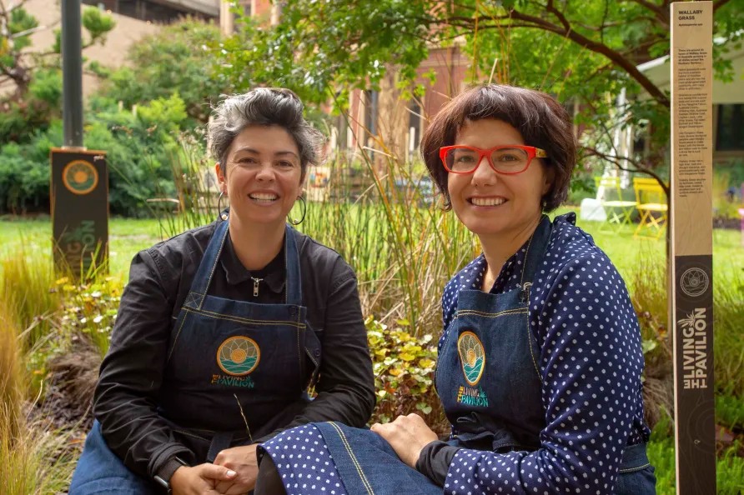
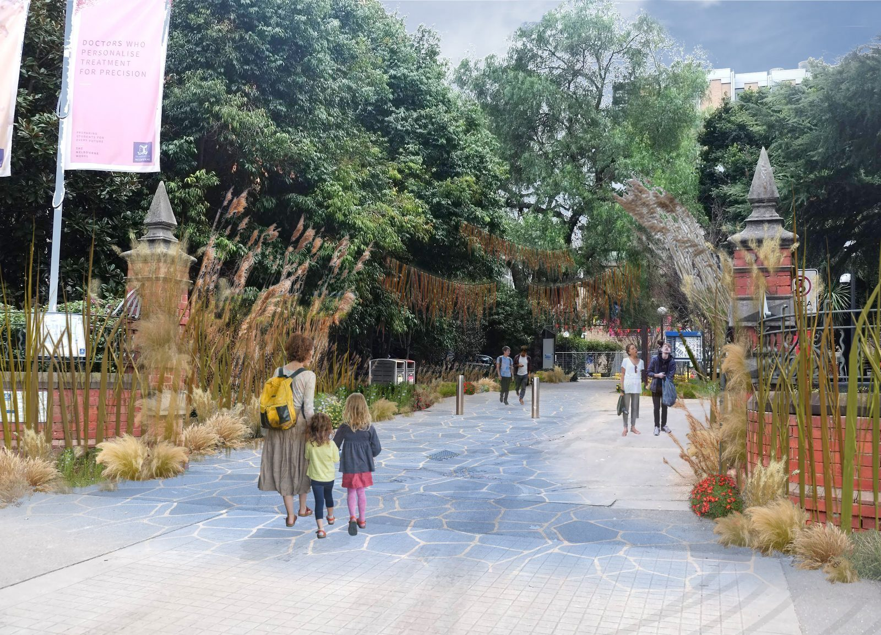
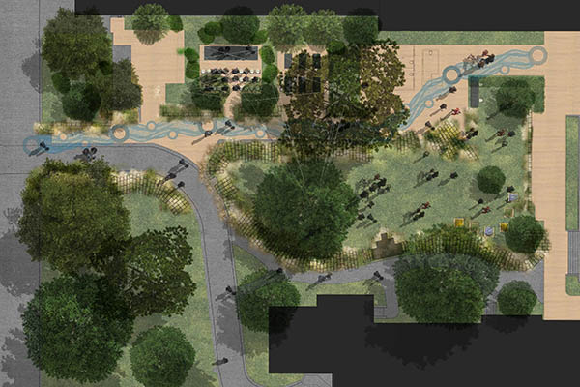
Nature in placemaking: case studies
Pop up parks:
A few weeks - months
https://unimelb.placeagency.org.au/studio_champions/the-living-pavilion/

Slide 46
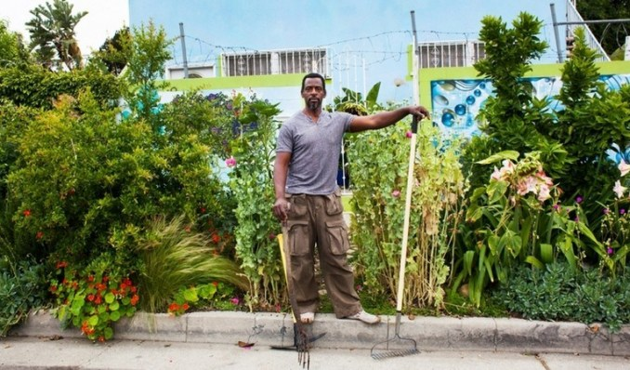
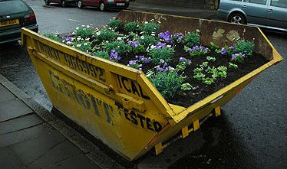
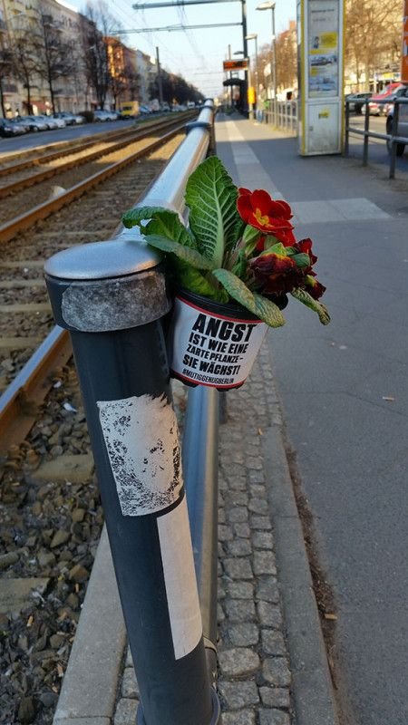
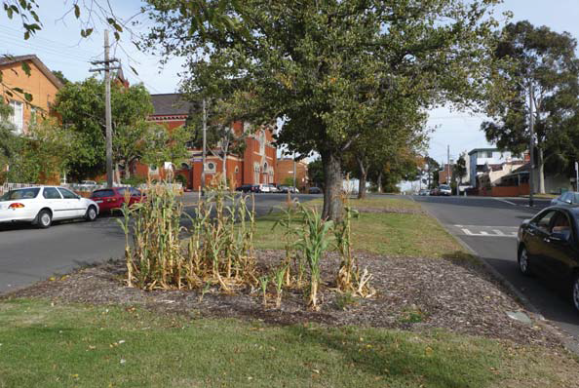
Nature in placemaking: case studies
Guerrilla gardening
Thanks Google…

Slide 47
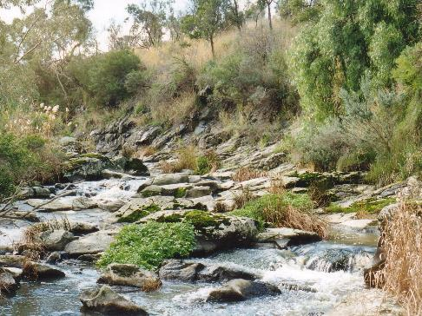
Nature in placemaking: case studies
Long-term: Merri Creek

